Slide 1
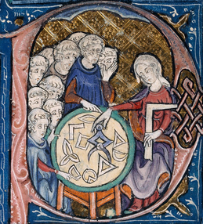

Quasi-arithmetic centers,
quasi-arithmetic mixtures, and the
Jensen-Shannon ∇-divergences
Frank Nielsen
Sony Computer Science Laboratories Inc
GSI'23
June 2023
arXiv:2301.10980

Slide 2
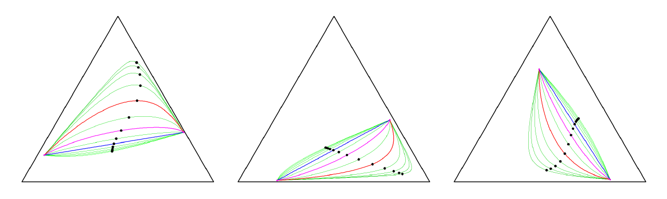
Talk outline, and contributions
Goals:
Generalize scalar quasi-arithmetic means to multivariate cases
Show that the dually flat spaces of information geometry yields a natural framework for defining and studying this generalization
Outline of the talk:
Weighted quasi-arithmetic means
Quasi-arithmetic centers and their invariance and equivariance properties
Quasi-arithmetic mixtures
Jensen-Shannon ∇-divergences
examples of
α-geodesics
with midpoints
in the
probability simplex

Slide 3
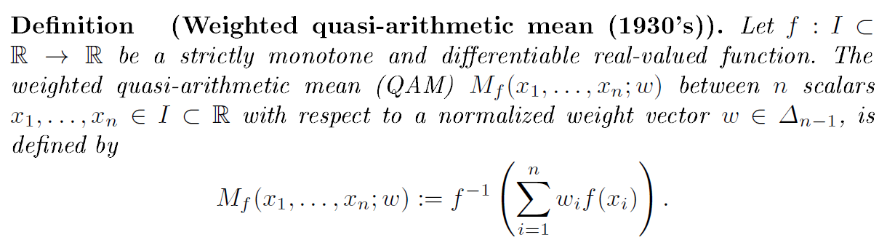
Weighted quasi-arithmetic means (QAMs)
Standard (n-1)-dimensional simplex:
QAMs enjoy the in-betweenness property:
[Kolmogorov 1930] [Nagumo 1930] [De Finetti 1931]

Slide 4
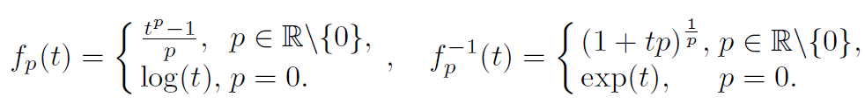

Quasi-arithmetic means (QAMs)
Classes of generators [f]=[g] with f ≡ g yieldings the same QAM:
So let us fix wlog. strictly increasing and differentiable f since we can always either consider either f or -f (i.e., λ=-1, c=0).
QAMs include p-power means for the smooth family of generators f_{p}(t):
Pythagoras means: Harmonic (p=-1), Geometric (p=0), Arithmetic (p=1)
Homogeneous QAMs s are exactly p-power means

Slide 5





A generalization of the law of large numbers (LLN) and the central limit theorem (CLT)
Quasi-arithmetic means for a strictly monotone and smooth function f(u):
Quasi-arithmetic expected value of a random variable X:
Law of large numbers for an iid random vector with variance V[X]<∞:
Central limit theorem:
Miguel De Carvalho. Mean, what do you mean? The American Statistician, 70(3):270-274, 2016.

Slide 6
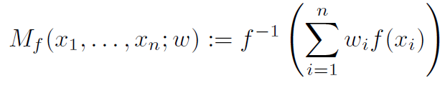
Quasi-Arithmetic Centers (QACs) = Multivariate QAMs:
Univariate QAMs:
Two problems we face when going from univariate to multivariate cases:
Define the proper notion of "multivariate increasing" function F and its equivalent class of functions
In general, the implicit function theorem only proves locally and inverse function F⁻¹ of F: R^{d} → R^{d} provided its Jacobian matrix is not singular
Information geometry provides the right framework to generalize QAMs to
quasi-arithmetic centers (QACs) and study their properties.
Consider the dually flat spaces of information geometry

Slide 7



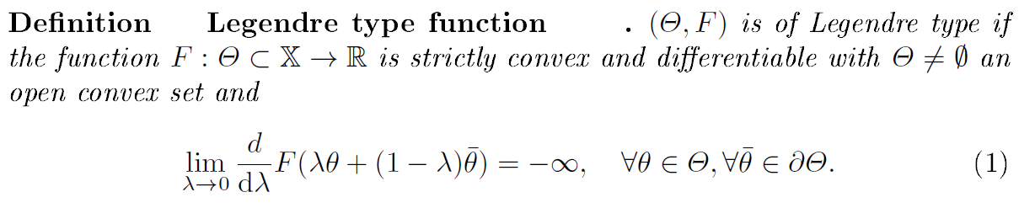

Legendre-type functions
Legendre-Fenchel transformation of a convex function:
Problem: Domain H of η may not be convex...
counterexample with
[Rockafeller 1967]
To by pass this problem:
Convex conjugate of a Legendre-type function (ϴ,F(θ)) is of Legendre-type:
Given by the Legendre function:
Gradient map ∇F is globally invertible: ∇F⁻¹

Slide 8
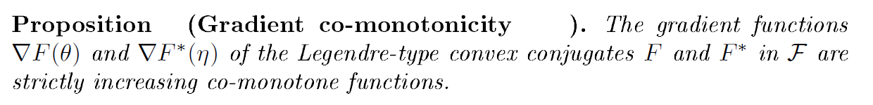
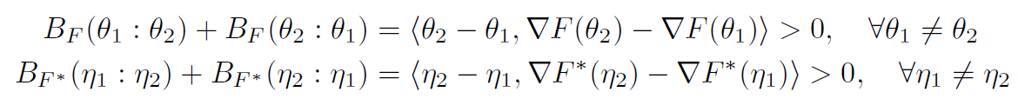
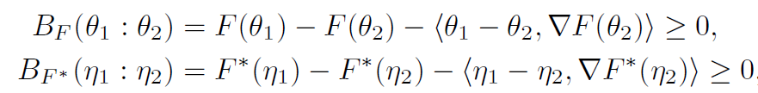
Comonotone functions in inner product spaces
Comonotone functions:
(i.e., comonotone = monotone with respect to the identity function)
Proof using symmetrization of Bregman divergences = Jeffreys-Bregman divergence:
because Bregman divergences(and sums thereof) are always non-negative
Remark: Generalization of monotonicity because when d=1, f(x) is strictly monotone iff
f(x₁)-f(x₂) is of same sign of x₁-x₂ that is, (f(x₁)-f(x₂)) (x₁-x₂)>0

Slide 9
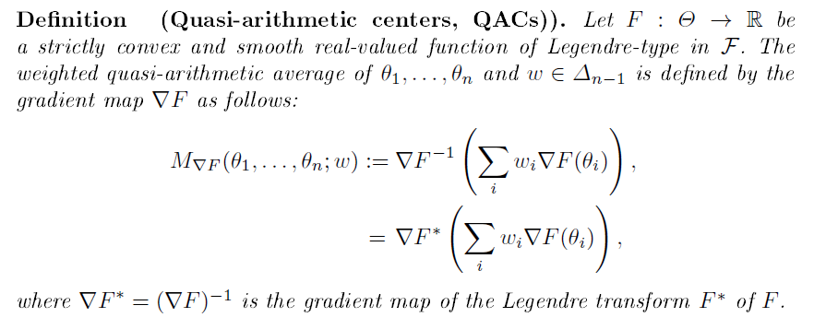


Quasi-arithmetic centers: Definition generalizing QAMs
This definition generalizes univariate quasi-arithmetic means :
Let
Then we have

Slide 10



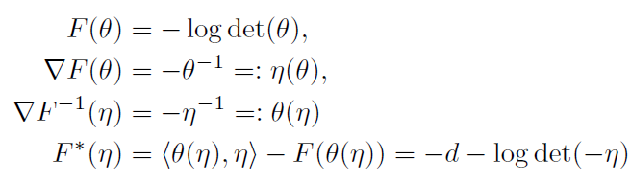




An illustrating example: The matrix harmonic mean
Consider the real-value minus logdet function
Domain F: the cone of symmetric positive-definite matrices
Inner product:
We have:
←Legendre-type function
←Legendre-type function
The quasi-arithmetic center with respect to F:
The quasi-arithmetic center with respect to F*:
Generalize univariate harmonic mean with F(x)= log x, f(x)=F'(x)=1/x:
A Legendre-type function F gives rise to a pair of dual quasi-arithmetic centers
M_{∇F} and M_{∇F*} : dual operators

Slide 11

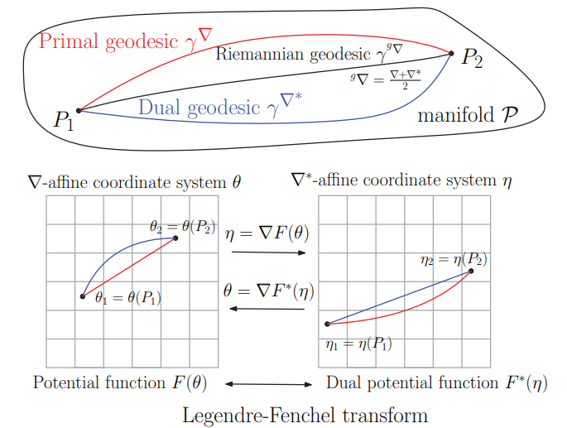
Dually flat structures of information geometry
A Legendre-type Bregman generator F() induces a dually flat space structure:
A point P can be either parameterized by θ-coordinate and dual η-coordinate
[AMS 2022]
Notes:
[Nielsen 2022]

Slide 12
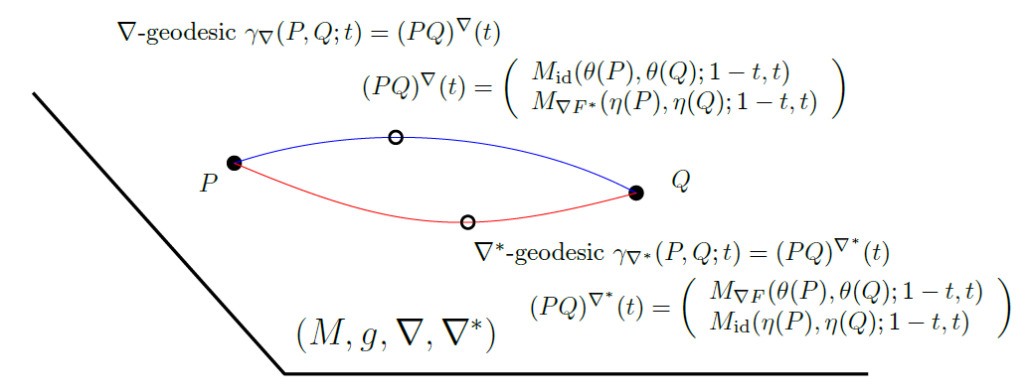
Quasi-arithmetic barycenters and dual geodesics
The dual geodesics induced by the dual flat connections can be expressed using dual weighted quasi-arithmetic centers:
←dual QAC M_{∇F*}
←primal QAC M_{∇F}

Slide 13


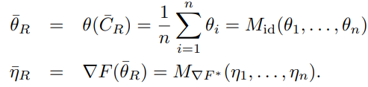

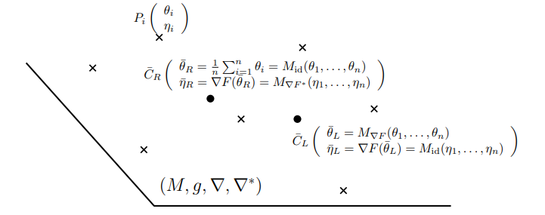
n-Variable Quasi-arithmetic centers as centroids in dually flat spaces
Consider
(canonical divergence = Bregman divergence)
Right-sided centroid:
Left-sided centroid:
Reference duality
←primal QAC
←dual QAC
Notice that when n=2, weighted dual
quasi-arithmetic barycenters
define the dual geodesics

Slide 14






Invariance/equivariance of quasi-arithmetic centers
Information geometry is well-suited to study the properties of QACs:
A dually flat space (DFS) can be realized by a class of Bregman generators:
Affine Legendre invariance of dually flat spaces:
By adding an affine term...
By an affine change of coordinate...
Invariance of quasi-arithmetic center:
Same DFS with
Same DFS with
such that
Equivariance of quasi-arithmetic center:
Same canonical divergence of the DFS
(= constrast function on the diagonal of the product manifold)

Slide 15


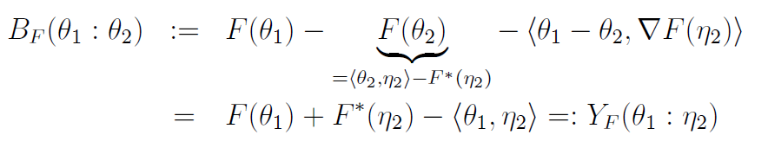

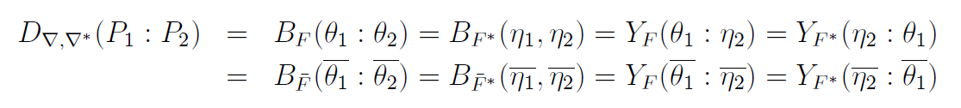
Canonical divergence versus Legendre-Fenchel/Bregman divergences
Canonical divergence induced by dual flat connections is between points
dual Bregman divergences B_{F} and B_{F*} between dual coordinates
Legendre-Fenchel divergence Y_{F} between mixed coordinates
Notes:
\def\DFS{\mathrm{DFS}}
\begin{document}
\begin{eqnarray*}
(M,g,\nabla,\nabla^*) &\leftarrow& \DFS([\Theta,F(\theta),H,F^*(\eta)])\\
&\leftarrow& \DFS([\bar\Theta,\bar F(\bar\theta),\bar H,\bar F^*(\bar\eta)])
\end{eqnarray*}
$$
F(\theta)+F^*(\eta)-\inner{\theta}{\eta}=0
$$
$$
\eta=\nabla F(\theta)
$$
\begin{eqnarray*}
B_F(\theta_1:\theta_2) &:=& F(\theta_1) - \underbrace{F(\theta_2)}_{=\inner{\theta_2}{\eta_2}-F^*(\eta_2)} - \inner{\theta_1-\theta_2}{\nabla F(\eta_2)}\\
&=& F(\theta_1)+F^*(\eta_2) -\inner{\theta_1}{\eta_2} =: Y_F(\theta_1:\eta_2)
\end{eqnarray*}
\begin{eqnarray*}
D_{\nabla,\nabla^*}(P_1:P_2) &=& B_F(\theta_1:\theta_2) = B_{F^*}(\eta_1,\eta_2)= Y_F(\theta_1:\eta_2)= Y_{F^*}(\eta_2:\theta_1)\\
&=& B_{\bar F}(\overline{\theta_1}:\overline{\theta_2}) = B_{\bar{F}^*}(\overline{\eta_1},\overline{\eta_2})= Y_F(\overline{\theta_1}:
\overline{\eta_2})= Y_{F^*}(\overline{\eta_2}:\overline{\theta_1})
\end{eqnarray*}
\end{document}

Slide 16


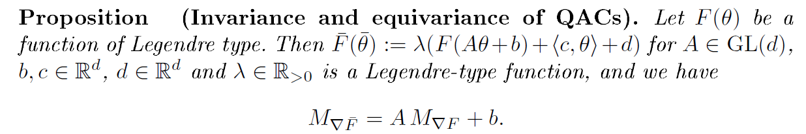
Affine Legendre invariance of dually flat spaces plus setting the unit scale of divergences
Affine Legendre invariance:
Set the unit scale of canonical divergence (DFS differ here, rescaled):
(does not change the quasi-arithmetic center)
amount to scale the potential function λF(θ) vs F(θ)

Slide 17


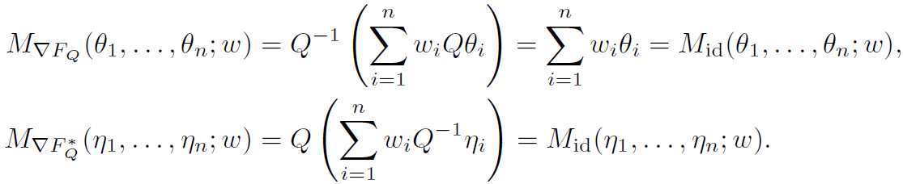
Illustrating example: Mahalanobis divergence
Mahalanobis divergence = squared Mahalanobis metric distance
The dual QACs induced by the dual Mahalanobis generators F and F* coincide to weighted arithmetic mean M_{id}:
fails triangle inequality
of metric distances
Primal potential function:
Dual potential function:

Slide 18
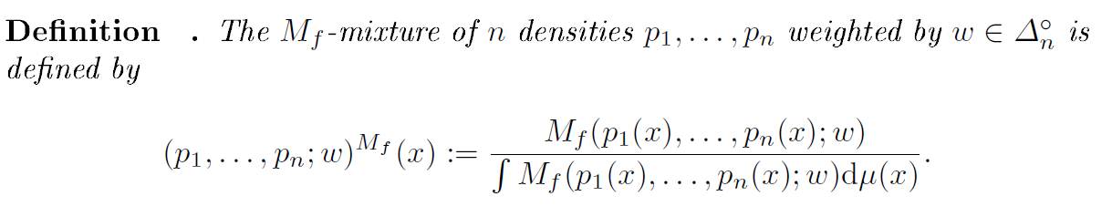
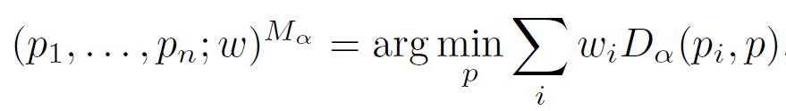
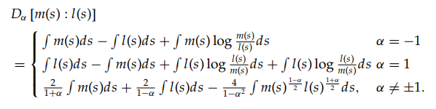
Quasi-arithmetic mixtures (QAMixs), and α-mixtures
Centroid of n densities with respect to the α-divergences yields a QAMix:
D_{α} denotes the α-divergences:
α-families of probability distributions
[Amari 2007]
[arXiv:2209.07481]

Slide 19
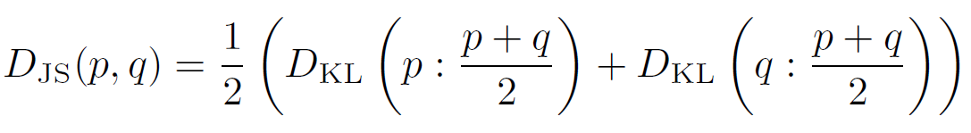
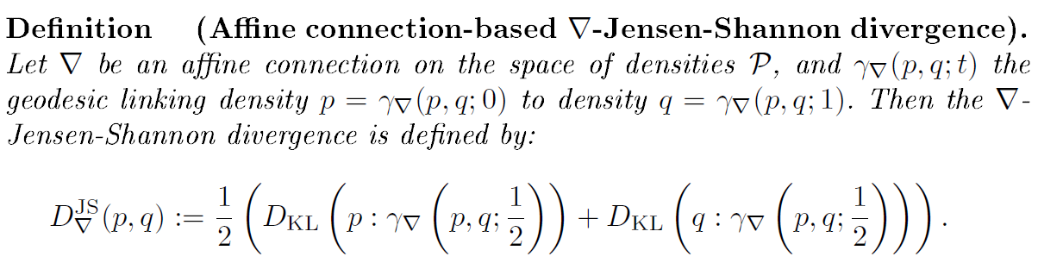
k=2 QAMixs and the ∇-Jensen-Shannon divergence
Jensen-Shannon divergence is bounded symmetrization of KL divergence:
Interpret arithmetic mixture as the midpoint of a mixture geodesic (wrt to the flat non-parametric mixture connection ∇^{m} in information geometry).
Generalize Jensen-Shannon divergence with arbitrary ∇-connections:
≤ log(2)

Slide 20

∇^{α}-connections and geodesics in the probability simplex, ∇^{α}-Jensen-Shannon divergence

Slide 21
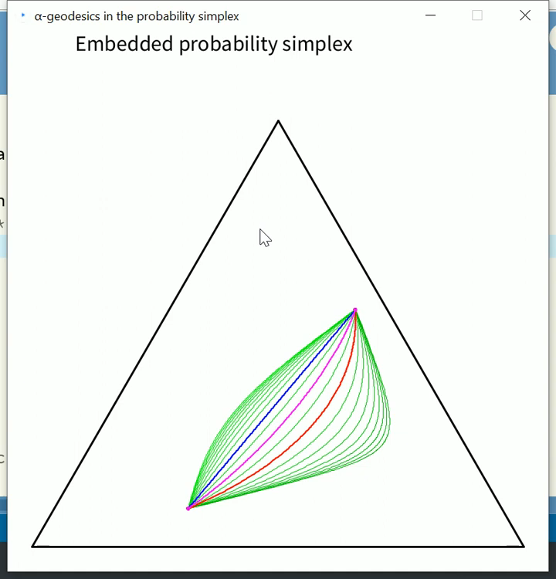
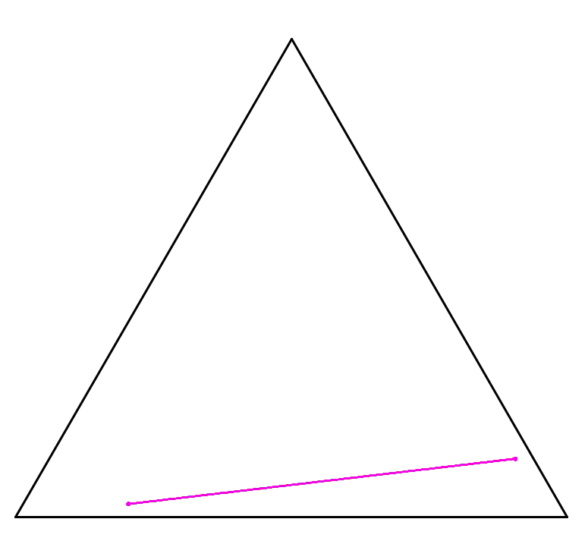
α-geodesics coincide when they pass through a standard simplex vertex
non-degenerate
degenerate
grateful for fruitful discussions with Fábio Meneghetti and Sueli Costa
Notes:
ProbabilitySimplexAlphaGeodesic.pde

Slide 22
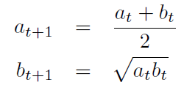
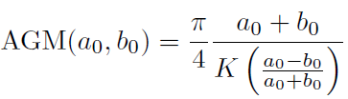

Inductive Means: Geodesics/quasi-arithmetic centers
Gauss and Lagrange independently studied the following convergence of pairs of iterations:
In general, choosing two strict means M and M' with interness property will converge but difficult to analytically express the common limits of iterations
When M=Arithmetic and M'=Harmonic, the arithmetic-harmonic mean AHM yields the geometric mean:
and proves quadratic convergence to
the arithmetic-geometric mean AGM
where K is complete elliptic integral of the first kind
AGM also used to approximate ellipse perimeter and 𝜋

Slide 23
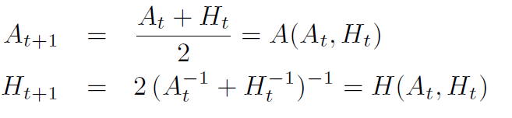


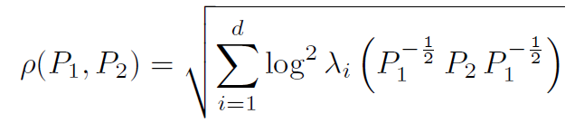

Inductive matrix arithmetic-harmonic mean
Consider the cone of symmetric positive-definite matrices (SPD cone), and extend the AHM to SPD matrices:
Then the sequences converge quadratically to the matrix geometric mean:
←arithmetic mean
←harmonic mean
which is also the Riemannian center of mass with respect to the trace metric:
Riemannian distance
[Nakamura 2001, Atteia-Raissouli 2001 ]
Notes:
Atteia-Raissouli

Slide 24
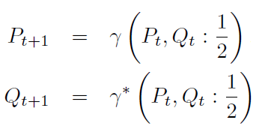
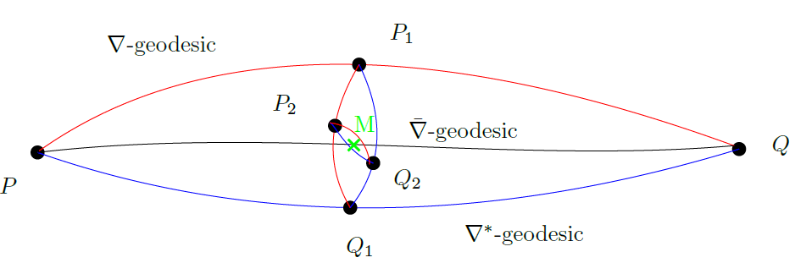






Geometric interpretation of the AHM matrix mean
(SPD, g^{G}, ∇^{A}, ∇^{H}) is a dually flat space, ∇^{G} is Levi-Civita connection
Dually flat space (SPD, g^{G}, ∇^{A}, ∇^{H})
in information geometry defines
quasi-arithmetic centers as geodesic midpoints
Primal geodesic midpoint is the arithmetic center wrt Euclidean metric
Dual geodesic midpoint = harmonic center wrt an isometric Eucl. metric
Levi-Civita geodesic midpoint is geometric Karcher mean (not QAC)
[Nakamura 2001]

Slide 25
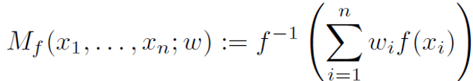
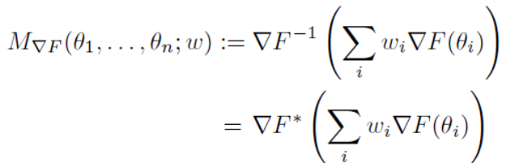

Summary: Beyond scalar quasi-arithmetic means
Information geometry of dually flat spaces yields a generalization of quasi-arithmetic means:
1d monotone function generalize to gradient map of a Legendre-type multivatiate function
(comonotone)
dual centers of mass of n≥2 points expressed using weighted quasi-arithmetic centers
dual geodesics expressed in coordinate systems as weighted quasi-arithmetic centers (n=2)
invariance/equivariance analyzed from the viewpoint of information geometry
define quasi-arithmetic mixtures which provides a way to integrate density components
define ∇-Jensen-Shannon divergences
Inductive arithmetic-harmonic geometric matrix mean expressed using QACs
dual quasi-arithmetic centers
induced by a Legendre-type function
Applications of QACs:

Slide 26
Some references
Amari, Shun-ichi: Information Geometry and Its Applications. Applied Mathematical Sciences, Springer Japan (2016)
Masrani, V., Brekelmans, R., Bui, T., Nielsen, F., Galstyan, A., Ver Steeg, G., Wood, F.: q-paths: Generalizing the geometric annealing path using power means. In: Uncertainty in Articial Intelligence. pp. 1938-1947. PMLR (2021)
Nakamura, Y.: Algorithms associated with arithmetic, geometric and harmonic means and integrable systems. Journal of computational and applied mathematics 131(1-2), 161174 (2001)
Rockafellar, R.T.: Conjugates and Legendre transforms of convex functions. Canadian Journal of Mathematics 19, 200205 (1967)
Zhang, J.: Nonparametric information geometry: From divergence function to referential-representational biduality on statistical manifolds. Entropy 15(12), 5384-5418 (2013)
Nielsen, Frank. "The many faces of information geometry." Not. Am. Math. Soc 69.1 (2022): 36-45.
Atteia, Marc, and Mustapha Raïssouli. "Self dual operators on convex functionals: Geometric mean and square root of convex functionals." Journal of Convex Analysis 8.1 (2001): 223-240.
Ben-Tal, A., Charnes, A., Teboulle, M.: Entropic means. Journal of Mathematical Analysis and Applications 139(2), 537551 (1989)
Amari, Shun-ichi: Integration of stochastic models by minimizing -divergence. Neural computation 19(10), 27802796 (2007)
Nielsen, F.: On the Jensen-Shannon symmetrization of distances relying on abstract means. Entropy 21(5), 485 (2019)

