Slide 1
Functional Bregman divergences in Hilbert spaces
kernelised functional Bregman divergences generalizing MMDs

Slide 2
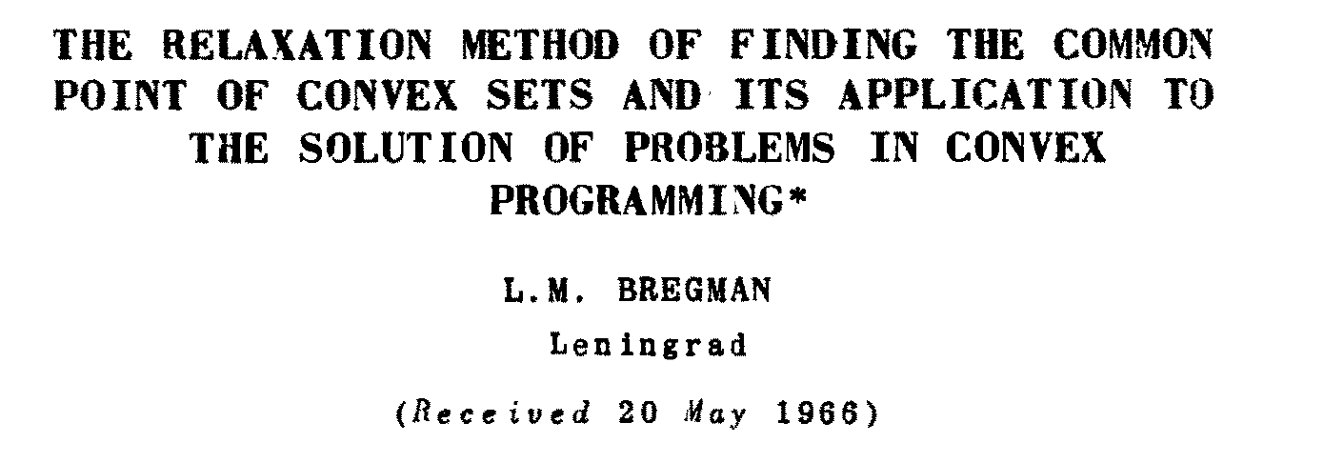

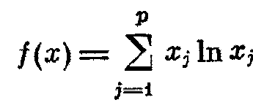


Slide 3

Bregman left-sided projection

Slide 4

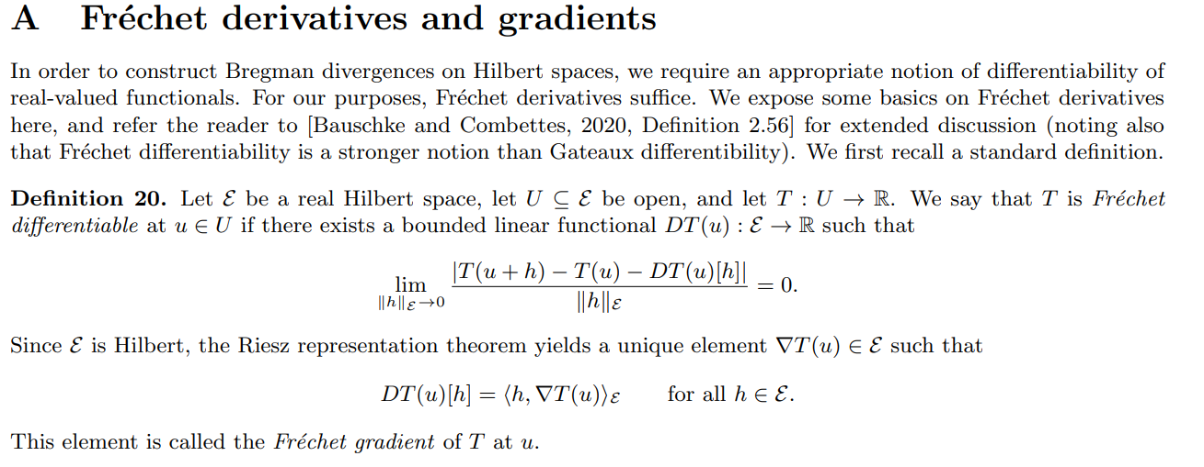
Riesz representer theorem and Fréchet gradient

Slide 5


Slide 6



Slide 7





Slide 8


Slide 9



Slide 10

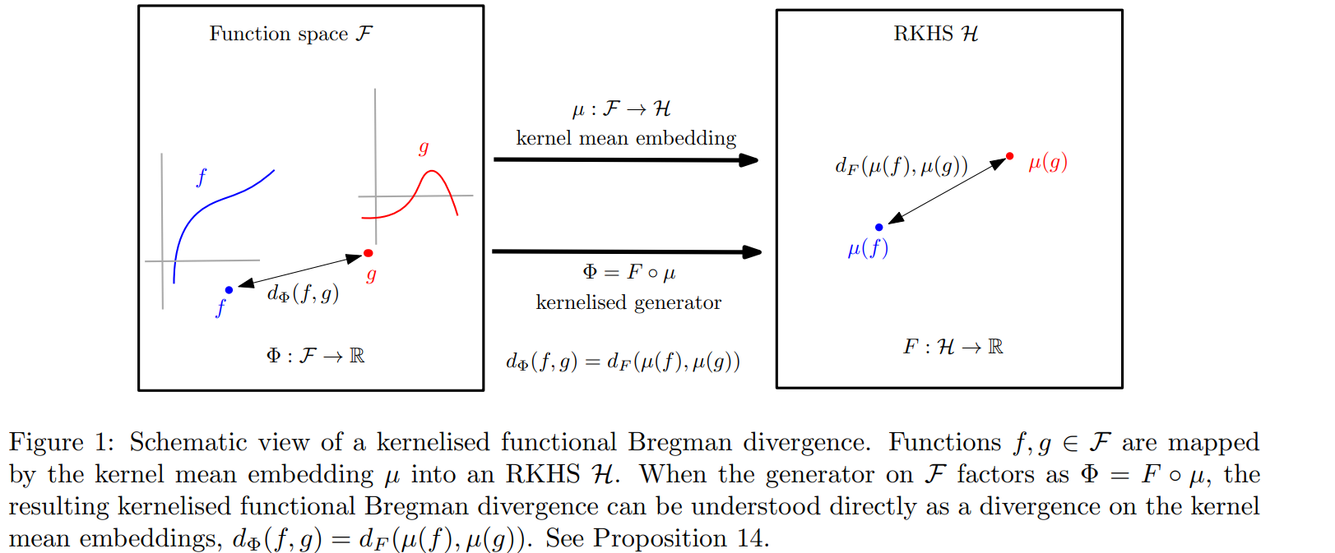

Slide 11



Slide 12
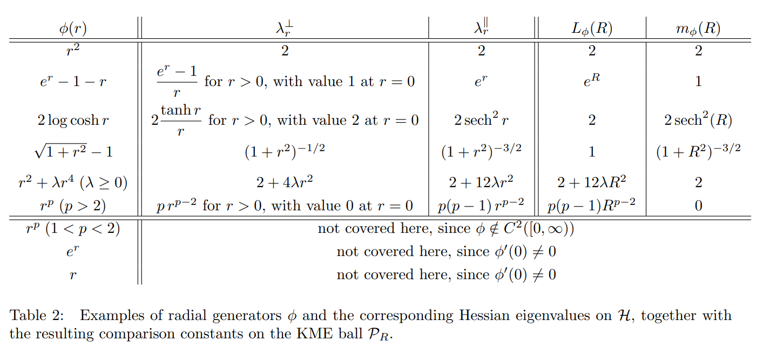

Slide 13
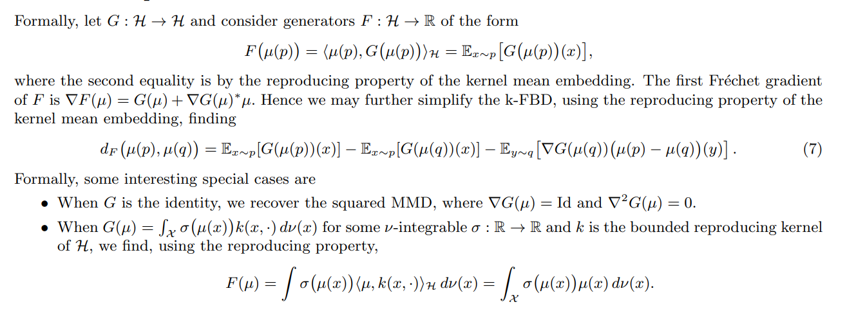


Slide 15
