Slide 1

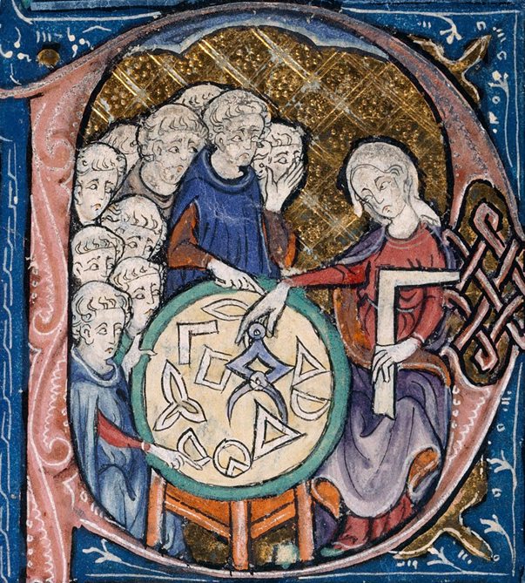


The 5th international conference on
Geometric Science of Information
Learning geometric structures
Best Paper Award
GSI 2021
July 21st-23rd 2021
Paris-Sorbonne University
PRESENTED TO
SPONSORED BY
Thomas Bendokat and Ralf Zimmermann
AUTHORS OF THE PAPER
Efficient Quasi-Geodesics on the Stiefel Manifold
Frédéric Barbaresco
Thales, France
General co-chair
Frank Nielsen
Sony Computer Science Laboratories, Japan
General co-chair
Gabriel Peyré
CNRS, ENS, France
Prize committee, President

