Slide 1
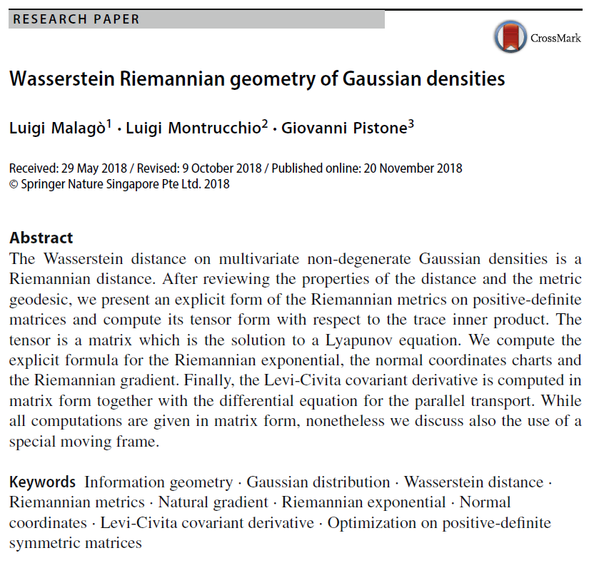

Volume 1
Issue 2
Article 5

Slide 2
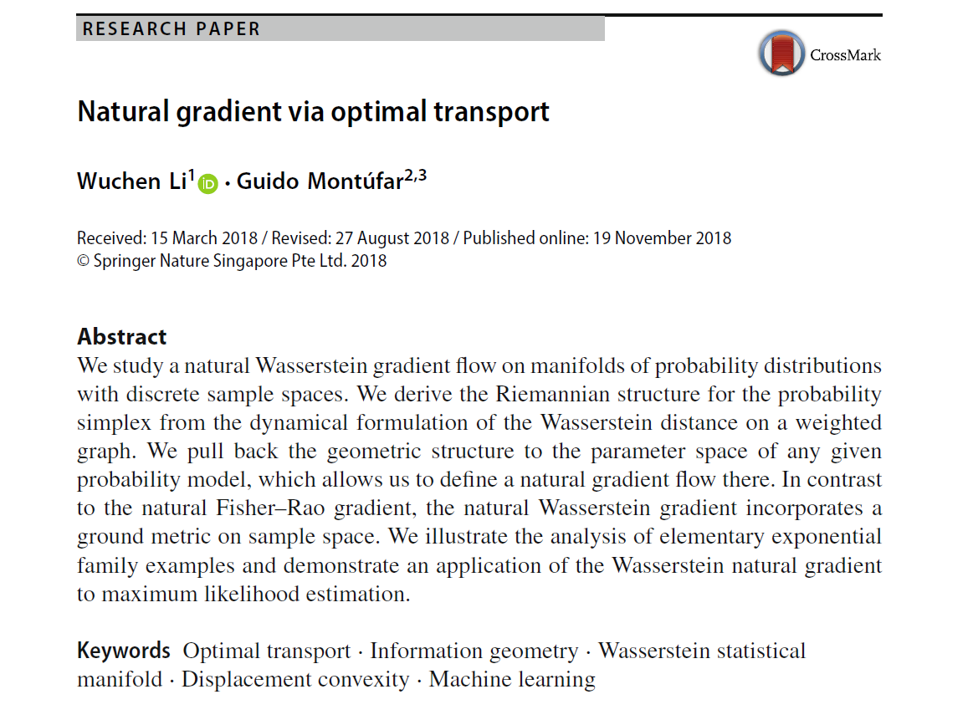
Volume 1
Issue 2
Article ６

Slide 3

Volume 1
Issue 2
Article 7

Slide 4

Volume 1
Issue 2
Article 8

Slide 5

Volume 1
Issue 2
Article 9

Slide 6

Volume 1
Issue 2
Article 10

