Slide 1


Volume 2
Issue 1
Article 11
Notes:
Local equivalence problem in hidden Markov model
https://link.springer.com/article/10.1007/s41884-019-00016-z

Slide 2

Volume 2
Issue 1
Article 12
Notes:
Information geometry of modal linear regression
https://link.springer.com/article/10.1007/s41884-019-00017-y

Slide 3
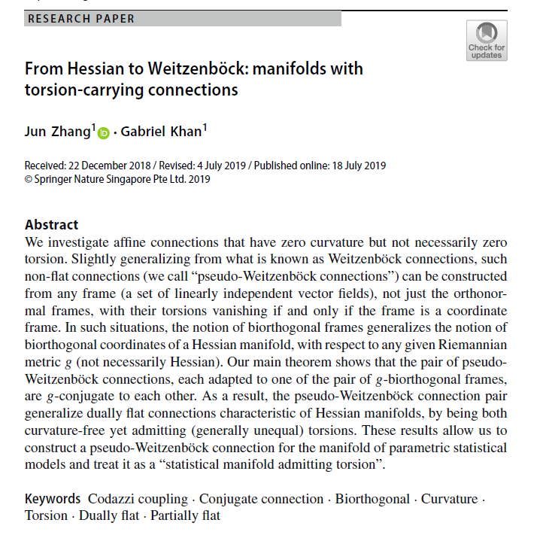
Volume 2
Issue 1
Article 13
Notes:
From Hessian to Weitzenböck: manifolds with torsion-carrying connections
https://link.springer.com/article/10.1007/s41884-019-00018-x

