Slide 1


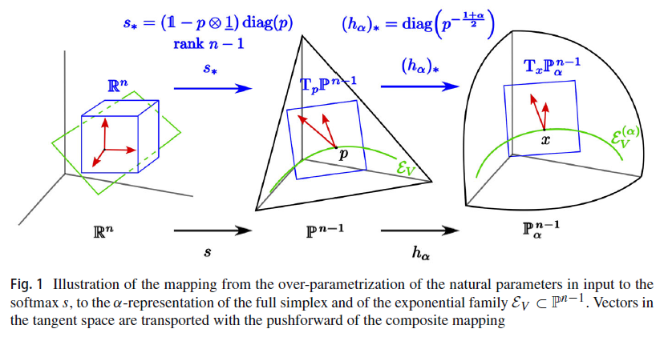
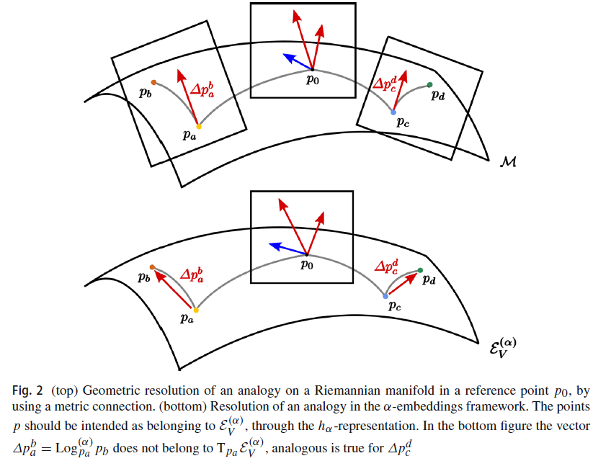
Volume 4
Issue 1
Article 26
Notes:
Natural alpha embeddings
https://link.springer.com/article/10.1007/s41884-021-00043-9

Slide 2
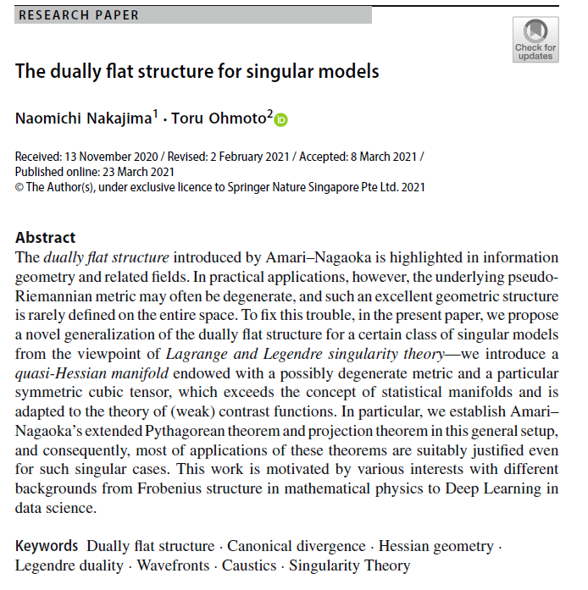
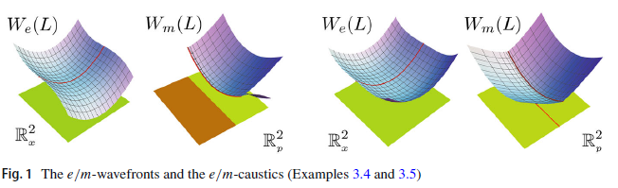
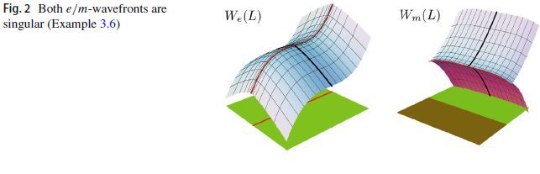
Volume 4
Issue 1
Article 27
Notes:
The dually flat structure for singular models
https://link.springer.com/article/10.1007/s41884-021-00044-8

Slide 3
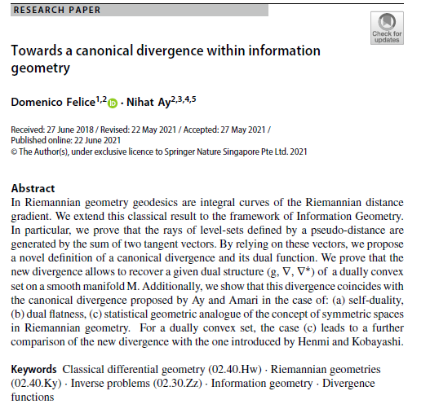
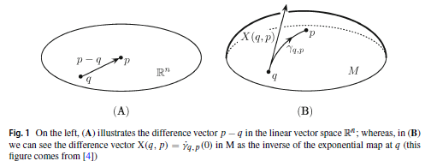
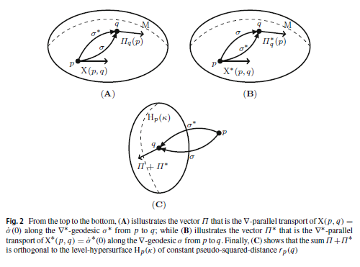
Volume 4
Issue 1
Article 28
Notes:
Towards a canonical divergence within information geometry
https://link.springer.com/article/10.1007/s41884-021-00047-5

Slide 4

Volume 4
Issue 1
Article 29
Notes:
Information geometry and asymptotic geodesics on the space of normal distributions
https://link.springer.com/article/10.1007/s41884-021-00049-3

Slide 5
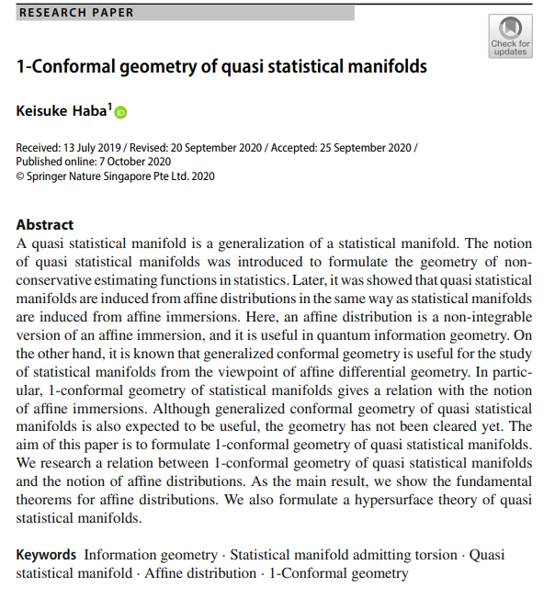
Volume 4
Issue 1
Article 30
Notes:
1-Conformal geometry of quasi statistical manifolds
https://link.springer.com/article/10.1007/s41884-020-00036-0

Slide 6

Volume 4
Issue 1
Article 31
Notes:
A characterization of the alpha-connections on the statistical manifold of normal distributions
https://link.springer.com/article/10.1007/s41884-020-00037-z

Slide 7

Volume 4
Issue 1
Article 32
Notes:
Statistical submanifolds from a viewpoint of the Euler inequality
https://link.springer.com/article/10.1007/s41884-020-00032-4

Slide 8
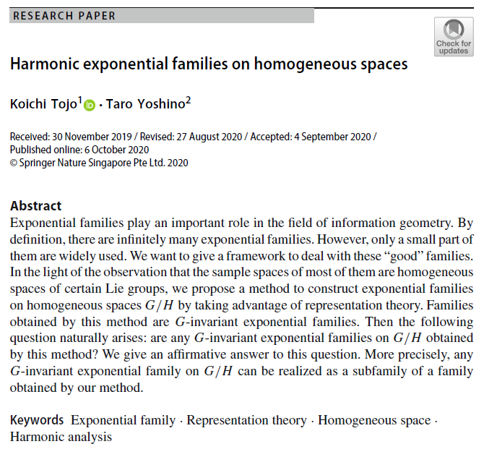
Volume 4
Issue 1
Article 33
Notes:
Harmonic exponential families on homogeneous spaces
https://link.springer.com/article/10.1007/s41884-020-00033-3

Slide 9
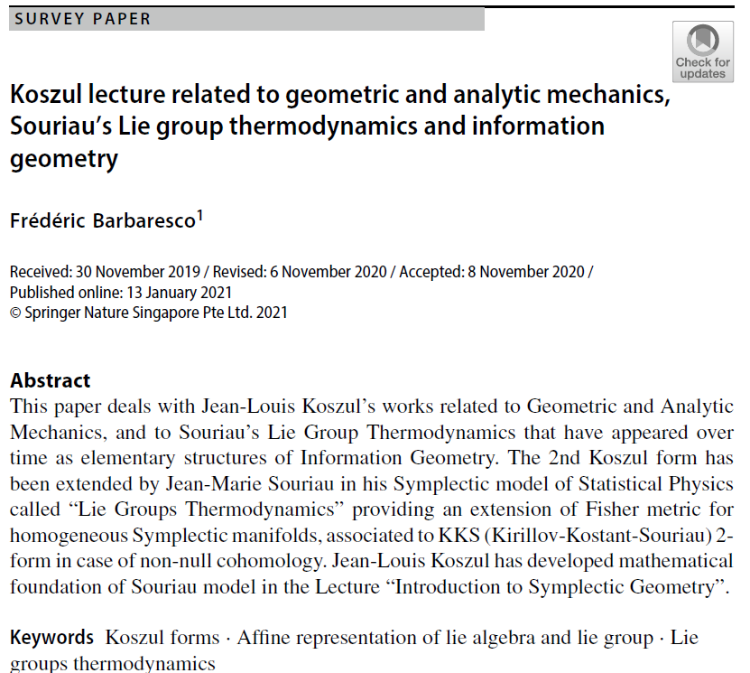
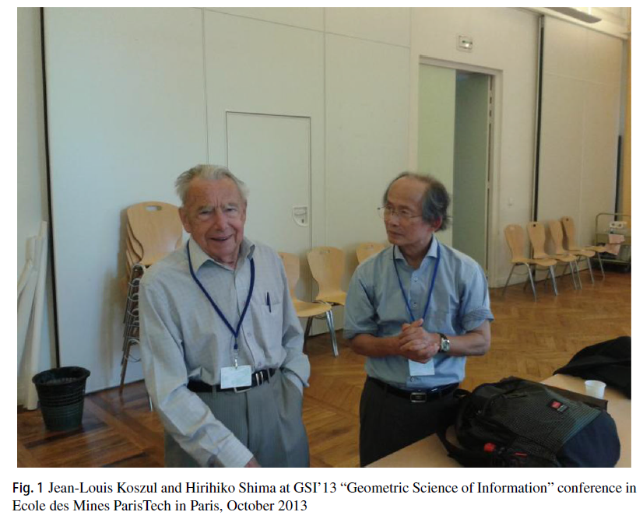
Volume 4
Issue 1
Article 34
Notes:
Koszul lecture related to geometric and analytic mechanics, Souriau’s Lie group thermodynamics and information geometry
https://link.springer.com/article/10.1007/s41884-020-00039-x

Slide 10
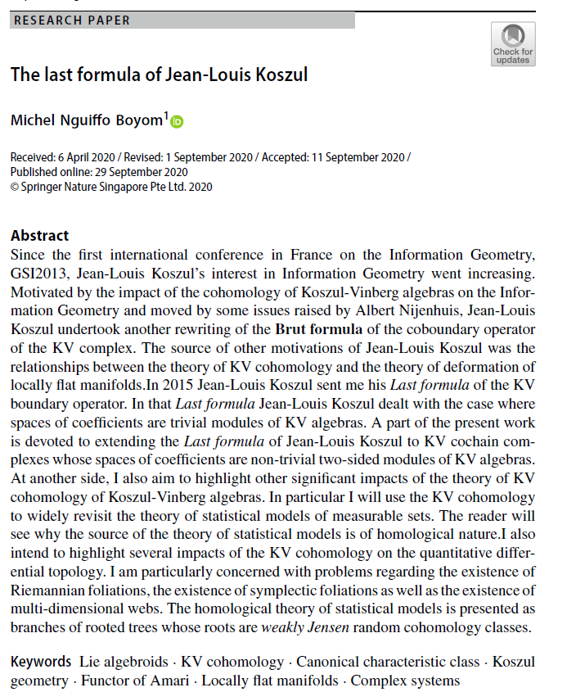
Volume 4
Issue 1
Article 35
Notes:
The last formula of Jean-Louis Koszul
https://link.springer.com/article/10.1007/s41884-020-00034-2

