Slide 1


Volume 7
Issue 1
Article 75
Notes:
On the geometric mechanics of assignment flows for metric data labeling
https://link.springer.com/article/10.1007/s41884-023-00120-1
#INGE

Slide 2
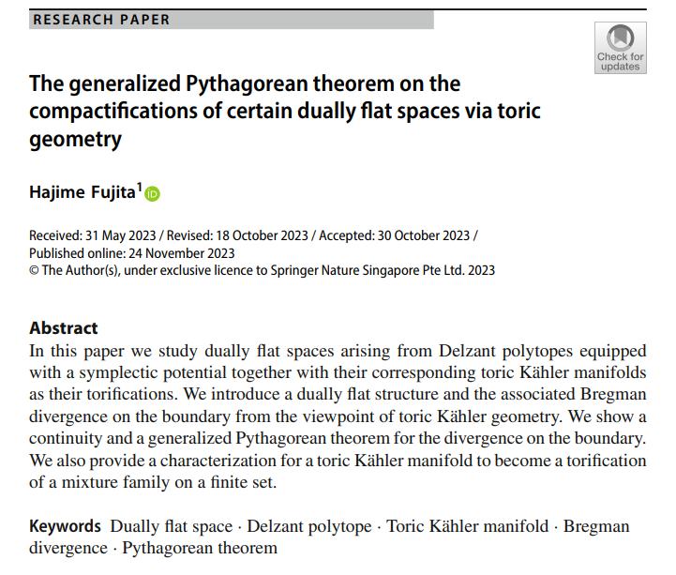
Volume 7
Issue 1
Article 76
Notes:
The generalized Pythagorean theorem on the compactifications of certain dually flat spaces via toric geometry
https://link.springer.com/article/10.1007/s41884-023-00123-y

Slide 3
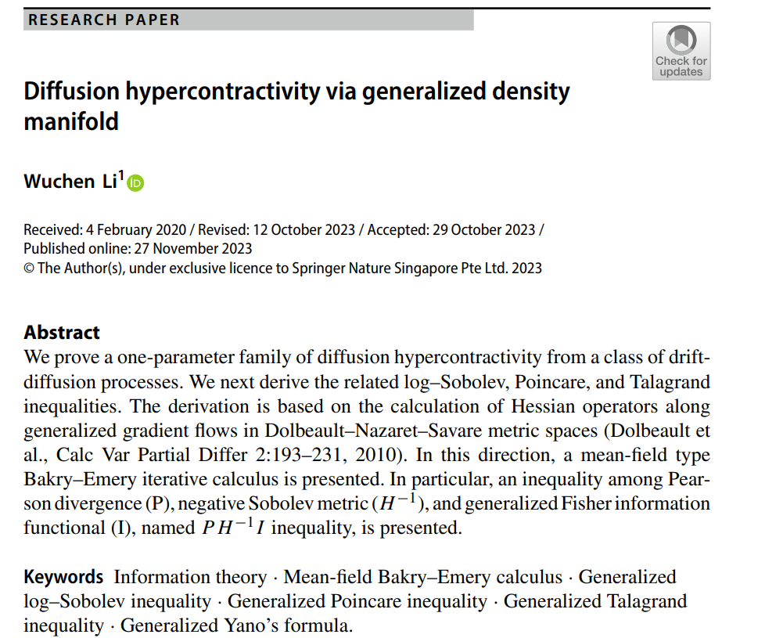
Volume 7
Issue 1
Article 77
Notes:
Diffusion hypercontractivity via generalized density manifold
https://link.springer.com/article/10.1007/s41884-023-00124-x
#INGE

Slide 4
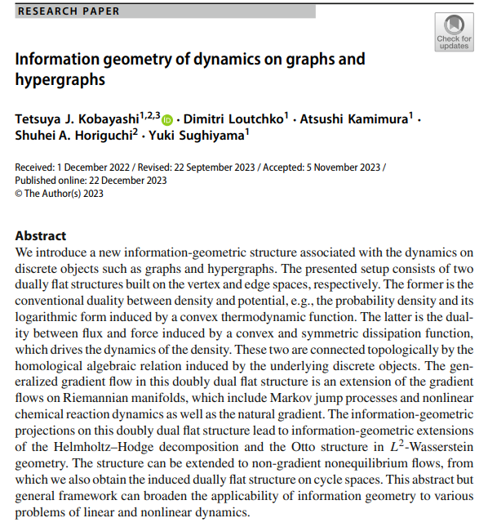
Volume 7
Issue 1
Article 78
Notes:
Information geometry of dynamics on graphs and hypergraphs
https://link.springer.com/article/10.1007/s41884-023-00125-w
#INGE

Slide 5
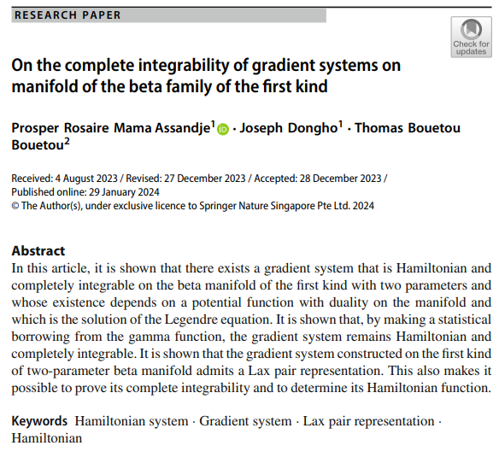
Volume 7
Issue 1
Article 79
Notes:
On the complete integrability of gradient systems on manifold of the beta family of the first kind
https://link.springer.com/article/10.1007/s41884-023-00130-z
#INGE

Slide 6

Volume 7
Issue 1
Article 80
Notes:
Variational representations of annealing paths: Bregman information under monotonic embedding
https://link.springer.com/article/10.1007/s41884-023-00129-6
#INGE

Slide 7
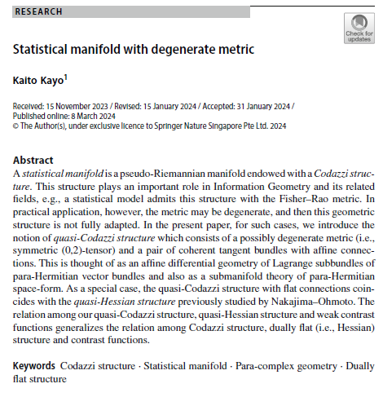
Volume 7
Issue 1
Article 81
Notes:
Statistical manifold with degenerate metric
https://link.springer.com/article/10.1007/s41884-024-00131-6

Slide 8

Volume 7
Issue 1
Article 82
Notes:
Codivergences and information matrices
https://link.springer.com/article/10.1007/s41884-024-00135-2
#INGE

