Slide 1
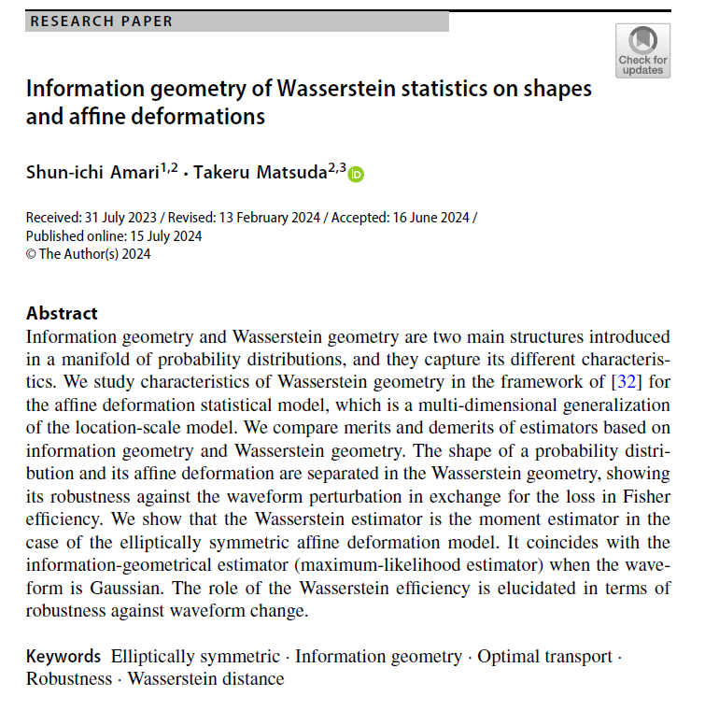

Volume 7
Issue 2
Article 83
Notes:
Information geometry of Wasserstein statistics on shapes and affine deformations
https://link.springer.com/article/10.1007/s41884-024-00139-y

Slide 2
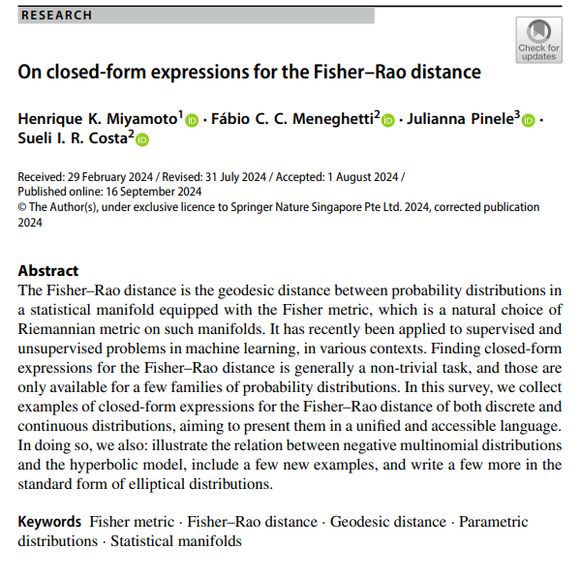
Volume 7
Issue 2
Article 84
Notes:
On closed-form expressions for the Fisher–Rao distance
https://link.springer.com/article/10.1007/s41884-024-00143-2

Slide 3
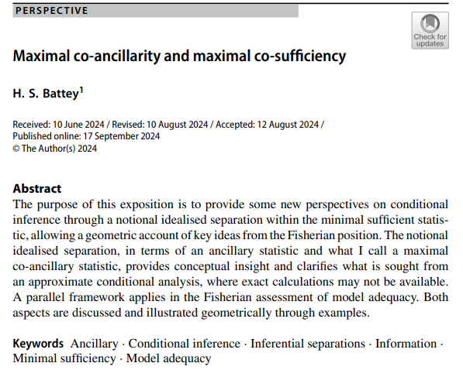
Volume 7
Issue 2
Article 85
Notes:
Maximal co-ancillarity and maximal co-sufficiency
https://link.springer.com/article/10.1007/s41884-024-00144-1

Slide 4
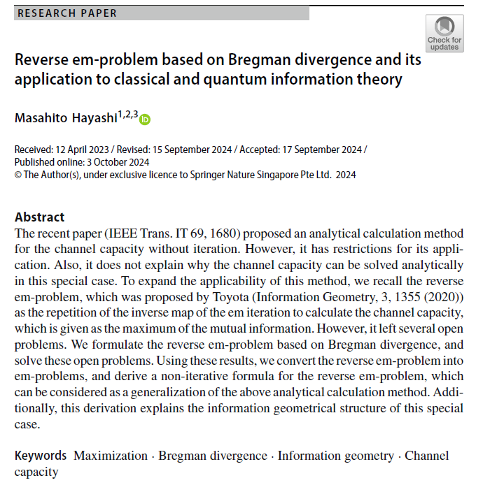
Volume 7
Issue 2
Article 86
Notes:
Reverse em-problem based on Bregman divergence and its application to classical and quantum information theory
https://link.springer.com/article/10.1007/s41884-024-00147-y

Slide 5
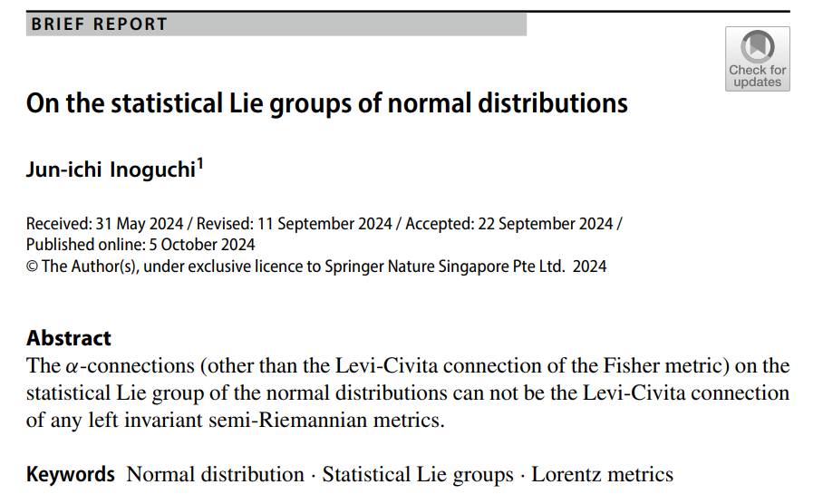
Volume 7
Issue 2
Article 87
Notes:
On the statistical Lie groups of normal distributions
https://link.springer.com/article/10.1007/s41884-024-00148-x

Slide 6
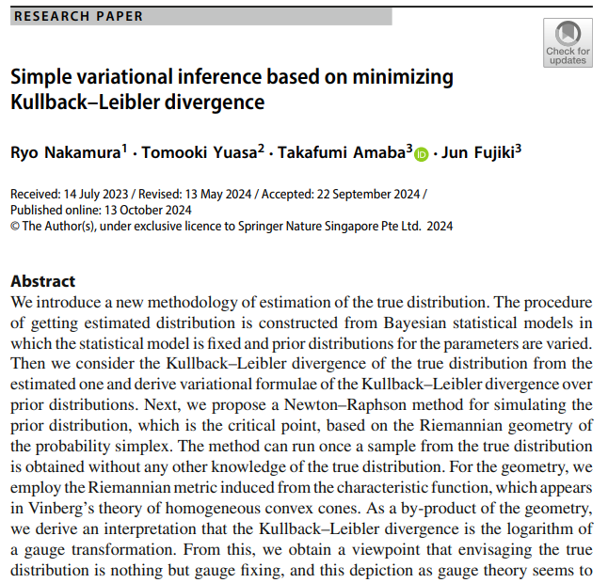
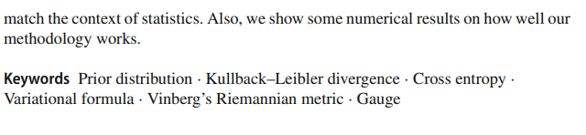
Volume 7
Issue 2
Article 88
Notes:
Simple variational inference based on minimizing Kullback–Leibler divergence
https://link.springer.com/article/10.1007/s41884-024-00151-2

Slide 7
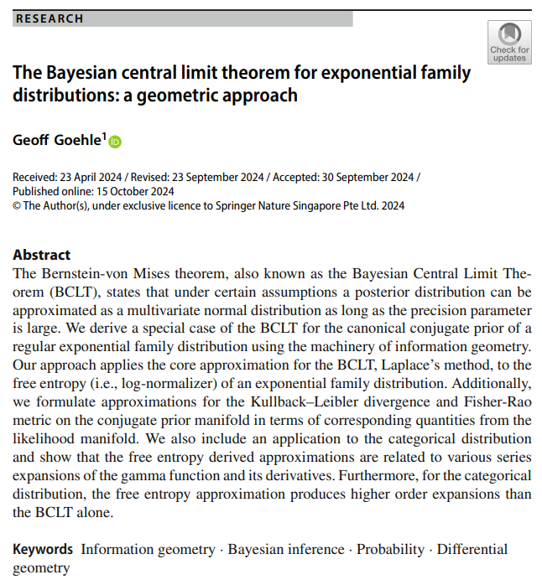
Volume 7
Issue 2
Article 89
Notes:
The Bayesian central limit theorem for exponential family distributions: a geometric approach
https://link.springer.com/article/10.1007/s41884-024-00152-1

Slide 8
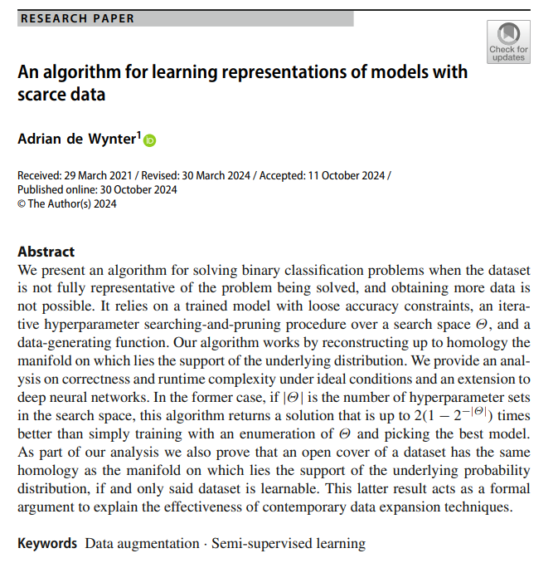
Volume 7
Issue 2
Article 90
Notes:
An algorithm for learning representations of models with scarce data
https://link.springer.com/article/10.1007/s41884-024-00153-0

Slide 9
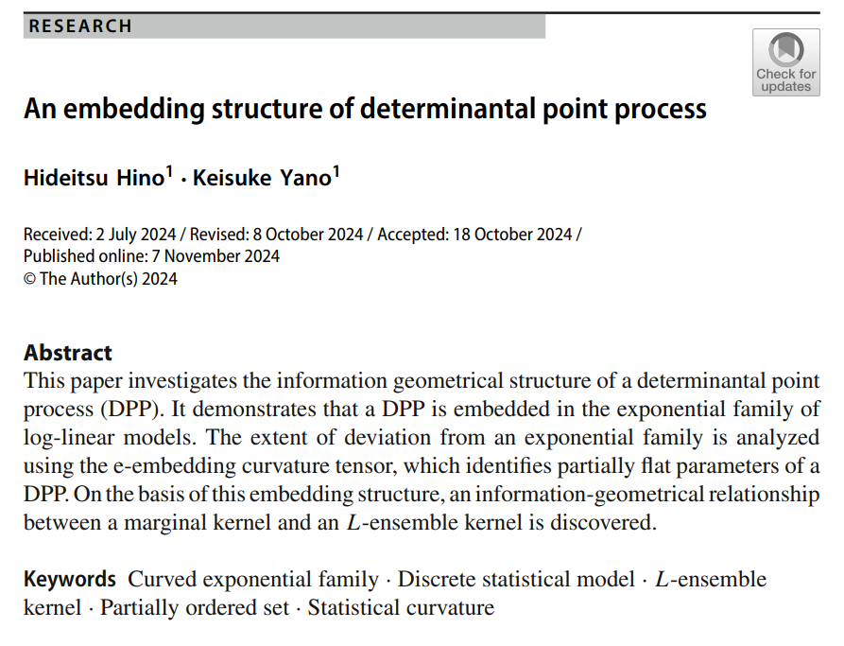
Volume 7
Issue 2
Article 91
Notes:
An embedding structure of determinantal point process
https://link.springer.com/article/10.1007/s41884-024-00156-x

Slide 10

Volume 7
Issue 2
Article 92
Notes:
On statistics which are almost sufficient from the viewpoint of the Fisher metrics
https://link.springer.com/article/10.1007/s41884-024-00160-1

