Slide 1
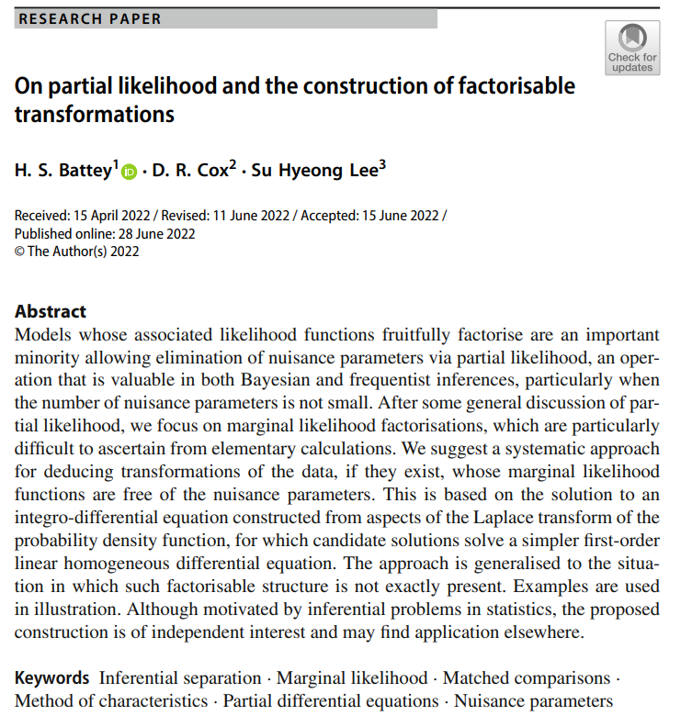

Volume 7
Special Issue １
Article 1
Number 93
Notes:
On partial likelihood and the construction of factorisable transformations
https://link.springer.com/article/10.1007/s41884-022-00068-8

Slide 2
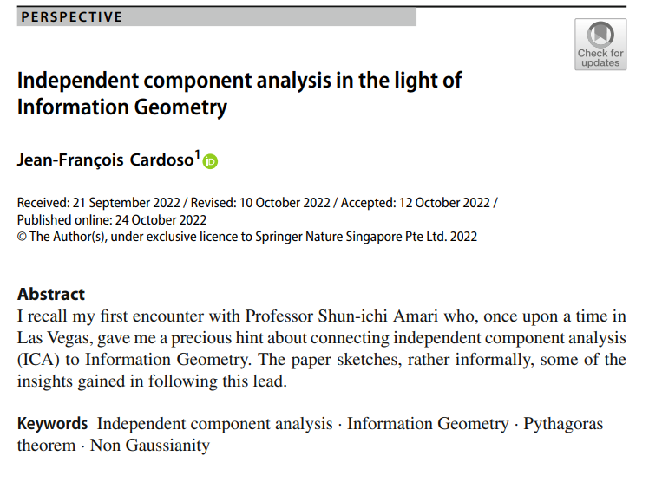
Volume 7
Special Issue １
Article 2
Number 94
Notes:
Independent component analysis in the light of Information Geometry
https://link.springer.com/article/10.1007/s41884-022-00073-x

Slide 3
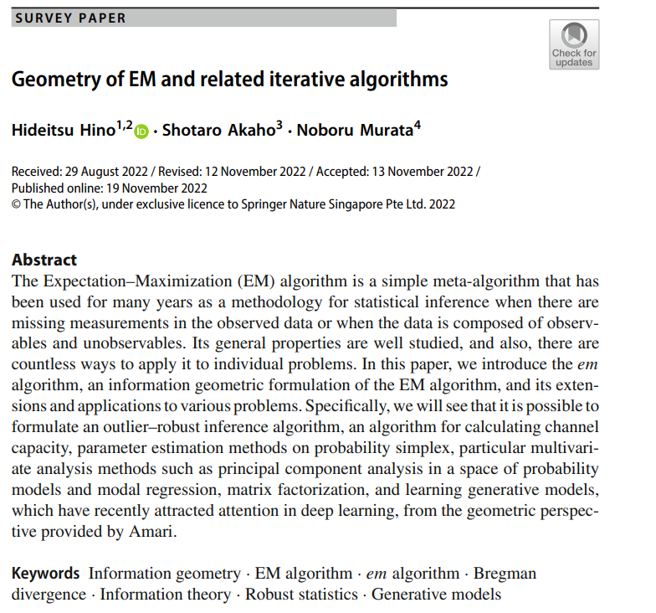
Volume 7
Special Issue １
Article 3
Number 95
Notes:
Geometry of EM and related iterative algorithms
https://link.springer.com/article/10.1007/s41884-022-00080-y

Slide 4
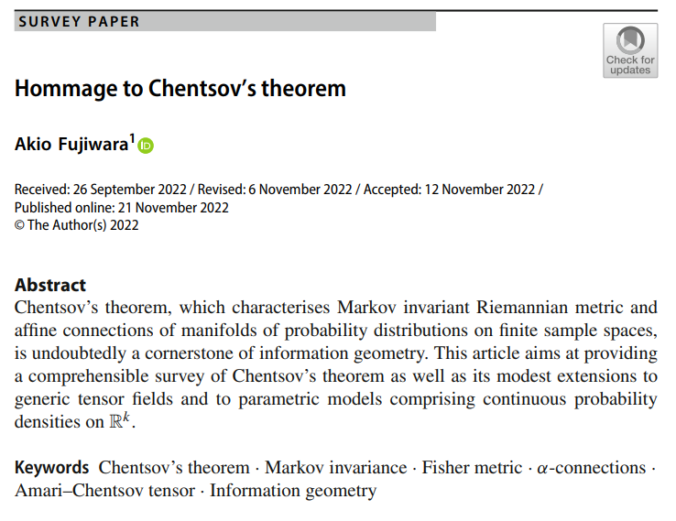
Volume 7
Special Issue １
Article 4
Number 96
Notes:
Hommage to Chentsov’s theorem
https://link.springer.com/article/10.1007/s41884-022-00077-7

Slide 5

Volume 7
Special Issue １
Article 5
Number 97
Notes:
Toward differential geometry of statistical submanifolds
https://link.springer.com/article/10.1007/s41884-022-00075-9

Slide 6
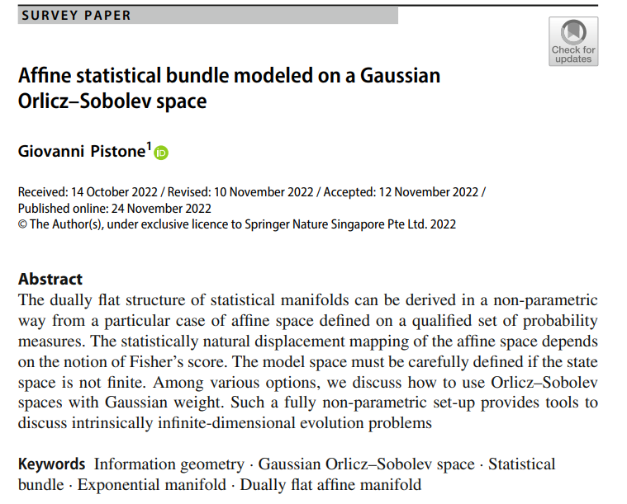
Volume 7
Special Issue １
Article 6
Number 98
Notes:
Affine statistical bundle modeled on a Gaussian Orlicz–Sobolev space
https://link.springer.com/article/10.1007/s41884-022-00078-6

Slide 7
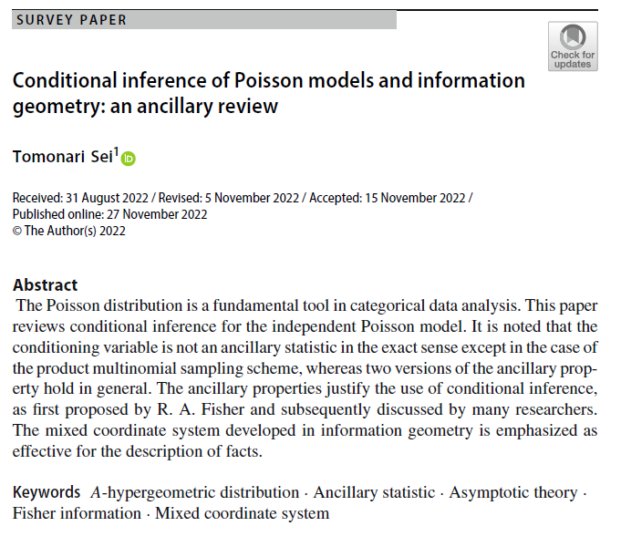
Volume 7
Special Issue １
Article 7
Number 99
Notes:
Conditional inference of Poisson models and information geometry: an ancillary review
https://link.springer.com/article/10.1007/s41884-022-00082-w

Slide 8
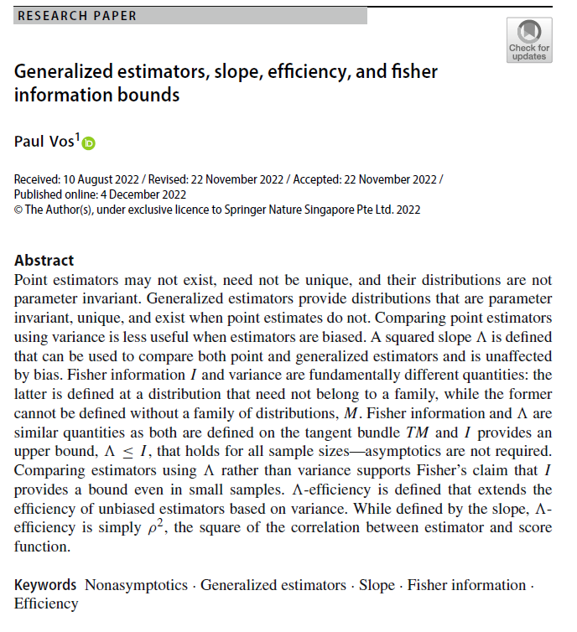
Volume 7
Special Issue １
Article 8
Number 100
Notes:
Generalized estimators, slope, efficiency, and fisher information bounds

Slide 9
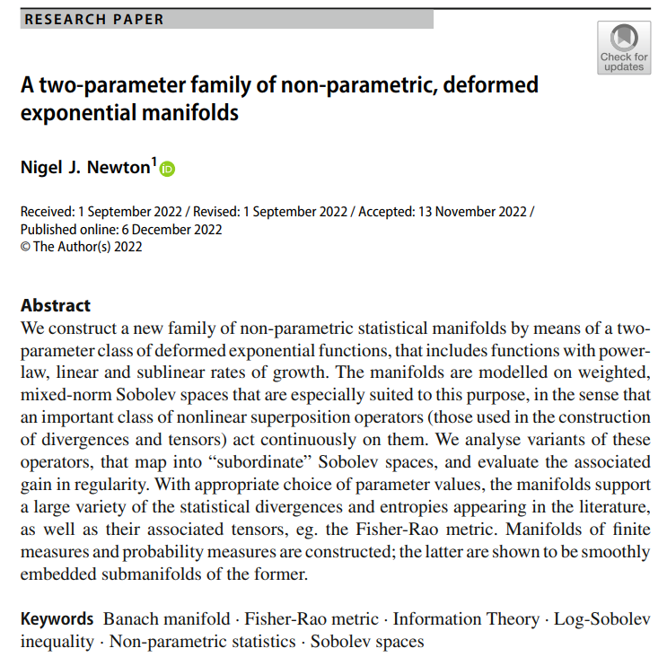
Volume 7
Special Issue １
Article 9
Number 101
Notes:
A two-parameter family of non-parametric, deformed exponential manifolds

Slide 10
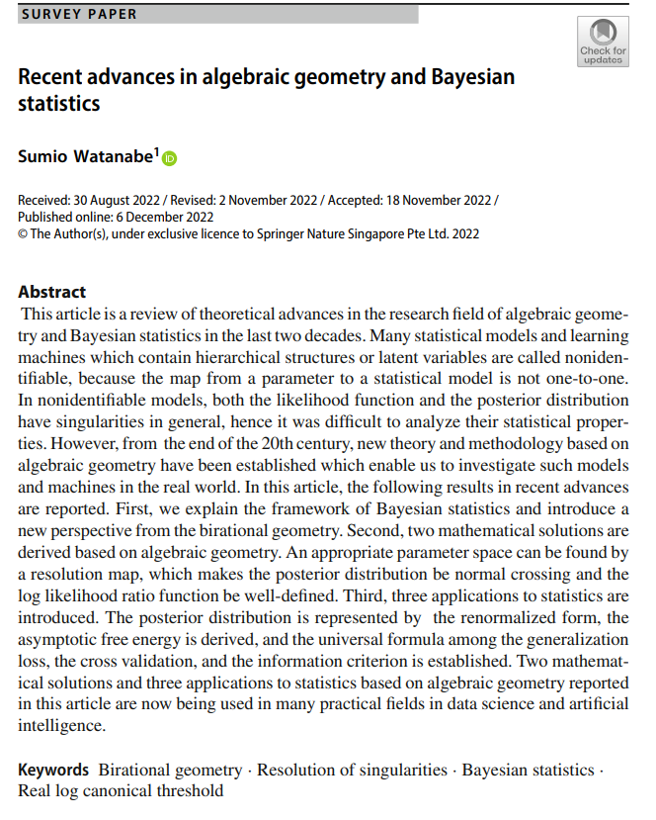
Volume 7
Special Issue １
Article 10
Number 102
Notes:
Recent advances in algebraic geometry and Bayesian statistics
https://link.springer.com/article/10.1007/s41884-022-00083-9

Slide 11
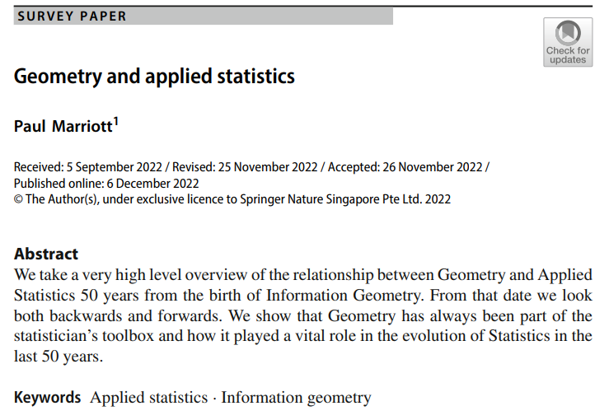
Volume 7
Special Issue １
Article 11
Number 103
Notes:
Geometry and applied statistics
https://link.springer.com/article/10.1007/s41884-022-00086-6

Slide 12
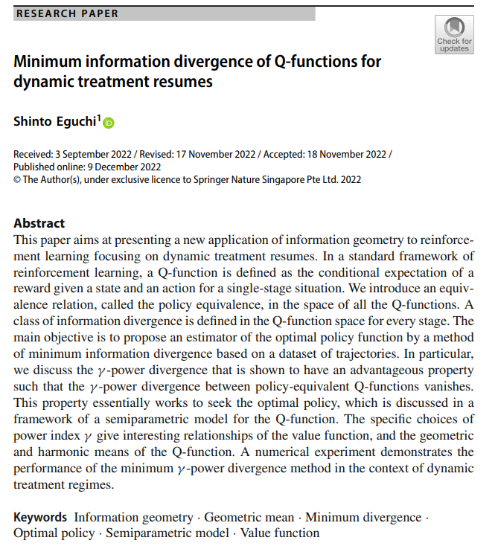
Volume 7
Special Issue １
Article 12
Number 104
Notes:
Minimum information divergence of Q-functions for dynamic treatment resumes
https://link.springer.com/article/10.1007/s41884-022-00084-8

Slide 13
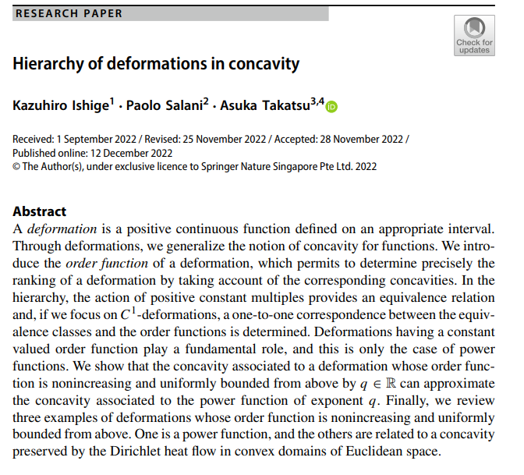
Volume 7
Special Issue １
Article 13
Number 105
Notes:
Hierarchy of deformations in concavity
https://link.springer.com/article/10.1007/s41884-022-00088-4

Slide 14

Volume 7
Special Issue １
Article 14
Number 106
Notes:
Natural differentiable structures on statistical models and the Fisher metric
https://link.springer.com/article/10.1007/s41884-022-00090-w

Slide 15
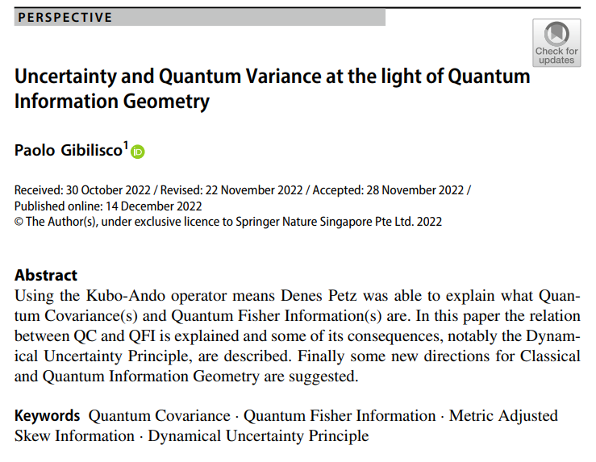
Volume 7
Special Issue １
Article 15
Number 107
Notes:
Uncertainty and Quantum Variance at the light of Quantum Information Geometry
https://link.springer.com/article/10.1007/s41884-022-00087-5

Slide 16
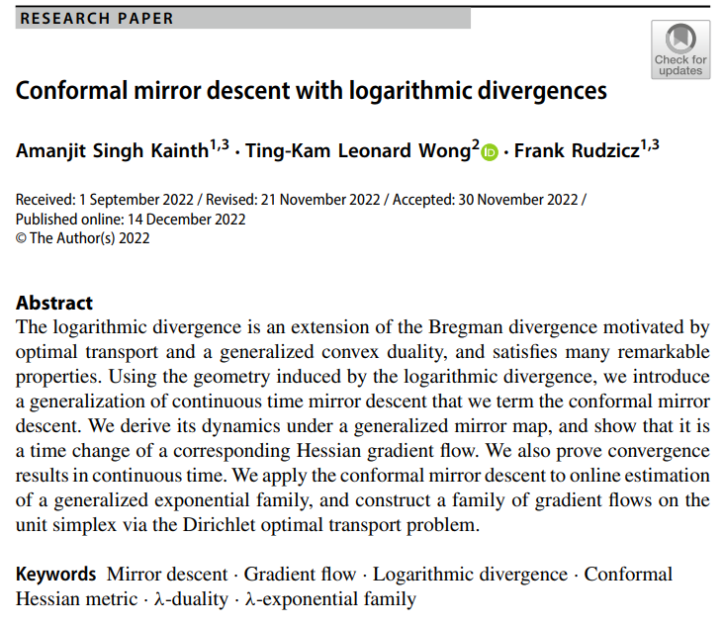
Volume 7
Special Issue １
Article 16
Number 107
Notes:
Conformal mirror descent with logarithmic divergences
https://link.springer.com/article/10.1007/s41884-022-00089-3

Slide 17
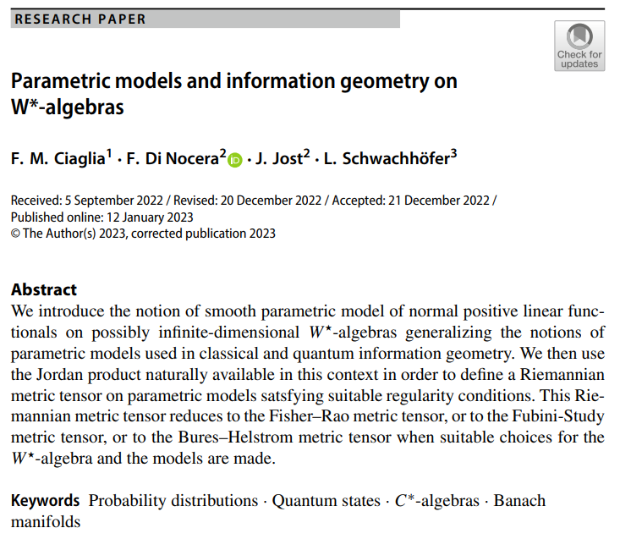
Volume 7
Special Issue １
Article 17
Number 108
Notes:
Parametric models and information geometry on W*-algebras
https://link.springer.com/article/10.1007/s41884-022-00094-6

Slide 18

Volume 7
Special Issue １
Article 18
Number 109
Notes:
Gram matrices of quantum channels via quantum Fisher information with applications to decoherence and uncertainty
https://link.springer.com/article/10.1007/s41884-023-00096-y

Slide 19
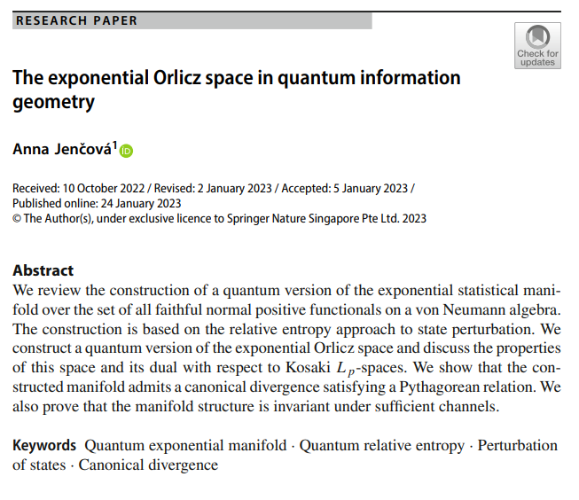
Volume 7
Special Issue １
Article 19
Number 110
Notes:
The exponential Orlicz space in quantum information geometry
https://link.springer.com/article/10.1007/s41884-023-00097-x

Slide 20
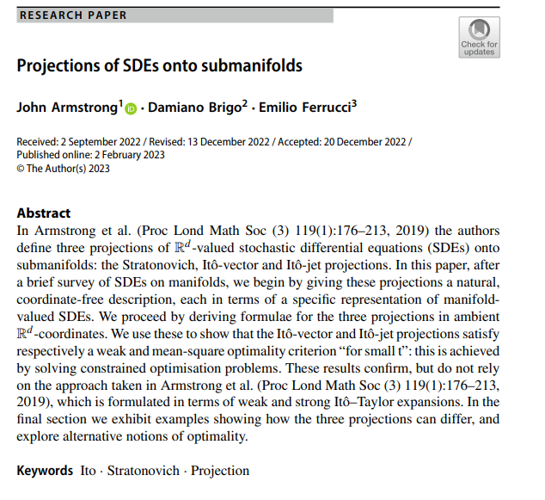
Volume 7
Special Issue １
Article 20
Number 111
Notes:
Projections of SDEs onto submanifolds
https://link.springer.com/article/10.1007/s41884-022-00093-7

Slide 21
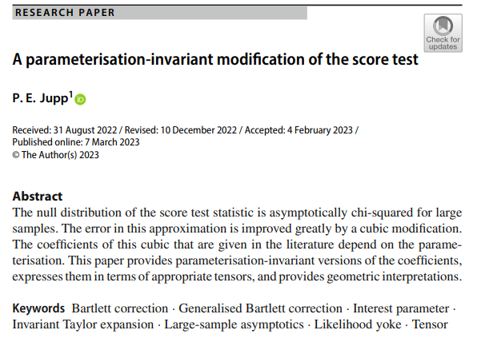
Volume 7
Special Issue １
Article 21
Number 112
Notes:
A parameterisation-invariant modification of the score test
https://link.springer.com/article/10.1007/s41884-023-00101-4

Slide 22
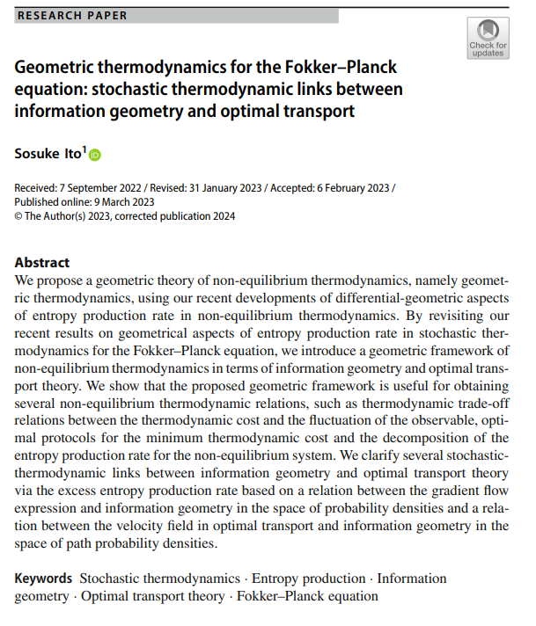
Volume 7
Special Issue １
Article 22
Number 113
Notes:
Geometric thermodynamics for the Fokker–Planck equation: stochastic thermodynamic links between information geometry and optimal transport
https://link.springer.com/article/10.1007/s41884-023-00102-3

Slide 23
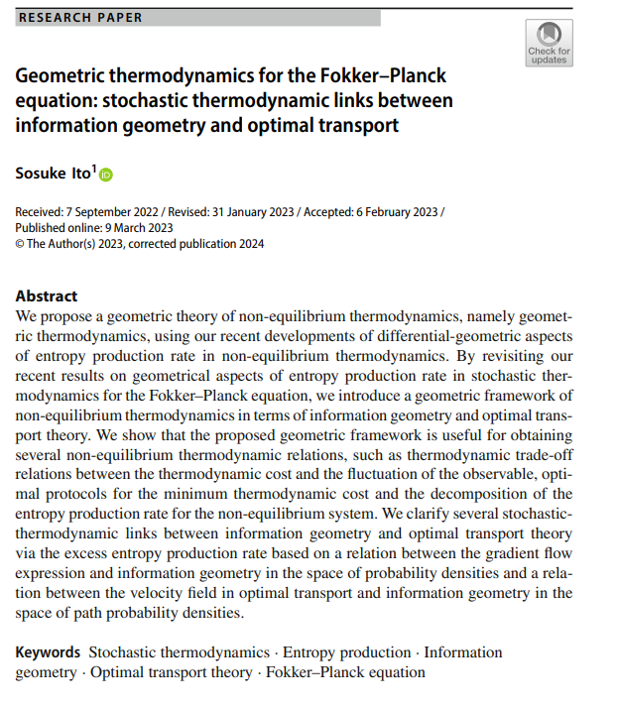
Volume 7
Special Issue １
Article 23
Number 114
Notes:
Geometry and convergence of natural policy gradient methods
https://link.springer.com/article/10.1007/s41884-023-00106-z

Slide 24
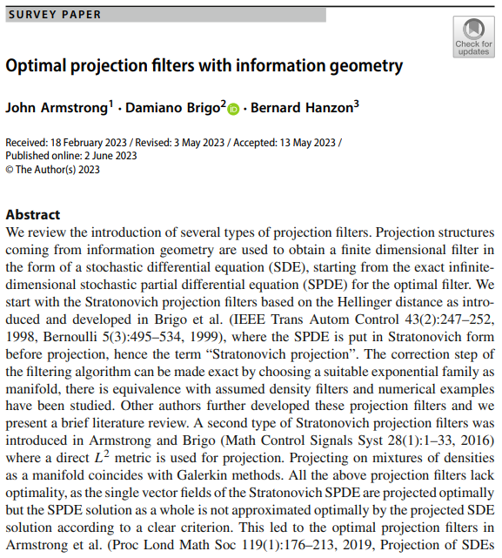
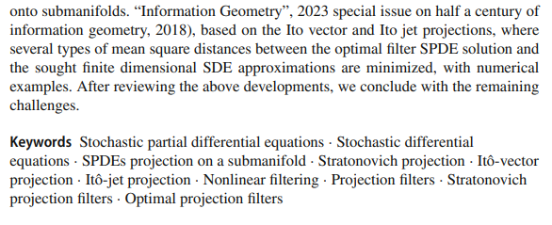
Volume 7
Special Issue １
Article 24
Number 115
Notes:
Optimal projection filters with information geometry
https://link.springer.com/article/10.1007/s41884-023-00108-x

Slide 25
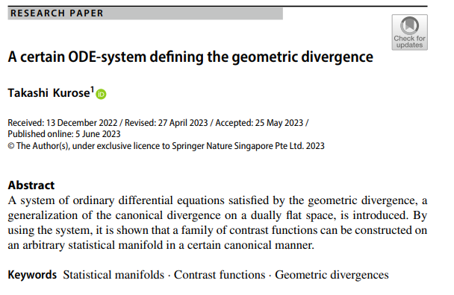
Volume 7
Special Issue １
Article 25
Number 116
Notes:
A certain ODE-system defining the geometric divergence
https://link.springer.com/article/10.1007/s41884-023-00110-3

Slide 26
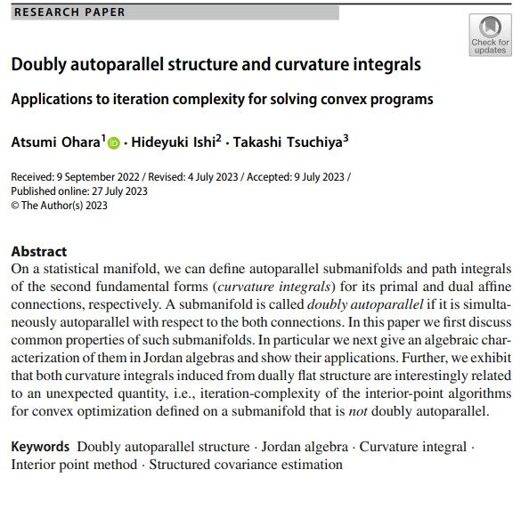
Volume 7
Special Issue １
Article 26
Number 117
Notes:
Doubly autoparallel structure and curvature integrals
https://link.springer.com/article/10.1007/s41884-023-00116-x

Slide 27
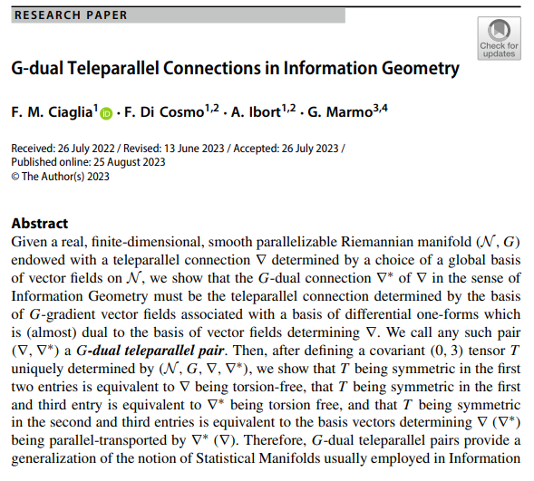

Volume 7
Special Issue １
Article 27
Number 118
Notes:
G-dual Teleparallel Connections in Information Geometry
https://link.springer.com/article/10.1007/s41884-023-00117-w

Slide 28
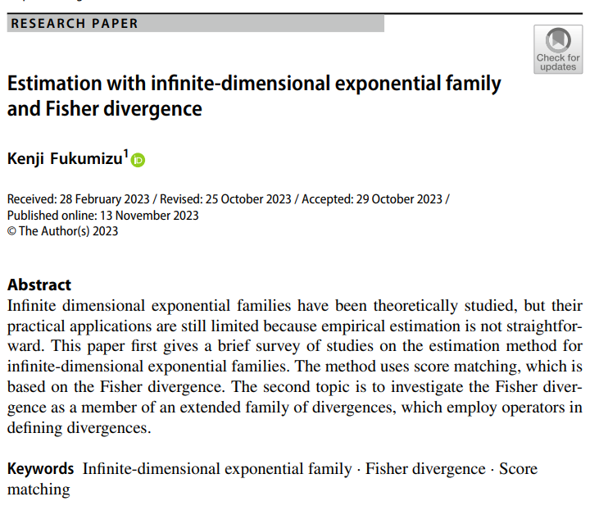
Volume 7
Special Issue １
Article 28
Number 119
Notes:
Estimation with infinite-dimensional exponential family and Fisher divergence
https://link.springer.com/article/10.1007/s41884-023-00122-z

Slide 29
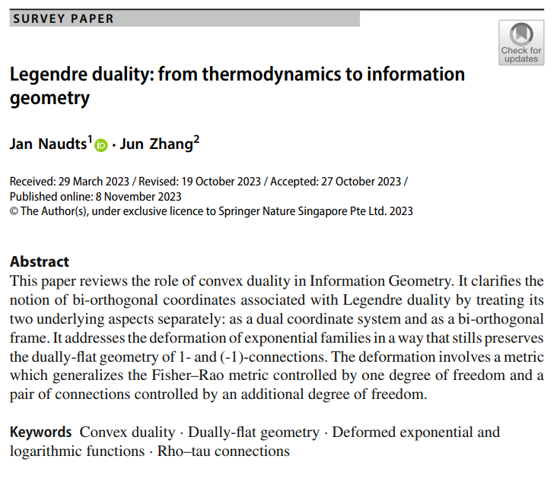
Volume 7
Special Issue １
Article 29
Number 120
Notes:
Legendre duality: from thermodynamics to information geometry
https://link.springer.com/article/10.1007/s41884-023-00121-0

Slide 30

Volume 7
Special Issue １
Article 30
Number 121
Notes:
The Fisher metric as a metric on the cotangent bundle
https://link.springer.com/article/10.1007/s41884-023-00126-9

