Slide 1


Volume 7
Special Issue 2
Article 1
Number 122
Notes:
Gibbs manifolds
https://link.springer.com/article/10.1007/s41884-023-00111-2

Slide 2
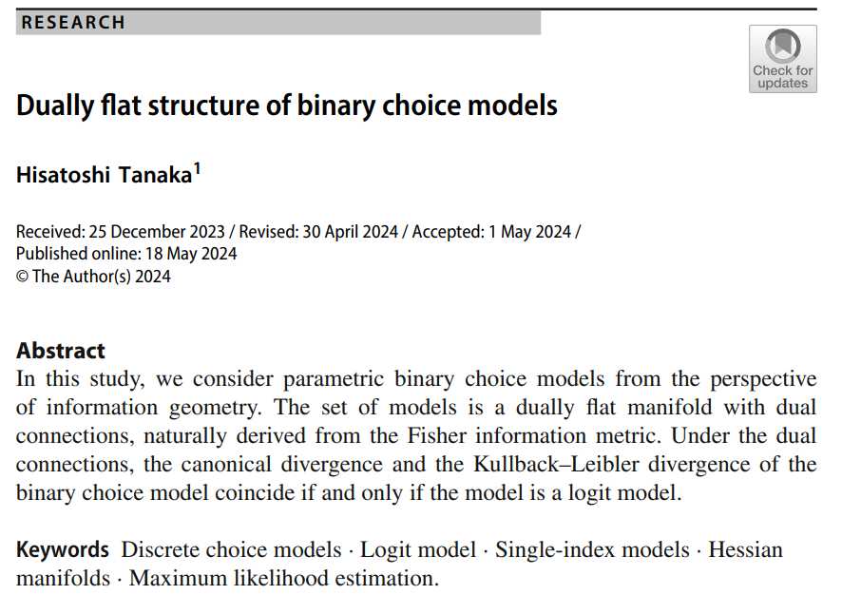
Volume 7
Special Issue 2
Article 2
Number 123
Notes:
Dually flat structure of binary choice models
https://link.springer.com/article/10.1007/s41884-024-00136-1

Slide 3

Volume 7
Special Issue 2
Article 3
Number 124
Notes:
A historical perspective on Schützenberger-Pinsker inequalities (extended version)
https://link.springer.com/article/10.1007/s41884-024-00138-z

Slide 4
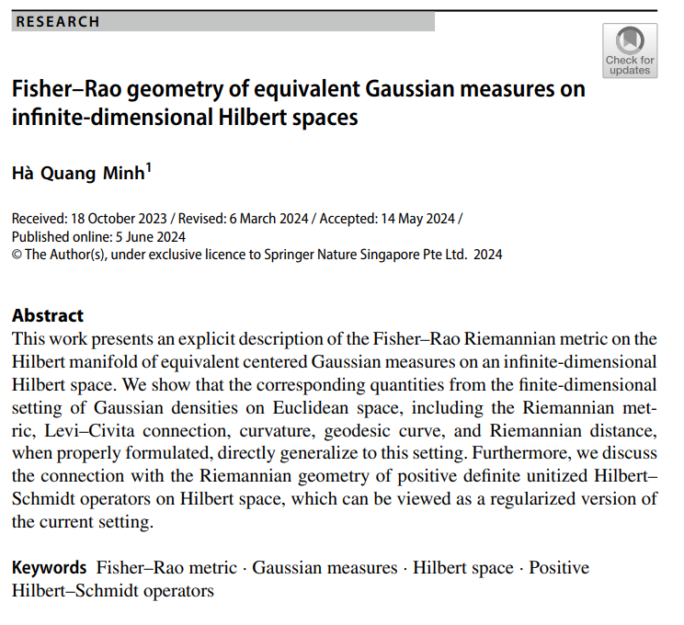
Volume 7
Special Issue 2
Article 4
Number 125
Notes:
Fisher–Rao geometry of equivalent Gaussian measures on infinite-dimensional Hilbert spaces
https://link.springer.com/article/10.1007/s41884-024-00137-0

Slide 5

Volume 7
Special Issue 2
Article 5
Number 126
Notes:
Unveiling cellular morphology: statistical analysis using a Riemannian elastic metric in cancer cell image datasets
https://link.springer.com/article/10.1007/s41884-024-00145-0

Slide 6
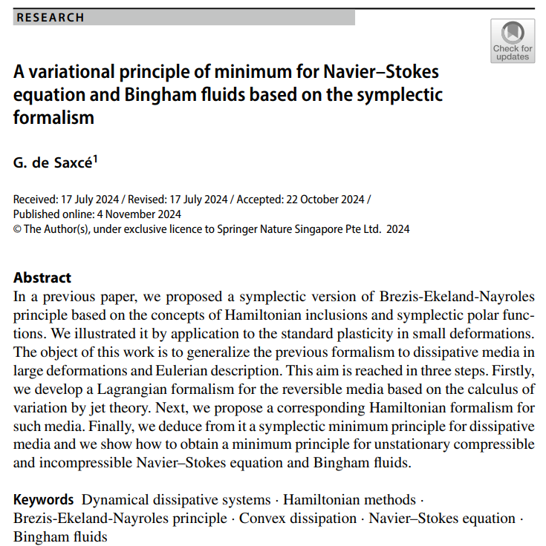
Volume 7
Special Issue 2
Article 6
Number 127
Notes:
A variational principle of minimum for Navier–Stokes equation and Bingham fluids based on the symplectic formalism
https://link.springer.com/article/10.1007/s41884-024-00157-w

Slide 7

Volume 7
Special Issue 2
Article 7
Number 128
Notes:
Cartan moving frames and the data manifolds
https://link.springer.com/article/10.1007/s41884-024-00159-8

Slide 8
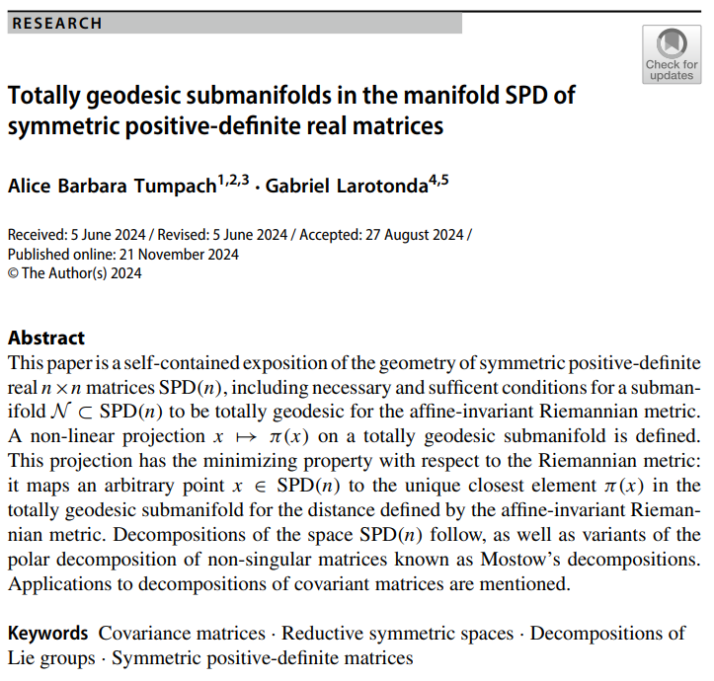
Volume 7
Special Issue 2
Article 8
Number 129
Notes:
Totally geodesic submanifolds in the manifold SPD of symmetric positive-definite real matrices
https://link.springer.com/article/10.1007/s41884-024-00146-z

Slide 9

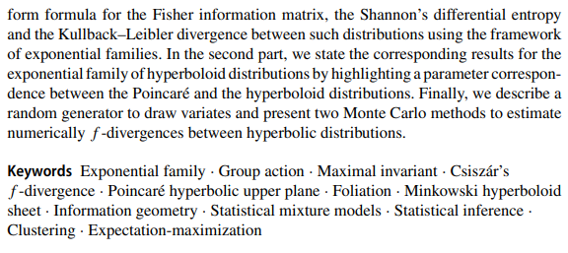
Volume 7
Special Issue 2
Article 9
Number 130
Notes:
Information measures and geometry of the hyperbolic exponential families of Poincaré and hyperboloid distributions
https://link.springer.com/article/10.1007/s41884-024-00158-9

