Slide 1


Volume 8
Issue 1
Article 1
Number 131
Notes:
Some computational results on Koszul–Vinberg cochain complexes
https://link.springer.com/article/10.1007/s41884-024-00155-y

Slide 2

Volume 8
Issue 1
Article 2
Number 132
Notes:
Information geometry of system spaces
https://link.springer.com/article/10.1007/s41884-024-00162-z

Slide 3
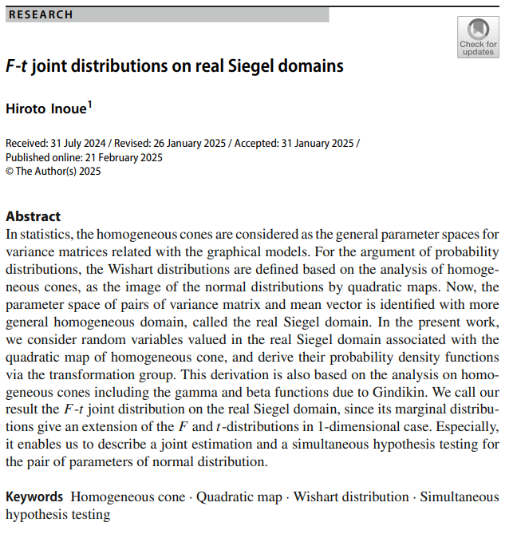
Volume 8
Issue 1
Article 3
Number 133
Notes:
F-t joint distributions on real Siegel domains
https://link.springer.com/article/10.1007/s41884-025-00163-6

Slide 4
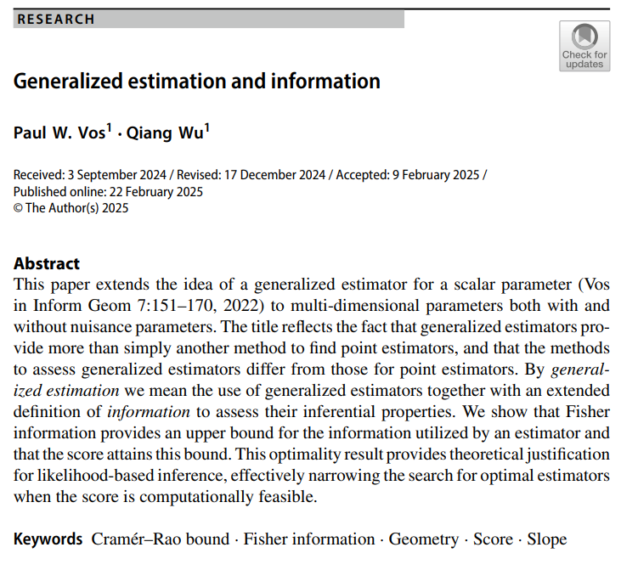
Volume 8
Issue 1
Article 4
Number 134
Notes:
Generalized estimation and information
https://link.springer.com/article/10.1007/s41884-025-00164-5

Slide 5
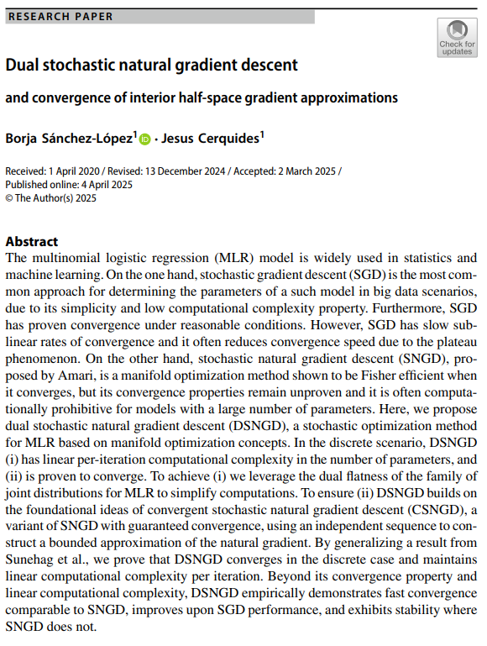
Volume 8
Issue 1
Article 5
Number 135
Notes:
Dual stochastic natural gradient descent and convergence of interior half-space gradient approximations
https://link.springer.com/article/10.1007/s41884-025-00165-4

Slide 6
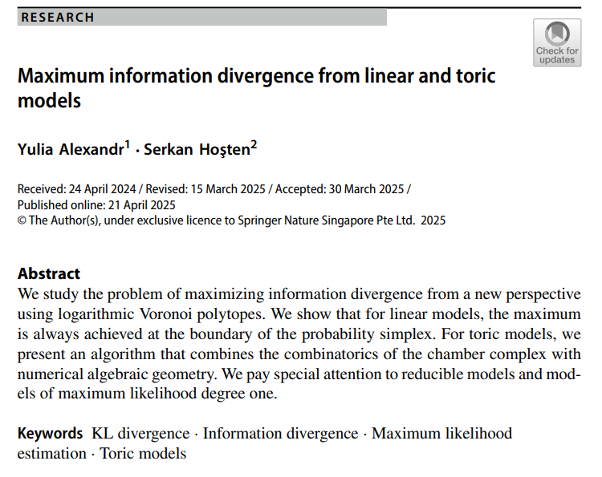
Volume 8
Issue 1
Article 6
Number 136
Notes:
Maximum information divergence from linear and toric models
https://link.springer.com/article/10.1007/s41884-025-00166-3

