Slide 1
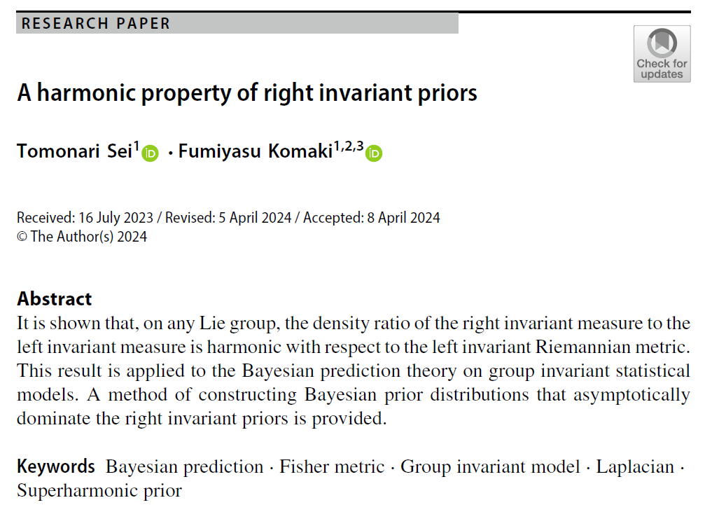

Volume ??
Issue ??
Article ??
Number ??
Notes:
A harmonic property of right invariant priors
https://link.springer.com/article/10.1007/s41884-024-00133-4

Slide 2
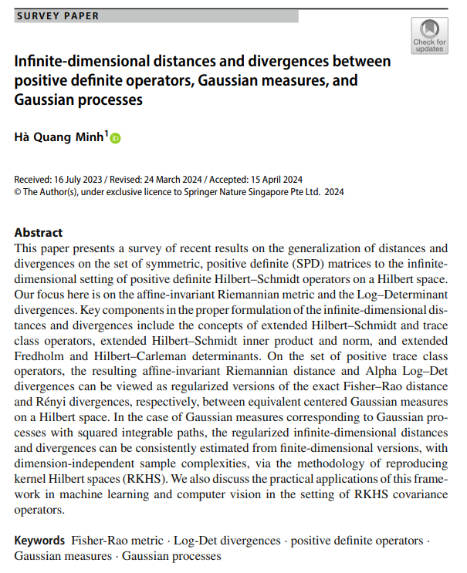
Volume ??
Issue ??
Article ??
Number ??
Notes:
Infinite-dimensional distances and divergences between positive definite operators, Gaussian measures, and Gaussian processes
https://link.springer.com/article/10.1007/s41884-024-00134-3

Slide 3
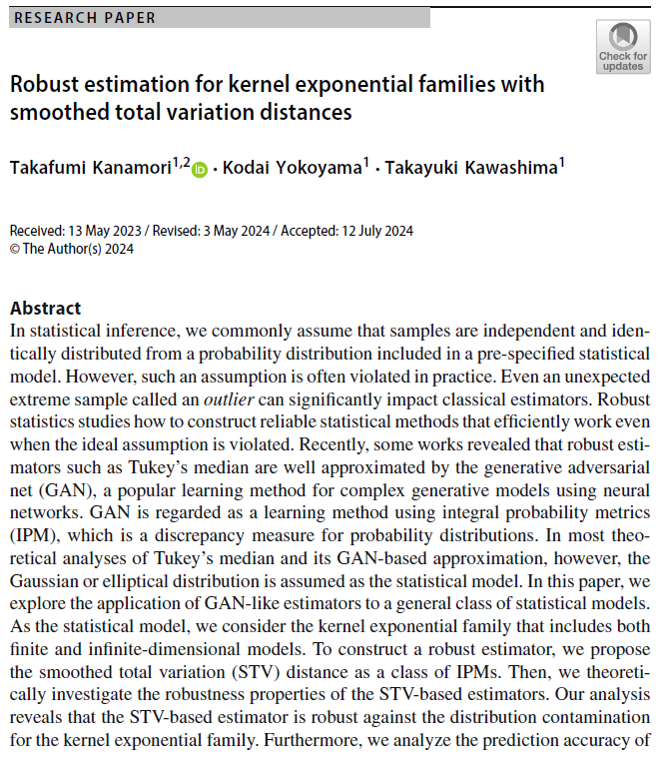
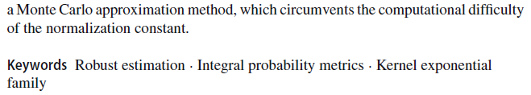
Volume ??
Issue ??
Article ??
Number ??
Notes:
Robust estimation for kernel exponential families with smoothed total variation distances
https://link.springer.com/article/10.1007/s41884-024-00141-4

Slide 4
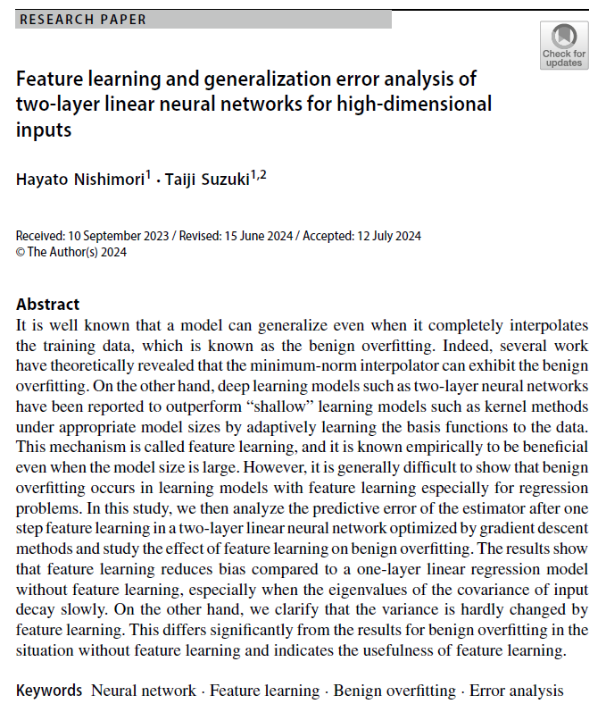
Volume ??
Issue ??
Article ??
Number ??
Notes:
Feature learning and generalization error analysis of two-layer linear neural networks for high-dimensional inputs
https://link.springer.com/article/10.1007/s41884-024-00142-3

Slide 5
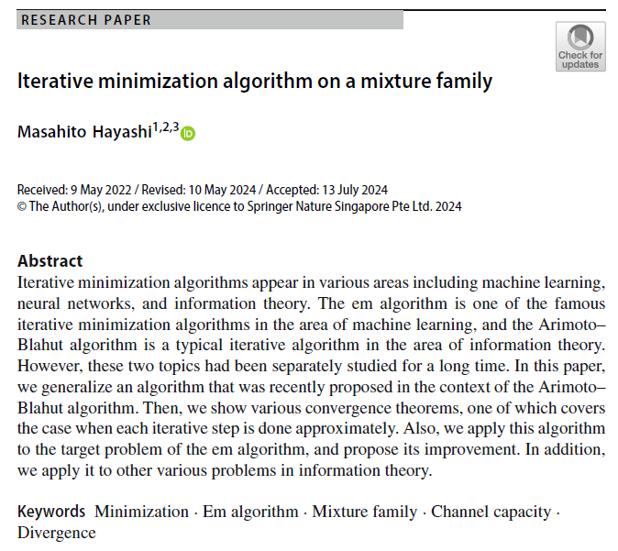
Volume ??
Issue ??
Article ??
Number ??
Notes:
Iterative minimization algorithm on a mixture family
https://link.springer.com/article/10.1007/s41884-024-00140-5

Slide 6
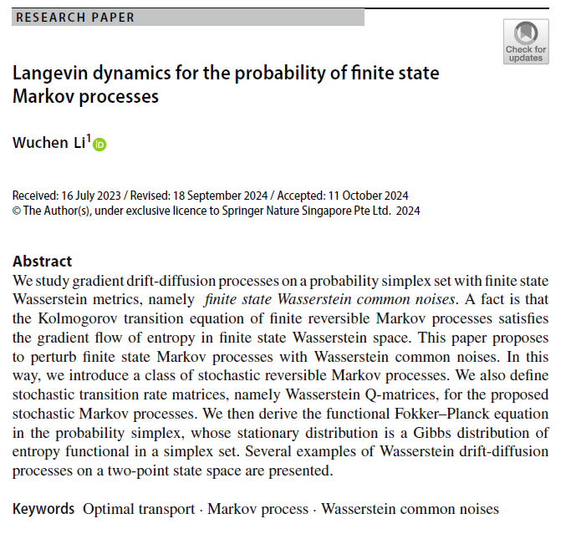
Volume ??
Issue ??
Article ??
Number ??
Notes:
Langevin dynamics for the probability of finite state Markov processes
https://link.springer.com/article/10.1007/s41884-024-00154-z

Slide 7
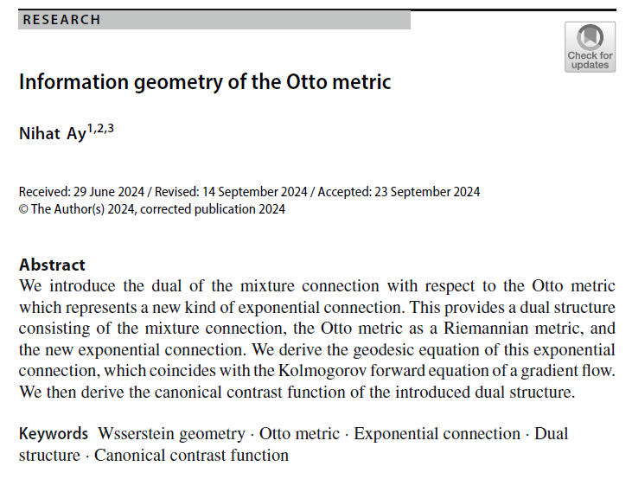
Volume ??
Issue ??
Article ??
Number ??
Notes:
Information geometry of the Otto metric
https://link.springer.com/article/10.1007/s41884-024-00149-w

Slide 8
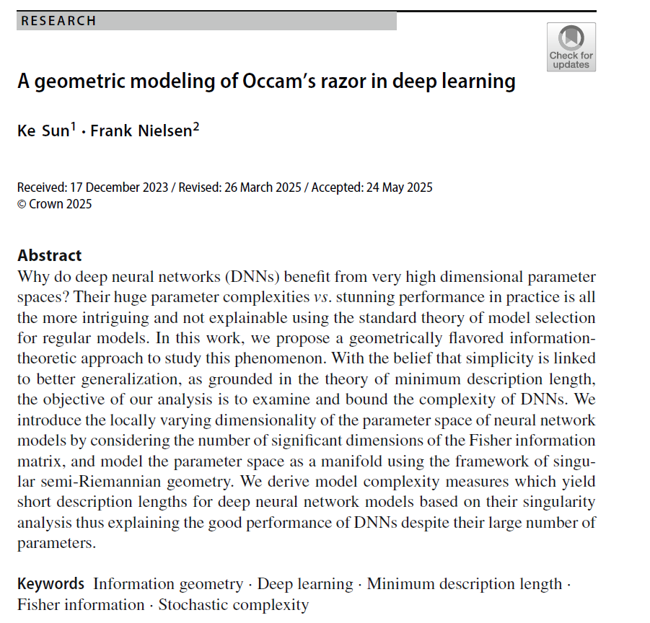
Volume ??
Issue ??
Article ??
Number ??
Notes:
A geometric modeling of Occam’s razor in deep learning
https://link.springer.com/article/10.1007/s41884-025-00167-2

Slide 9
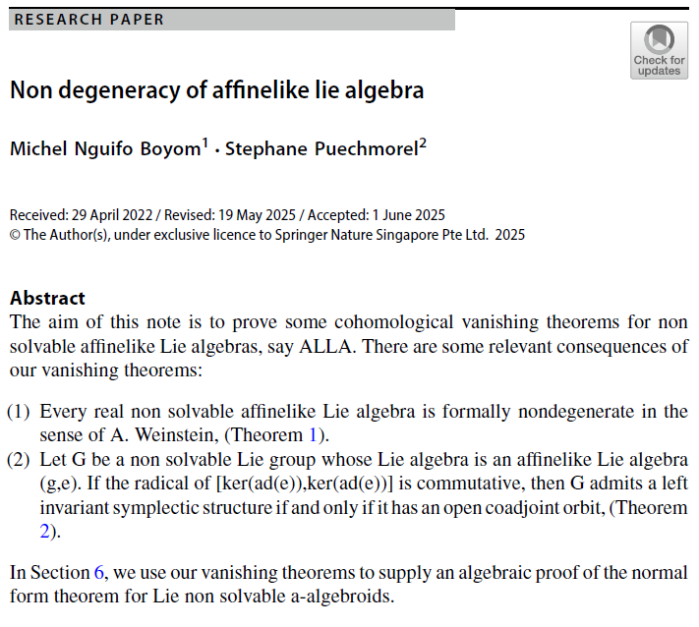
Volume ??
Issue ??
Article ??
Number ??
Notes:
Non degeneracy of affinelike lie algebra
https://link.springer.com/article/10.1007/s41884-025-00168-1

Slide 10
Volume ??
Issue ??
Article ??
Number ??

