Slide 1


Non-linear Embeddings in
Hilbert Simplex Geometry
Frank Nielsen
Sony Computer Science Laboratories Inc
Ke Sun
CSIRO Data 61
arXiv:2203.11434
ICML TAG-ML'23
2023

Slide 2
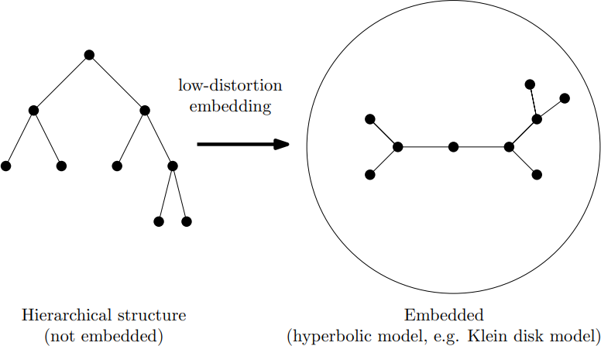
Embedding discrete hierarchical structures in hyperbolic spaces: Continuous representations
Discrete tree/hierarchies
Downstream tasks
Theorem: One can embed any weighted edge tree as a Delaunay graph of embedded tree nodes in hyperbolic geometry with arbitrary small distortion
Sarkar, Low distortion delaunay embedding of trees in hyperbolic plane International symposium on graph drawing, 2011
Notes:
https://hazyresearch.stanford.edu/hyperE/
https://dawn.cs.stanford.edu/2018/03/19/hyperbolics/

Slide 3
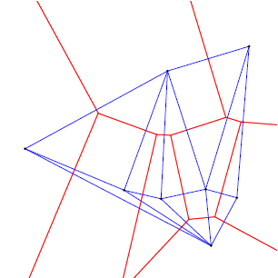
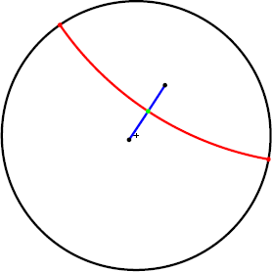
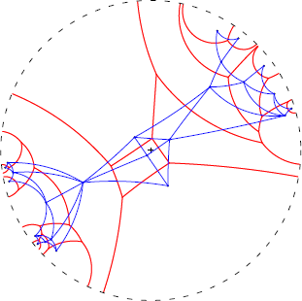
Hyperbolic Voronoi diagram/Delaunay complex
Ordinary Voronoi/Delaunay
Poincaré bisector/geodesic
Poincaré Voronoi/Delaunay
On Voronoi diagrams on the information-geometric Cauchy manifolds Entropy 22.7 (2020)

Slide 4
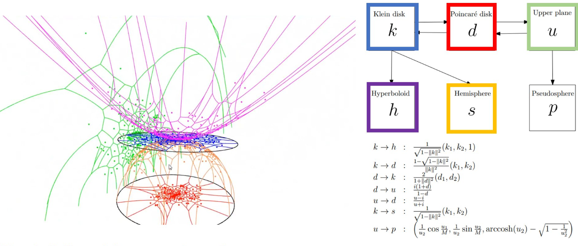
Various models of hyperbolic geometry
Minkowski/Lorentz model is well-suited for optimization since the domain is uncontrained
Visualizing hyperbolic Voronoi diagrams, Symp. Computational Geometry 2014
Representation tradeoffs for hyperbolic embeddings, ICMLR 2018

Slide 5
Outline and contributions
Present Hilbert simplex geometry (HSG) for embeddings of graphs
Contributions:
Simple proof of monotonicity of Hilbert distance
Connection of Hilbert distance with Aitchison distance
Differentiable approximation of Hilbert distance for machine learning
Application to non-linear HSG embedding: experimentally fast, robust, and competitive

Slide 6
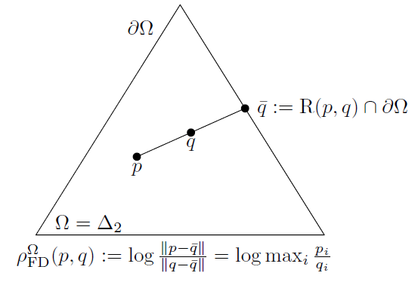



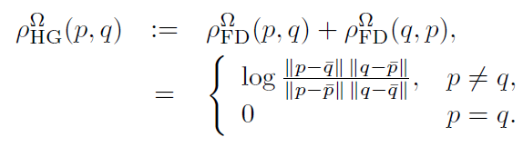
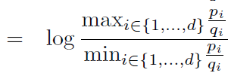
Funk and Hilbert distance
Consider an open bounded convex set Ω of a space (eg open standard simplex)
Funk asymmetric distance (weak distance satisfies the triangular inequality):
Hilbert metric distance (1895) is the symmetrization of Funk distance:
Independent of the chosen norm since

Slide 7

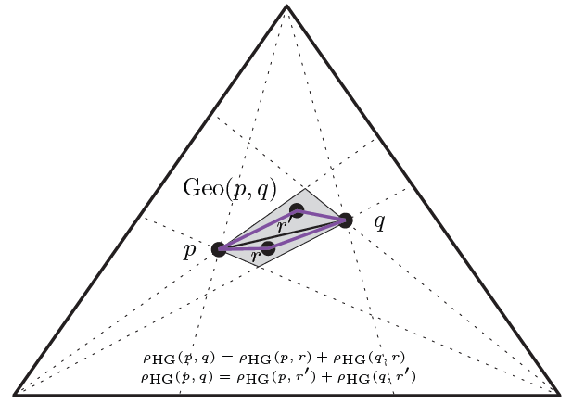
Hilbert distance: The log cross-ratio metric
A metric distance which satisfies the triangle inequality:
Straight lines are geodesics but geodesics are not unique:

Slide 8
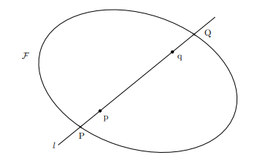
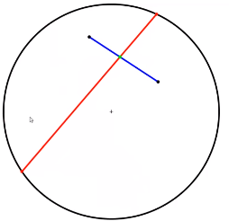
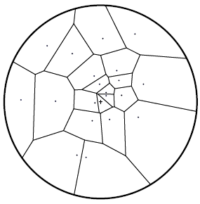
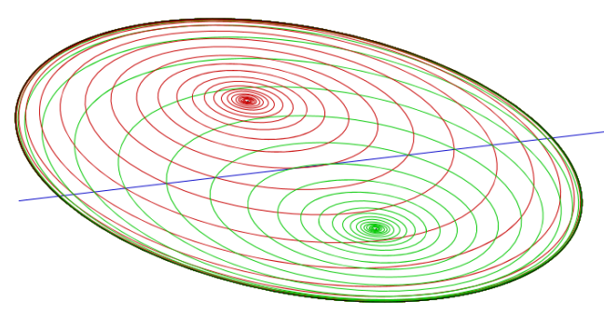
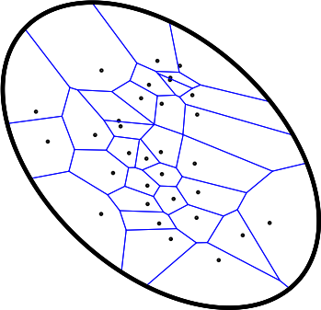

Hilbert geometry generalizes Klein and Cayley projective geometries
When Ω=Open disk → Klein geometry
When Ω=Open ellipsoid → Cayley-Klein geometry
When Ω=Open convex with smooth boundary → hyperbolic-type Finsler geometry
Cayley-Klein
Klein
Notes:
Classification with mixtures of curved Mahalanobis metrics." 2016 IEEE International Conference on Image Processing (ICIP)

Slide 9
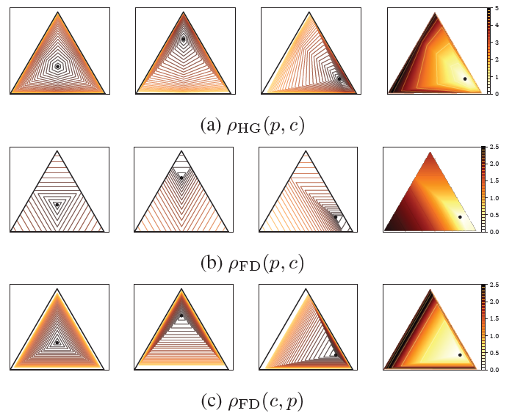
Funk and Hilbert balls
Hilbert balls have
Euclidean hexagonal shapes
On balls in a Hilbert polygonal geometry, SoCG 2017
Notes:
Nielsen, Frank, and Laetitia Shao. "On balls in a Hilbert polygonal geometry (multimedia contribution)." 33rd International Symposium on Computational Geometry (SoCG 2017). Schloss Dagstuhl-Leibniz-Zentrum fuer Informatik, 2017.

Slide 10
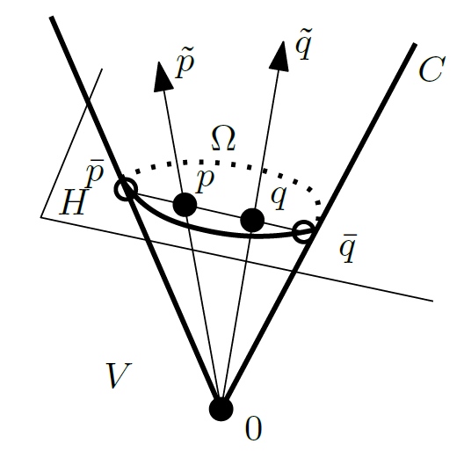
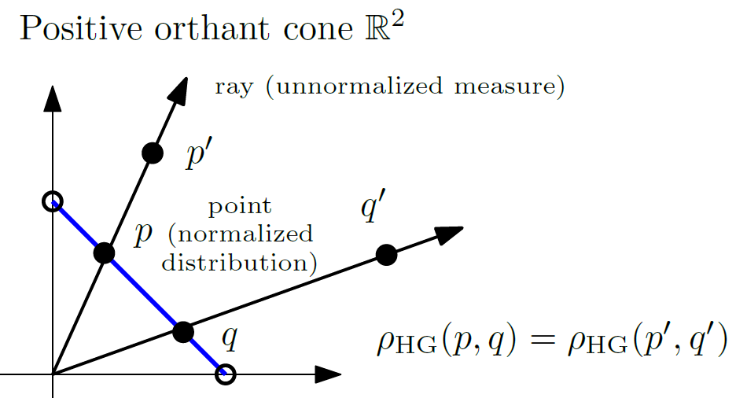

Hilbert: Metric vs Projective distance
Metric distance on an open bounded convex set Ω of d-dim space
Projective distance on the pointed cone C defined by homothets λΩ in dim d
distances between points vs pseudo-distance between rays
Ω=standard simplex
Notes:
https://en.wikipedia.org/wiki/Hilbert_metric

Slide 11


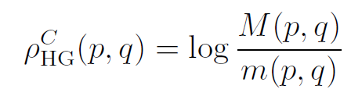




Hilbert projective distance in a cone
Cone:
Cone defines a partial ordering:
Projective Hilbert distance:
where
Projective distance:
which becomes a metric distance on Ω:
Notes:
$$
C=\{(\lambda ,x) \st \lambda\in\bbR_{>0}, x\in\Omega\}
$$
$$
p \preceq_C q \Leftrightarrow q-p\in C
$$
$$
M(p,q)=\inf\{\lambda\in\bbR_{>0} \st p \preceq_C \lambda q\}
$$
$$
m(p,q)=\sup\{\lambda\in\bbR_{>0}\st \lambda q\preceq_C p\}
$$
$$
\rho^C_\HG(p,q)=\log\frac{M(p,q)}{m(p,q)}
$$
$$
\rho^C_\HG(p,q)=\rho^C_\HG(\alpha p,\beta q), \quad\alpha,\beta>0
$$
$$
\rho^\Omega_\HG(p,q)=\rho^C_\HG(p,q),\quad \forall p,q\in\Omega
$$

Slide 12



Monotone distances
Let T be a map. A distance is monotone or strictly monotone iff
In information geometry, the separable monotone "distances" are precisely the f-divergences when d>2.
Theorem: Funk distance and Hilbert simplex distance are non-separable monotone distances
Contraction theorem (Birkhoff, 1957):
Jiao, Information measures: the curious case of the binary alphabet, IEEE Transactions on Information Theory 60.12 (2014)
Notes:
$$
\rho(T(p),T(q))\leq \rho(p,q),\quad \forall p,q
$$
$$
\rho(T(p),T(q))< \rho(p,q),\quad \forall p\not =q
$$

Slide 13
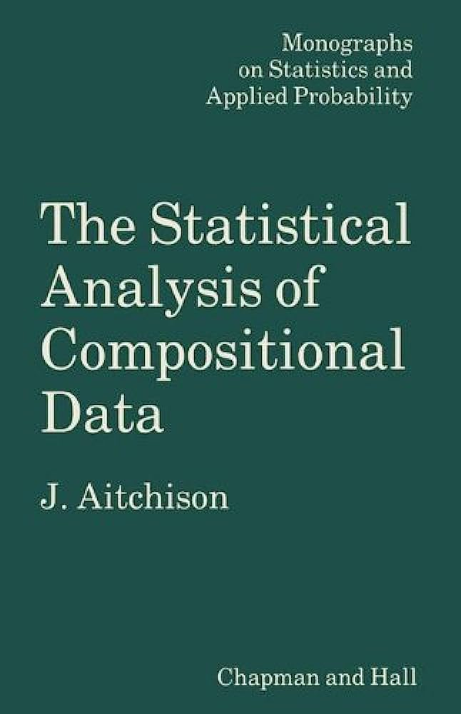
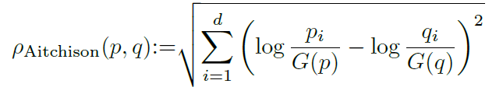
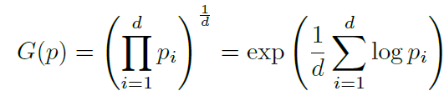
Aitchison distance: Another non-separable monotone distance
Often used in COmpositional Data Analysis (CODA)
where G is the geometric mean
Erb and Ay, The information-geometric perspective of Compositional Data Analysis
Advances in Compositional Data Analysis: Festschrift in Honour of Vera Pawlowsky-Glahn, 2021.

Slide 14

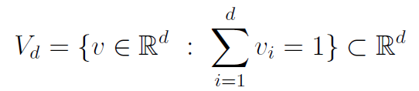
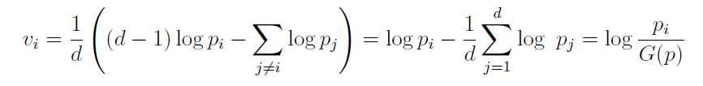

HSG: Isometry to a vector space (Normed Hilbert)
The only Hilbert geometries isometric to vector spaces are obtained with open simplex domains:
Slanted hyperplane:
Isometric mapping:
Norm/unit ball in vector space:
Distance:
Minkowski sum of sets:
Foertsch and Karlsson, Hilbert metrics and Minkowski norms, Journal of Geometry 83.1-2 (2005)
Notes:
de La Harpe, Pierre. Topics in geometric group theory. University of Chicago Press, 2000.
$$
(\Delta_d,\rho_\HG)\cong (V_d,\|\cdot\|_\NH)
$$
Hyperplane
$$
V_d=\left\{v\in\bbR^{d} \st \sum_{i=1}^d v_i=1\right\}\subset\bbR^d
$$
$$
v: p=(p_1,\ldots,p_{d})\in\Delta_d \rightarrow v(p)=(v_1,\ldots, v_{d})\in V_d
$$
$$
v_i= \frac{1}{d} \left((d-1)\log p_i -\sum_{j\neq{i}}\log p_j \right)= \log p_i - \frac{1}{d}\sum_{j=1}^d \log\ p_j = \log\frac{p_i}{G(p)}
$$
$$
B_V=\{v\in V_d \st |v_i-v_j|\leq 1, \forall i\not =j\}=\{v\in V_d \st \|v\|_\NH\leq 1\}.
$$
$$
\rho_V(v,v')= \|v-v'\|_\NH = \inf \left\{ \tau\in\bbR_{>0} \st v'\in \tau(B_V\oplus \{v\}) \right\}
$$
$$
A\oplus B=\{a+b \st a\in A,b\in B\}
$$

Slide 15
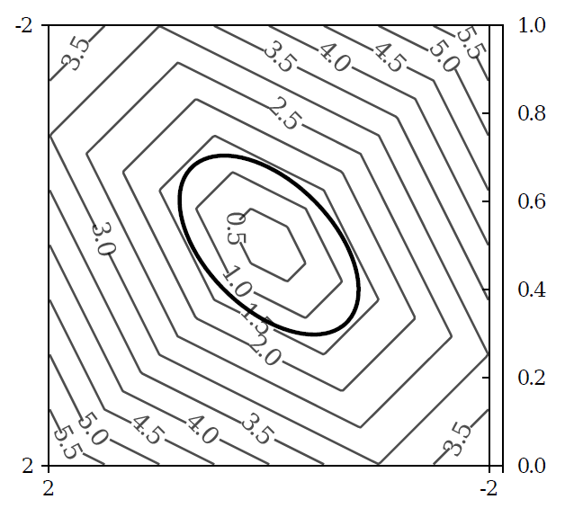
Symmetric polytope norm NH
Visualized on the slanted plane V₂:
de la Harpe, P. On Hilbert’s metric for simplices.
In Geometric Group Theory, volume 1, 1991
Notes:
https://math.stackexchange.com/questions/4641094/obtaining-an-ellipse-when-a-sphere-is-cut-with-a-plane

Slide 16
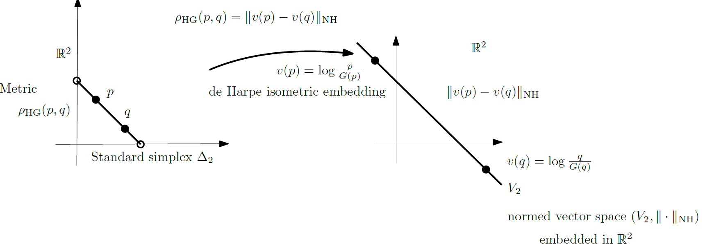
HSG isometry to a normed space

Slide 17


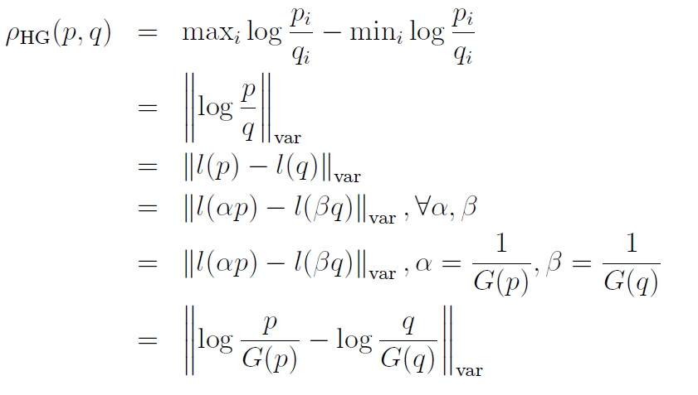


Logarithmic mapping and variation semi-norm
Logarithmic representation:
Hilbert distance as normed distance:
Hilbert projective distance as semi-normed variation distance:
(log monotone increasing: log max=max log, log min=min log)
variation semi-norm:
Notes:
$$
l(p)=(\log p_1,\ldots, \log p_d) \in\bbR^d
$$
$$
\|x\|_\var:=\max_i x_i-\min_i x_i=\|x\|_{+\infty}-\|x\|_{-\infty}
$$
$$
\rho_\HG(p,q)=\|v(p)-v(q)\|_\NH=\left\| \log\frac{p}{G(p)}-\log\frac{q}{G(q)}\right\|_\NH
$$
\begin{eqnarray*}
\rho_\HG(p,q) &=& \max_i \log\frac{p_i}{q_i} -\min_i \log\frac{p_i}{q_i}\\
&=& \left\|\log\frac{p}{q}\right\|_\var\\
&=& \left\|l(p)-l(q)\right\|_\var\\
&=& \left\|l(\alpha p)-l(\beta q)\right\|_\var, \forall \alpha,\beta\\
&=& \left\|l(\alpha p)-l(\beta q)\right\|_\var, \alpha=\frac{1}{G(p)},\beta=\frac{1}{G(q)}\\
&=& \left\|\log \frac{p}{G(p)}-\log \frac{q}{G(q)}\right\|_\var
\end{eqnarray*}
$$
\|(\lambda,...,\lambda)\|_\var =0 \forall \lambda\in\bbR
$$

Slide 18
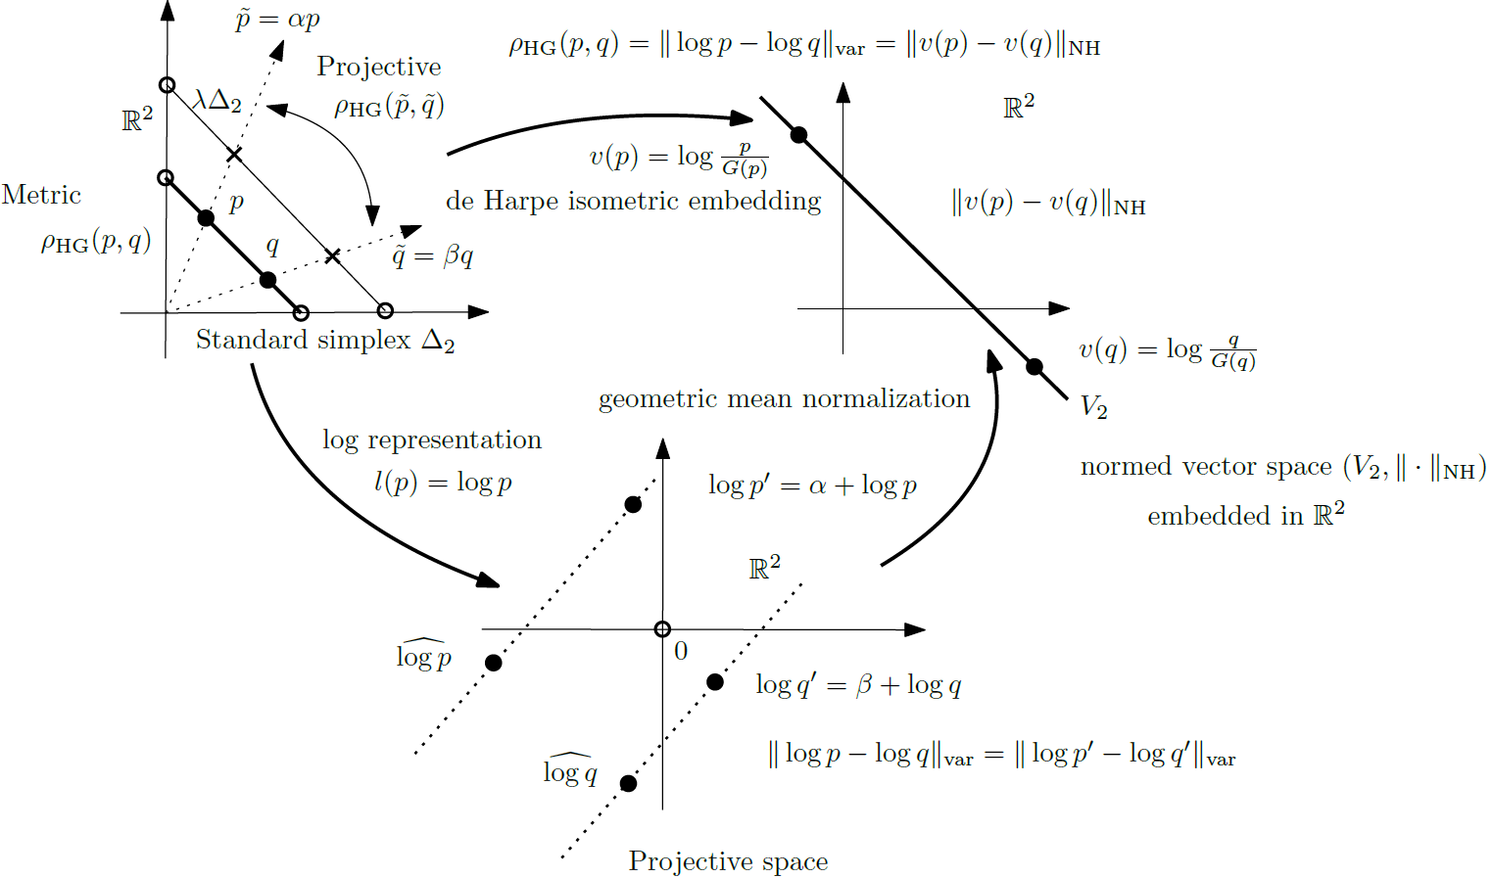
Metric/projective Hilbert simplex/pos. orthant distance

Slide 19

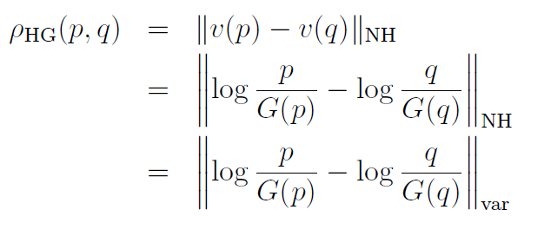

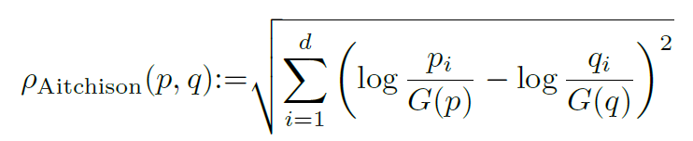
Relationship between HSG and Aitchison
Logarithm mapping normalized by homogeneous geometric mean:
Hilbert distance:
Aitchison distance:

Slide 20
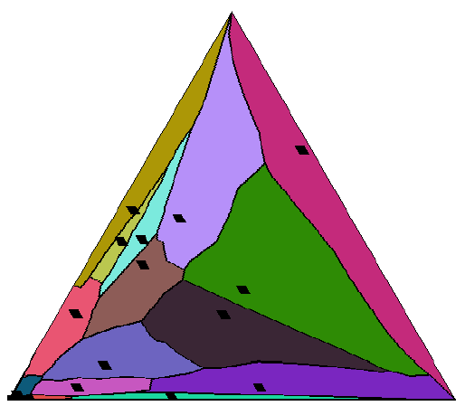
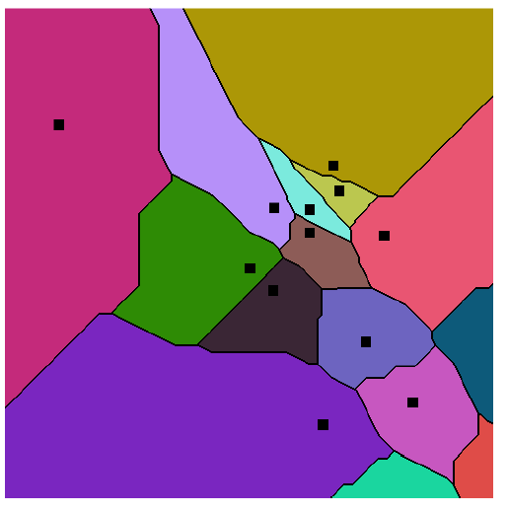


Hilbert simplex Voronoi diagrams

Slide 21
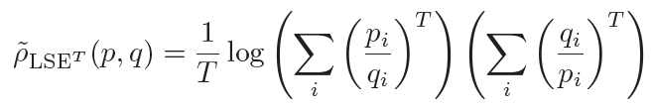
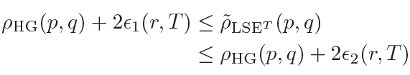
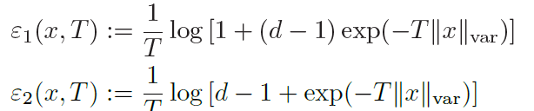

Differentiable approximation of Hilbert simplex distance
max and min operations in Hilbert simplex distance are not differentiable
log-sum-exp (LSE) commonly used in ML to approximate max operator
We approximate Hilbert simplex distance by differentiable function:
with guarantees
where
The larger T, the better the approximation:
Guaranteed bounds on information-theoretic measures of univariate mixtures
using piecewise log-sum-exp inequalities. Entropy 18.12 (2016)

Slide 22

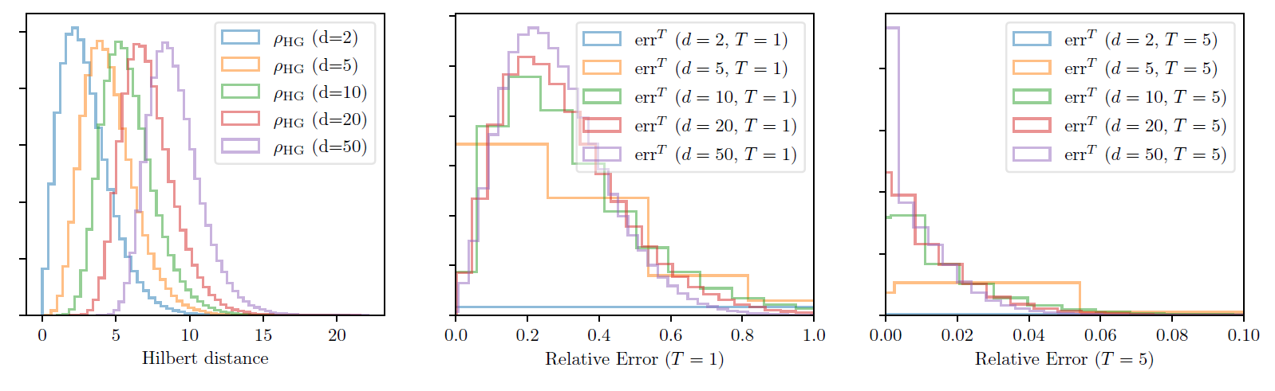
Differentiable approximation: Experiments
10⁶ pairs of points randomly sampled inside the d-dimensional standard simplex
We measure:

Slide 23
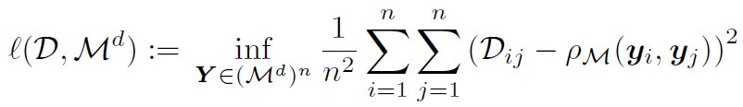
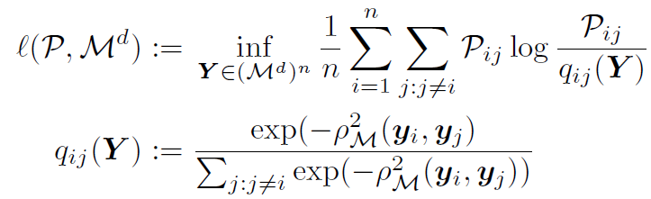
Non-linear embeddings: Evaluation metrics
Remark: When (M₁,ρ₁) isometric to (M₂,ρ₂) ↔ same representation power
Loss associated to a distance matrix [D_{ij}] (e.g., calculated from weighted graphs):
or use row-stochastic probability matrix [P_{ij}] (loss in manifold learning/graph embedding):
empirical average of the KL divergence
between pmf P_{i} and q_{i}
heat kernel

Slide 24
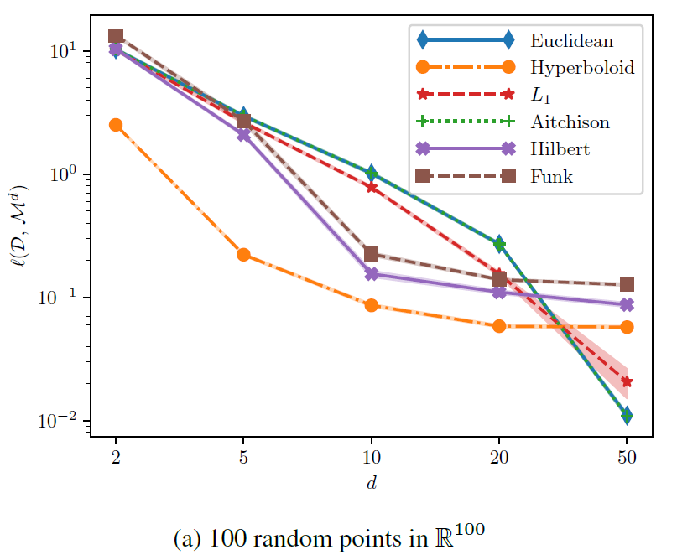
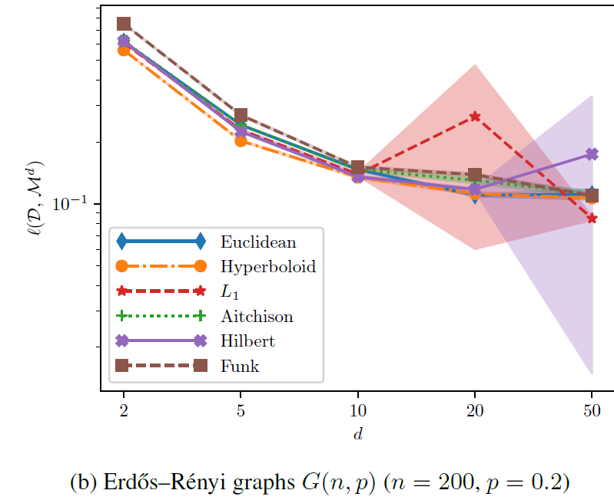
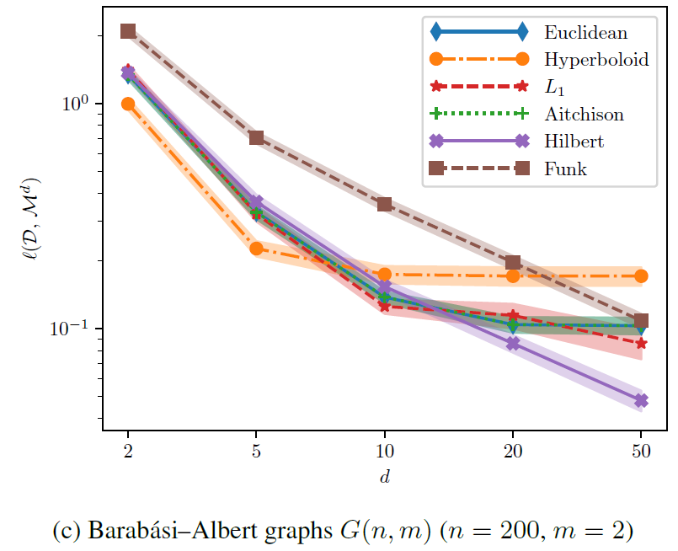
Non-linear embeddings: Results (MSE)
Use Adam local optimizer [Kingma & Ba, 2015]
Repeat 10 different instances to get standard deviation shown in color bands
Hilbert simplex geometry
is the winner
for discrete graphs
The larger the embedding dimension, the better!
Hilbert & hyperbolic hyberboloid geometries experimentally performed best

Slide 25
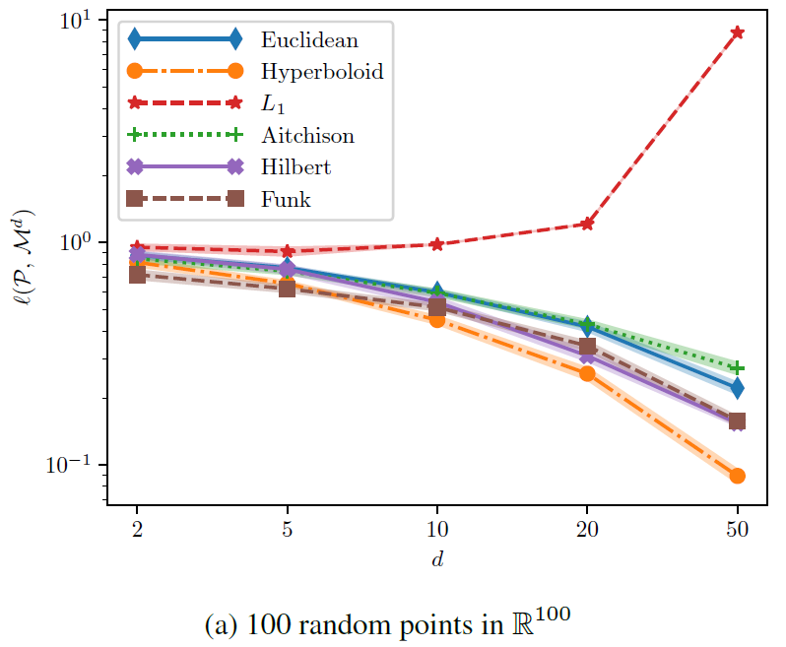
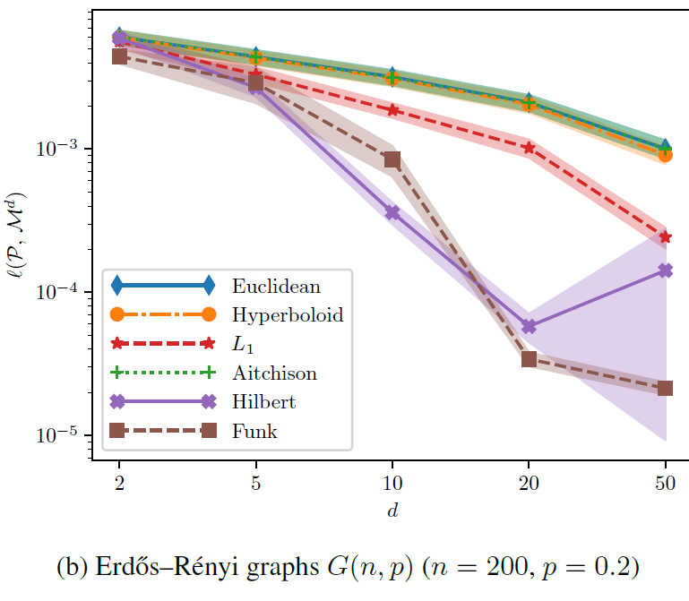
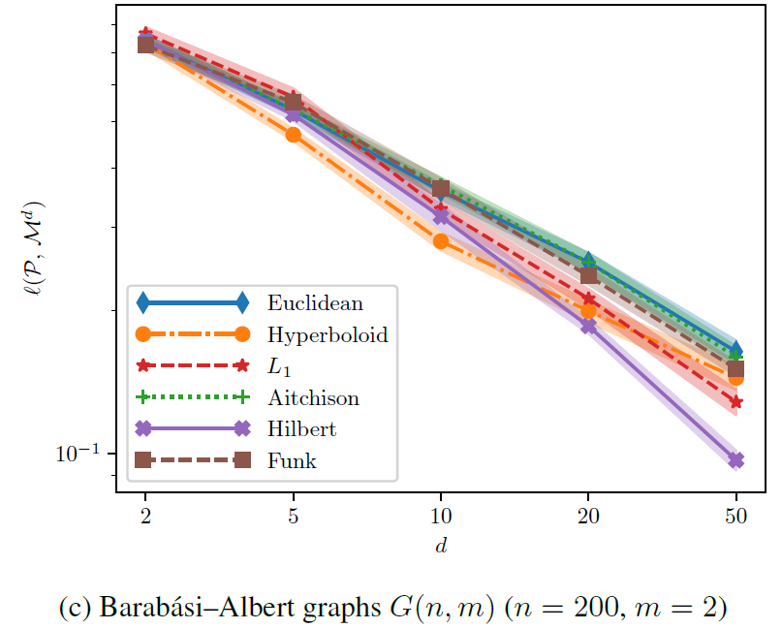
Non-linear embeddings: Results (empirical KLD)
hyperbolic geometry
is the winner for continuous data
Funk geometry also
good for embedding!
Hilbert simplex geometry
is the winner
for discrete graphs

Slide 26
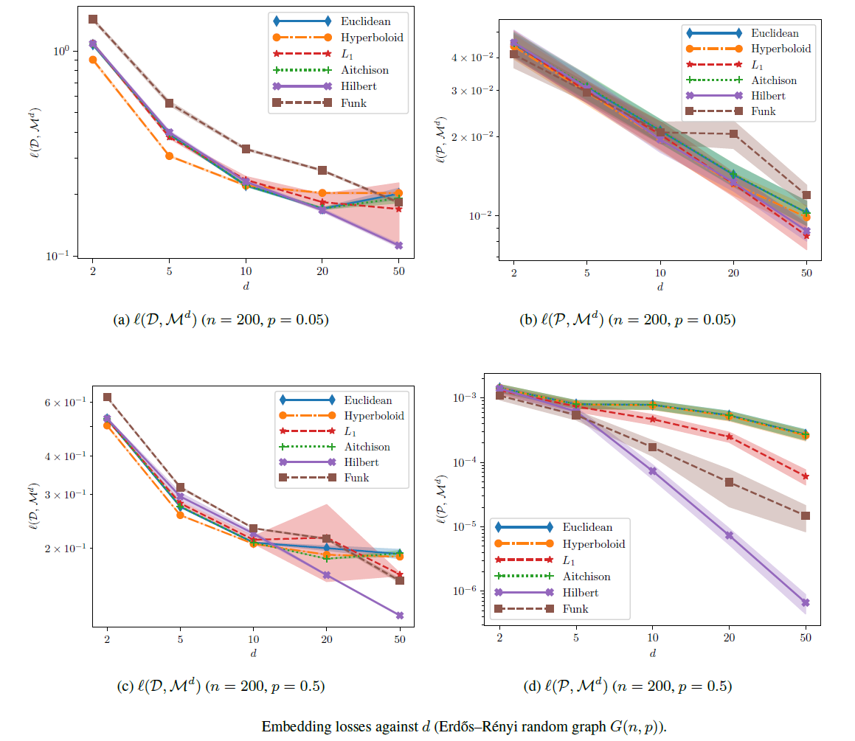
Non-linear embeddings: Comparative results

Slide 27
Summary
Proposed differentiable approximation of Hilbert distance
Presented Hilbert simplex geometry for graph embeddings via distance matrices using Adam optimizer
Results for non-linear embeddings: Hilbert/Funk simplex geometry is experimentally fast, robust, and competitive compared to L₁, L₂, Aitchison and hyperbolic hyperboloid embeddings
Proved the monotonicity of Funk and Hilbert distances
Shown a connection between Hilbert distance and Aitchison distance via
the normalized logarithmic representation of standard simplex points

Slide 28
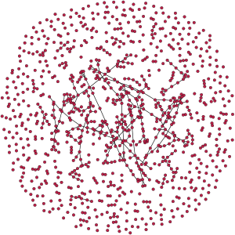
Erdős–Rényi random graph datasets G(n,p)
Graph with n nodes constructed by connecting nodes randomly
An edge Eij is included in the graph with probability p
(independently from other edges)
Image courtesy of Wikipedia
Caption:
"An Erdős–Rényi–Gilbert graph with 1000 vertices at the critical edge probability p=1/(n−1)
showing a large component and many small ones"
Notes:
https://en.wikipedia.org/wiki/Erd%C5%91s%E2%80%93R%C3%A9nyi_model
a graph is constructed by connecting labeled nodes randomly. Each edge is included in the graph with probability , independently from every other edge.
An Erdős–Rényi–Gilbert graph with 1000 vertices at the critical edge probability p=1/(n−1), showing a large component and many small ones

Slide 29
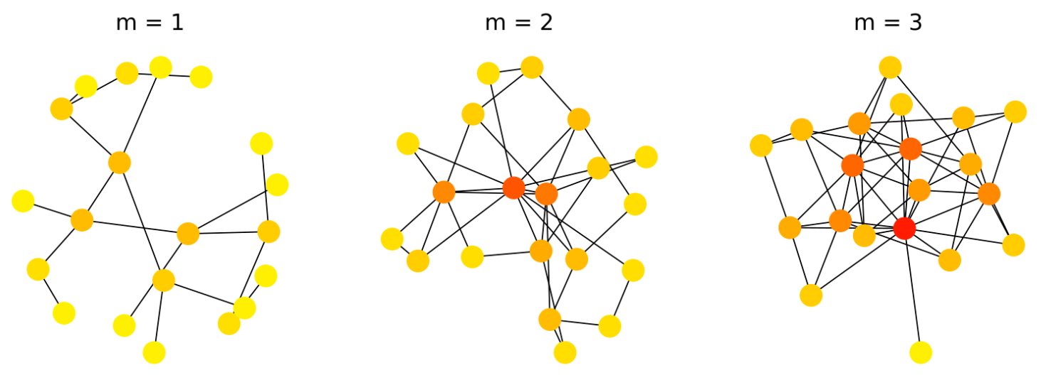
Barabási–Albert random graph datasets G(n,m)
Generating random scale-free networks with power-law degree distributions
Preferential attachment m:
the more connected a node is, the more likely it is to receive new links.
Begins with an initial connected network of m₀ vertices.
Add vertices incrementally: A new vertex v is connecto to already existing vertex v_{i} with
probability deg(v_{i})/Σ_{j}deg(v_{j})
Image courtesy of Wikipedia
Caption:
"Display of three graphs generated with the Barabasi-Albert (BA) model. Each has 20 nodes and a parameter of attachment m as specified. The color of each node is dependent upon its degree (same scale for each graph)."
Notes:
https://en.wikipedia.org/wiki/Barab%C3%A1si%E2%80%93Albert_model

Slide 30
References
Clustering in Hilbert’s projective geometry: The case studies of the probability simplex and the elliptope of correlation matrices, Geometric structures of information (2019)
Non-linear Embeddings in Hilbert Simplex Geometry, Topology, Algebra, and Geometry in Machine Learning Workshop (ICML TAGML'23), arXiv:2203.11434 (2022)
Home page: https://franknielsen.github.io/HSG/

Slide 31
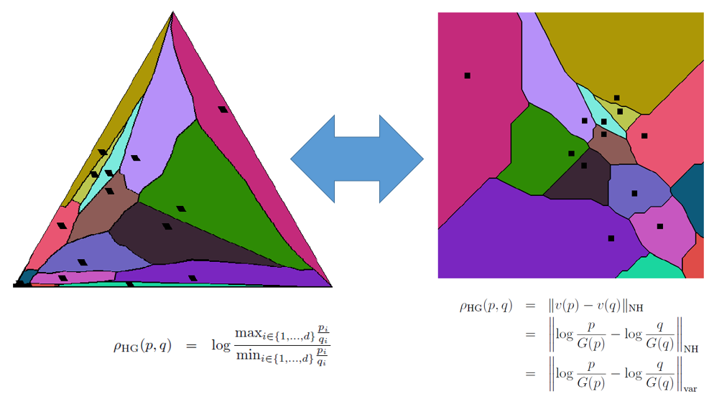
Non-linear Embeddings in Hilbert Simplex Geometry
Hilbert distance
on the simplex:
Hilbert simplex geometry isometric to normed vector space:
Voronoi
diagram
HD is projective distance on the positive orthant cone.
Differentiable approximation of the
Hilbert distance:
Loss functions for embedding distance matrices:
or empirical average Kullback-Leibler divergence:

