Slide 1

Curved Bregman divergences
Frank Nielsen
Sony Computer Science Laboratories, Inc.
https://arxiv.org/abs/2504.05654

Slide 2
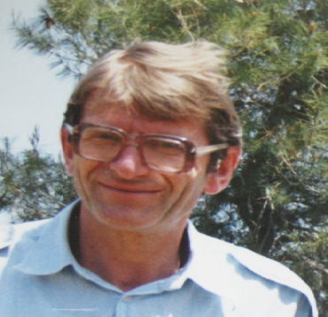

Bregman divergences (1960’s)
F: Θ⊆ℝ^{m}→ℝ a strictly convex and smooth
real-valued function on a finite dim. Hilbert space <.,.>
Bregman divergence B_{F}: Θ x Interior(Θ) →ℝ_{≥0}
Lev M. Bregman
(1941 - 2023)
Photo: courtesy of
Alexander Fradkov
B_{F}(θ₁ : θ₂)=F(θ₁)-F(θ₂)-< θ₁ - θ_{2 ,} ∇F(θ₂) >
Smooth measure of discrepancy, not a metric distance because it violates the triangle inequality.
BD is asymmetric when F is not quadratic function. Hence the delimiter notation “:” instead of B_{F}(θ₁ , θ₂)
BD interpreted as remainder of a first order Taylor expression of F(θ₁) around θ₂:
F(θ₁)=F(θ₂)+< θ₁ - θ_{2 ,} ∇F(θ₂) >+ B_{F}(θ₁ : θ₂)
Taylor remainder
Example of remainder: Lagrange remainder (smooth C² generators): ∇²F SPD ⇒ B_{F}(θ₁ : θ₂) ≥ 0
B_{F}(θ₁ : θ₂)= ½ (θ₂- θ₁)^{T} ∇²F(θ) (θ₂- θ₁) ≥0 , θ ∈ [θ₁ θ₂]
Notes:
https://en.wikipedia.org/wiki/Mathematical_operators_and_
ℝ
symbols_in_Unicode
Θθ∇≻ξ∈
http://lib.physcon.ru/doc?id=5d34ad008433
Σ
Lev Meerovich Bregman
(1941 - 2023)

Slide 3
Some taxonomy of BDs
Full Bregman divergences when Θ=Ω is effective domain of F
Regular Bregman divergence when F is Legendre-type (dual BDs)
Reparameterized BD B_{F}(θ(u₁): θ(u₂)), for u in U:
Representational BD when dim(U)=dim(Θ)
Subdimensional BD when dim(U)<dim(Θ) and U⊂Ω is convex (not full)
Curved BD (=not BD) when dim(U)<dim(Θ) and non-convex U (not full). Analogy with curved exponential families
When not full BD, replace Interior(Θ) by Relative Interior(Θ)
(Θ,F) BD B_{F}
B_{F}: Θ x RelInt(Θ) →ℝ_{≥0}
B_{F}(θ₁ : θ₂)=F(θ₁)-F(θ₂)-< θ₁ - θ_{2 ,} ∇F(θ₂) >

Slide 4
Representational Bregman divergences (2009)
In fact, we used a representation function R (e.g., θ(λ )) for
Calculating the KLD between two multivariate normal distributions:
B_{F,R}(λ ₁ : λ ₂):= B_{F}(R(λ ₁ ):R(λ ₂))
= F(R(λ ₁))-F(R(λ ₂))-< R(λ ₁)–R(λ ₂ ),∇F(R(λ ₂) ) >
Note that F∘R may not be a Bregman generator, i.e., not be strictly convex.
KLD between two densities of a generic exponential family with natural parameter from representation function
θ(λ ): natural parameter corresponding to λ, representation function R(.)=θ(. )
include normal, Gamma/Beta, Wishart, Poisson, etc.
D_{KL}[p(x| λ ₁) : p(x| λ ₂) ] = B_{F,} _{θ} ^{rev}(θ (λ ₁): θ (λ ₂))=B_{F,} _{θ}(θ (λ ₂): θ (λ ₁))
Notes:
Λ
A *representational Bregman divergence* is a Bregman divergence applied on a representation of the parameter space.
The α-divergences extended positive measures are an example of representational Bregman divergences.
Dual representational Fenchel-Young divergence with dual representation function
But restricted to the (m-1)-dimensional probability simplex is not a
Nielsen, Frank, and Richard Nock.
"The dual Voronoi diagrams with respect to representational Bregman divergences." IEEE ISVD 2009

Slide 5
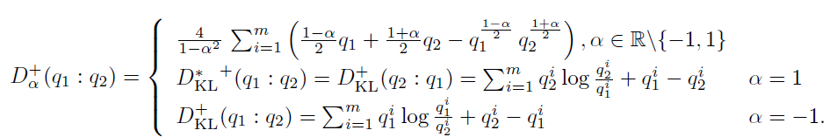



Extendedα-divergences are representational BDs
α-divergences extended to m-dim. positive measures (orthant cone)
are representational Bregman divergences:
Bregman generator:
Representation function:
And also
β-divergences!
Bregman divergence:
B_{F}(θ₁ : θ₂)=F(θ₁)-F(θ₂)-< θ₁ - θ_{2 ,} ∇F(θ₂) >
"The dual Voronoi diagrams with respect to representational Bregman divergences." IEEE ISVD 2009

Slide 6
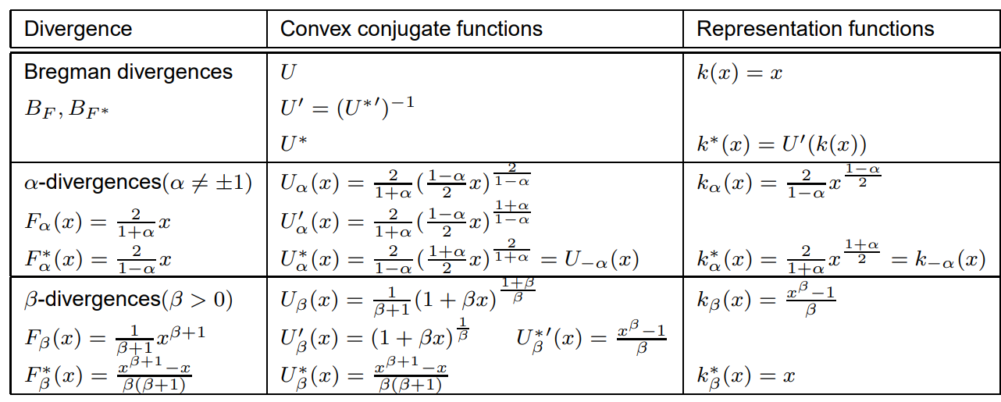
β-divergences are representational BDs

Slide 7
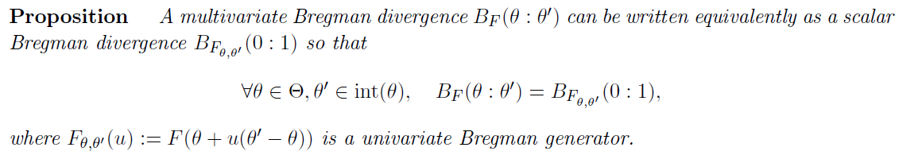

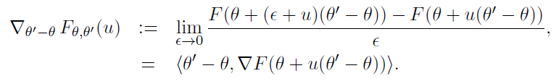
Subdimensional Bregman divergences…

Slide 8
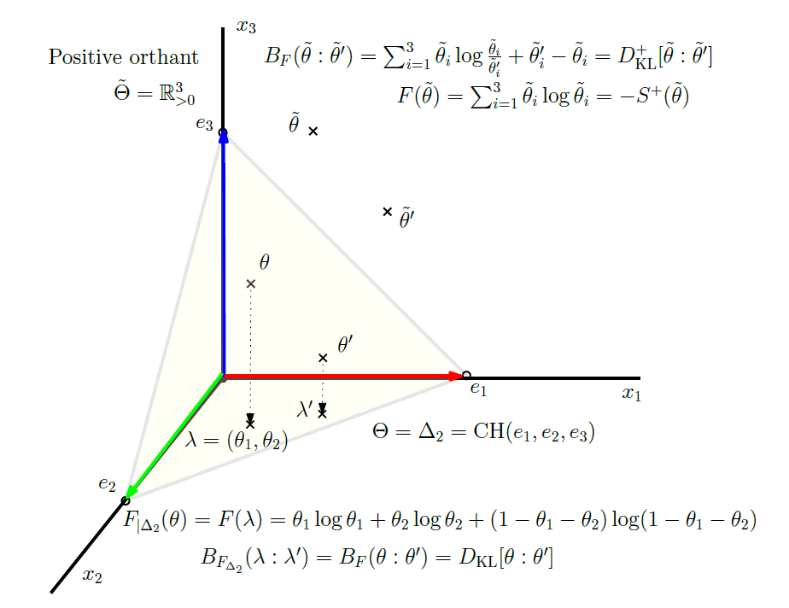
Subdimensional Bregman divergences…
Extended KLD+ is Bregman divergence with separable generator
KLD between normalized densities is sub-dimensional KLD+ restricted to standard simplex (affine U)
Notes:
https://www2.sonycsl.co.jp/person/nielsen/infogeo/pdf/Slide-ISVD2009.pdf

Slide 9
Subdimensional Bregman divergences…
Extended KLD+ is Bregman divergence with separable generator
KLD between normalized densities is sub-dimensional KLD+ restricted to standard simplex (affine U)
Notes:
https://www2.sonycsl.co.jp/person/nielsen/infogeo/pdf/Slide-ISVD2009.pdf

Slide 10
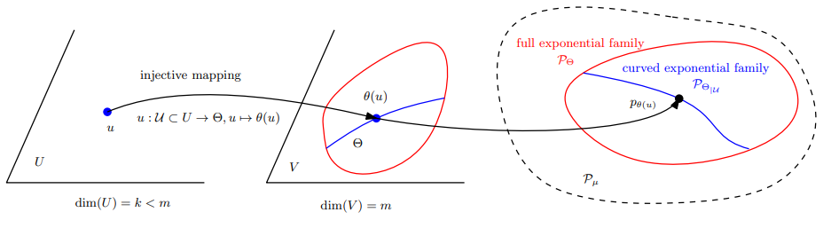
Curved Bregman divergences (cBDs)
Consider a domain U which maps to a subset of Θ by θ =c(u) with dim(U) < dim(Θ) : B_{F,c}(u₁ : u₂) := B_{F}(c(u₁ ):c( u₂)) is not Bregman when {c(u) | u ∈ U} not convex. cBDs usually not BDs unless constraints c(.) are affine
By analogy to curved exponential families
For example, U is real vector space, V is symmetric matrix vector space, CEF is sub-family of Gaussians
Notes:
Example:
KLD between 0-centered normal distributions with covariance matrices c(λ)=λΣ

Slide 11
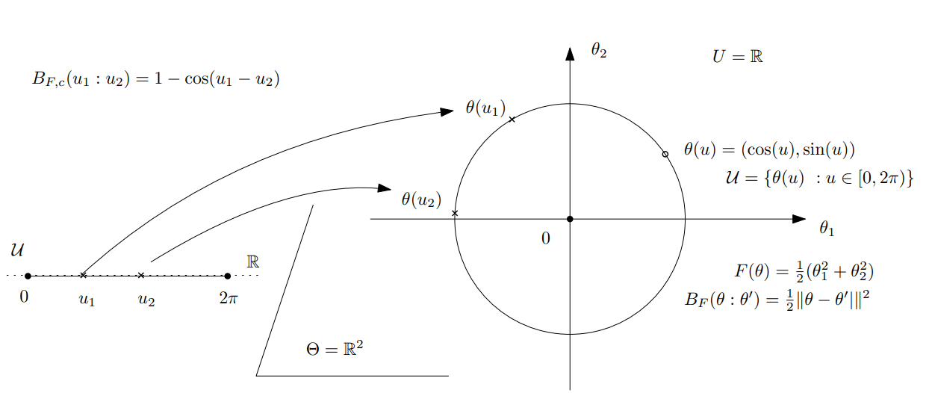
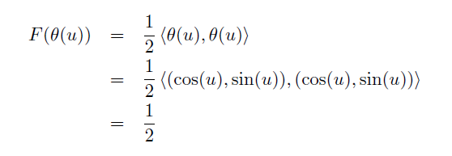
Curved Bregman divergence example: The cosine dissimilarity between unit vectors
Curved Bregman divergence:
Not a Bregman divergence
arXiv:2504.05654
A constant on the circle submanifold, thus not a proper Bregman generator!

Slide 12
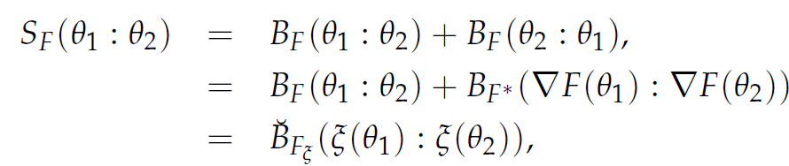


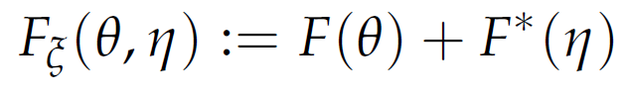

Example of curved BDs: Symmetrized BDs
= Jeffreys-Bregman divergences are curved Bregman divergences:
S_{F}(θ₁ ,θ₂)=< θ₁ -θ₂ ,η₁ -η ₂ >
Curved domain:
m-dimensional submanifold in 2m-dimensional space
(usually not cvx affine space, hence not a Bregman divergence)
Only affine for quadratic generators (squared Mahalanobis divergences)
“Sided and symmetrized Bregman centroids.” IEEE transactions on Information Theory 55.6 (2009)

Slide 13
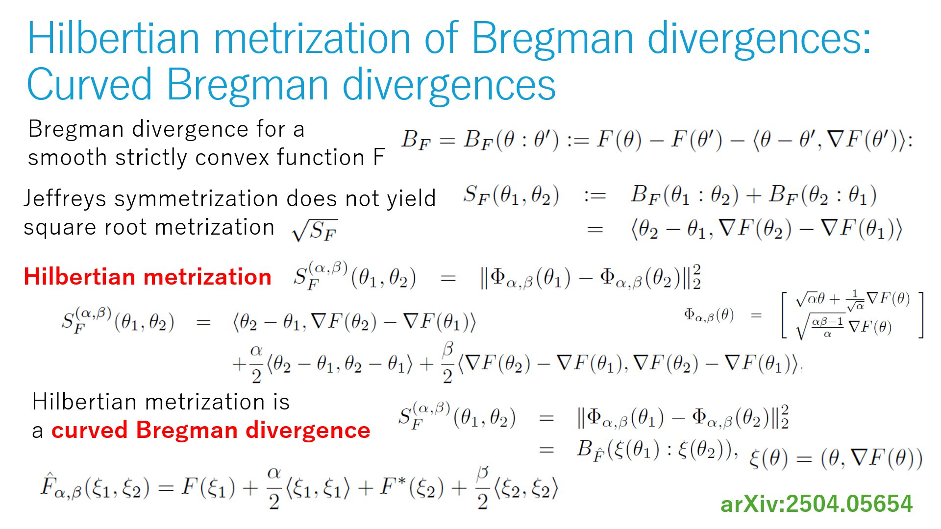

Slide 14



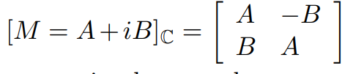


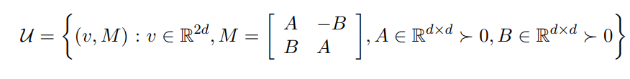
Another example of curved Bregman divergences:
Consider d-variate circular complex normal distributions
CNDs handled as 2d real normal distributions
Then KLD between CNDs amounts to a curved Bregman divergence:
Curved submanifold parameter in R^{2d} x Mat(2d)
Natural parameters
2504.05654
See also Nakashika, T: "Complex-Valued Variational Autoencoder: A Novel Deep Generative Model for Direct Representation of Complex Spectra.“
INTERSPEECH. 2020.
Notes:
Kullback-Leibler distance between complex generalized Gaussian distributions

Slide 15

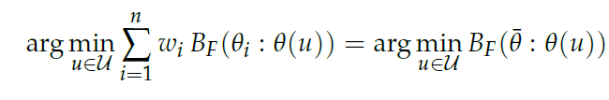
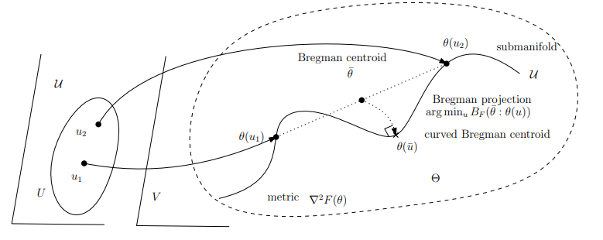

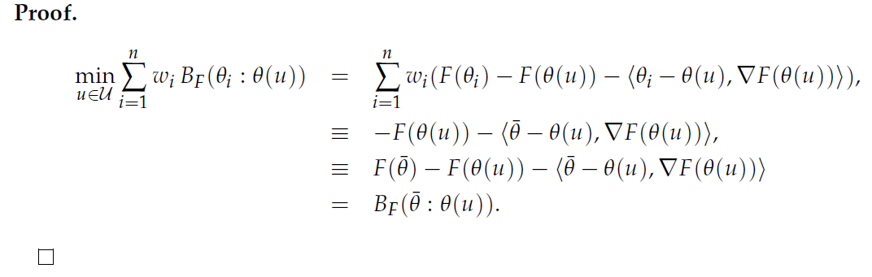
Curved Bregman centroid is the Bregman projection of the full Bregman centroid
Right Bregman projection of Bregman centroid
Theorem:
From n-point opt
to
One-point opt!
N-point opt.
Simple
"What is... an information projection?" Notices of the AMS 65.3 (2018): 321-324.

Slide 16

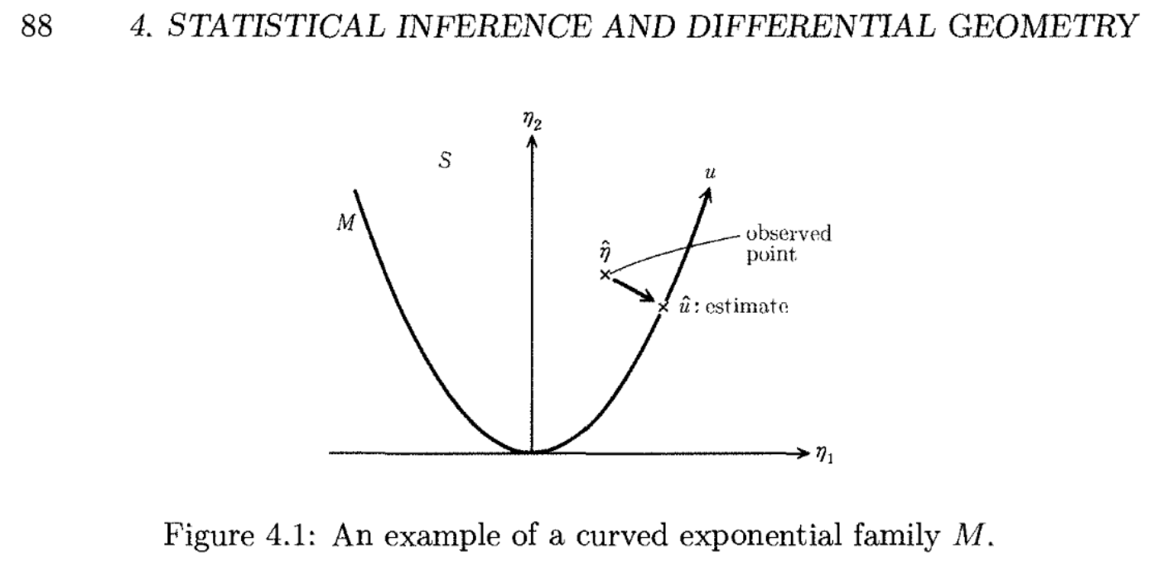
Usually duality of regular BD with regular EF
Projection theorem of MLE for curved EFs
https://arxiv.org/abs/1203.5181

Slide 17







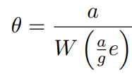
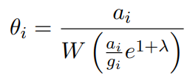

Symmetrized Bregman centroids in closed-form
-log det generator (in 1D, Itakura-Saito symmetrization called COSH distance)
Shannon negentropy for finite alphabets (Jeffreys divergence)

Slide 18
Summary: Some examples of curved BDs
Cosine dissimilarity!
Symmetrized Bregman divergences
Augmented mixed-Bregman Jeffreys-Bregman divergence
Kullback-Leibler divergence between complex circular normal distributions is a curved BD
KLD between curved exponential families
Curved Bregman centroid is Bregman centroid projected onto submanifold

Slide 20
Uniqueness of symmetrized BD centroid: As a Jeffreys centroid which is a SKL f-divergence

Slide 21



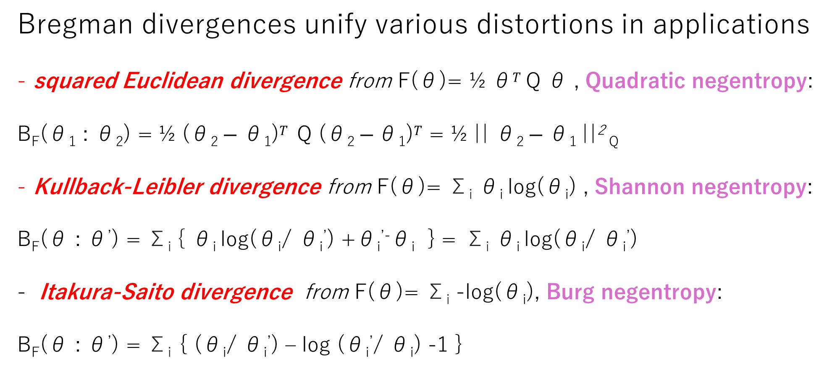
BDs: A versatile class of dissimilarities
Bregman divergences unify various distortions in applications
squared Euclidean divergence from F(θ)= ½ θ$T$ Q θ , Quadratic negentropy:
B_{F}(θ₁ : θ₂) = ½ (θ₂ $− \text{θ}\text{1}\text{)}T$ Q (θ₂ $− \text{θ}\text{1}\text{)}T$ = ½ || θ₂ $− \text{θ}\text{1} \text{||}$² _{Q}
Kullback-Leibler divergence from F(θ)= Σ_{i} θ_{i} log(θ_{i}) , Shannon negentropy:
B_{F}(θ : θ’) = Σ_{i} { θ_{i} log(θ_{i}/ θ_{i}’) +θ_{i}^{’-}θ_{i} } = Σ_{i} θ_{i} log(θ_{i}/ θ_{i}’)
Itakura-Saito divergence from F(θ)= Σ_{i} -log(θ_{i}), Burg negentropy:
B_{F}(θ : θ’) = Σ_{i} { (θ_{i}/ θ_{i}’) – log (θ_{i}’/ θ_{i}) -1 }
Notes:
Q SPD,

Slide 22
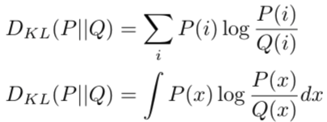

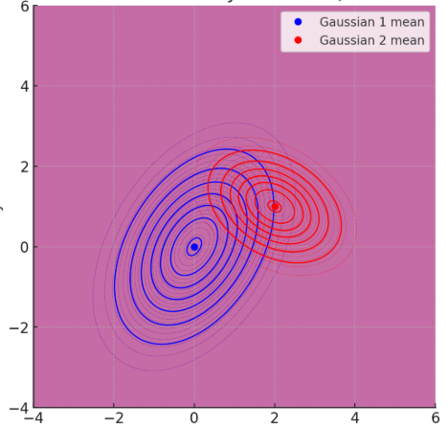
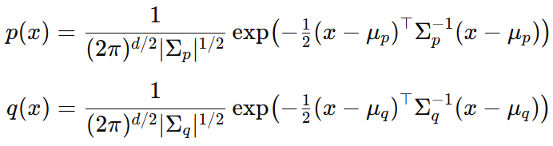
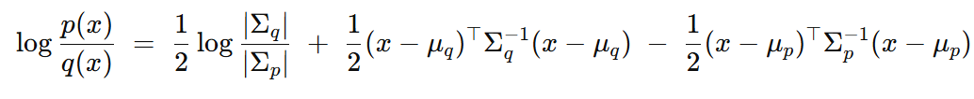
Relative entropy between Gaussian distributions?
Relative entropy = cross-entropy minus entropy, a dissimilarity measure in information theory, statistics, ML, etc.
called Kullback-Leibler divergence (KLD) in information theory:
How to calculate the KLD between multivariate Gaussian distributions?
D_{KL}[p(x):q(x)]= ∫ p(x) log (p(x)/q(x)) dμ(x)
KLD integrals ∫ is non-trivial but….
We need expectation wrt p(x) of this term !?
Notes:
a f-divergence for f(u)=-log u

Slide 23

BDs first impacts in ML: Link with exponential families
Kullback-Leibler divergence between two probability densities:
D_{KL}[p(x):q(x)]= ∫ p(x) log (p(x)/q(x)) dμ(x)
can be difficult to calculate in closed form because of the integral ∫
But Kullback-Leibler divergence between two probability densities of an exponential family with densities p(x| θ) = exp( <t(x), θ >-F(θ) )
amount to a reverse Bregman divergence B_{F}^{rev}(θ₁ : θ₂) := B_{F}(θ₂ : θ₁)
where F is the cumulant function (log partition/log Laplace function)
D_{KL}[p(x|θ₁) : p(x|θ₂) ] = B_{F}^{rev}(θ₁ : θ₂) = B_{F}(θ₂ : θ₁)
BDs wrt CFs between parameters = reverse KLD distributions
⇒ Easy calculations of KLDs
Bypass the ∫, ∇F in BD easy to calculate!
Azoury, Katy S., and Manfred K. Warmuth. "Relative loss bounds for on-line density estimation with the exponential family of distributions." Machine learning 43 (2001)
Notes:
∫μ
∇F easy!
Information geometry proves that B_{F}(θ₁ : θ₂)= D_{KL}*[p(x|θ₁) : p(x|θ₂) ]
when F(θ)=log ∫ exp(<x, θ >) dμ(x) where D_{KL}*[p(x):q(x)]:= D_{KL}[q(x):p(x)] is the reverse Kullback-Leibler divergence

Slide 24
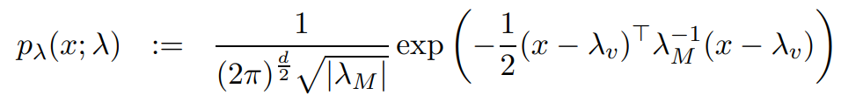
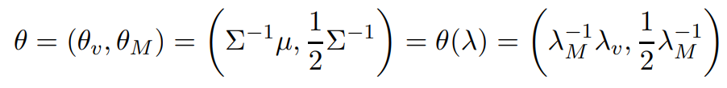
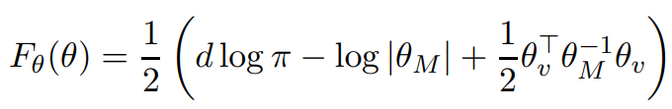



Example: KLD between Gaussians from BD
D_{KL}[p(x|θ₁) : p(x|θ₂) ] = B_{F}(θ₂ : θ₁)
p(x| θ) = exp( <t(x), θ >-F(θ) )
Non-unique canonical decomposition:

Slide 25
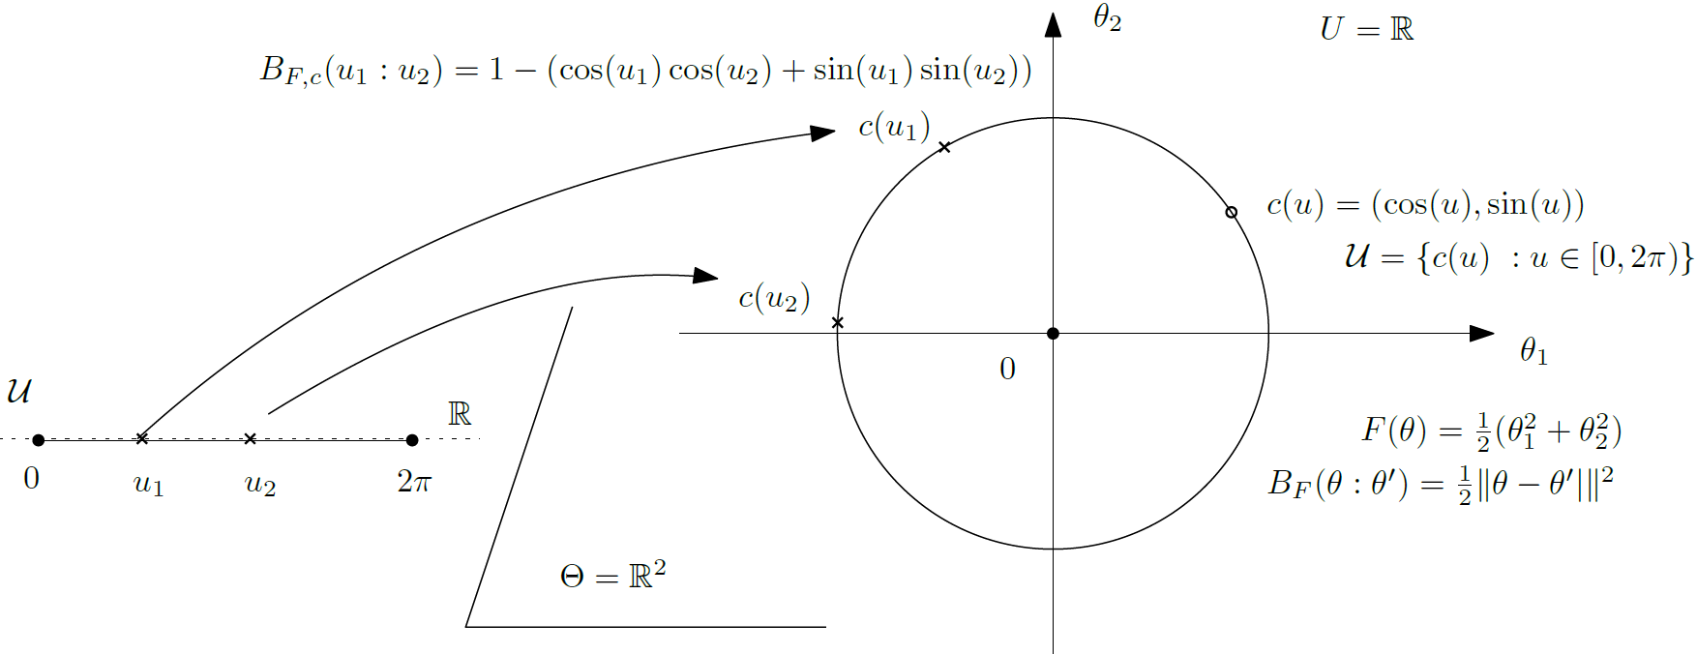
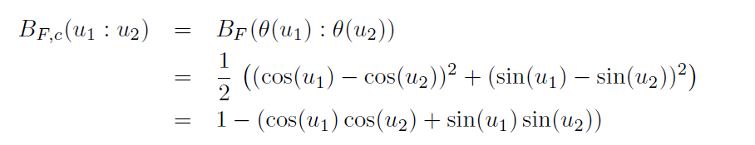
Toy example: curved circle Euclidean divergence
A toy example: Curved circle Euclidean divergence
Not a Bregman divergence
A constant, thus not a Bregman generator!

