Slide 1
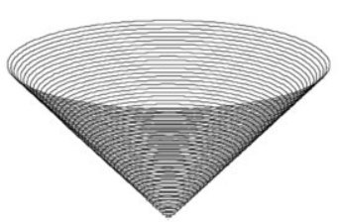
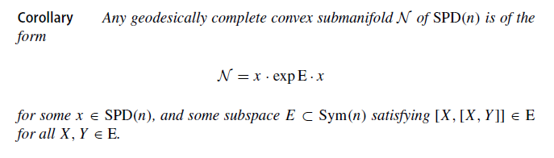
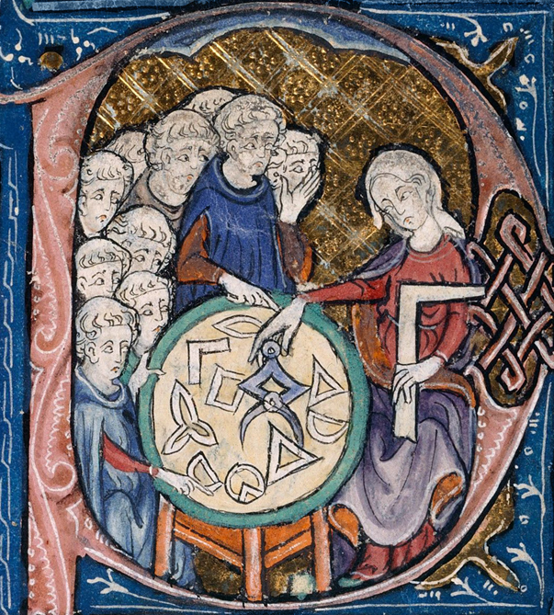



Characterizing all geodesically complete convex submanifolds of the symmetric positive definite (SPD) cone using Mostow theorem
Tumpach, Alice Barbara, and Gabriel Larotonda. "Totally geodesic submanifolds in the manifold SPD
of symmetric positive-definite real matrices." Information Geometry 7.2 (2024): 913-942.
Mostow, G.D.: Some new decomposition theorems for semi-simple groups.
Mem. Amer. Math. Soc. 14, 31–54 (1955)
Notes:
https://link.springer.com/article/10.1007/s41884-024-00146-z

Slide 2
Olivier RIOUL (LTCI, Comelec)
Télécom Paris, Institut Polytechnique de Paris
19, place Marguerite Perey
91120 Palaiseau
France
tel: (+33) 1 75 31 92 93

Slide 3
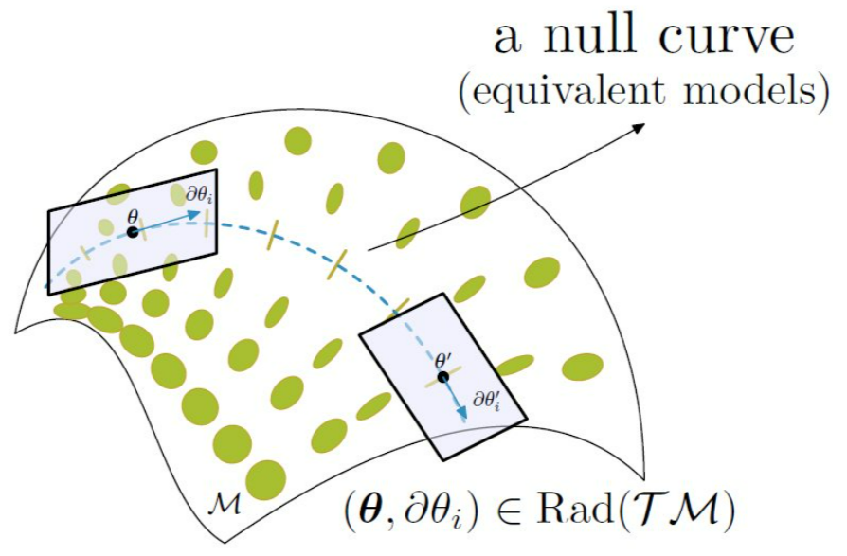
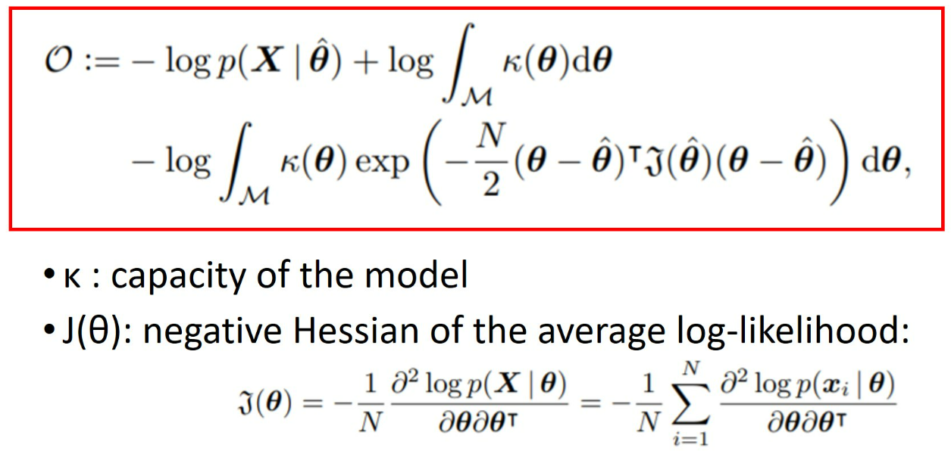
Lightlike neuromanifold
1905.11027

