Slide 1
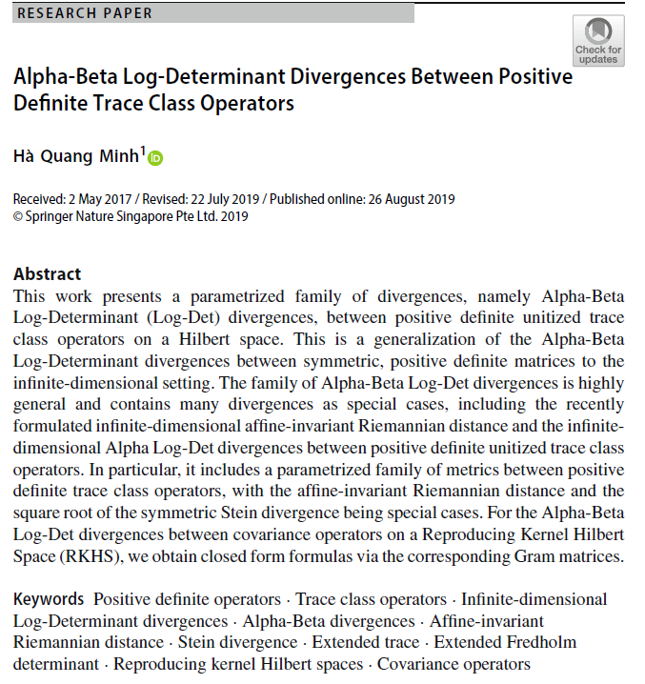

Volume 2
Issue 2
Article 14

Slide 2
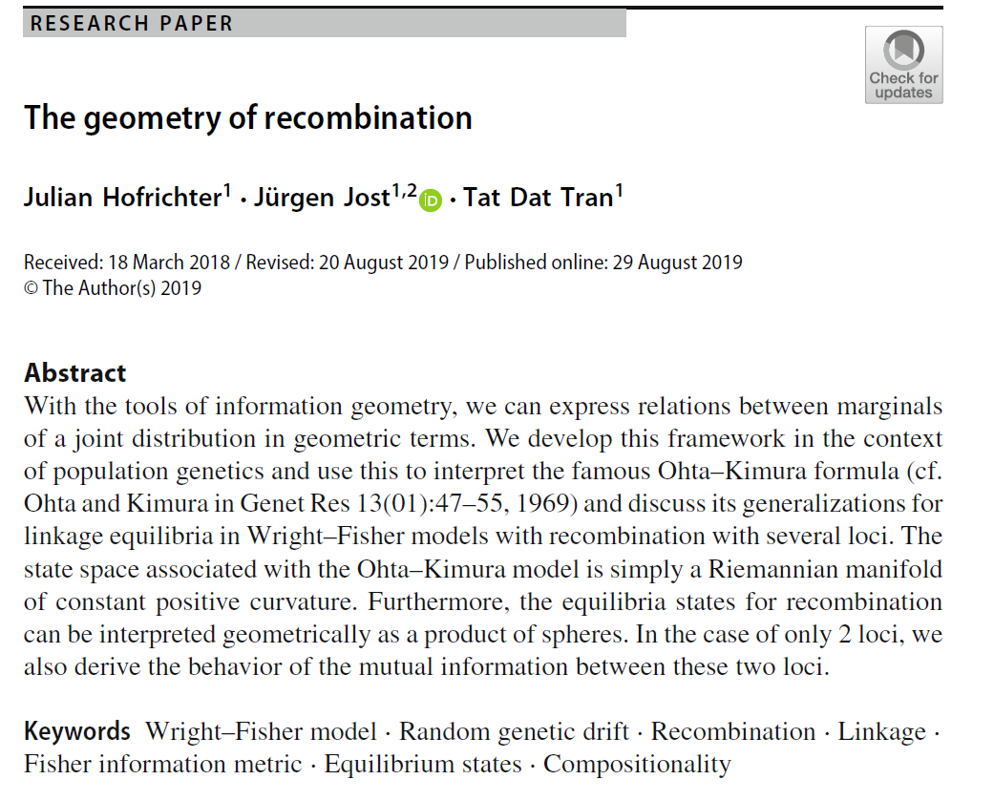
Volume 2
Issue 2
Article 15

Slide 3

Volume 2
Issue 2
Article 16

Slide 4

Volume 2
Issue 2
Article 17

Slide 5
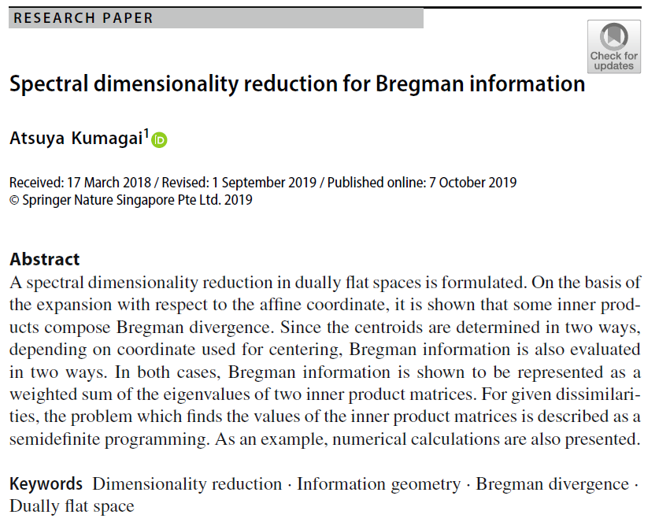
Volume 2
Issue 2
Article 18

Slide 6
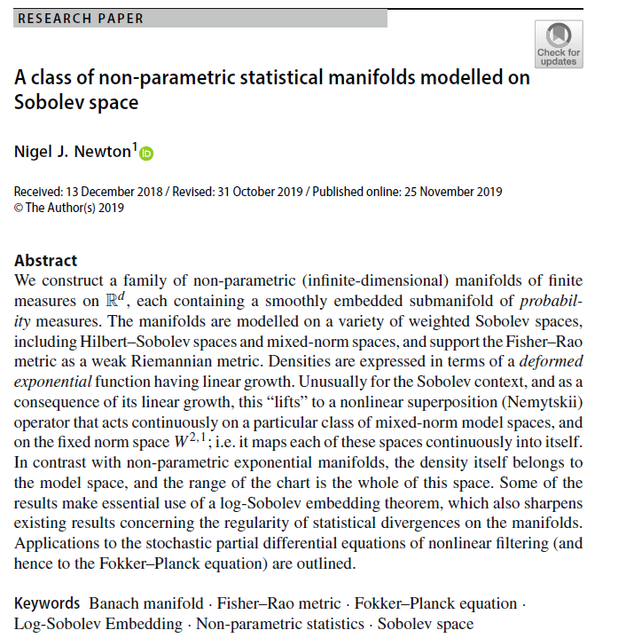
Volume 2
Issue 2
Article 19

