Slide 1
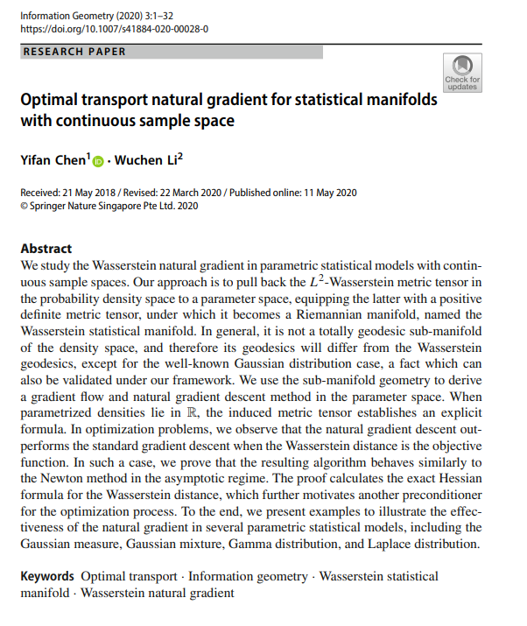

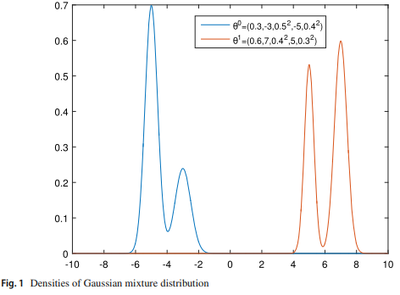
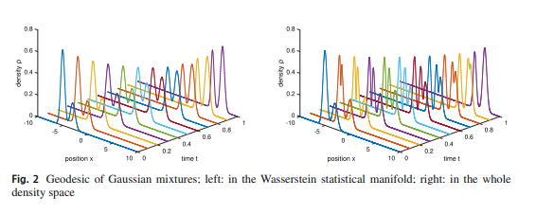
Volume 3
Issue 1
Article 20
Notes:
https://link.springer.com/article/10.1007/s41884-020-00028-0

Slide 2
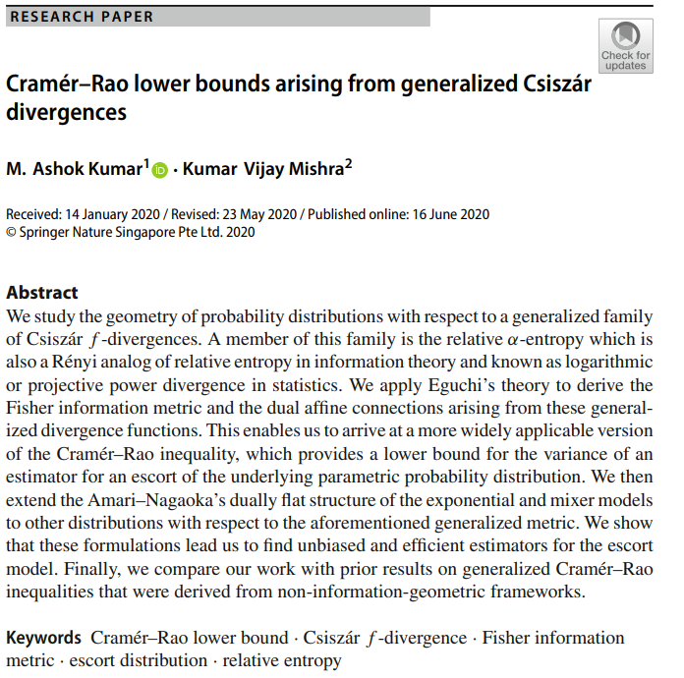
Volume 3
Issue 1
Article 21
Notes:
https://link.springer.com/article/10.1007/s41884-020-00029-z

Slide 3
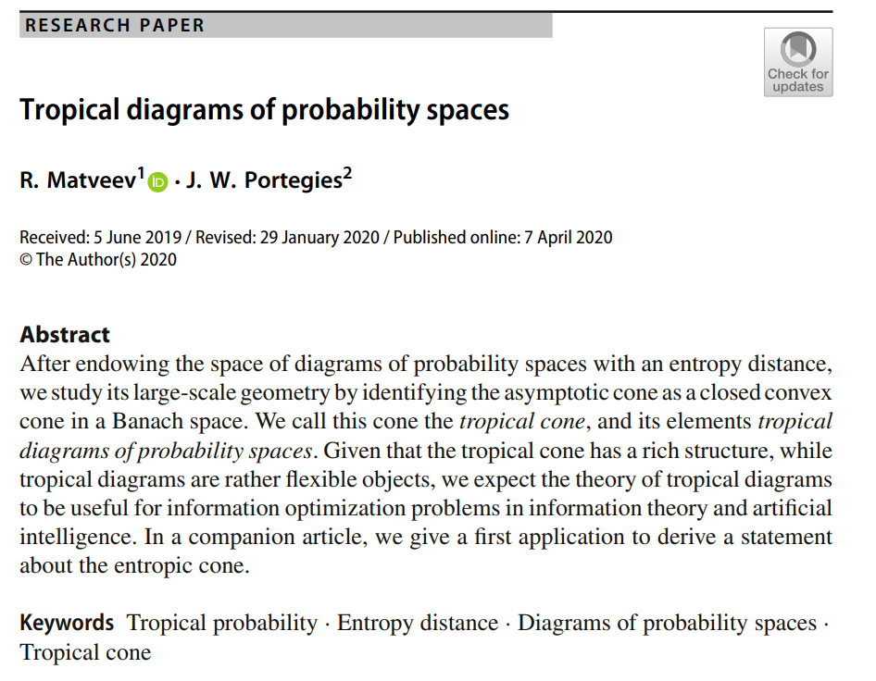
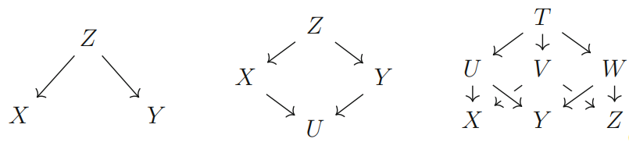
Volume 3
Issue 1
Article 22
Notes:
https://link.springer.com/article/10.1007/s41884-020-00027-1

Slide 4
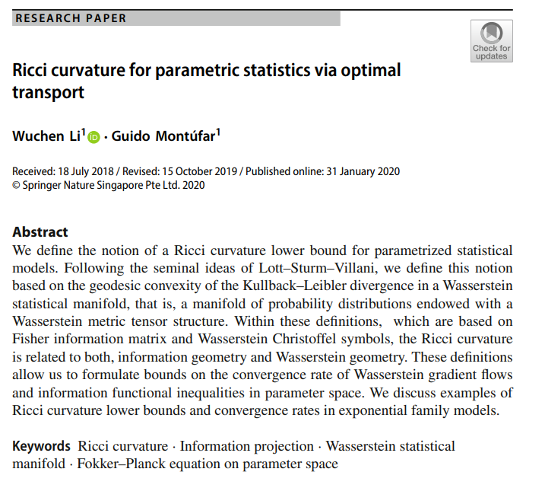
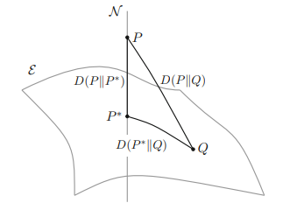
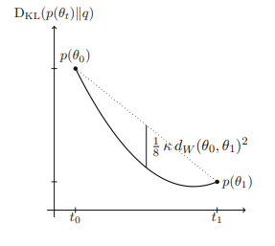
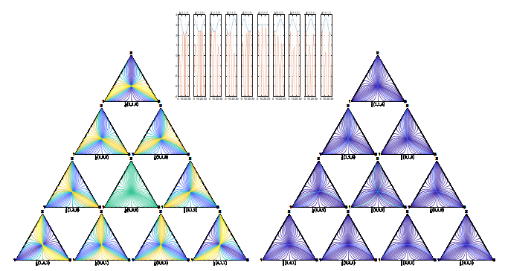
Volume 3
Issue 1
Article 22
Notes:
https://link.springer.com/article/10.1007/s41884-020-00026-2

