Slide 1
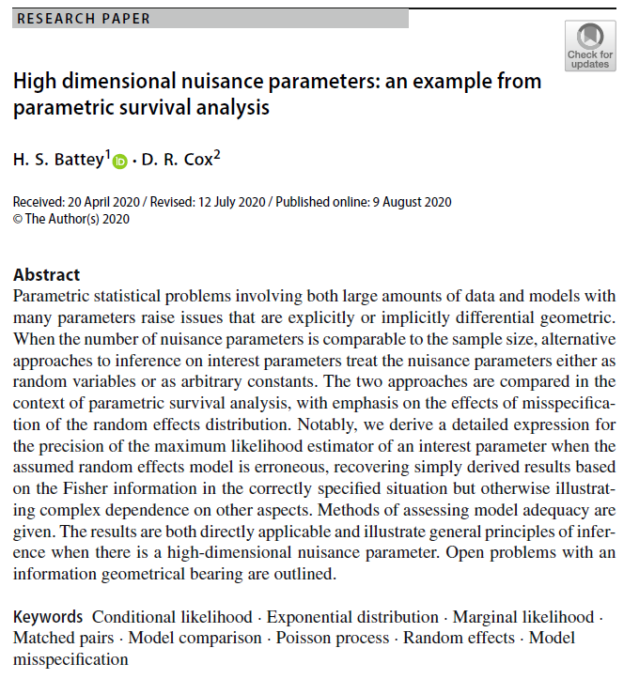

Volume 3
Issue 2
Article 23
Notes:
High dimensional nuisance parameters: an example from parametric survival analysis
https://link.springer.com/article/10.1007/s41884-020-00030-6

Slide 2
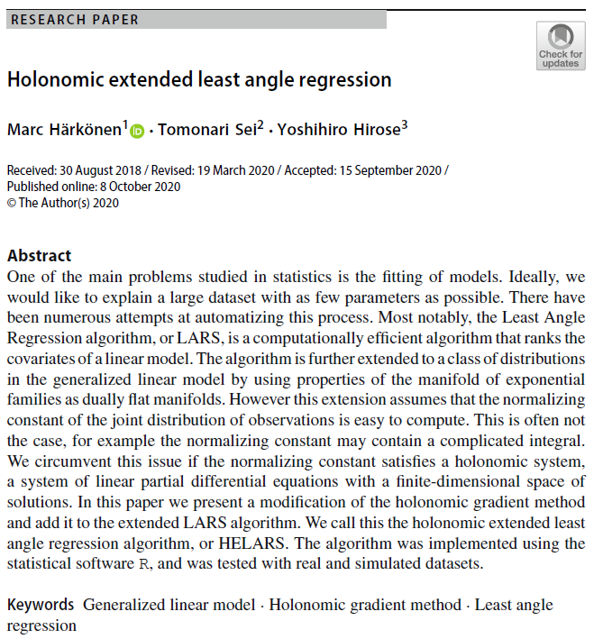
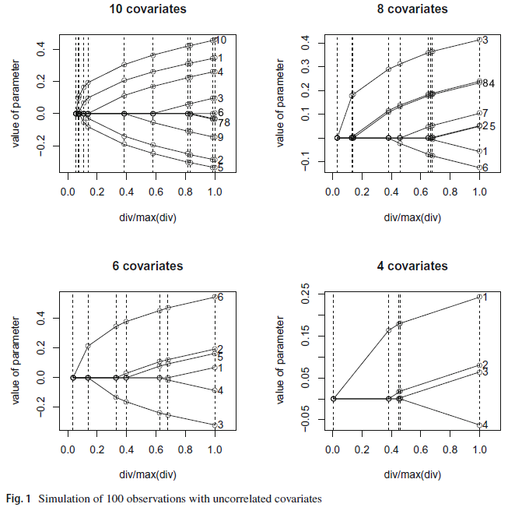
Volume 3
Issue 2
Article 24
Notes:
Holonomic extended least angle regression
https://link.springer.com/article/10.1007/s41884-020-00035-1

Slide 3
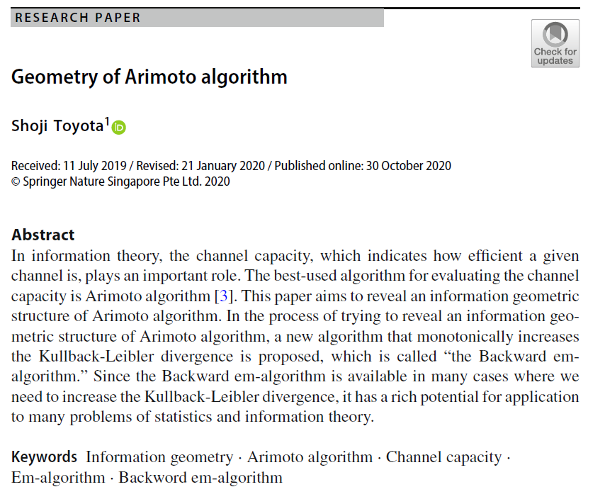
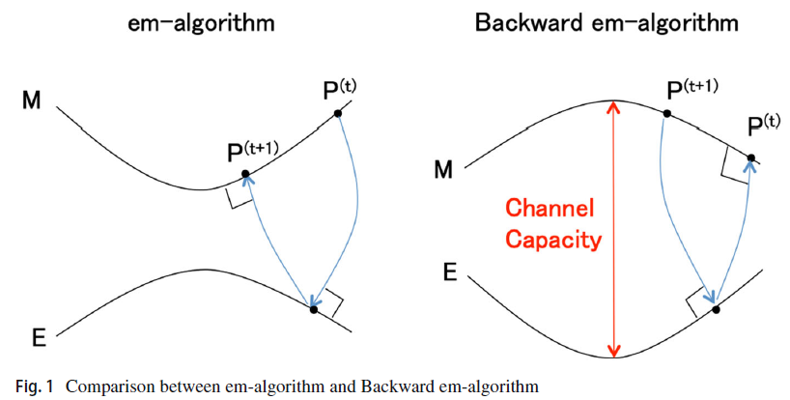
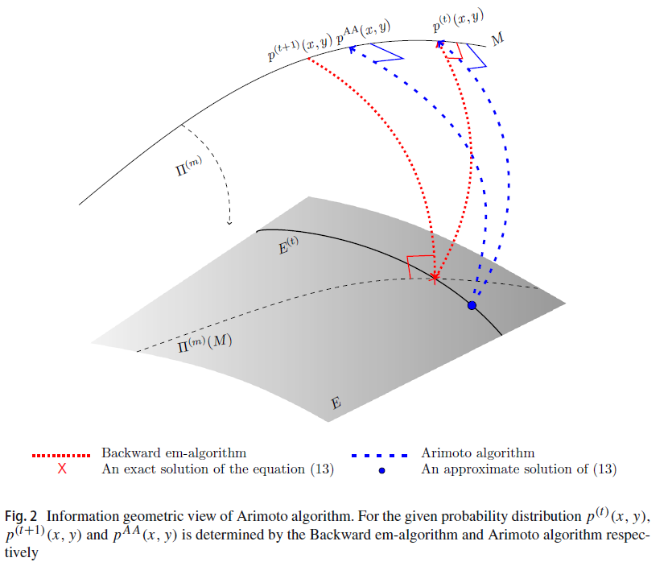
Volume 3
Issue 2
Article 25
Notes:
Geometry of Arimoto algorithm
https://link.springer.com/article/10.1007/s41884-020-00031-5

