Slide 1

Divergences and comparative convexity
Frank Nielsen
Sony Computer Science Laboratories Inc
Tokyo, Japan
arXiv:2312.12849
2024

Slide 2

Rationale
Need to define statistical dissimilarity measures D(p,q) between statistical models p and q in statistics and machine learning: for example, total variation distance, Kullback-Leibler divergence, Wasserstein, Maximum Mean Discrepancy, etc.
Infer models from a statistical model P={p_{θ}}: estimate θ and measure goodness-of-fit from data (empirical distribution)
Statistical dissimilarity measure between parametric models P={p_{θ}} amount to dissimilarity between parameters:
In this talk, we investigate some relationships between statistical dissimilarities, statistical models, model parameter dissimilarities, and their underlying geometries.

Slide 3
Outline
Background
Kullback-Leibler divergence, exponential families, and Bregman divergences
Dual information geometry of convex functions
Two normalizations of exponential families: cumulant or partition functions, and their relationships with parameter divergences:
well-known: Bhattacharyya distances/Rényi divergences and skewed Jensen divergences with respect to cumulant function
New:α-divergences and skewed Jensen divergences with respect to partition function of exponential families
Comparative convexity, quasi-arithmetic means, and convex deformations preserving convexity
Some generalization of Bregman divergences yielding conformal Bregman divergences
Interplay of
Models/distances
Deforming
convex functions

Slide 4
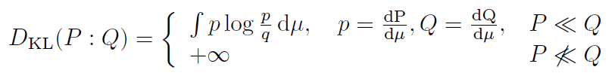
Kullback-Leibler divergence: relative entropy
The Kullback-Leibler divergence (KLD) is a dissimilarity measure between probability distributions or measures P and Q :
KLD fails symmetry and triangle inequality of metrics but is always non-negative, a property known as Gibbs’ inequality:
KLD also called relative entropy because it is the difference between the cross-entropy and Shannon entropy:
Interpretation of KLD in information theory: expected difference of the number of bits required for Huffman encoding of P using a code optimized for Q rather than the Huffman code optimized for P.

Slide 5
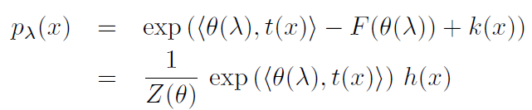


Exponential families: Discrete/continuous/measures
A parametric family of distributions {P_{λ}} all dominated by a measure μ is an exponential family iff the densities wrt μ can be expressed canonically as
θ is natural parameter
t(x) is sufficient statistics, and k(x) or h(x) is an auxiliary carrier term
Inner product (e.g., scalar product for vectors, tr(AB) for symmetric matrices)
Unnormalized density:
Subtractive normalization:
Divisive normalization:
F called cumulant function in statistics
F called free energy and Z called partition function in thermodynamics

Slide 6
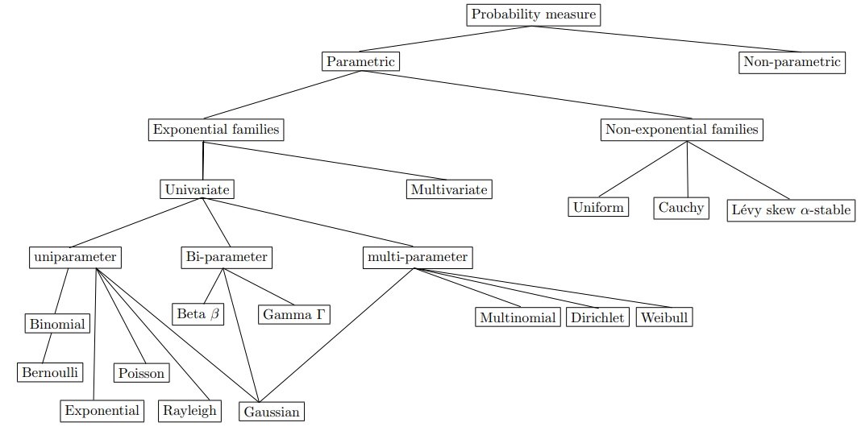
Exponential families (EFs): Some examples
Many common distributions in statistics are exponential families in disguise (common support)
Many statistical models in machine learning are exponential families: undirected graphical models, energy-based models including Markov random fields and conditional random fields:
➤ Normalizers F or Z are often computationally intractable

Slide 7
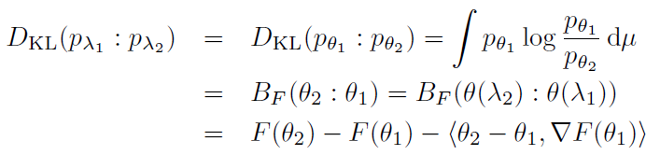

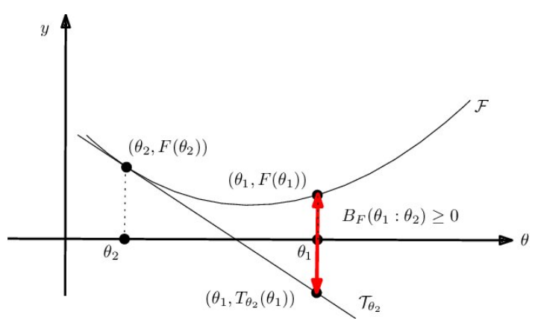




KLD between two densities of an Exp. Fam.
Bypass integral calculations of KLDs, and express the KLD as a divergence between parameters: Bregman divergences
Dual expectation/moment parameterization:
Many equivalent parameterizations of EFs:
Geometric interpretation of BDs:
N(μ,σ), N(μ,σ²), N(μ,logσ), etc

Slide 8
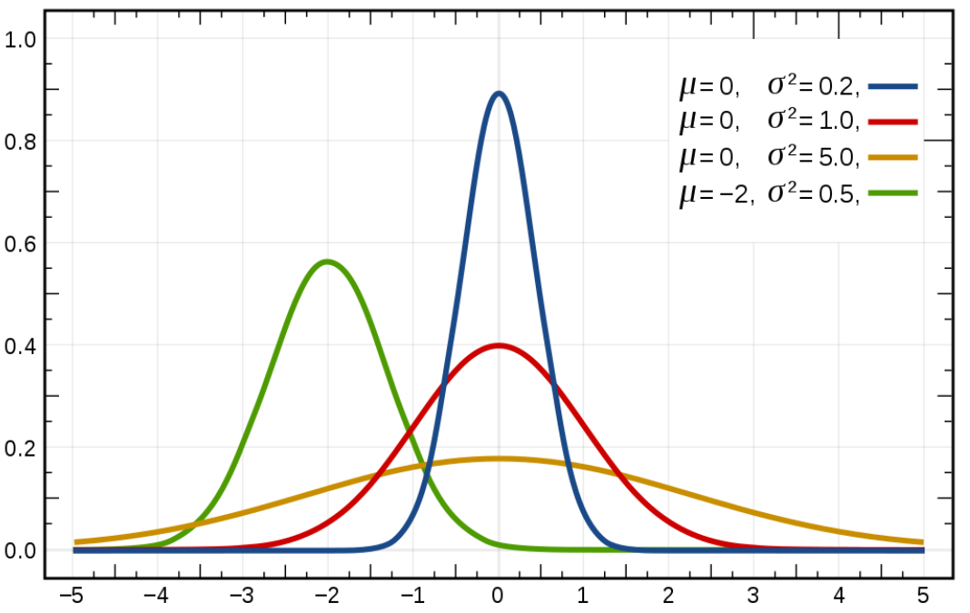

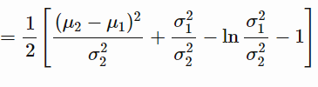
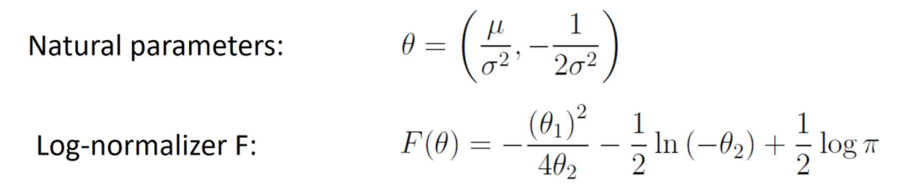
Exponential family of univariate normal distributions
Usual parametrization λ = (μ,σ) or (μ,σ²) :
p_{μ,σ}(x)
Density:
Normal family N={p_{θ}}:
Auxiliary carrier term k(x)=0, h(x)=1 with respect to Lebesgue measure μ
Sufficient statistic: t(x)=(x,x²)
KLD
Equivalent
BD
Mahalanobis²+Itakura-Saito
natural parameters unique up to affine transformations
constant can be added/subtracted with k(x)

Slide 9
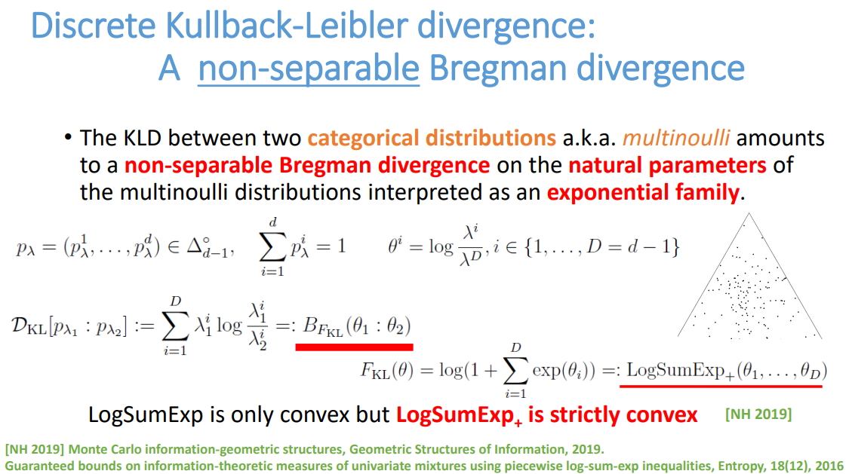

Slide 10









Convex duality: convex conjugate pairs (F,F*)
Legendre-Fenchel transformation of a function:
as known as slope transform:
Supremum reached for : defines the gradient map
Moment parameter space:
Restrict F to Legendre-type function so that
the convex conjugate is also of Legendre type:
And we have: and , reciprocal gradient:
Legendre transformation:
only need to invert ∇F

Slide 11

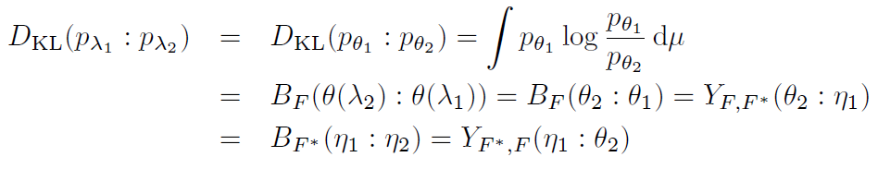
Dual Bregman divergence/Fenchel-Young divergence
Bregman divergence can be expressed equivalently as
a Fenchel-Young divergence using the convex pairs:
Dual Bregman divergence:
KLD between densities of an exponential family expressed equivalently as:
①
②
③
④

Slide 12
Information geometry: Dually structures
Differential geometry
Riemannian metric g is smooth inner product on a manifold which allows to measure vector lengths and angles between vectors in tangent spaces
Affine connection ∇ defines how to connect vectors between infinitesimally close tangent spaces. Affine connection defines ∇-geodesic as autoparallel curves
Information geometry considers dual structures: A manifold M equipped with a Riemannian metric tensor g and dual torsion-free affine connections ∇ and ∇* coupled to the metric so that the Levi-Civita connection wrt g is (∇+∇* )/2: Structure (M,g, ∇,∇*)
Information geometry induced by ① statistical models {p_{θ}}, ② information geometry induced by divergences, ③ information geometry induced by convex functions, ④ information geometry induced by regular cones, etc.

Slide 13
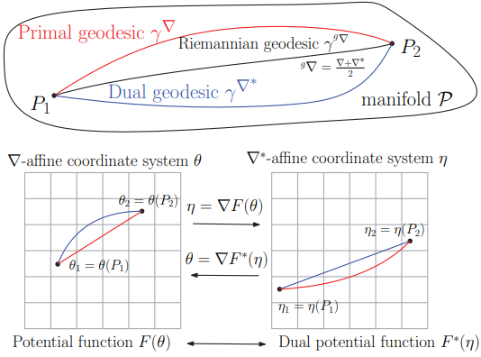
Information geometry of convex functions: Dually flat spaces, global Hessian manifolds
An affine connection ∇ is flat if there exists a coordinate system θ called ∇-affine coordinate system such that the Christoffel symbols Γ vanish
∇-geodesics are straight lines in θ-chart
Hessian metric tensor g expressed in θ-chart as ∇²F(θ)
Legendre duality yields dual expression of Hessian metric ∇²F*(η) and dual affine flat connection ∇* with ∇*-geodesics straight inη-chart
Dually flat space DFS(F(θ), ϴ)=(M,g,∇,∇*)

Slide 14
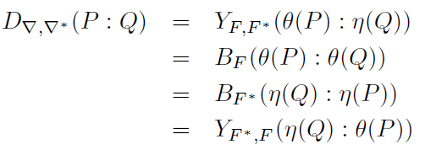
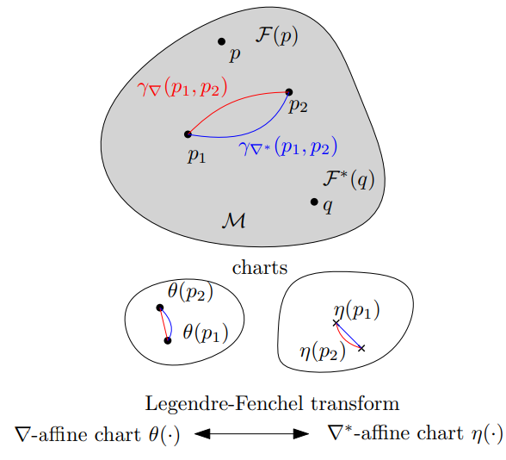
Canonical divergences of dually flat spaces: Dually flat divergences
Given a dually flat space (M,g,∇,∇*), we can reconstruct locally two potential functions F(θ) and F*(η) related by Legendre-Fenchel transformation
The dually flat divergence D∇, ∇* (P:Q) can be expressed using the mixed coordinate system θ and η as a Fenchel-Young divergence or equivalently using dual Bregman divergences either in the θ- or η-charts

Slide 15


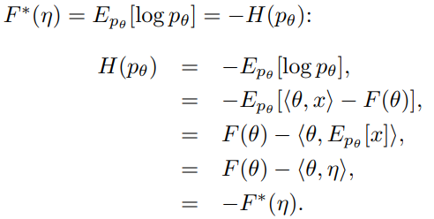
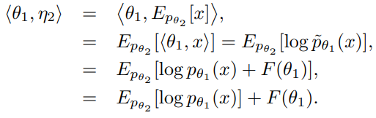
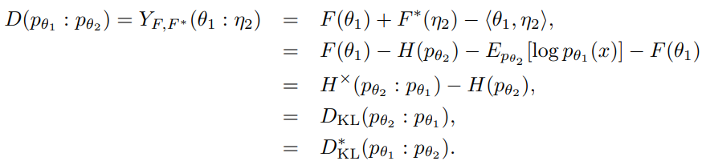
Canonical divergence of cumulant functions amount to statistical reverse KLD:
Usually, in Statistics/ML, we prove ⇒:
where D* is dual divergence:
Let us prove ⇐ from information geometry of canonical divergence of DFS(F(θ), ϴ)
①
②
③

Slide 16
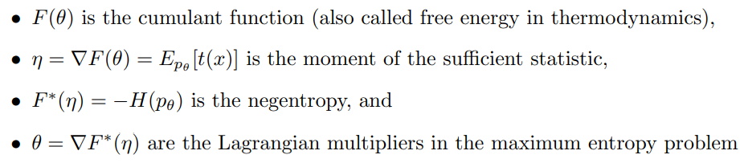
Canonical divergence of cumulant functions amount to statistical reverse KLD:
We reconstruct Kullback-Leibler divergence by relaxing to arbitrary densities
⇒KLD
Interpretations:

Slide 17
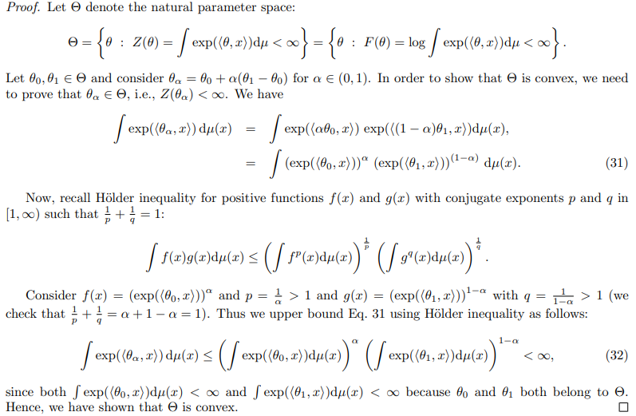
Natural parameter space ϴ of Exp Fam is convex

Slide 18


Partition function Z(θ)=exp(F(θ)) is strictly log-convex Cumulant function F(θ)=log Z(θ) is strictly convex
When we proved that natural parameter space is convex, we had
That is for short:
(Z=partition function)
Take the logarithm on both sides:
F is strictly convex since Eq. iff θ₁= θ₂
Definition: A function Z is stricty log-convex is log Z is strictly convex
⇒ Z(θ)=exp(F(θ)) is strictly convex because F(θ) strictly convex:

Slide 19
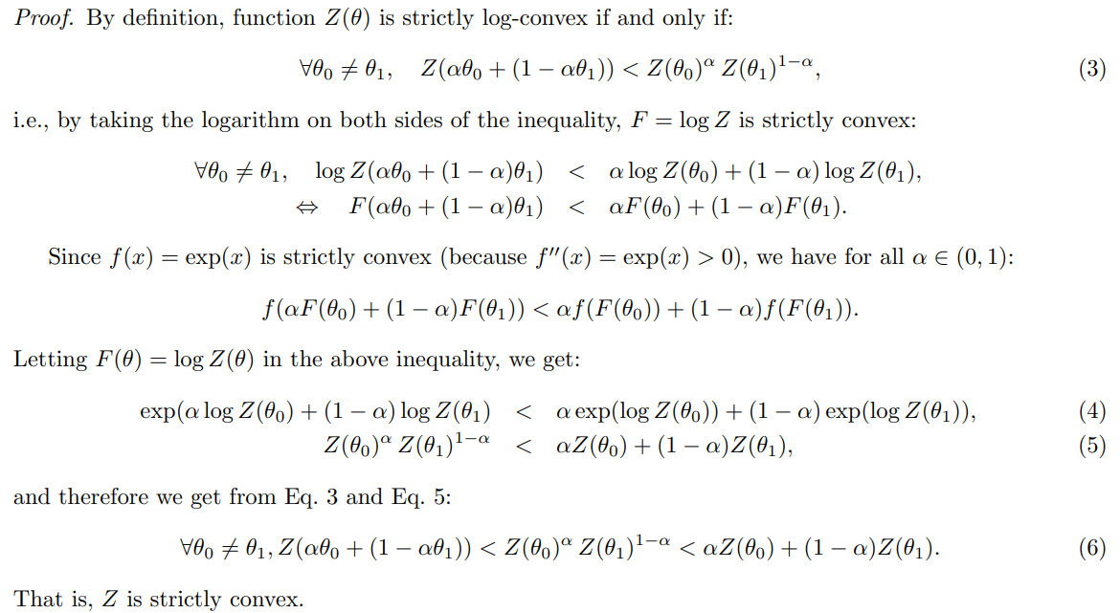
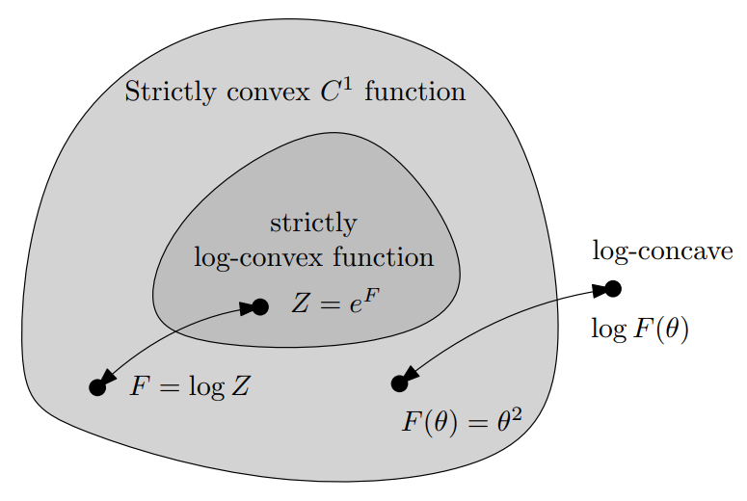
Property: A log-convex function is also convex (but not necessarily the converse)
★
★

Slide 20
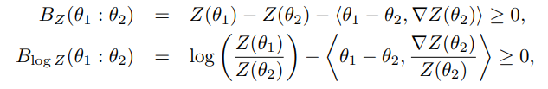
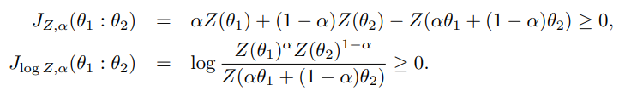

Bregman divergences B_{F=log Z} and B_{Z=exp F}
And furthermore, we can define skewed Jensen divergences from the convex generators:
Including the symmetric Jensen divergence when 𝛼=1/2:

Slide 21



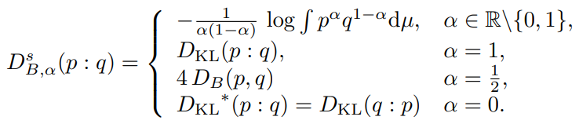
Bhattacharyya distances and Rényi divergences
Question: If KLD between EF densities = B_{F}*, to what statistical divergences correspond J_{F} and J_{𝛼,F}?
Define scaled skewed Bhattacharyya distances:
which are scaled Rényi divergences:
Scaling by (1/𝛼(1-𝛼)) allows to unify KLD with Bhattacharyya distances:

Slide 22
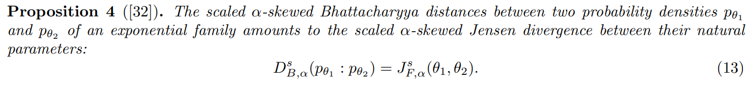
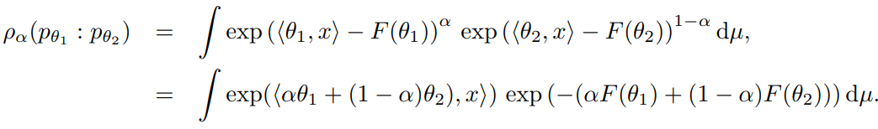

Bhattacharyya distances and Rényi divergences between densities of an exponential family
Cumulant function F
Proof: consider the α-skewed Bhattacharyya similarity coefficient:

Slide 23
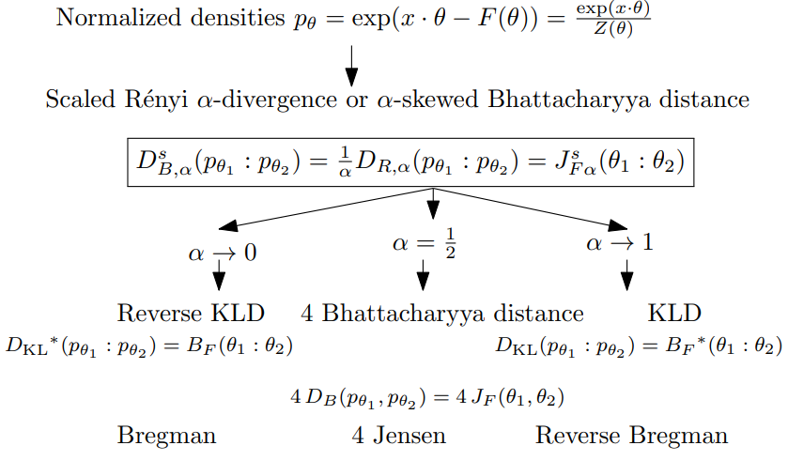
Overview of classical statistical/Jensen divergences

Slide 24
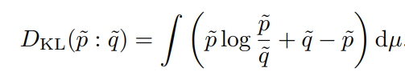



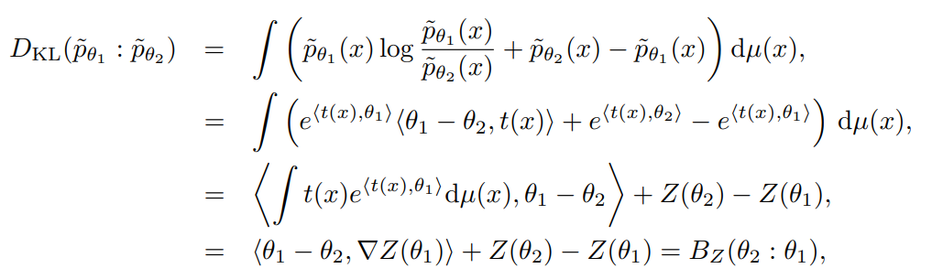

Extended Kullback-Leibler divergences between unnormalized densities: Bregman divergence B_{Z}
Extend KLD to unnormalized densities:
Reverse extended KLD:

Slide 25
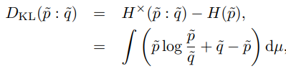





KLD between arbitrary positive densities
Consider arbitrary densities (not necessarily exp fams):
Above formula when specialized to densities p and q of exponential family:

Slide 26
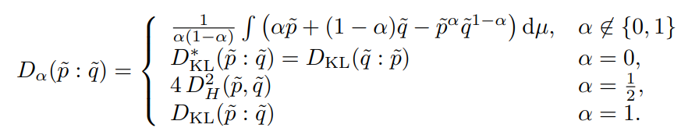
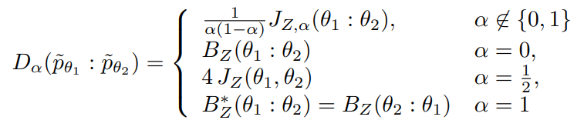
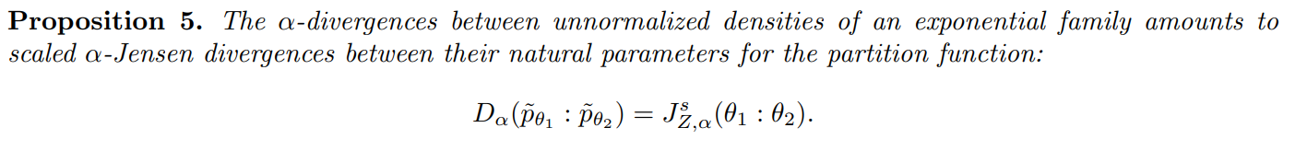
α-divergences between unnormalized densities
Statistical α-divergences between positive measures:
When considering unnormalized exponential family densities:
Partition function Z

Slide 27
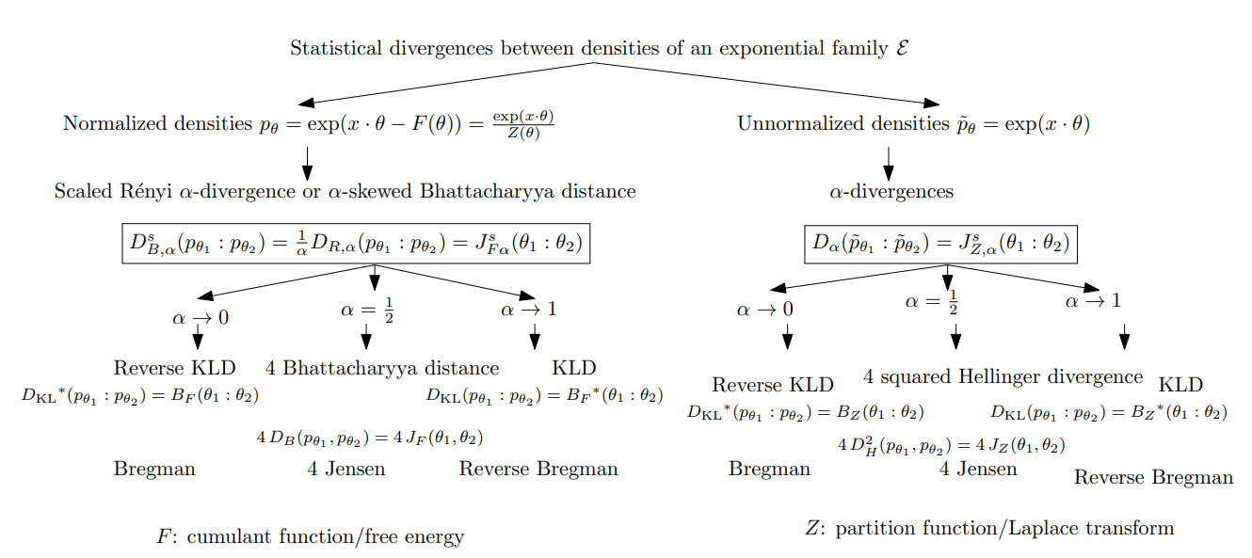
Overview of divergences between (un)normalized EF densities

Slide 28

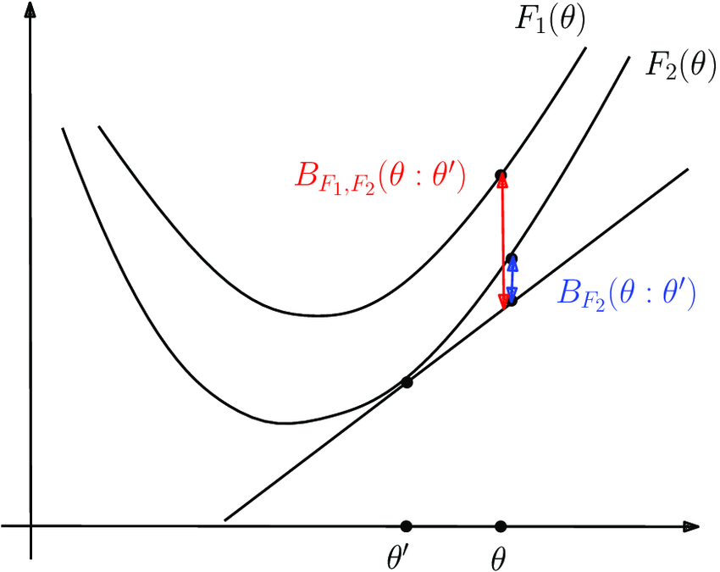
KLD between normalized and unnormalized densities
with
where we generalized Bregman divergences to duo Bregman pseudo-divergences:
with

Slide 29


Comparative convexity: (M,N)-convexity
Definition: A function Z is (M,N)-convex iff for in α in [0,1]:
Ordinary convexity: (A,A)-convexity wrt to arithmetic weighted mean
Log-convexity: (A,G)-convexity wrt to A/geometric weighted means:

Slide 30



Comparative convexity wrt quasi-arithmetic means
Kolmogorov-Nagumo-De Finitti quasi-arithmetic mean for a strictly monotone generator h(u):
Includes power means which are homogeneous means:
Include the geometric mean when p→0

Slide 31
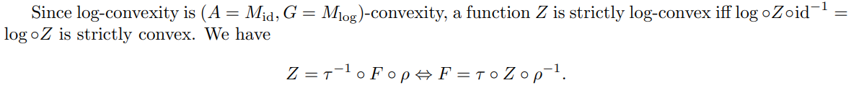
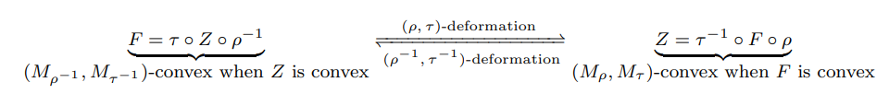
Deforming convex functions with comparative convexity
We consider deformations with two strictly monotone functions which preserve
convexity and thus induces family of Bregman and Jensen divergences,
and families of dually flat spaces:
Deform both (1) the function F (by 𝜏⁻¹) and (2) the argument θ (by ρ)
by considering functions Z =𝜏⁻¹(F(θ))

Slide 32
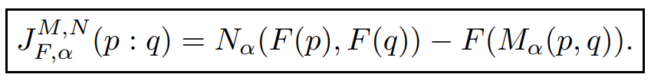
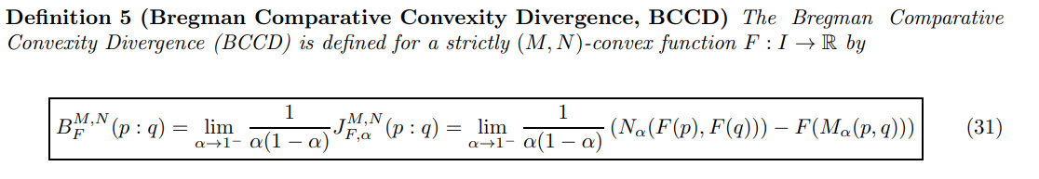
Generalizing Bregman divergences with (M,N)-convexity
Skew Jensen comparative convexity divergence:
Non-negative for (M,N)-convex generators F provided regular means M and N (e.g. power means)
Definition:
Analogy to limit of skewed Jensen divergences amount to forward/reverse Bregman divergences.

Slide 33
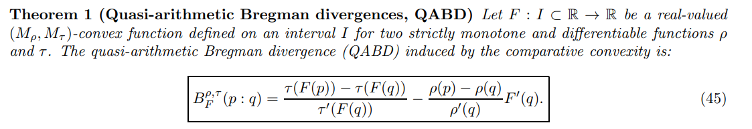
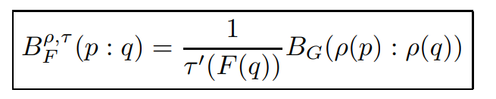

Generalizing Bregman divergences with quasi-arithmetic mean convexity
Amounts to a conformal Bregman divergence:
Conformal factor
with
Remark: Conformal Bregman divergences may yield robustness in applications

Slide 34
References (partial list)
John Aczel. A generalization of the notion of convex functions. Det Kongelige Norske Videnskabers Selskabs Forhandlinger, Trondheim, 19(24):87–90, 1947
Katy S Azoury and Manfred K Warmuth. Relative loss bounds for on-line density estimation with the exponential family of distributions. Machine learning, 43:211–246, 2001.
Ole Barndorff-Nielsen. Information and exponential families. John Wiley & Sons, 2014.
Kazuhiro Ishige, Paolo Salani, and Asuka Takatsu. Hierarchy of deformations in concavity. Information Geometry, pages 1–19, 2022.
Thomas Kailath. The divergence and Bhattacharyya distance measures in signal selection. IEEE transactions on communication technology, 15(1):52–60, 1967.
Andrei Kolmogorov. Sur la notion de la moyenne. G. Bardi, tip. della R. Accad. dei Lincei, 1930.
Constantin Niculescu and Lars-Erik Persson. Convex functions and their applications, volume 23. Springer, 2018. second edition
Tim Van Erven and Peter Harremos. Renyi divergence and Kullback-Leibler divergence. IEEE Transactions on Information Theory, 60(7):3797–3820, 2014.
Jun Zhang and Ting-Kam Leonard Wong. λ-deformed probability families with subtractive and divisive normalizations. In Handbook of Statistics, volume 45, pages 187–215. Elsevier, 2021.

Slide 35
References and related works
NF and Richard Nock. "Generalizing skew Jensen divergences and Bregman divergences with comparative convexity." IEEE Signal Processing Letters 24.8 (2017): 1123-1127.
"Divergences induced by dual subtractive and divisive normalizations of exponential families and their convex deformations." arXiv preprint arXiv:2312.12849 (2023).
"Statistical divergences between densities of truncated exponential families with nested supports: Duo Bregman and duo Jensen divergences." Entropy 24.3 (2022): 421.
Nock, Richard, FN, and Shun-ichi Amari. "On conformal divergences and their population minimizers." IEEE Transactions on Information Theory 62.1 (2015): 527-538.
Rob Brekelmans and FN. “Variational representations of annealing paths: Bregman information under monotonic embedding”, Information geometry, 2024. Doi: 10.1007/s41884-023-00129-6
"Quasi-arithmetic Centers, Quasi-arithmetic Mixtures, and the Jensen-Shannon-Divergences." International Conference on Geometric Science of Information. Cham: Springer Nature Switzerland, 2023.

Slide 36
Kullback-Leibler divergence: relative entropy
Exponential families: Discrete, continuous, measures
KLD between densities of an EF
Information geometry of convex function: Dually flat space
Information geometry of divergence
Bhattacharyya distance and Rényi divergence
Jensen divergence
Overview of classical divergences
Partition function is log-convex and hence convex
Bregman divergence wrt Z: KLD between unnormalized EF densities
Jensen divergence wrt Z: alpha divergences
Overview of divergences between (un)normalized EF densities
Comparative convexity
Comparative convexity wrt quasi-arithmetic means
Deforming convex functions wrt quasi-arithmetic generators
(M,N)-Jensen divergence
(M,N)-Bregman divergence
Equivalence with a conformal Bregman divergence
Power Bregman divergences
Conclusion

Slide 37
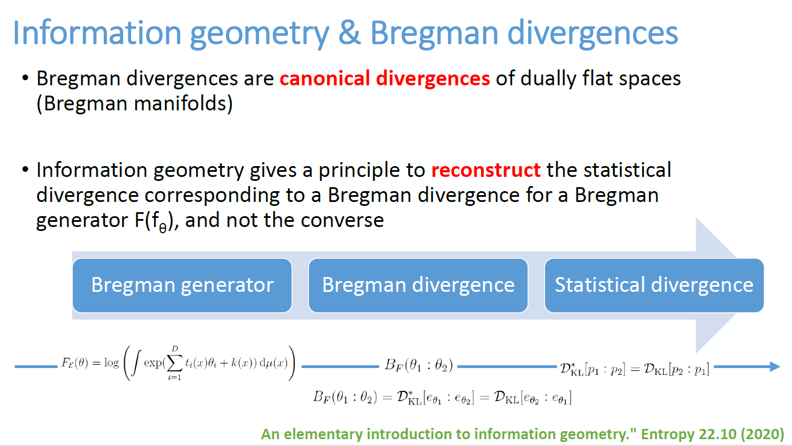
Divergences and comparative convexity by Frank Nielsen, Sony Computer Science Laboratories Inc , Japan
In this talk, we first recall the equivalence between the Kullback-Leibler divergence between densities of an exponential family and Bregman divergences, and then highlight the connection with dually flat spaces of information geometry.
Exponential families can be normalized either by cumulant functions (free energies) or by partition functions, both functions being strictly convex and inducing Bregman and Jensen divergences.
It is well-known that skewed Bhattacharryya distances between probability densities of an exponential family amounts to skewed Jensen divergences induced by the cumulant function between their corresponding natural parameters, and in limit cases that the sided Kullback-Leibler divergences amount to reverse-sided Bregman divergences.
We show that α-divergences between unnormalized densities of an exponential family amounts to scaled α-skewed Jensen divergences induced by the partition function.
Finally, we show how comparative convexity with respect to a pair of quasi-arithmetic means allows to deform both convex functions and their arguments, and thereby define dually flat spaces with corresponding divergences when ordinary convexity is preserved.
References:
NF and Richard Nock. "Generalizing skew Jensen divergences and Bregman divergences with comparative convexity." IEEE Signal Processing Letters 24.8 (2017): 1123-1127.
NF. "Divergences induced by dual subtractive and divisive normalizations of exponential families and their convex deformations." arXiv preprint arXiv:2312.12849 (2023).

Slide 38
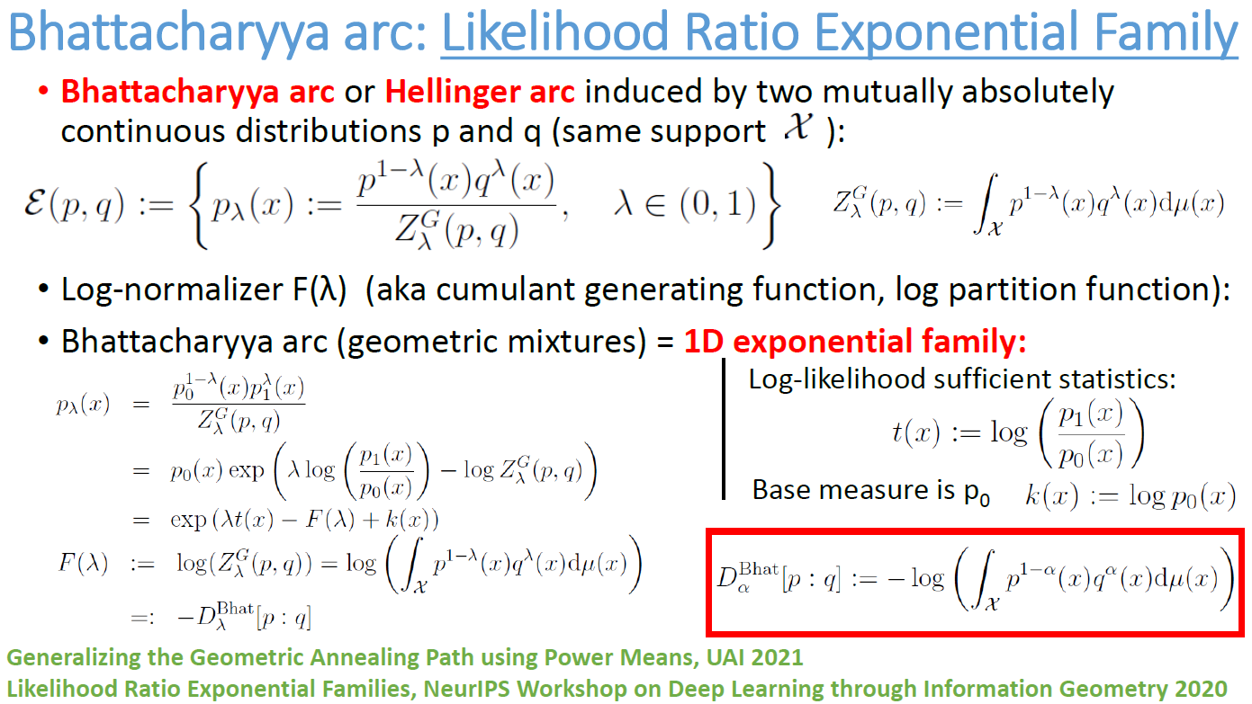

Slide 39

Weighted quasi-arithmetic means when α tends to zero:
M_{𝜏}(p,q;1- α; α)=

