Slide 1

Information measures and geometry of the Zeta distributions and related distributions
Frank Nielsen
Sony Computer Science Laboratories Inc.
Tokyo, Japan
https://franknielsen.github.io/
[arXiv:2104.10548]
Notes:
20 minutes : 15 minutes + question

Slide 2
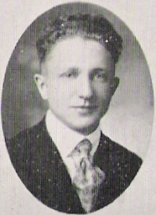
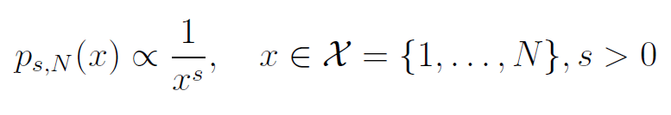
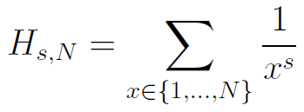
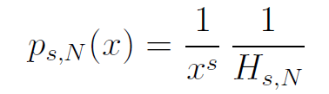
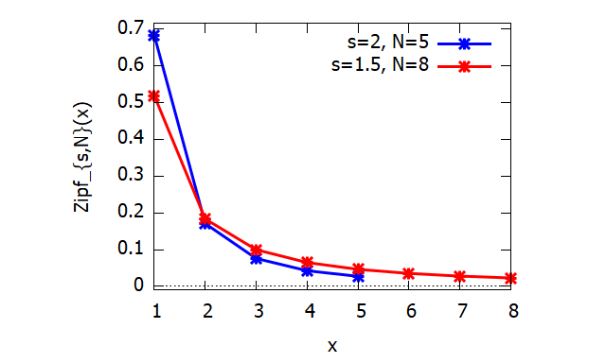
Zipf's distributions
A discrete power law with probability mass function
Normalizers are generalized harmonic numbers :
Examples: Empirical distributions of word frequencies sorted by their rankings in natural languages, population sizes of cities, etc.
George K. Zipf
1902-1950
American linguist
Notes:
$$
p_{s,N}(x)\propto \frac{1}{x^s},\quad x\in\calX=\{1,\ldots,N\}, s>0
$$
$$
H_{s,N}=\sum_{x\in\{1,\ldots,N\}} \frac{1}{x^s}
$$
$$
p_{s,N}(x) = \frac{1}{x^s}\, \frac{1}{H_{s,N}}
$$

Slide 3
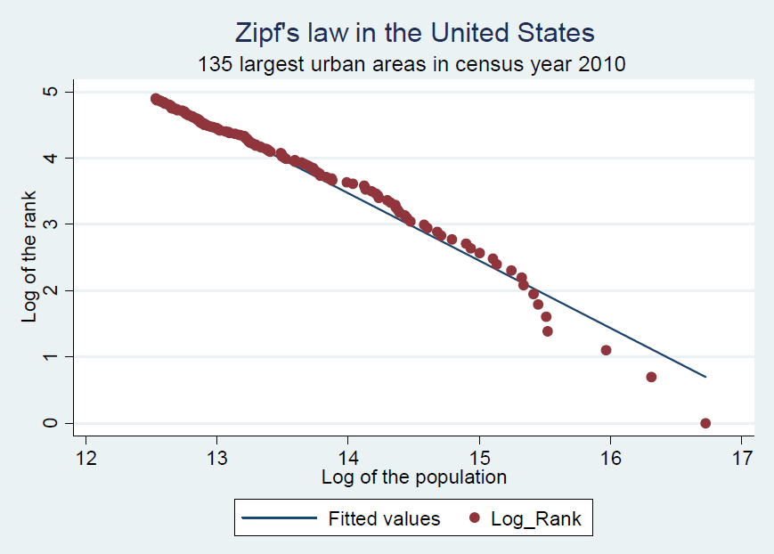

Zipf's law: Human populations in cities
slope=-1.019
in log-log expression: linear
log-rank versus log-size plot
Arshad, Sidra, Shougeng Hu, and Badar Nadeem Ashraf. "Zipf’s law and city size distribution: A survey of the literature and future research agenda." Physica A: Statistical mechanics and its applications 492 (2018): 75-92.
Notes:
-1.019

Slide 4
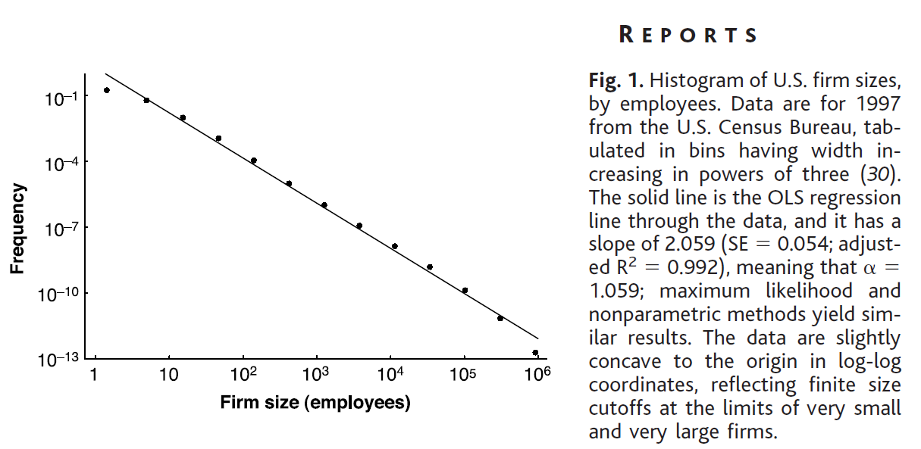
Zipf's law: US firm sizes, surname frequencies, etc.
Remark: Estimators by line fitting methods in log-log coordinates...
Axtell, Robert L. "Zipf distribution of US firm sizes." Science 293.5536 (2001): 1818-1820.
Fox, Wendy R., and Gabriel W. Lasker. "The distribution of surname frequencies." International Statistical Review (1983): 81-87.

Slide 5
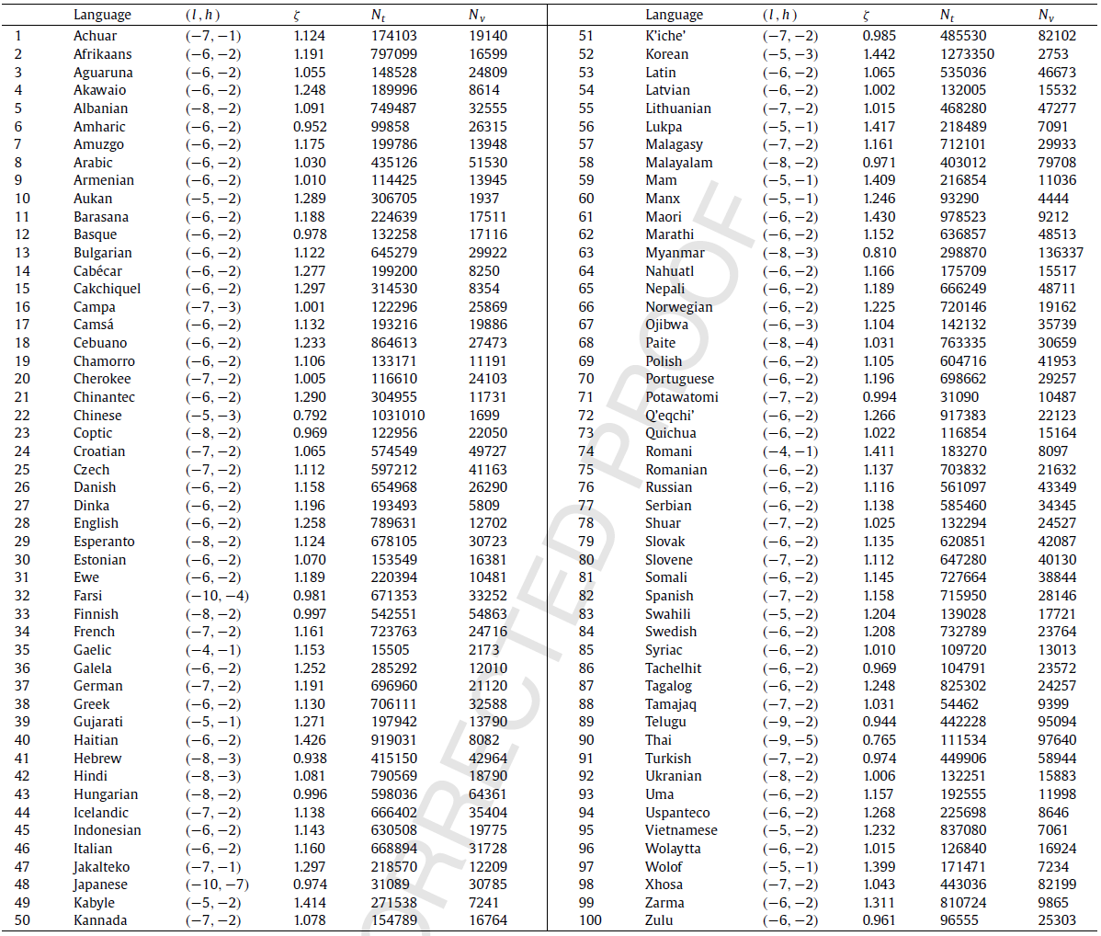
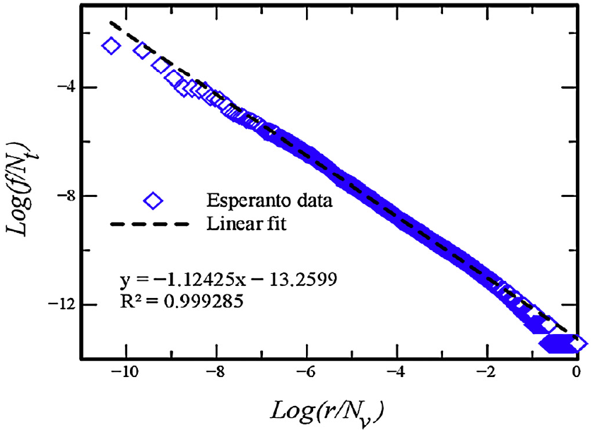
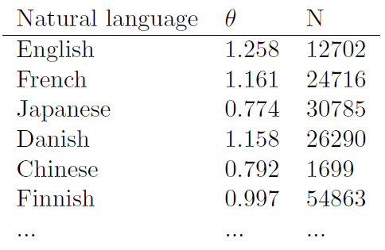
Zipf's distributions: A rank-frequency distribution
In general, languages have a power law range
- Ali Mehri and Maryam Jamaati. Variation of Zipf's exponent in one hundred live languages: A study of the Holy Bible translations. Physics Letters A, 381(31):2470{2477, 2017.
- Ferrer i Cancho, Ramon. "The variation of Zipf's law in human language." The European Physical Journal B-Condensed Matter and Complex Systems 44.2 (2005): 249-257.

Slide 6
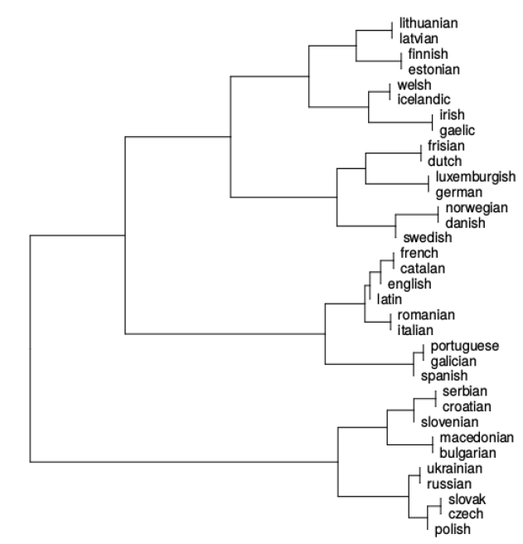
Clustering Zipf's distributions
Agglomerative hierarchical clustering yields a dendrogram for finding similarities between human languages
Delta-Eder distance
Kullback-Leibler divergence
Pablo Gamallo, Jose Ramom Pichel, and Inaki Alegria. Measuring language distance of isolated european languages. Information, 11(4):181, 2020.
Notes:
Delta-Eder distance

Slide 7
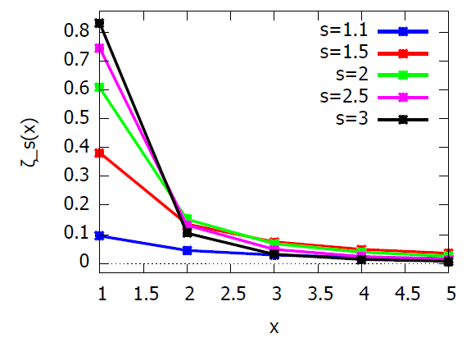
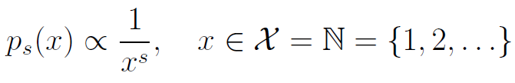
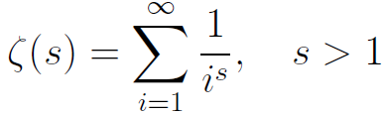
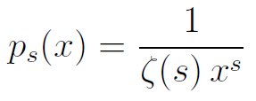
Zeta distributions
Discrete power law distributions on natural numbers
Normalizing function is the real Riemann zeta function:
⇨ many fast approximation algorithms to numerically calculate zeta
Because of infinite summation, we need s>1 for convergence. This contrasts with Zipf's distributions are defined for s>0.
Probability mass function
of a zeta distribution:
Notes:
$$
p_s(x) \propto\frac{1}{x^s},\quad x\in\calX=\bbN=\{1,2,\ldots\}.
$$
$$
\zeta(s)=\sum_{i=1}^\infty \frac{1}{i^s}, \quad s>1.
$$
$$
p_s(x)=\frac{1}{\zeta(s)\, x^s}
$$

Slide 8
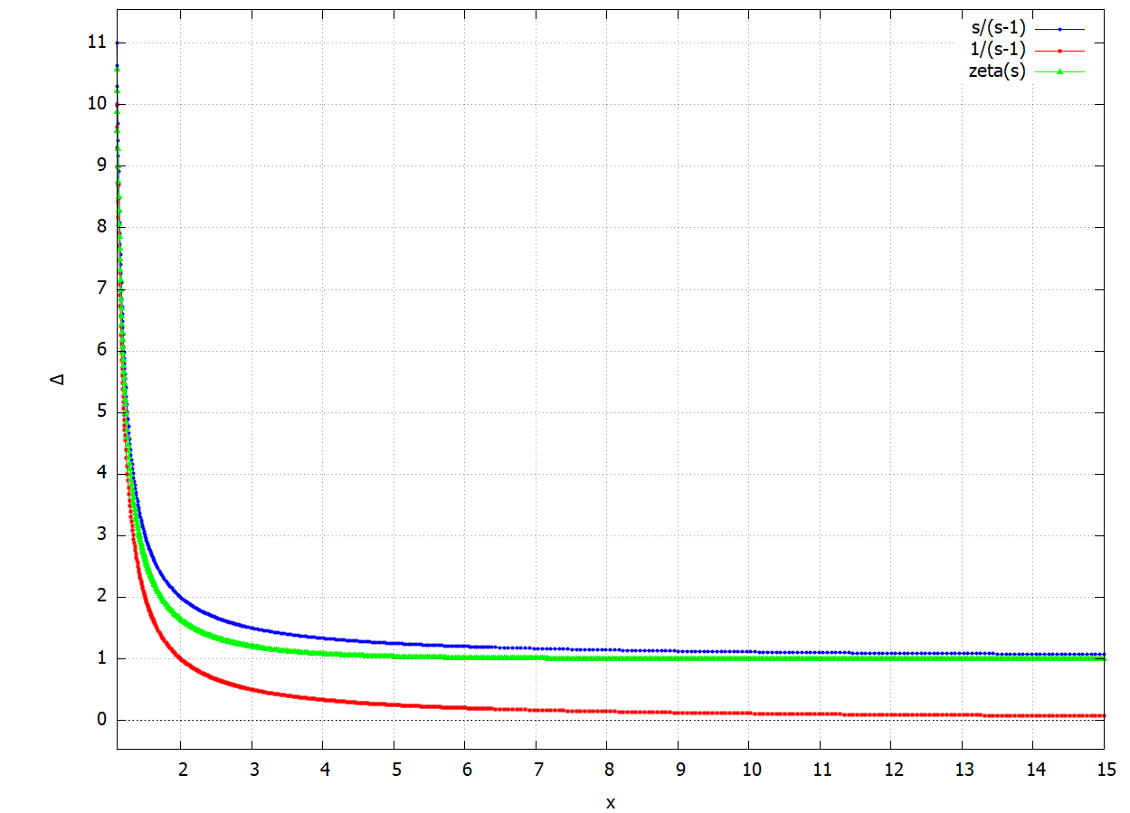
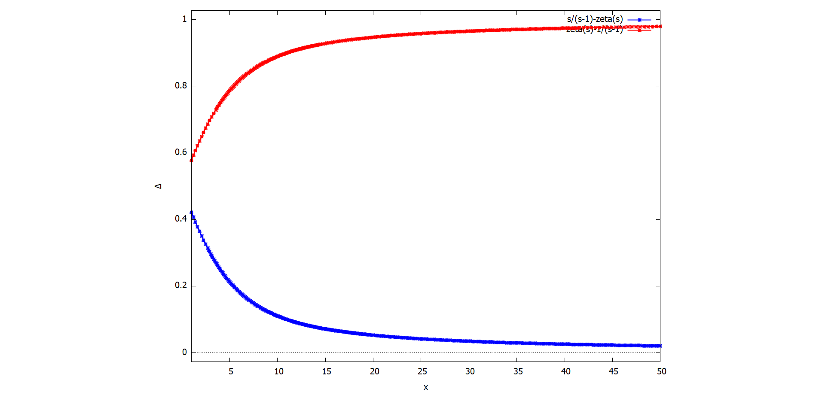
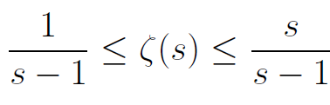
Bounding the real zeta function ζ(s)
Interesting range in practice is in (1,small s) not asymptotic s→∞
Ferrer and Fernández. "Power laws and the golden number." Problems of general, germanic and slavic linguistics, 518-523.

Slide 9




Zeta distributions: A discrete exponential family
Canonical decomposition of exponential families:
Natural parameter and sufficient statistic:
Log-normalizer (also called cumulant function):
Fisher information:

Slide 10
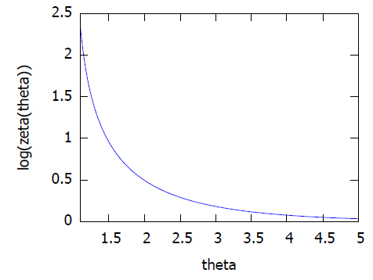
Log-normalizer F(θ) of Zeta distributions
A strictly convex and real-analytic C∞ smooth function

Slide 11
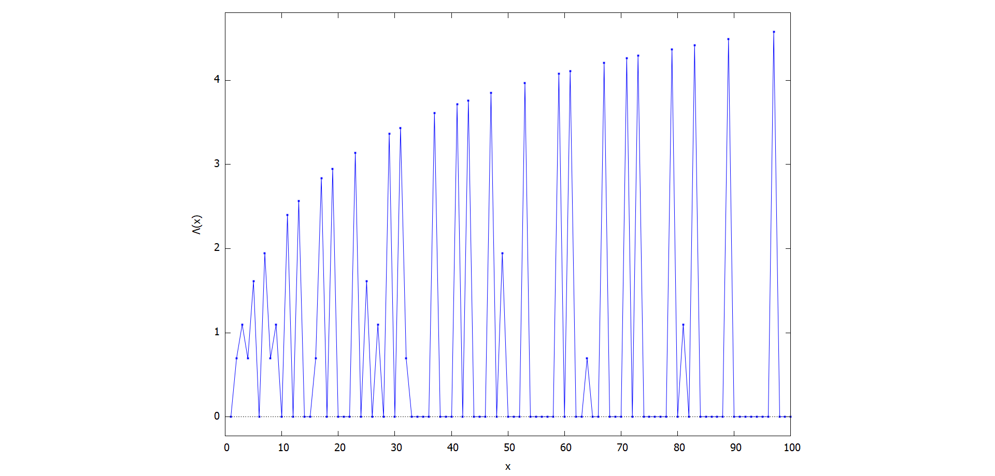
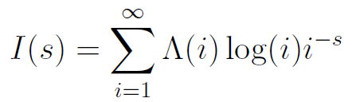
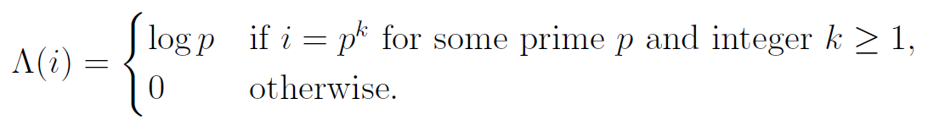
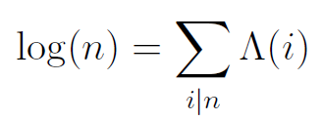
Fisher information and von Mangoldt function
von Mangoldt function satisfies the identity:
Notes:
$$
p_s(x)=\exp\left(\theta(s)t(x)-F(\theta(s))\right).
$$
$$
\theta=s
$$
$$t(x)=-\log x$$
$$
F(\theta)=\log\zeta(\theta)
$$
$$
I(s)=-E_{p_s}[(\log p_s(x))'']=F''(s)=(\log\zeta(s))''=\frac{\zeta(s)\zeta''(s)-\zeta'(s)^2}{\zeta^2(s)}.
$$
$$
I(s)=\sum_{i=1}^\infty \Lambda(i)\log(i)i^{-s}
$$
$$
\Lambda(i) = \begin{cases} \log p & \text{if }i=p^k \text{ for some prime } p \text{ and integer } k \ge 1, \\ 0 & \text{otherwise.} \end{cases}
$$
$$
\log(n)=\sum_{i | n} \Lambda(i)
$$

Slide 12
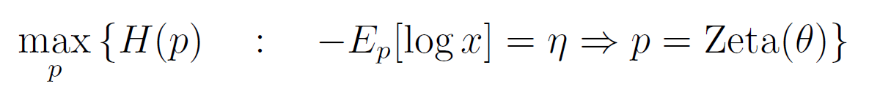
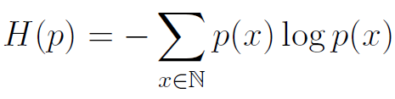
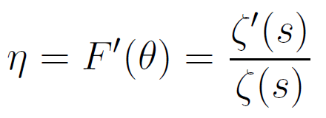
Zeta distribution: A maximum entropy distribution
Exponential families are distributions which maximize entropy subject to the moment constraints of their sufficient statistics.
Shannon's entropy:
Dual moment parameterization of zeta distributions:
Efficient numerical evaluation algorithms of F' but difficult to inverse!
Guiasu, Silviu. "An optimization problem related to the zeta-function." Canadian Mathematical Bulletin 29.1 (1986): 70-73.
Notes:
Guiasu, Silviu. "An optimization problem related to the zeta-function." Canadian Mathematical Bulletin 29.1 (1986): 70-73.
$$
H(p)=-\sum_{x\in\bbN} p(x)\log p(x)
$$
$$
\max_p \left\{H(p)\quad :\quad -E_p[\log x]=\eta \Rightarrow p=\mathrm{Zeta}(\theta)\right\}
$$
$$
\eta=F'(\theta)=\frac{\zeta'(s)}{\zeta(s)}
$$

Slide 13
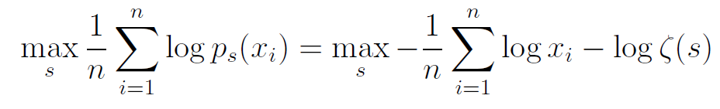
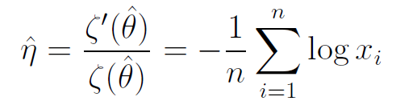
Zeta distribution: Maximum likelihood estimator
Given n identically and independently variates, estimate the Zeta moment parameter eta by maximum likelihood:
Better quadratic distance estimator which is also consistent:
QDE amounts to a line fitting procedure
Louis G Doray and Andrew Luong. Quadratic distance estimators for the zeta family.
Insurance: Mathematics and Economics, 16(3):255{260, 1995.
Notes:
$$
\frac{1}{s-1}\leq \zeta(s)\leq \frac{s}{s-1}.
$$
$$
\max_s \frac{1}{n}\sum_{i=1}^n \log p_s(x_i)= \max_s -\frac{1}{n}\sum_{i=1}^n \log x_i-\log\zeta(s)
$$
$$
\hat\eta=-\frac{1}{n}\sum_{i=1}^n \log x_i
$$
$$
\hat{\eta}=\frac{\zeta'(\hat{\theta})}{\zeta(\hat{\theta})}=-\frac{1}{n}\sum_{i=1}^n \log x_i
$$
$$
-E_p[\log x]=\eta
$$

Slide 14


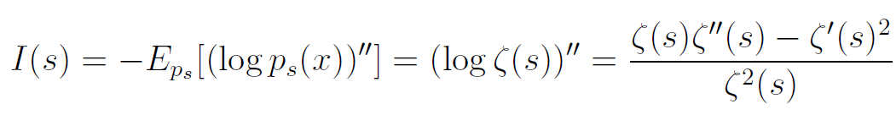
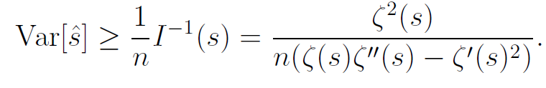
Zeta distribution: Cramér–Rao lower bound
The variance of any unbiased estimator is bounded by its inverse Fisher information (CRLB):
Fisher information of iid random vector is additive:
Variance of unbiased estimator matches the CRLB only for exponential families
Louis G Doray and Andrew Luong. Quadratic distance estimators for the zeta family.
Insurance: Mathematics and Economics, 16(3):255{260, 1995.
in accordance with Section 2 of

Slide 15
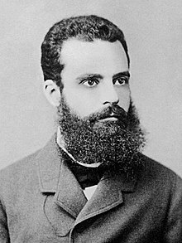
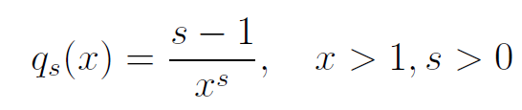
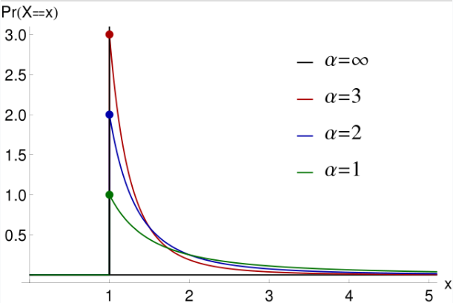
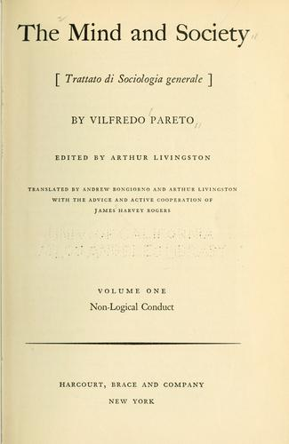
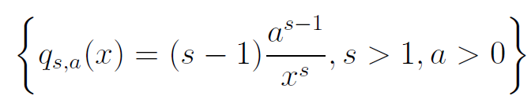

Pareto distributions: Continuous exponential family
Power law distribution with probability density function:
Shape parameter s in (0,∞)
Continuous exponential family (of order 1):
Support (1,∞)
Natural parameter θ=s
sufficient statistics t(x)=-log(x)
log-normalizer F(θ)=-log(θ-1)
Differential entropy -F*(η)=1+1/(s-1)-log(s-1)
Fisher information I(θ)=1/(θ-1)²
Vilfredo F. D. Pareto
(1848-1923)
Sociologist
Two-parameter Pareto distributions:
Positive-curvature Fisher-Rao manifold
Notes:
$$
q_s(x)=\frac{s-1}{x^s},\quad x>1, s>0
$$
$$
\left\{q_{s,a}(x)=(s-1) \frac{a^{s-1}}{x^{s}}, s>1, a>0\right\}
$$
$$
q_s(x)=q_{s,1}(x)
$$

Slide 16
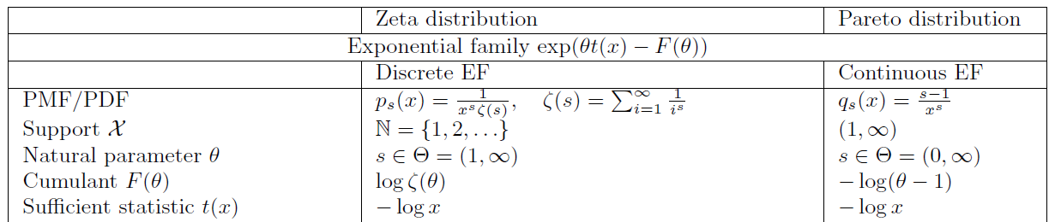
Power laws: Discrete versus continuous distributions
Power law distributions have long tail distributions
George Kingsley Zipf
1902-1950
American linguist
Vilfredo F. D. Pareto
(1848-1923)
Sociologist

Slide 17
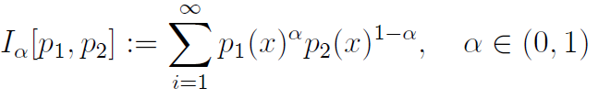



Skewed Bhattacharrya coefficients and related statistical divergences
Bhattacharrya similarity coefficients:
α-divergences:
When the densities belong to the same exponential family:
get a Jensen divergence induced by log-normalizer:
α=1/2 yields the squared Hellinger divergence
Notes:
$$
I_\alpha[p_1,p_2]:= \sum_{i=1}^\infty p_{1}(x)^\alpha p_{2}(x)^{1-\alpha},\quad \alpha\in (0,1)
$$
$$
D_\alpha[p_{s_1}:p_{s_2}] := \frac{1}{\alpha(1-\alpha)}\left(1-I_\alpha[p_{s_1}:p_{s_2}]\right)
$$
$$
I_\alpha[p_{s_1}:p_{s_2}] = \exp\left(-J_{F,\alpha}(s_1:s_2)\right),
$$
\begin{eqnarray*}
J_{F,\alpha}(s_1:s_2)&:=&\alpha F(s_1)+(1-\alpha)F(s_2)-F(\alpha s_1+(1-\alpha)s_2)\geq 0,\\
&=& \log\left( \frac{\zeta(s_1)^\alpha \zeta(s_2)^{1-\alpha}}{\zeta(\alpha s_1+(1-\alpha)s_2)}\right).
\end{eqnarray*}
$$
D_\alpha[p_{s_1}:p_{s_2}] = \frac{1}{\alpha(1-\alpha)} \left(1-\frac{\zeta(\alpha s_1+(1-\alpha)s_2)}{\zeta(s_1)^\alpha \zeta(s_2)^{1-\alpha}}\right), \quad \alpha\in (0,1)
$$

Slide 18
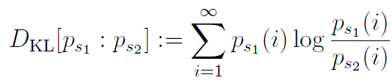


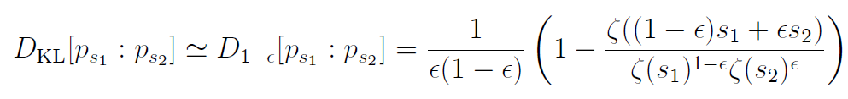
Limit cases of α-divergences: α→±1 Forward and reverse Kullback-Leibler divergences
Kullback-Leibler divergence :
Limit case α→1:
Limit case α→-1:
Thus by choosing values for α close to ±1, we can approximate the forward or reverse Kullback-Leibler divergence:
Efficient method in practice to approximate the KLD between zeta distributions
Notes:
$$
D_\KL[p_{s_1}:p_{s_2}]:=\sum_{i=1}^\infty p_{s_1}(i)\log\frac{p_{s_1}(i)}{p_{s_2}(i)},
$$
$$
D_\KL[p_{s_1}:p_{s_2}]\simeq D_{1-\epsilon}[p_{s_1}:p_{s_2}]= \frac{1}{\epsilon(1-\epsilon)} \left(1-\frac{\zeta((1-\epsilon) s_1+\epsilon s_2)}{\zeta(s_1)^{1-\epsilon} \zeta(s_2)^{\epsilon}}\right).
$$
$$
\lim_{\alpha\rightarrow 1} D_\alpha[p_{s_1}:p_{s_2}]=D_\KL[p_{s_1}:p_{s_2}]
$$
$$
\lim_{\alpha\rightarrow -1} D_\alpha[p_{s_1}:p_{s_2}]=D_\KL[p_{s_2}:p_{s_1}]=D_\KL^*[p_{s_1}:p_{s_2}]
$$
$$
\lim_{\alpha\rightarrow -1} D_\alpha[p_{s_1}:p_{s_2}]=D_\KL[p_{s_2}:p_{s_1}]=D_\KL^*[p_{s_1}:p_{s_2}]=\sum_{i=1}^\infty p_{s_2}(i)\log\frac{p_{s_2}(i)}{p_{s_1}(i)}.
$$

Slide 19



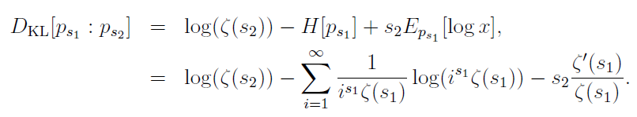

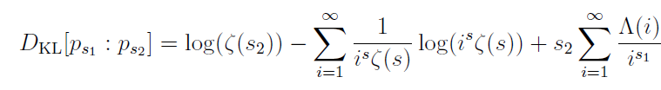
Kullback-Leibler divergence between two zeta distributions
Since zeta distributions are exponential families, it amounts to a reverse Bregman divergence:
or equivalently a Fenchel-Young divergence using dual parameterizations:
using the dual parameterization:
and negentropy convex conjugate:
Thus the KLD between two zeta distributions is
Notes:
$$
D_\KL[p_{\theta,N}:q_s]=B_{F_2,F_1}(s:\theta)=F_2(s)-F_1(\theta)-(s-\theta)F_1'(\theta),
$$

Slide 20
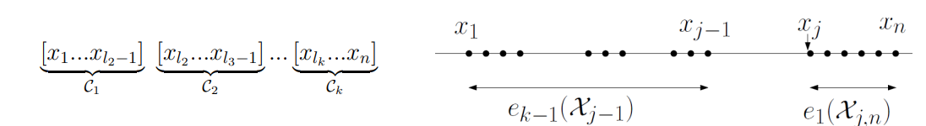
Clustering finite sets of Zeta distributions
Agglomerative hierarchical clustering (e.g.,single linkage, average linkage etc, get dendograms) or partition-based k-means/k-center clustering
Since zeta distributions are 1D EFs, Kullback-Leibler divergence k-means clustering amounts to 1D Bregman k-means: Optimal solution using dynamic programming. Interval clustering because Bregman Voronoi diagrams have connected cells.
Multivariate product Zeta distributions can be clustered using Lloyd's k-means heuristics but then best k-means is then NP-hard
"Optimal interval clustering: Application to Bregman clustering and statistical mixture learning." IEEE Signal Processing Letters 21.10 (2014): 1289-1292.

Slide 21
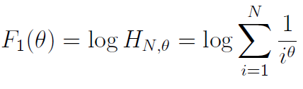

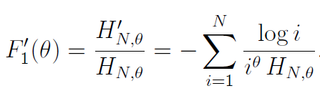
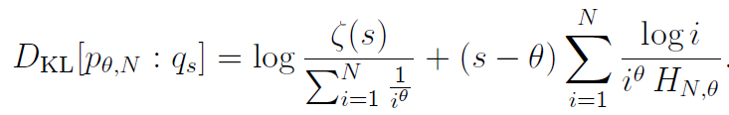
Clustering sets of Zipf's distributions
Problem: Zipf's distributions do not have the same support
Consider k-means prototypes (cluster centers) as zeta distributions.
Thus we need a distance between a Zipf's distribution (=right truncated zeta distribution) and a zeta distribution. This is a duo Bregman divergence (with two generators in dominance relation):
Since , we get
is larger than
Notes:
"Statistical Divergences between Densities of Truncated Exponential Families with Nested Supports: Duo Bregman and Duo Jensen Divergences." Entropy 24.3 (2022)
$$
D_\KL[p_{\theta,N}:q_s]=B_{F_2,F_1}(s:\theta)=F_2(s)-F_1(\theta)-(s-\theta)F_1'(\theta),
$$
$$
F_2(s)=\log \zeta(s)$$ $$F_1(\theta)=\log H_{N,\theta}=\log \sum_{i=1}^N \frac{1}{i^\theta}
$$
$$
F_1'(\theta)=\frac{H_{N,\theta}'}{H_{N,\theta}}=-\sum_{i=1}^N \frac{\log i}{i^\theta\, H_{N,\theta}}.
$$
$$
D_\KL[p_{\theta,N}:q_s]=\log \frac{\zeta(s)}{\sum_{i=1}^N \frac{1}{i^\theta}}+(s-\theta)\sum_{i=1}^N \frac{\log i}{i^\theta\, H_{N,\theta}}.
$$
\end{document}
Nielsen, Frank. "Statistical Divergences between Densities of Truncated Exponential Families with Nested Supports: Duo Bregman and Duo Jensen Divergences." Entropy 24.3 (2022): 421.
$$
\log p_{s,N}(x)=-\log H_{s,N}-s\log x
$$

Slide 22
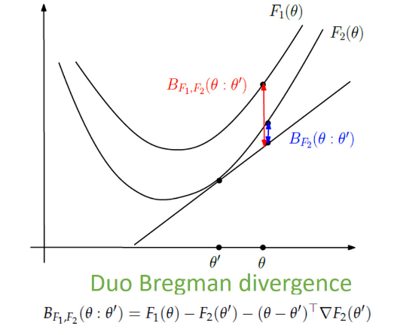
Visualizing duo Bregman (pseudo-)divergences
Generator F₁ dominates generator F₂
Only pseudo divergence because strictly positive
Recover Bregman divergences when F=F₁=F₂
"Statistical Divergences between Densities of Truncated Exponential Families with Nested Supports: Duo Bregman and Duo Jensen Divergences." Entropy 24.3 (2022)

Slide 23
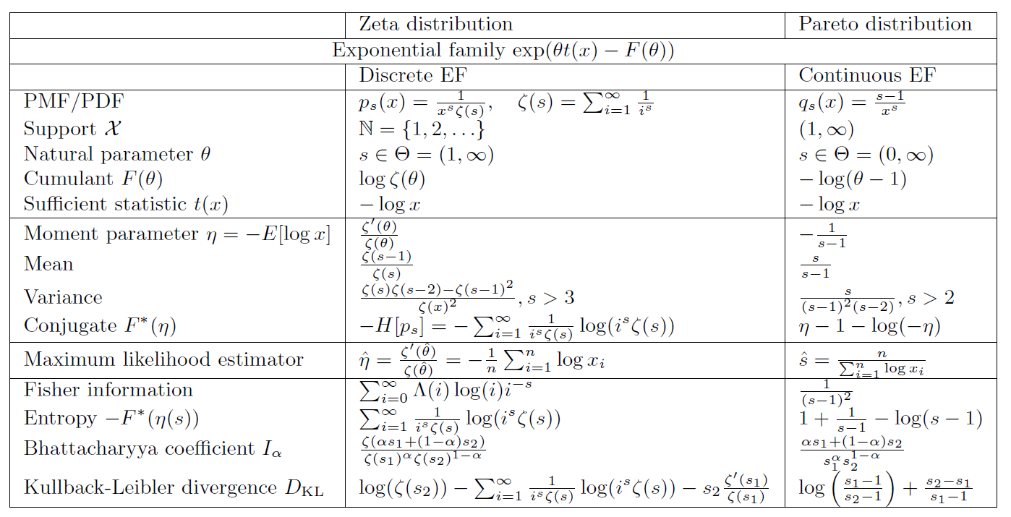
Comparisons of discrete vs continuous power laws
Notice: Differential entropy may be negative (large s) but never the discrete entropy!
Notes:
$$D_\KL[p_{s_1}:p_{s_2}]=B_F^*(\theta_1:\theta_2):=B_F(\theta_2:\theta_1)$$
$$
D_\KL[p_{s_1}:p_{s_2}]=B_F(\theta_2:\theta_1)=F(\theta(s_2))+F^*(\eta(s_1))-\theta(s_2)\eta(s_1):=Y_{F,F^*}(\theta(s_2):\eta(s_1)),
$$
$$\eta(s)=F'(\theta(s))=E_{p_s}[t(x)]=-E_{p_s}[\log x]$$
$$
F^*(\eta(s))=-H[p_s]=\sum_{i=1}^\infty p_s(i)\log{p_s(i)}
$$
\begin{eqnarray*}
D_\KL[p_{s_1}:p_{s_2}]&=&
\log(\zeta(s_2))-H[p_{s_1}]+s_2 E_{p_{s_1}}[\log x],\\
&=& \log(\zeta(s_2)) - \sum_{i=1}^\infty \frac{1}{i^{s_1}\zeta(s_1)}\log(i^{s_1}\zeta(s_1)) - s_2 \frac{\zeta'(s_1)}{\zeta(s_1)}.
\end{eqnarray*}
$$
\eta(\theta)=\frac{\zeta'(\theta)}{\zeta(\theta)} = -\sum_{i=1}^{\infty} \frac{\Lambda(i)}{i^{\theta}},
$$
$$
D_\KL[p_{s_1}:p_{s_2}]=
\log(\zeta(s_2)) - \sum_{i=1}^\infty \frac{1}{i^s\zeta(s)}\log(i^s\zeta(s)) + s_2 \sum_{i=1}^{\infty} \frac{\Lambda(i)}{i^{s_1}}.
$$

Slide 24
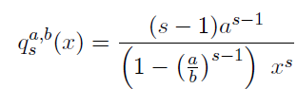


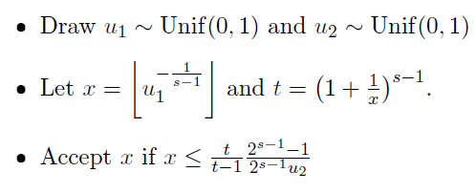


Drawing discrete/continuous power law variates
Zeta variates:
Truncated Pareto variates:
Acceptance/rejection method:
Inverse transform method:
may require several rounds

Slide 25
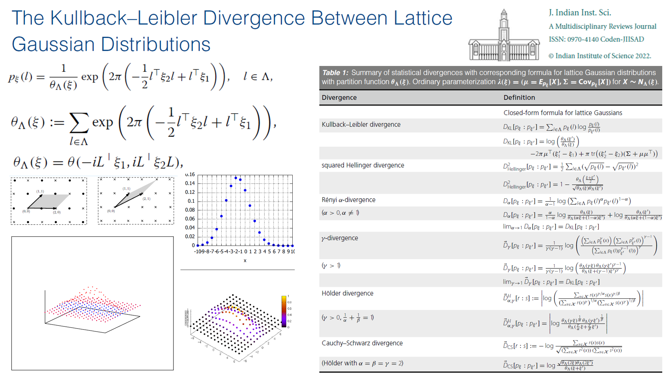
Thank you!
[arXiv:2104.10548]
Related work:
Discrete vs Continuous Normal distributions
"The Kullback–Leibler Divergence Between Lattice Gaussian Distributions." Journal of the Indian Institute of Science (2022): 1-12.

