Slide 1
Monte Carlo and Neural Information Geometry

Slide 2
Implementing information-geometric structures
Notes:
https://en.wikipedia.org/wiki/Pole_and_polar
A polarity is a correlation that is also an involution.
In projective geometry, a correlation is a transformation of a d-dimensional projective space that maps subspaces of dimension k to subspaces of dimension d − k − 1, reversing inclusion and preserving incidence. Correlations are also called reciprocities or reciprocal transformations.
non-involutory dualities
The concepts of pole, polar and reciprocation can be generalized from circles to other conic sections which are the ellipse, hyperbola and parabola.
https://en.wikipedia.org/wiki/Correlation_(projective_geometry)

Slide 3
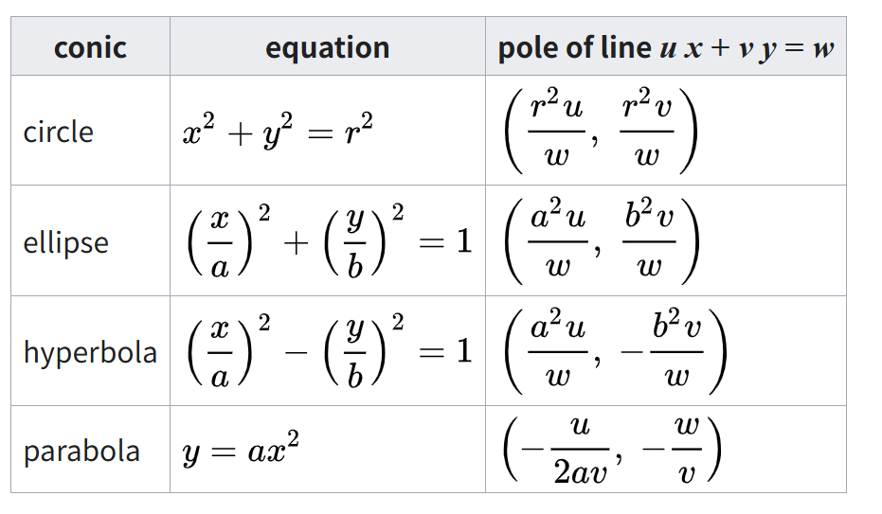
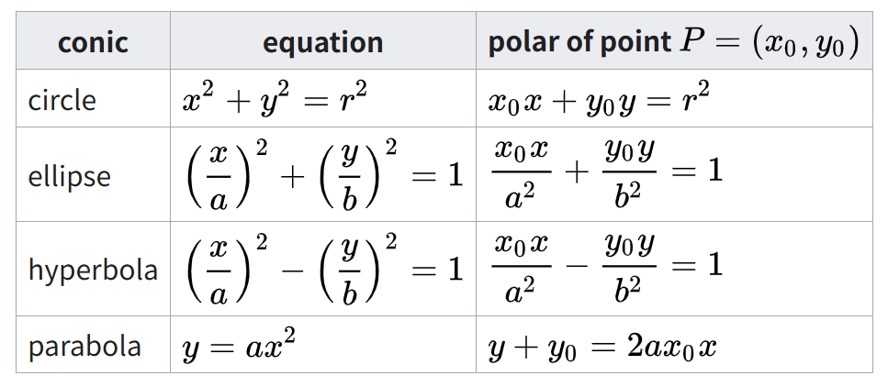
Incidence preserving, inclusion reversing
Notes:
https://graphics.stanford.edu/courses/cs268-16-fall/Notes/cmsc754-lects.pdf

