Slide 1

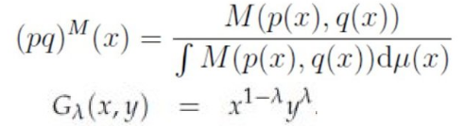
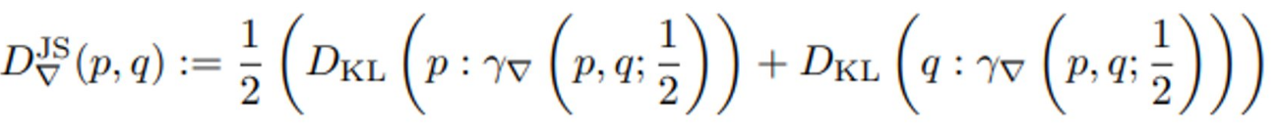
Geometric Jensen-Shannon divergences: Two meanings
Ordinary
Jensen-Shannon divergence
Replace arithmetic by abstract mean in the JSD: M-JSD
View JSD as a contrast divergence, a geometric function on the product manifold MxM using a ∇-geodesic: ∇-JSD
①
Mixture wrt
a mean M
Geometric mean M=G
②
Notes:
Two definitions of the geometric Jensen-Shannon divergences (G-JSD):
① Use M-statistical mixtures. Merit is to obtain closed-form formula for multivariate normal with M=geometric mean:
https://www.mdpi.com/1099-4300/21/5/485
② Define statistical divergence geometrically as a function on the product manifold. Then replace abstract mean by midpoint on a geodesic:
https://link.springer.com/chapter/10.1007/978-3-031-38271-0_15
Video: https://www.youtube.com/watch?v=m-mElw8nRPM

Slide 2

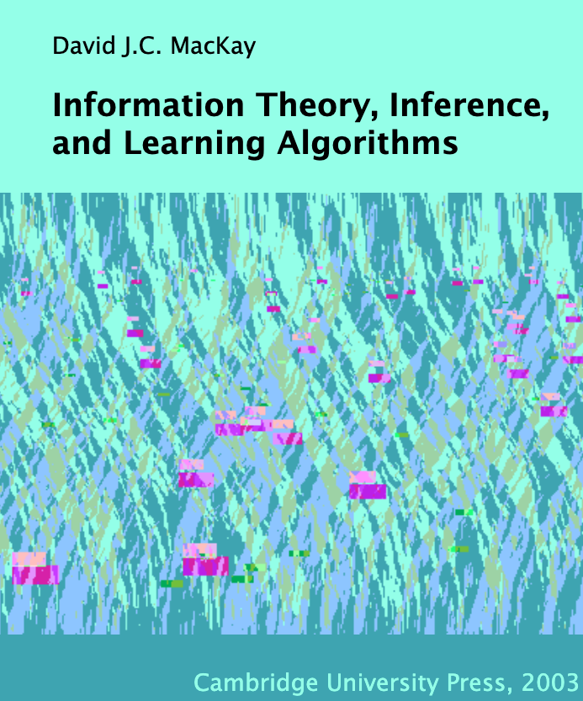

Slide 3

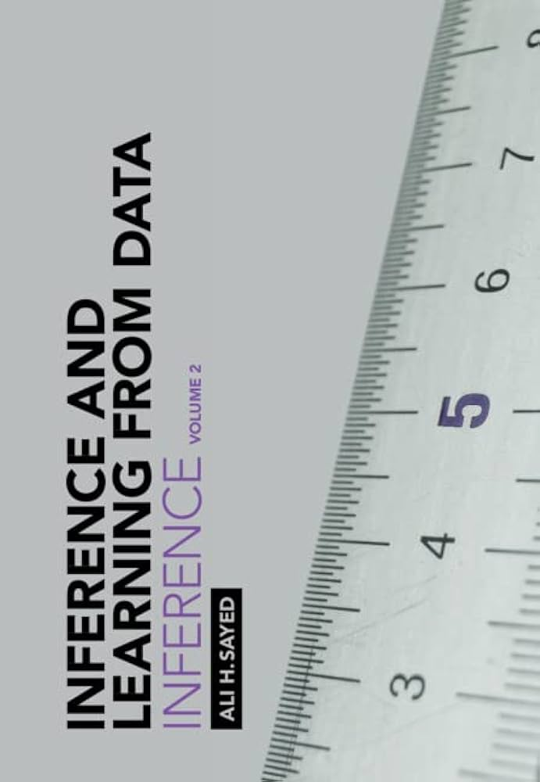

Notes:
Great trilogy books on machine learning by Prof. Ali Sayed (EPFL):
Foundations
Inference
Learning
https://tinyurl.com/TrilogyAliSayed

Slide 4

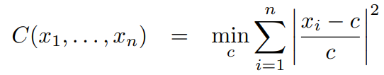
Contraharmonic or antiharmonic mean
Contraharmonic or antiharmonic mean of n positive reals:
The contraharmonic mean is the solution of the sum of the squares with relative errors:

Slide 5
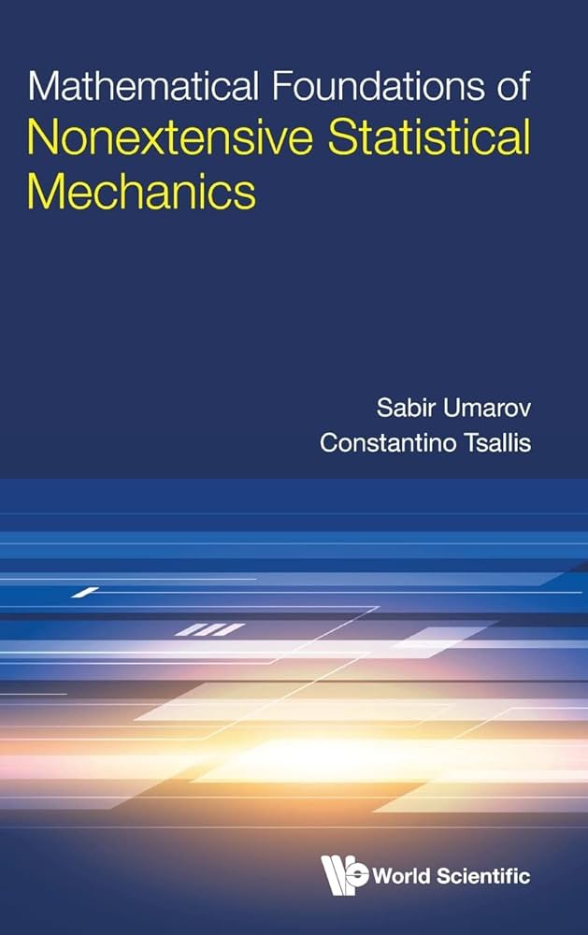
Andrej Karpathy

Slide 6

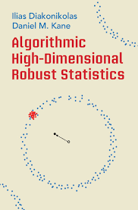






Slide 7


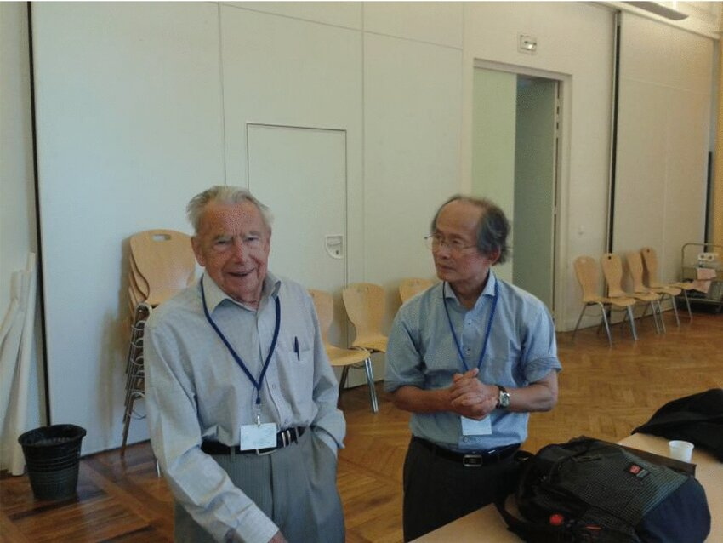
Hessian manifolds, Hessian geometry, Bregman geometry
Hessian structure on a manifold: (g, ∇) where g is a Hessian metric tensor and a torsion-free flat connection ∇
To every chart there is a potential function defining the Hessian metric in local coordinates of the chart
Hessian manifolds are special affine manifolds (M, ∇) where ∇ is a torsion-free flat connection
A Bregman divergence induces a Hessian manifold with a global chart, a Bregman manifold
Professor Jean-Louis Koszul (left)
Professor Hirohiko Shima (right)
at GSI 2013
志摩裕彦, へッセ幾何学， 裳華房， 2001
Shima, Hirohiko. The geometry of Hessian structures. World Scientific, 2007.
Tutorial on Bregman manifolds: "On geodesic triangles with right angles in a dually flat space." Progress in Information Geometry: Theory and Applications. Cham: Springer International Publishing, 2021. 153-190.
Notes:
Affine manifold (M, ∇): ∇ is a torsion-free flat connection
Hessian manifold : Affine manifold + Hessian metric tensor
Bregman manifold = Hessian manifold with global chart
Tutorial on Bregman manifolds:
https://tinyurl.com/HessBreg
https://twitter.com/FrnkNlsn/status/1712991125672518000
https://link.springer.com/chapter/10.1007/978-3-030-65459-7_7

Slide 8
Mathematics, proof, and computation
Mathematics can manipulate definite numbers (“mathematical entities”) as limits of computational processes. Shall computation be finite or how can we compute limits (halting problem, parallelism)?
For example: continued fractions, arithmetic-geometric means, etc.
Dualities in mathematics and computing: A program can be interpreted or solve many dual problems.
For example: cross product of two homogeneous 3D vectors interpreted as line passing through two points or dual intersection point of the corresponding two dual lines (here, projective geometry duality).

Slide 9
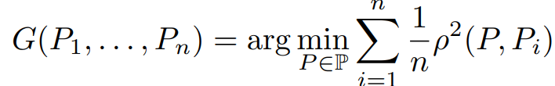
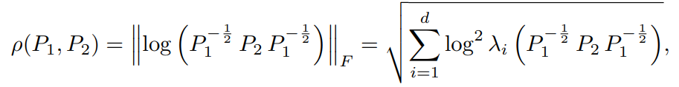






Geometric mean of n symmetric positive-definite matrices
Define the geometric mean of n SPD matrices as the unique minimizer of
When n=2: closed-form formula:
Unique solution is characterized by Karcher equation:
Simple inductive geometric mean: Let M₁=P₁ . Then iterate
In the limit, it converges to the geometric n-variable mean:
Extend to calculate expectations of SPD random variables with compact supports
with
with geodesic barycenter (weighted geometric bivariate mean):
What is... An inductive mean? AMS Notices, Dec. 2023
Notes:
Simple iterative algorithm to compute the geometric matrix mean of n SPD matrices.
Extend to approximate the expectations of SPD random variables with compact supports from variates:
https://franknielsen.github.io/MatrixGeometricMean/WhatIsInductiveMean-notformatted.pdf

