Slide 1
Geometric Information Theory: A hub for information sciences

Slide 2
GIT Geometric Information Theory: HUB A hub for information sciences

Slide 3
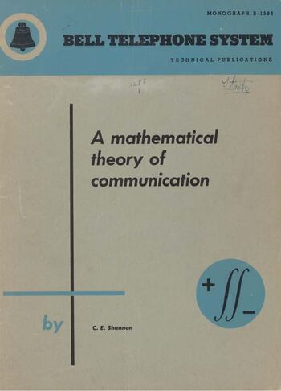
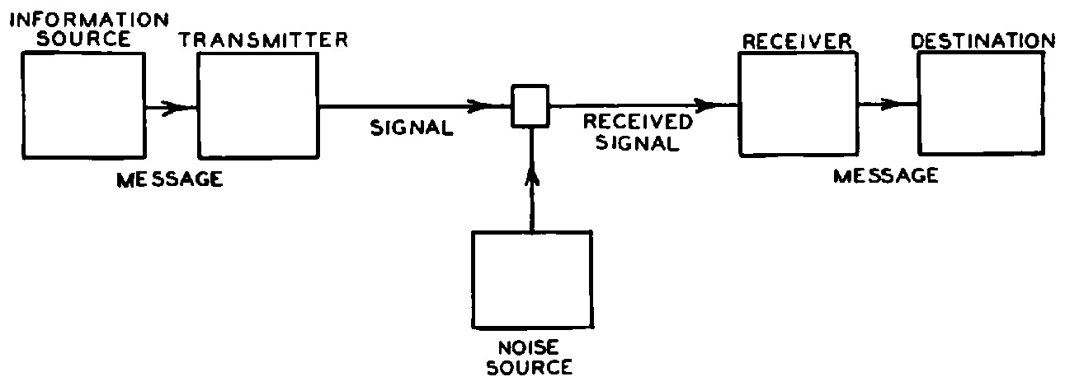
Classical information theory (1948)
Neat modeling of signal transmission problem
Telecommunication: coding+error correction
Axiomatization of Shannon entropy H
Confusing?! Greek letter eta : Eta is written η (lowercase) or Η (uppercase).
In Thermodynamics: S for Entropy and H=U(internal energy)+PV for enthalpy…

Slide 4
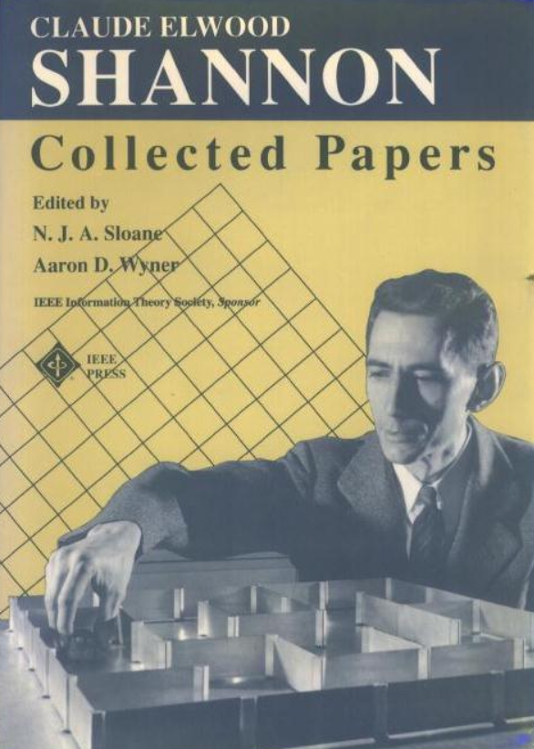
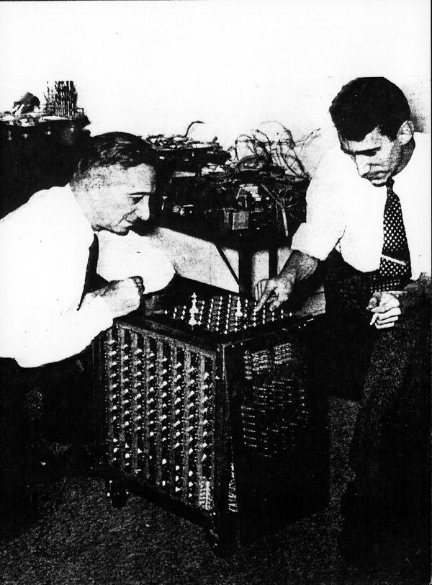
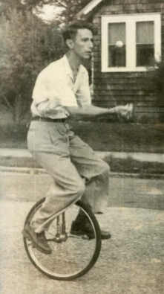

Claude Shannon, a playful mind
https://neilsloane.com/doc/shannon.html

Slide 5
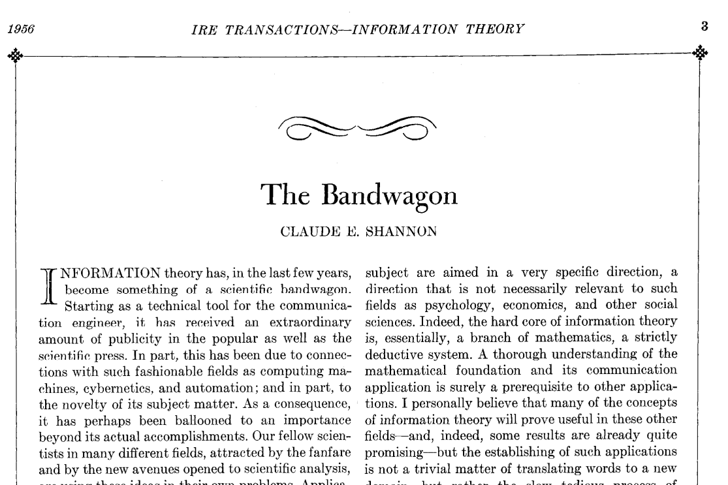
IT oversold? 1948…1956

Slide 6
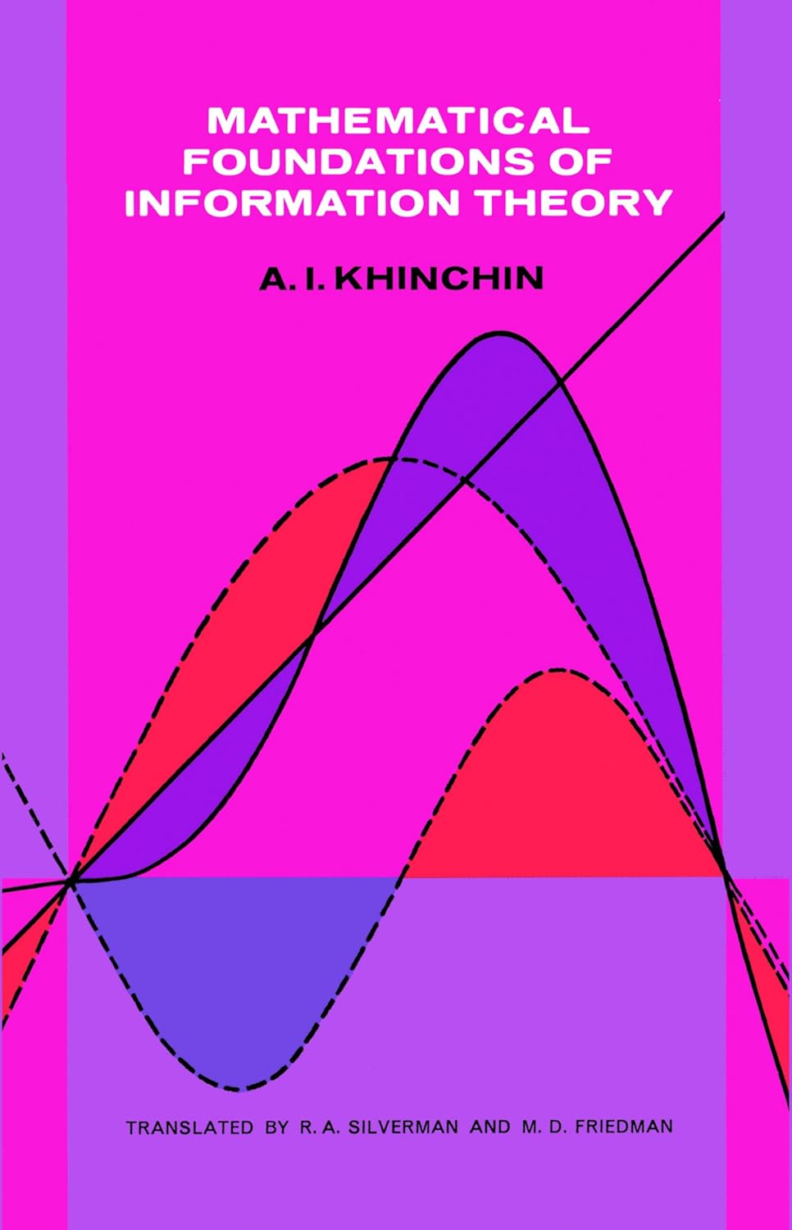


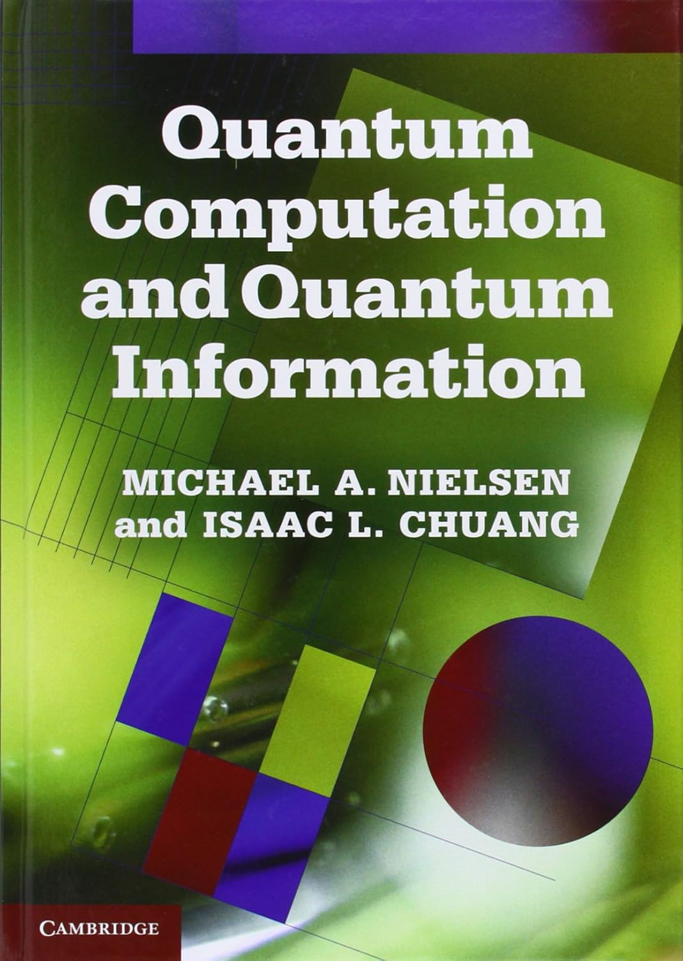
Classical information theory

Slide 7
Information theory in modern science…
…meaning IT in AI era?
Two sides: IT of AIs and AIs for IT?
Open complex problems (modeling/solving)
Modern Information Theory is the mathematical science of information: Its structure, geometry, dynamics, representation, quantification, measurement, fundamental limits, and its role in communication, computation, learning, intelligence, biological and physical systems (thermodynamics), etc.
“There is Nothing More Practical Than A Good Theory” (Kurt Lewin, psychologist)

Slide 8

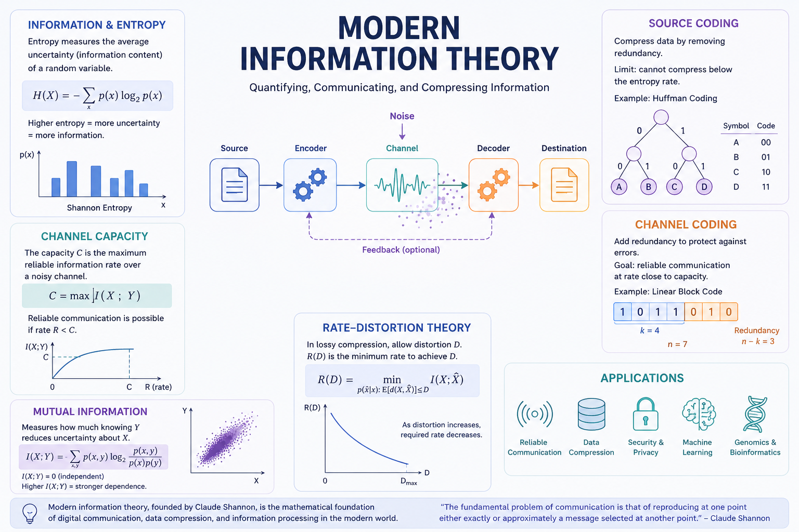

Slide 9
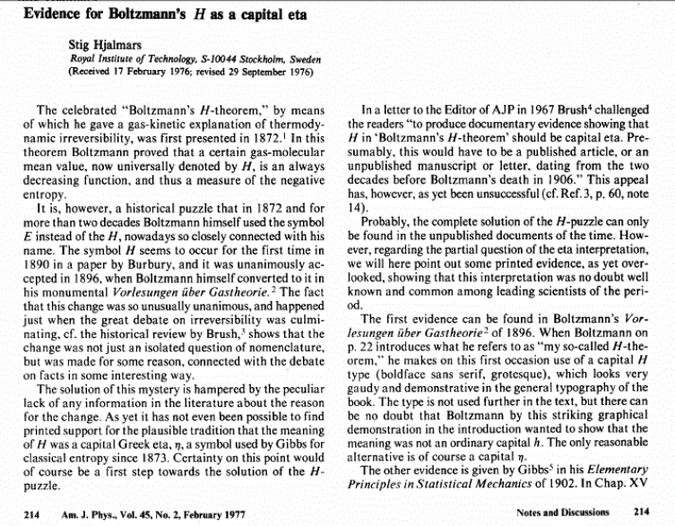
H-theorem, H-puzzle, capital eta
Hjalmars, Stig. "Evidence for Boltzmann’s H as a capital eta." American Journal of Physics 45.2 (1977): 214-215.

Slide 10
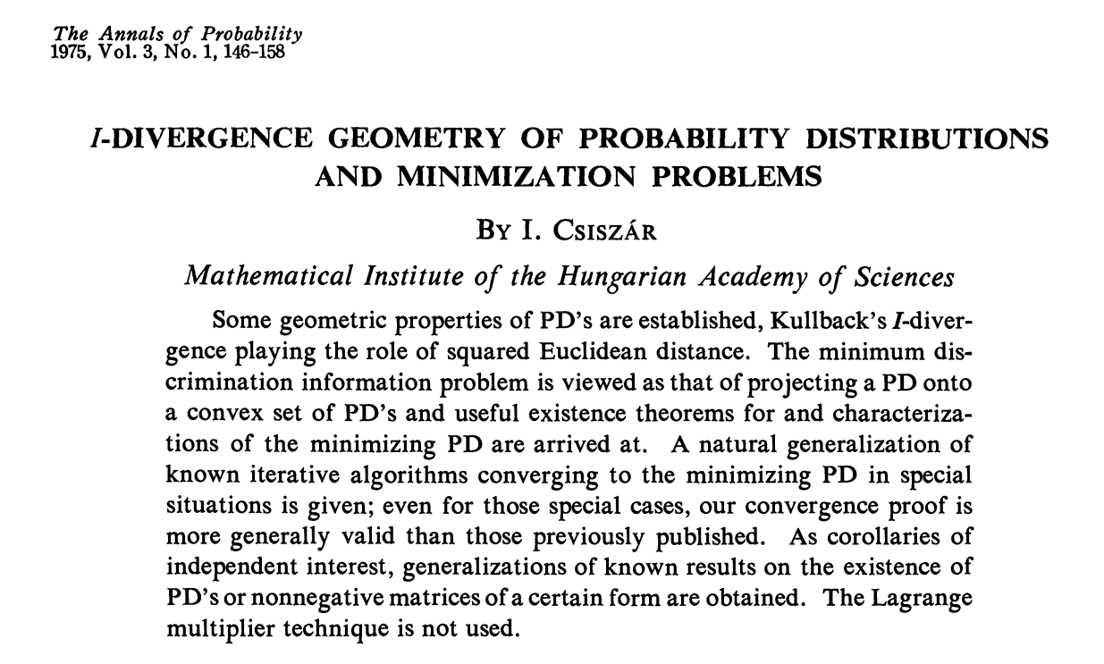

Slide 11
Information theory & Inference

