Slide 1
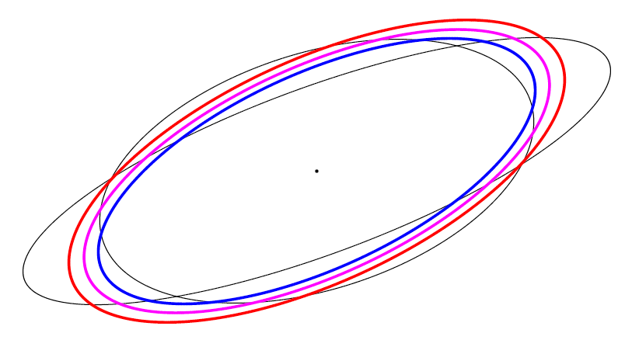
arithmetic-geometric-harmonic matrix mean inequality (AGH inequality)
Matrix X≻0 is symmetric positive-definite (SPD) iff. for all x ≠ 0, x^{T} X x >0,
Matrix X⪰ 0 positive semi-definite (PSD) iff. for all x, x^{T} X x ≥ 0,
Lowner partial ordering X ⪰ Y X-Y ⪰ 0
Means of two SPD matrices X and Y:
Arithmetic: A= (X+Y)/2
Geometric: G= X^{½} (X^{-½} Y X^{-½} )^{½} X^{½}
(Riemannian Karcher mean wrt. trace metric)
Harmonic: H=2 (X⁻¹+Y⁻¹)⁻¹
Visualize a 2x2 SPD matrix X by its ellipsoid E(X)={ x : x^{T} X x ≤ 1}
A ⪰ G ⪰ H ⇔ E(H) ⊆ E(G) ⊆ E(A)

Slide 2
Scale of MEANS
A scale of means {} is a parametric family of mean

Slide 3
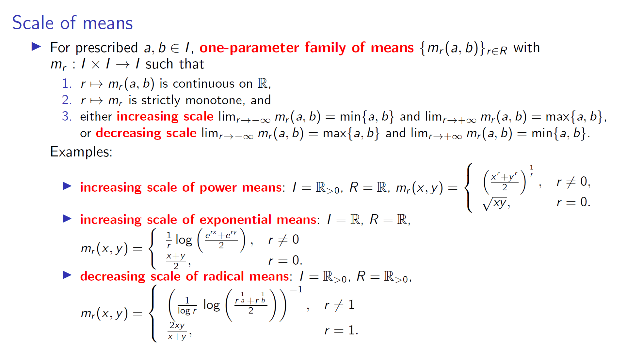
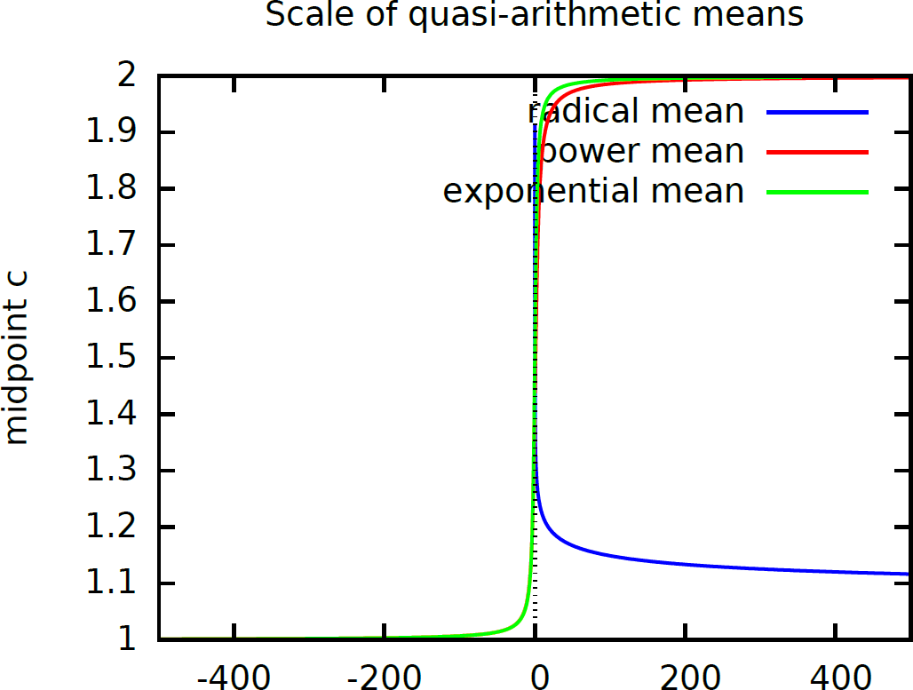
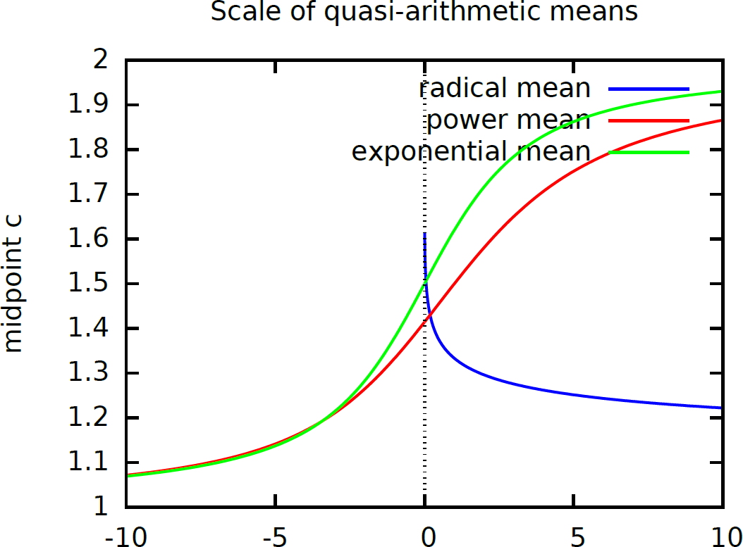
b=2
a=1
b=2
arXiv:2511.21173
a=1
r

