Slide 1

Information geometry: Geometry of dual structures
- A very short introduction -
Frank Nielsen
Sony Computer Science Laboratories Inc
Tokyo, Japan
2023

Slide 2
Information geometry (IG): Rationale and scope
IG field originally born by investigating geometric structures of statistical/probability models (e.g, space of Gaussians, space of multinomials)
Statistical models: parametric vs nonparametric models, regular vs singular (ML) models, hierarchical (ML) or simple models, ...
Define statistical invariance, use language of geometry (e.g., ball, projection, bisector) to design algorithms in statistics, information theory, statistical machine learning, etc.
IG study interplays of statistical/parameter divergences with geometric structures
Relationships between many types of dualities in IG: dual connections, reference duality (dual f-divergences), Legendre duality, duality of representations/monotone embeddings, etc
Pure geometric dual structures which can be used in many different contexts

Slide 3
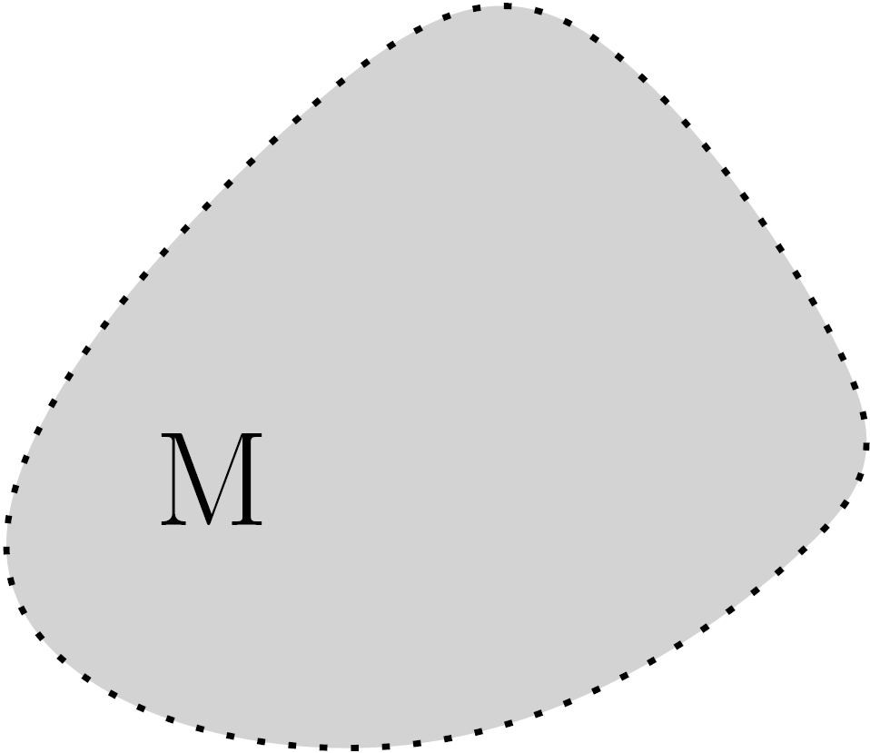
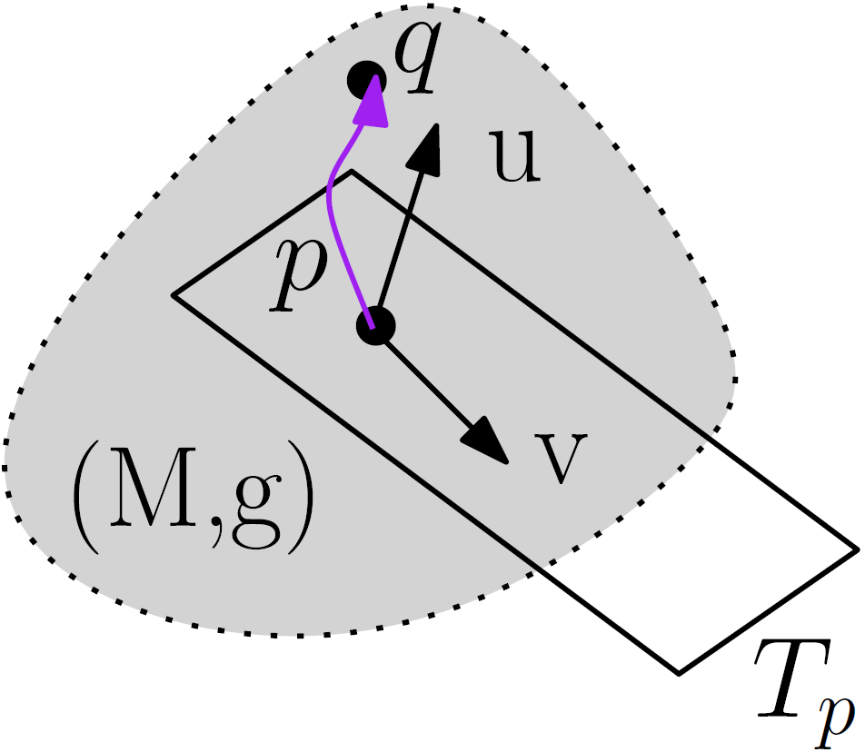
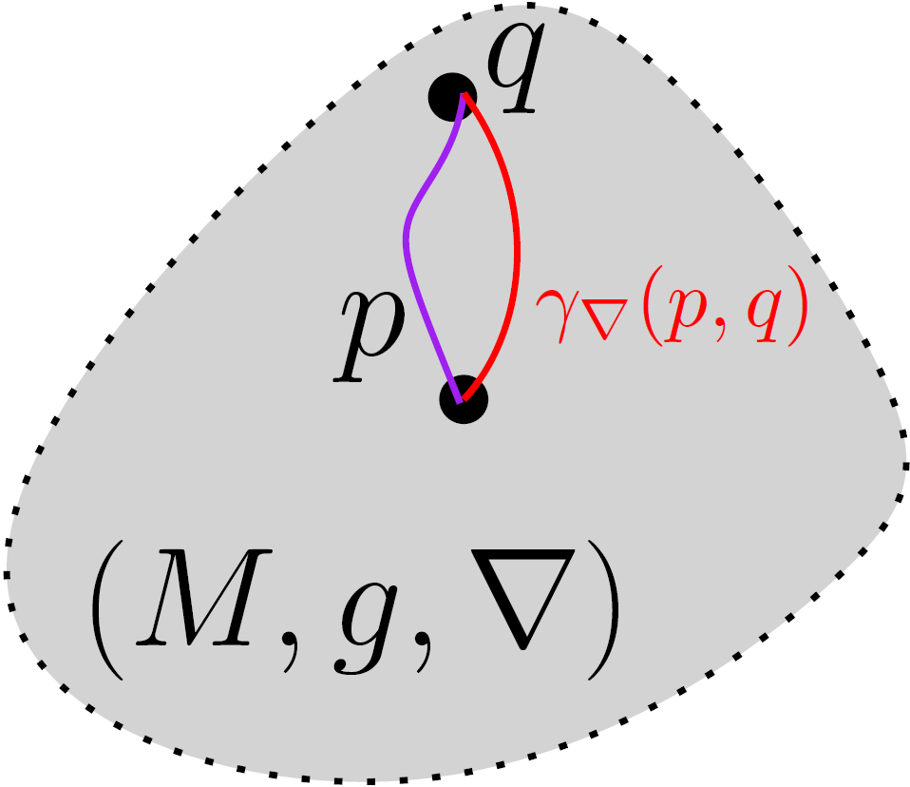
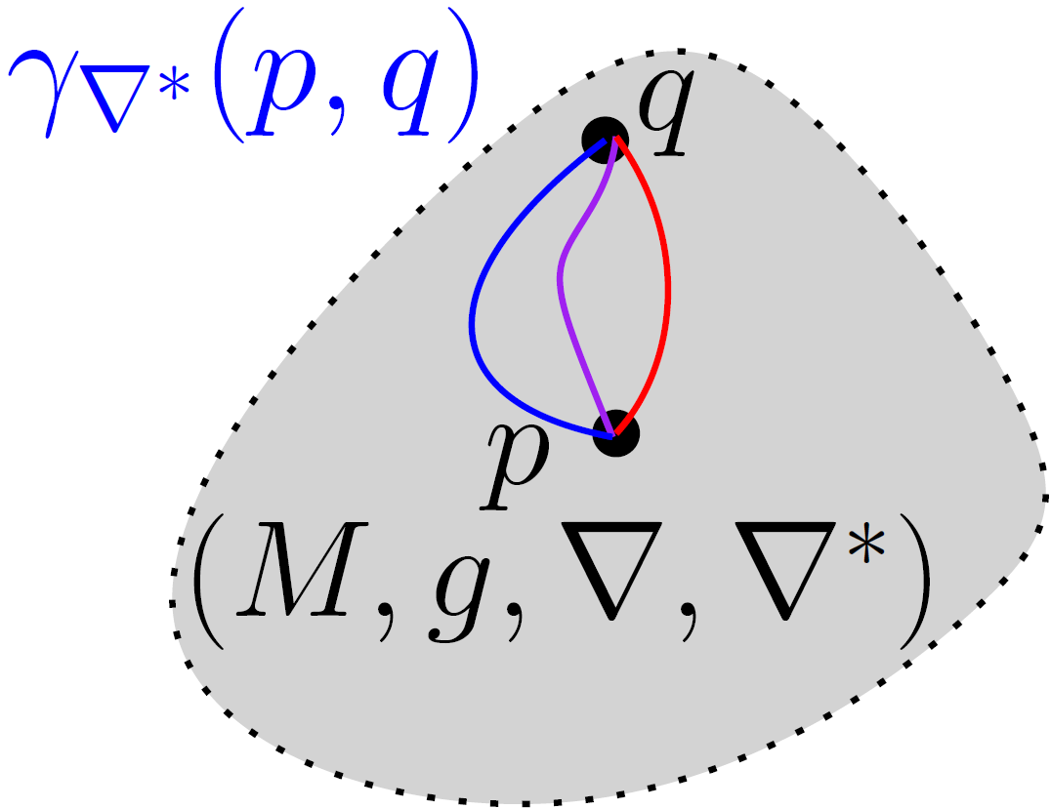

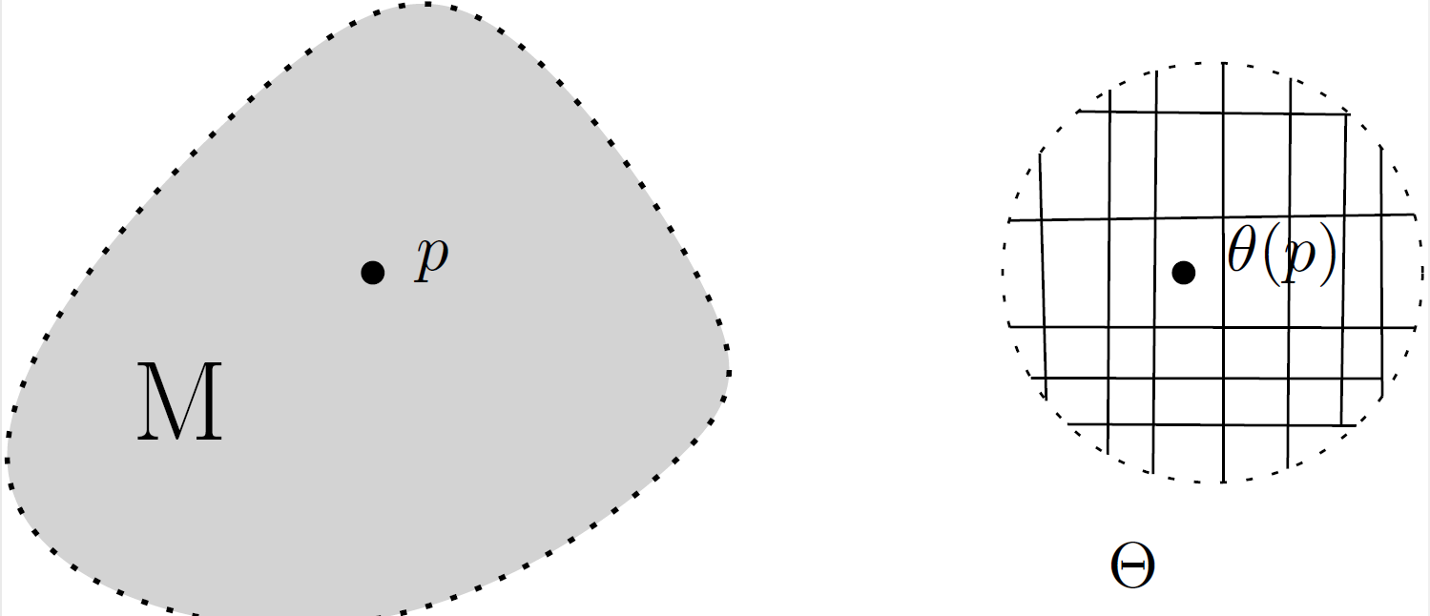
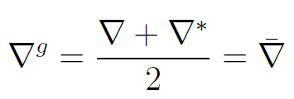
Build your own information geometry in three steps
Choose
Get dual IG
manifold
(M,g,∇,∇*)
① manifold M
② metric tensor g
③ affine connection ∇
du
dual
connection
Examples:
Gaussians
SPD cone
Probability simplex
Examples:
Fisher information metric
metric g^{D} from divergence
trace metric
Examples:
exponential connection
mixture connection
metric connection ∇^{g}
divergence connection ∇^{D}
α-connection
Concepts:
vector length
vector orthogonality
Riemannian geodesic
Riemannian distance
Levi-Civita connection ∇^{g}
chart
Concepts:
covariant derivative ∇
∇-geodesic
∇-parallel transport
curvature
Concepts:
local coordinates
locally Euclidean
Concepts:
dual connections coupled to metric g
dual parallel transport preserve metric g
Notes:
∇*=2∇^g- ∇

Slide 4




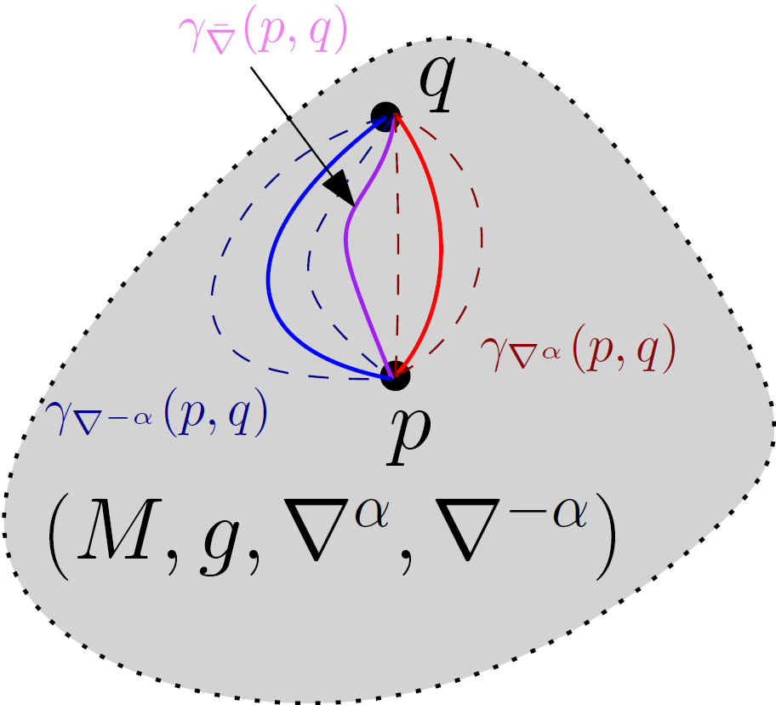




From dual information geometry to ±α-geometry, α∈ℝ
Choose
① manifold M
④ choose α
② metric tensor g
Examples:
Amari-Chentsov cubic tensor
Cubic tensor from divergence
③ affine connection ∇
by defining Christoffel symbols
Get dual IG manifold
(M,g,∇,∇*)
Get a family of dual connections/IG
(M,g,∇^{α},∇^{-α}): The ±α-geometry
Cubic
tensor
±α-geometry
0-geometry
= Riemannian geometry
with geodesic distance
Notes:
$$
\Gamma_{ijk}^\nabla
$$
$$
T_{ijk}=\Gamma_{ijk}^*-\Gamma_{ijk}
$$
$$
T_{ijk}=\nabla_i g_{jk}
$$
$$
\nabla^\alpha=\bar{\Gamma}_{ijk}-\frac{\alpha}{2}T_{ijk}
$$
$$
\nabla^{-\alpha}=\bar{\Gamma}_{ijk}+\frac{\alpha}{2}T_{ijk}
$$
$$
(M,g,\nabla^\alpha,\nabla^{-\alpha})
$$
$$
T_{ijk}(\theta)=E[\partial_i l\partial_j l\partial_k l]
$$
$$
T_{ijk}(\theta)=\partial_i \partial_j\partial_k F(\theta)
$$

Slide 5







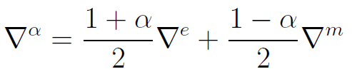
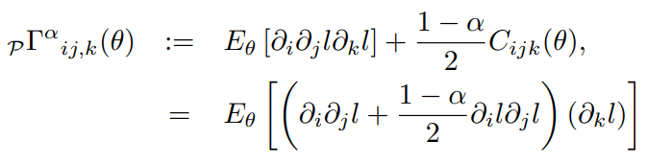
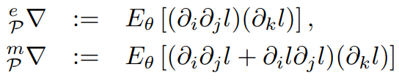
Information geometry from statistical models: (M,g^{F},∇^{-α},∇^{α})
Consider a parametric statistical/probability model:
Define metric tensor g from Fisher information = Fisher metric g^{F}
Model is regular if partial derivatives of l_{θ}(x) smooth and Fisher metric
is well-defined and positive-definite
Amari-Chentsov cubic tensor:
α-connections
Fisher-Rao geometry when α=0, get geodesic distance called Rao distance
Model Information Geometry (MIG)
covariance of the score
log-likelihood
α=1
← exponential connection (e)
α=-1
← mixture connection (m)
[Hotelling 1930]
[Rao 1945]
[Amari Nagaoka 1982]
Notes:
also called skewness tensor

Slide 6
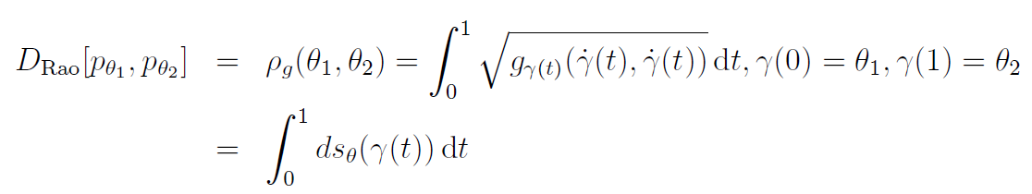
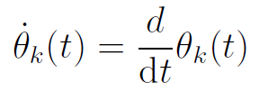
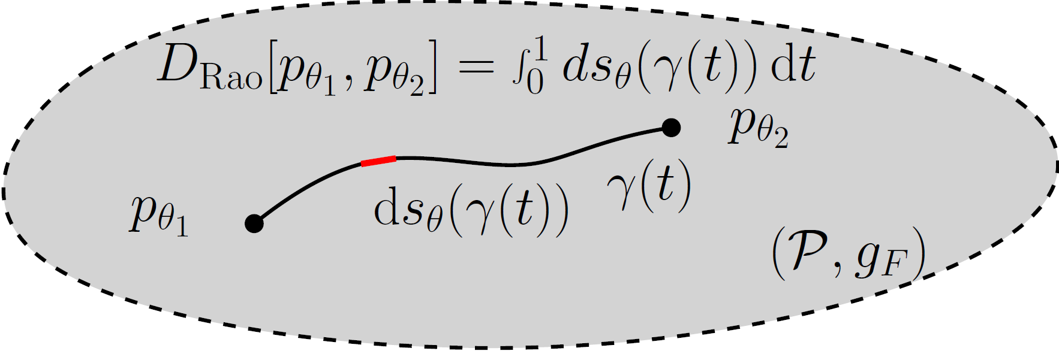
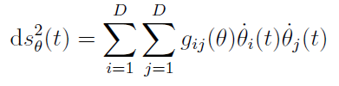
Rao distance on the Fisher-Rao manifold
Here, γ is the Riemannian geodesic
(or add a minimizer on all paths γ)
square Length element
In practice:
Need to calculate geodesics which are curves locally minimizing the length linking two endpoints (or equivalently minimize the energy of squared length elements)
Finding Fisher-Rao geodesics is a non-trivial tasks.
New in 2023: closed-form geodesics with boundary conditions for MultiVariate Normals
Fisher-Rao and pullback Hilbert cone distances on the multivariate Gaussian manifold
with applications to simplification and quantization of mixtures, ICML ws TAGML 2023
Notes:
â à é è ç ê

Slide 7


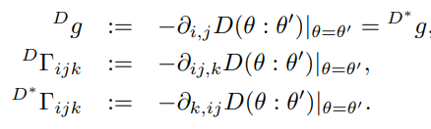




Information geometry from divergences: (M,g^{D},∇^{D},∇^{D*})
A statistical divergence like the Kullback-Leibler divergence is a smooth non-metric distance between probability measures
A statistical divergence between two densities of a statistical model is a parametric divergence (e.g., KLD between two normal distributions)
Construction of dual geometry from asymmetric parametric divergence D(θ₁:θ₂)
Dual divergence is D*(θ₁:θ₂)=D(θ₂:θ₁), reverse divergence
Divergence Information Geometry (DIG)
Hellinger divergence, chi-square divergence
f-divergence, α-divergence, etc.
[Eguchi 1983]
Dual structure:
Cubic tensor C or T:

Slide 8
Realizations of dual information geometry
Consider a statistical manifold structure (M,g,C) or equivalently (M,g,∇,∇)
Realize (M,g,∇,∇) as a divergence information geometry (M,g^{D},∇^{D},∇^{D*}):
always exists a divergence D such that (M,g,∇,∇)=(M,g^{D},∇^{D},∇^{D*})
Matumoto, "Any statistical manifold has a contrast function—On the C3-functions taking the minimum at the diagonal of the product manifold." Hiroshima Math. J 23.2 (1993)
Realize (M,g,∇,∇) as a model information geometry (M,g^{F},∇^{-α},∇^{α})
always exists a statistical model M such that (M,g,∇,∇)=(M,_{P}g^{F},_{P}∇^{-α},_{P}∇^{α})
Lê, Hông Vân. "Statistical manifolds are statistical models." Journal of Geometry 84 (2006): 83-93.

Slide 9



Equivalence: model α-IG ↔ divergence IG for f-divergences
Let P={p_{θ}} be a statistical model of probability distributions dominated by μ
Consider the f-divergence for a convex generator f(u) with f(1)=0, f'(1)=1, f''(1)=1 ← standard f-divergence (can always rescale g(u)=f(u)/f''(1))
The f-divergence between p_{θ1} and p_{θ2} is a parameter divergence D(θ₁:θ₂)
from which we can build the divergence information geometry (M,g^{D},∇^{D},∇^{D*})
Then model α-geometry for α=2 f'''(1)+3 coincide with divergence IG:
(M,g^{D},∇^{D},∇^{D*}) = (M,g^{F},∇^{-α},∇^{α}) for α=2 f'''(1)+3
metric tensor g^{D} and cubic tensor T^{D} coincides with Fisher metric g^{F} and Amari-Chentsov tensor T
Dual reverse f-divergence is a f-divergence for

Slide 10
Curvature is associated to affine connection ∇
For Riemannian structure (M,g), use default Levi-Civita connection ∇=∇^{g}
Riemannian manifolds of dim d can always be embedded into Euclidean spaces E^{D} of dim D=O(d²)
Euclidean spaces have a natural affine connection ∇=∇^{E}
images courtesy
© CNRS
Cylinder is flat, 0 curvature:
Parallel transport along a loop of a vector preserves the orientation
(PT of flat connection is path independent)
Sphere has positive constant curvature:
Parallel transport along a loop exhibits
an angle defect related to curvature
(PT is path dependent)

Slide 11
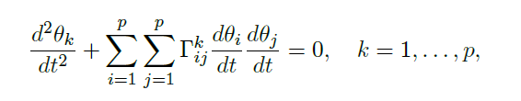
Dually flat spaces (M,g,∇,∇*)
Fundamental theorem of information geometry: If torsion-free affine connection ∇ is of constant curvature κ, then curvature of dual torsion-free affine connection ∇* is also constant κ
Corollary: if ∇ is flat (κ=0) then ∇* is flat → Dually flat space (M,g,∇,∇*)
A connection ∇ is flat if there exists a local coordinate system θ such that Γ(θ)=0
In ∇-affine coordinate system θ(.), ∇-geodesics are visualized as line segments
Γ(θ)=0
geodesics=line segments in θ

Slide 12

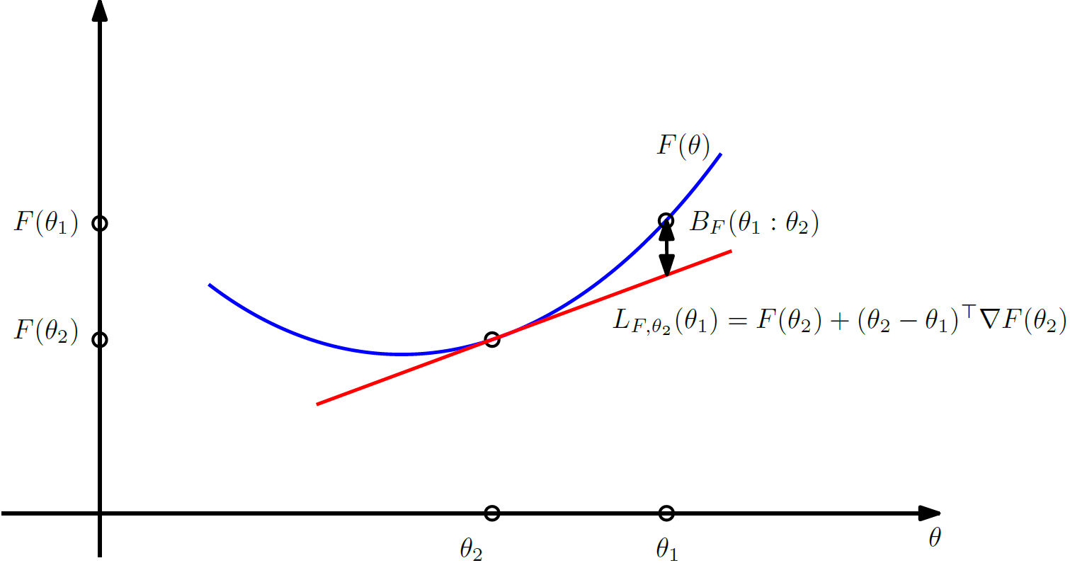
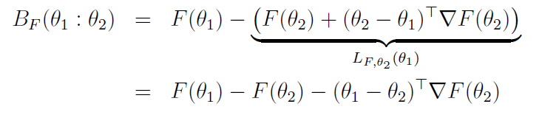
Canonical divergences of DFSs: Bregman divergences
Dually flat structure (M,g,∇,∇*) can be realized by a Bregman divergence
Let F(θ) be a strictly convex and differentiable function defined on an open convex domain ϴ
Bregman divergence interpreted as the vertical gap between
point (θ_{1,} F(θ₁)) and the linear approximation of F(θ) at θ₂ evaluated at θ₁ :
[Bregman 1967]
Notes:
â à é è ç ê

Slide 13
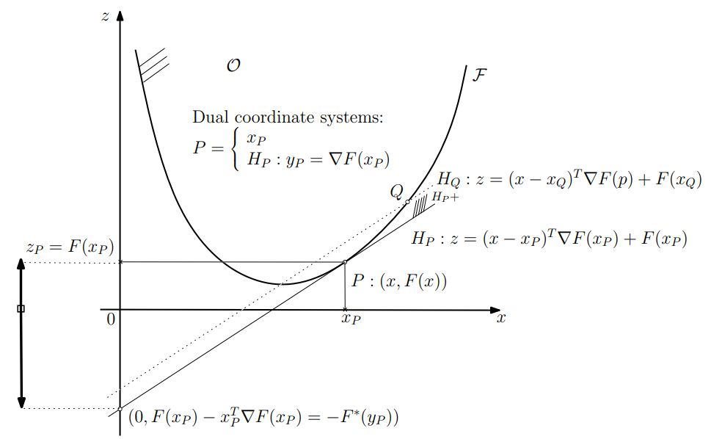
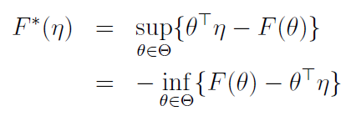
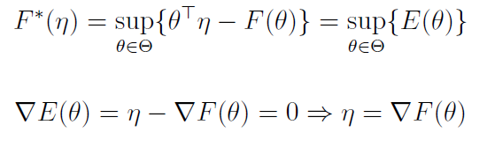

Legendre-Fenchel transformation: Slope transformation
Consider a Bregman generator of Legendre-type (proper, lower semi-continuous+condition). Then its convex conjugate obtained from the Legendre-Fenchel transformation is a Bregman generator of Legendre type.
Analogy of the Halfspace/Vertex representation of the epigraph of F
Fenchel-Moreau’s biconjugation theorem for F of Legendre-type:
Concave programming:
Epigraph
Slope
[Touchette 2005] Legendre-Fenchel transforms in a nutshell
[2010] Legendre transformation and information geometry
Notes:
proper, lower semi-continuous, and convex function,

Slide 14







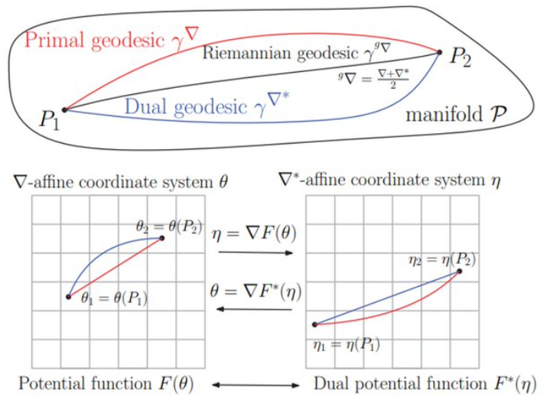
Mixed coordinates and the Legendre-Fenchel divergence
Dual Legendre-type functions
Convex conjugate of F is
Fenchel-Young inequality :
with equality holding if and only if
Fenchel-Young divergence make use of the mixed coordinate systems θ et η to express a Bregman divergence as :
Gradient
are inverse
of each other
Notes:
â à é è ç ê

Slide 15
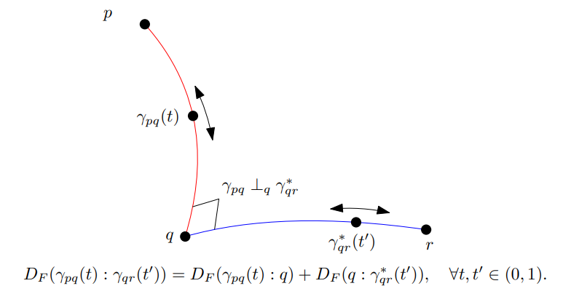

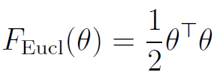

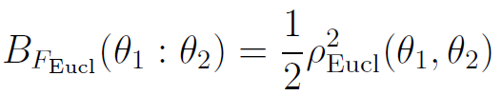
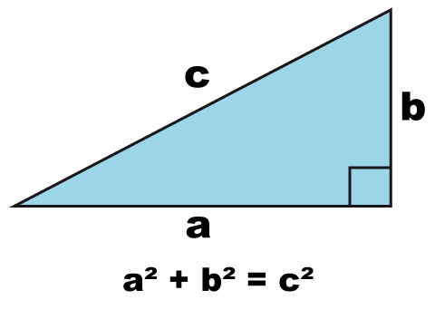
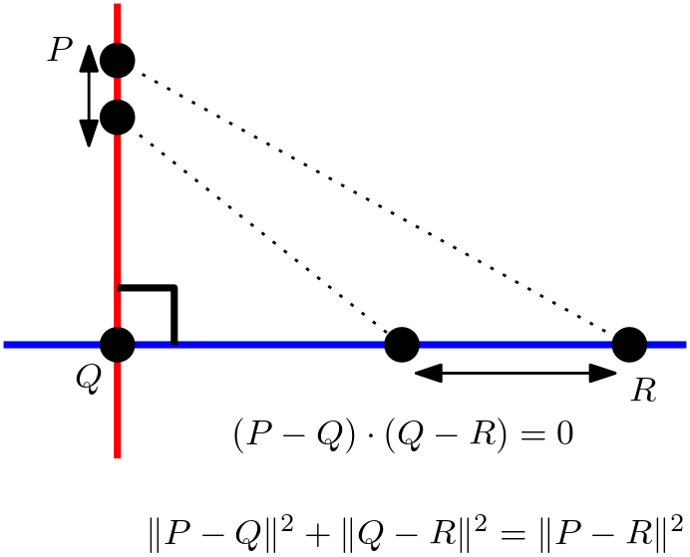
Generalized Pythagoras theorem in dually flat spaces
In general, Identity of Bregman divergence with three parameters = law of cosines
Generalized Pythagoras’ theorem
Pythagoras’ theorem in
the Euclidian geometry
(Self-dual)
orthogonality condition:
Notes:
â à é è ç ê ù û ï

Slide 16
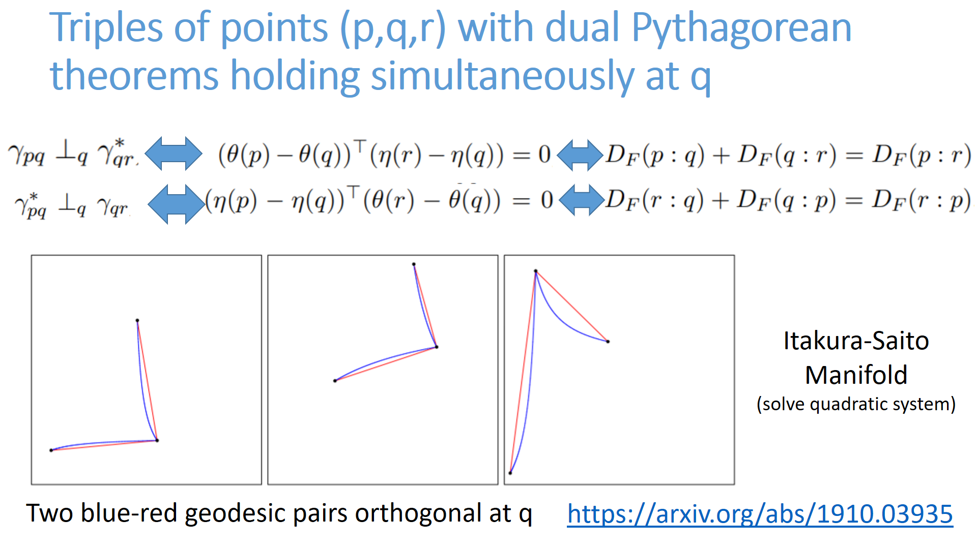
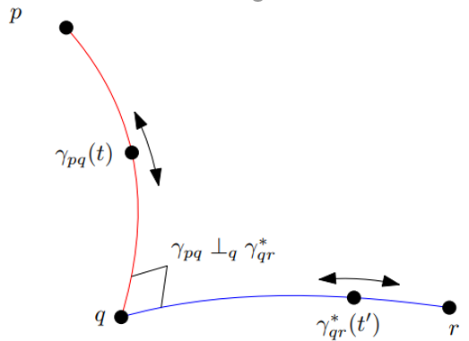

Slide 17

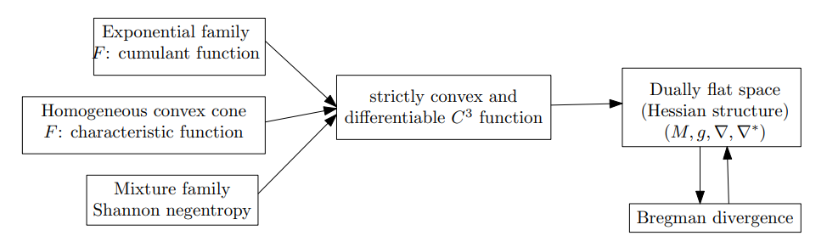


Dually flat space from a smooth strictly convex function F(θ)
A smooth strictly convex function F(θ) define a Bregman divergence and hence a dually flat space via Eguchi's divergence-based IG
Examples of DFSs induced by convex functions:
Domain
dual Bregman divergences
this direction
not unique

Slide 18
Dual geometry of information geometry: Information geometry as a tool to geometrize duality
A pair of (torsion-free) affine connections (∇,∇*) with (∇*)*=∇
Examples:
Geometrize
Objects: divergences D
duality = reverse divergence D*
(D*)*=D
(∇^{D},∇^{D*})
Geometrize
Objects: Legendre type functions F
duality = convex conjugate F*
(F*)*=F
(∇^{F},∇^{F*})
Geometrize
Type: strictly monotone functions
duality f* = reciprocal f⁻¹
(f*)*=f
(∇^{f},∇^{f*})
Geometric terminology:
dual contrast functions
dual potential functions
dual f-representations
(±α-representations)

Slide 19
Some references
Amari, Shun-ichi, and Hiroshi Nagaoka. Methods of information geometry. Vol. 191. American Mathematical Soc., 2000.
Amari, Shun-ichi. Information geometry and its applications. Vol. 194. Springer, 2016.
Calin, Ovidiu, and Constantin Udrişte. Geometric modeling in probability and statistics. Vol. 121. Berlin, Germany:: Springer, 2014.
Nielsen, Frank. "An elementary introduction to information geometry." Entropy 22.10 (2020): 1100.
Nielsen, Frank. "Legendre transformation and information geometry." no. CIG-MEMO2 (2010).
Nielsen, Frank. "On geodesic triangles with right angles in a dually flat space." Progress in Information Geometry: Theory and Applications. Springer, 2021. 153-190.

