Slide 1

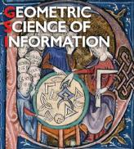
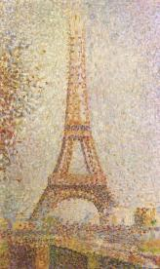
Société de l'électricité, de l'électronique et des technologies de l'information et de la communication
Geometric Science of Information
GSI’15
Frédéric BARBARESCO* & Frank Nielsen**
GSI’15 General Chairmen
(*) President of SEE SI²D Club (Signal, Image, Information & Decision)
(**) LIX Department, Ecole Polytechnique

Slide 2
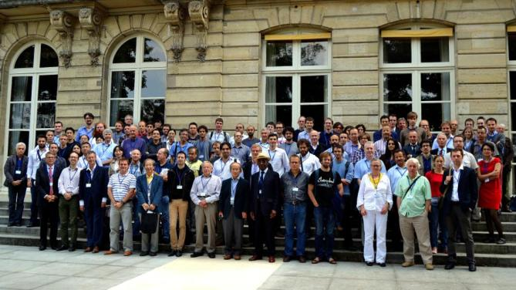
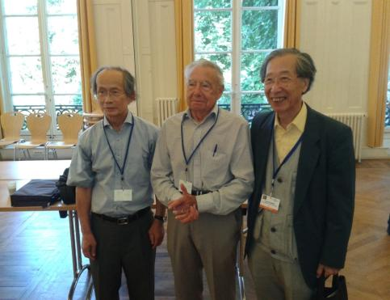
Flash-back
GSI’13 Ecole des Mines de Paris
Hirohiko Shima
Jean-Louis Koszul
Shin-Ichi Amari

Slide 3
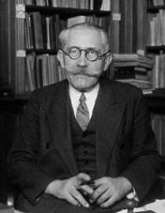
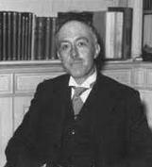
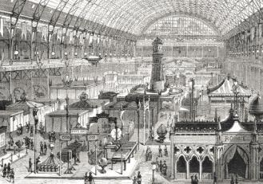


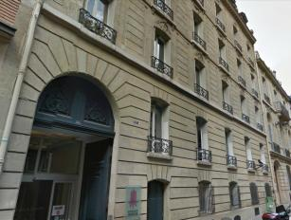
SEE at a glance
http://www.see.asso.fr/
Meeting place for science, industry and society
An officialy recognised non-profit organisation‏
About 2000 members and 5000 individuals involved
Large participation from industry (~50%)‏
19 «Clubs techniques» and 12 «Groupes régionaux»
Organizes conferences and seminars
Initiates/attracts International Conferences in France
Institutional French member of IFAC and IFIP
Awards (Glavieux/Brillouin Prize, Général Ferrié Prize, Néel Prize, Jerphagnon Prize, Blanc-Lapierre Prize,Thévenin Prize), grades and medals (Blondel, Ampère)
Publishes 3 periodical publications (REE, …)‏ & 3 monographs each year
Web: http://www.see.asso.fr and LinkedIn SEE group
SEE Presidents: Louis de Broglie, Paul Langevin, …
Paul Langevin
Louis de Broglie
1883-2015: From SIE & SFE to SEE: 132 years of Sciences
Société de l'électricité, de l'électronique et des technologies de l'information et de la communication
1883: SIE
Société Internationale des Electriciens
1886: SFE
Société Française
des Electriciens
2013: SEE
17 rue de l'Amiral Hamelin 75783 Paris Cedex 16
1881
Exposition Internationale d’Electricité

Slide 4

GSI’15 Sponsors

Slide 5
SMAI/SEE GSI’15
140 international attendees from 15 different countries
85 scientific presentations on 3 days
3 keynote speakers
  Mathilde MARCOLLI (CallTech): “From Geometry and Physics to Computational Linguistics”
  Tudor RATIU (EPFL): “Symmetry methods in geometric mechanics”
  Marc ARNAUDON (Bordeaux University): “Stochastic Euler-Poincaré reduction”
1 Short Course
  Chaired by Roger BALIAN
  Dominique SPEHNER (Grenoble University): “Geometry on the set of quantum states and quantum correlations”
1 Guest speaker
  Charles-Michel MARLE (UPMC): “Actions of Lie groups and Lie algebras on symplectic and Poisson manifolds. Application to Hamiltonian systems”
Social events:
  Welcome coktail at Ecole Polytechnique
  Diner in Versailles Palace Gardens

Slide 6
GSI’15 Topics
GSI’15 federates skills from Geometry, Probability and Information Theory:
  Dimension reduction on Riemannian manifolds
  Optimal Transport and applications in Imagery/Statistics
  Shape Space & Diffeomorphic mappings
  Random Geometry/Homology
  Hessian Information Geometry
  Topological forms and Information
  Information Geometry Optimization
  Information Geometry in Image Analysis
  Divergence Geometry
  Optimization on Manifold
  Lie Groups and Geometric Mechanics/Thermodynamics
  Computational Information Geometry
  Lie Groups: Novel Statistical and Computational Frontiers
  Geometry of Time Series and Linear Dynamical systems
  Bayesian and Information Geometry for Inverse Problems
  Probability Density Estimation

Slide 7
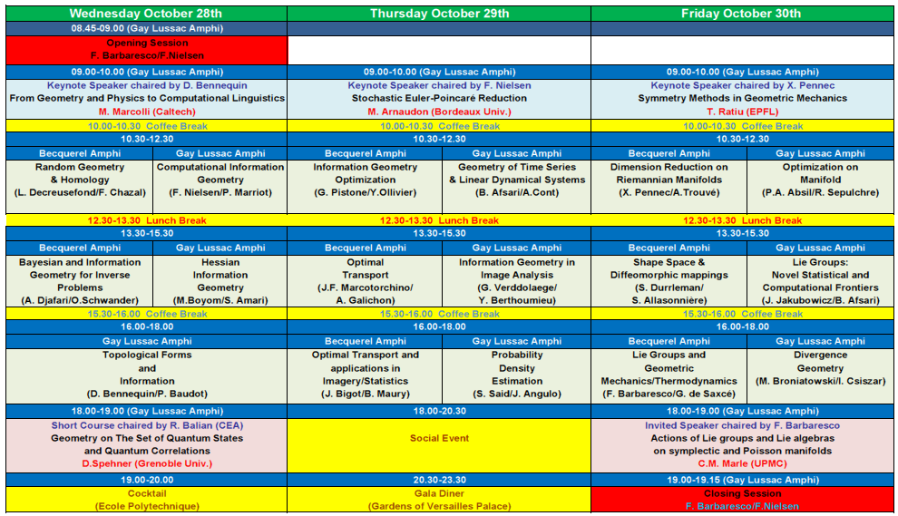
GSI’15 Program

Slide 8
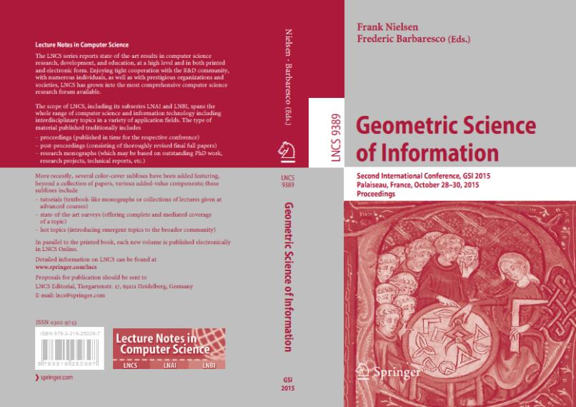
GSI’15 Proceedings
Publication by SPRINGER in « Lecture Notes in Computer Science » LNCS vol. 9389 (800 pages), ISBN 978-3-319-25039-7
http://www.springer.com/us/book/9783319250397

Slide 9


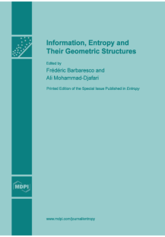
GSI’15 Special Issue
Authors will be solicited to submit a paper in a special Issue "Differential Geometrical Theory of Statistics” in ENTROPY Journal, an international and interdisciplinary open access journal of entropy and information studies published monthly online by MDPI
http://www.mdpi.com/journal/entropy/special_issues/entropy-statistics
A book could be edited by MDPI: e.g.

Slide 10


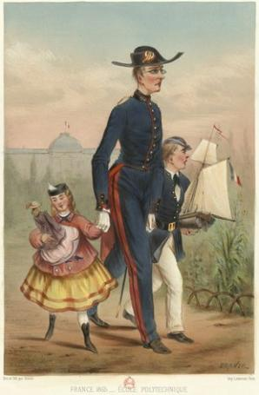
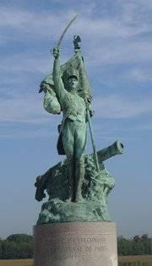
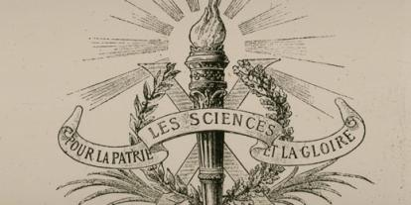
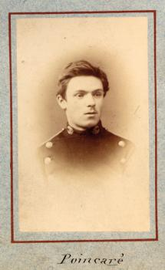
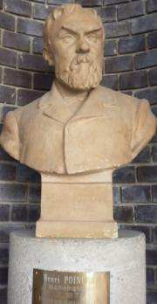
Ecole Polytechnique
Special thanks to « LIX » Department
A product of the French Revolution and the Age of Enlightenment, École Polytechnique has a rich history that spans over 220 years.
https://www.polytechnique.edu/en/history
Henri Poincaré – X1873

Slide 11
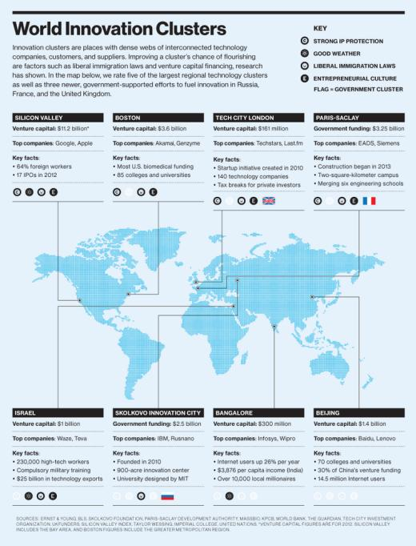
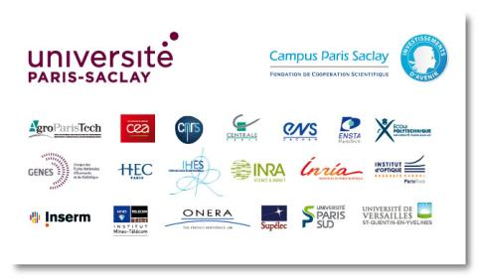
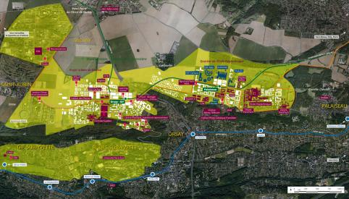
Paris-Saclay University
in Top 8 World Innovation Hubs
http://www.technologyreview.com/news/517626/infographic-the-worlds-technology-hubs/

Slide 12
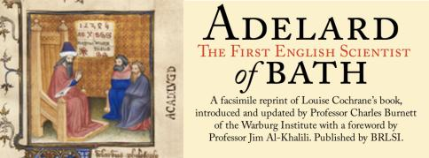
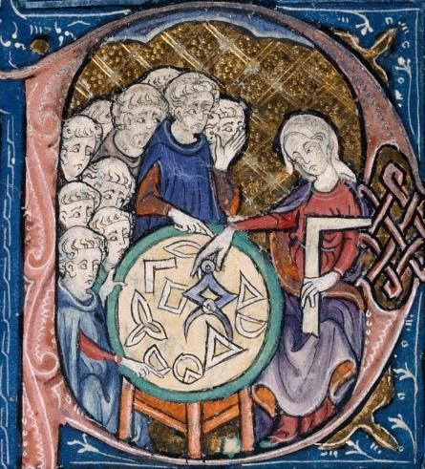
Adelard of Bath
He left England toward the end of the 11th century for Tours.
Adelard taught for a time at Laon, leaving Laon for travel no later than 1109.
After Laon, he travelled to Southern Italy and Sicily no later than 1116.
Adelard also travelled extensively throughout the "lands of the Crusades": Greece, West Asia, Sicily, Spain, and potentially Palestine.
Adelard of Bath was the first to translate Euclid’s Elements in Latin
Adelard of Bath has introduced the word « Algorismus » in Latin after his translation of Al Khuwarizmi
The frontispiece of an Adelard of Bath Latin translation of Euclid's Elements, c. 1309–1316; the oldest surviving Latin translation of the Elements is a 12th-century translation by Adelard from an Arabic version

Slide 13
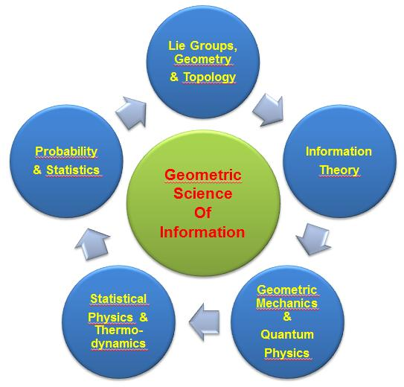
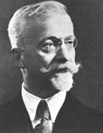
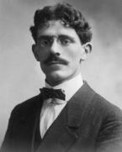
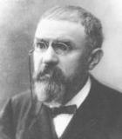
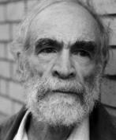
A new Grammar of Information
GROUP
EVERYWHERE
METRIC
EVERYWHERE
Elie Cartan
Maurice Fréchet
Henri Poincaré
Misha Gromov
“Mathematics is the art of giving the same name to different things” – Henri Poincaré

Slide 14
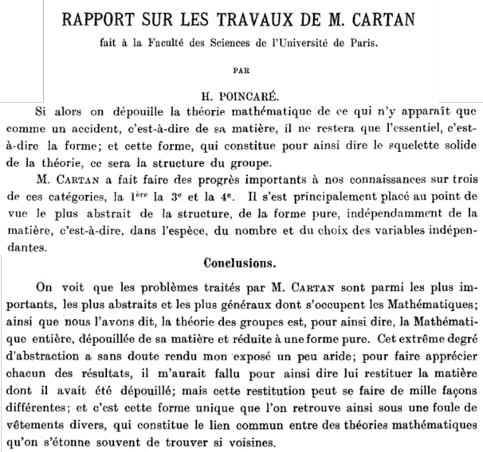
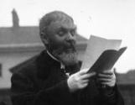
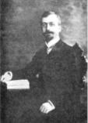
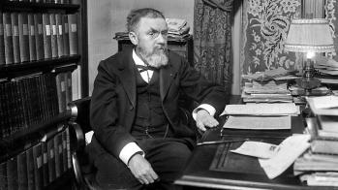
Elie Cartan: Group Everywhere
(Henri Poincaré review of Cartan’s Works)
“the problems addressed by Elie Cartan are among the most important, most abstract and most general dealing with mathematics; group theory is, so to speak, the whole mathematics, stripped of its material and reduced to pure form. This extreme level of abstraction has probably made my presentation a little dry; to assess each of the results, I would have had virtually render him the material which he had been stripped; but this refund can be made in a thousand different ways; and this is the only form that can be found as well as a host of various garments, which is the common link between mathematical theories that are often surprised to find so near”
H. Poincaré

Slide 15
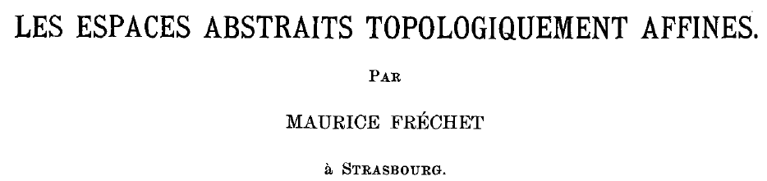
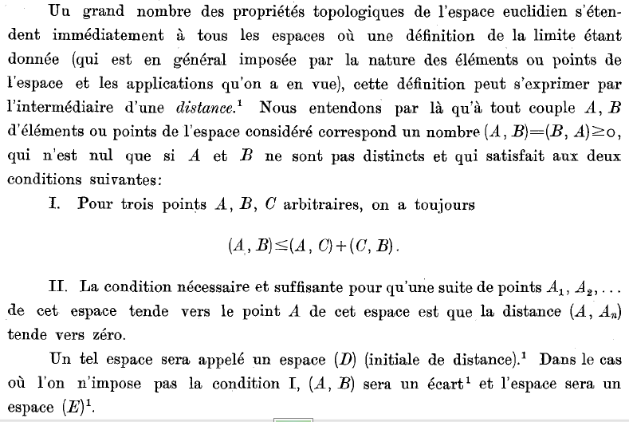
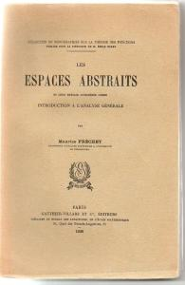
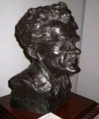
Maurice Fréchet:
Metric Everywhere
Maurice Fréchet made major contributions to the topology of point sets and introduced the entire concept of metric spaces.
His dissertation opened the entire field of functionals on metric spaces and introduced the notion of compactness.
He has extended Probability in Metric space
1948 (Annales de l’IHP)
Les éléments aléatoires de nature quelconque
dans un espace distancié
Extension of Probability/Statistic in abstract/Metric space

Slide 16
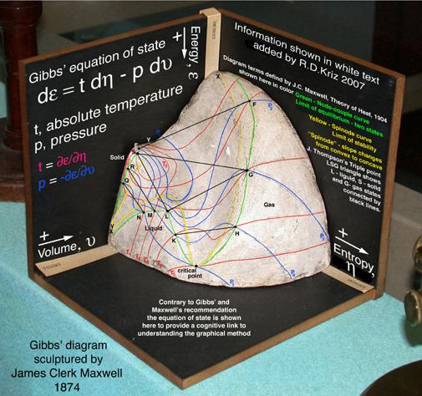
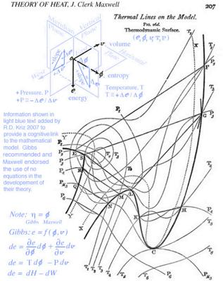
Geometric Thermodynamics
& Statistical Physics

Slide 17
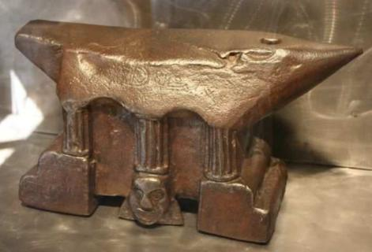

GSI’15 & Geometric Mechanics
The master of geometry during the last century, Elie Cartan, was the son of Joseph Cartan who was the village blacksmith.
Elie recalled that his childhood had passed under “blows of the anvil, which started every morning from dawn”.
We can imagine easily that the child, Elie Cartan, watching his father Joseph “coding curvature” on metal between the hammer and the anvil, insidiously influencing Elie’s mind with germinal intuition of fundamental geometric concepts.
The etymology of the word “Forge”, that comes from the late XIV century, “a smithy”, from Old French forge “forge, smithy” (XII century), earlier faverge, from Latin fabrica “workshop, smith’s shop”, from faber (genitive fabri) “workman in hard materials, smith”.
ANVIL = Curvature Libraries
HAMMER = The Coder

Slide 18
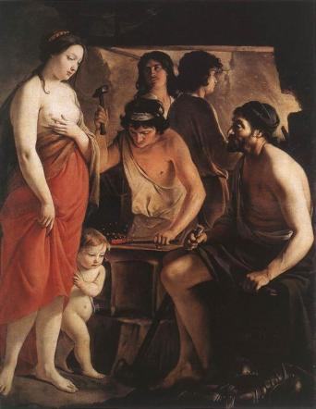
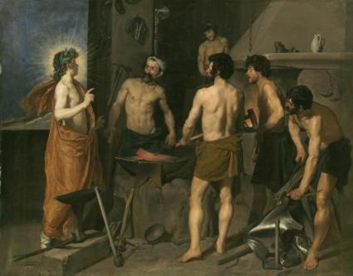
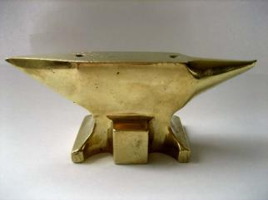
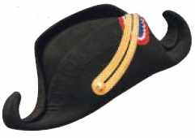
From Homo Sapiens to Homo Faber
“Intelligence is the faculty of manufacturing artificial objects, especially tools to make tools, and of indefinitely varying the manufacture.”
Henri Bergson
Venus at the Forge of Vulcan, Le Nain Brothers, Musée Saint-Denis, Reims
Into the Flaming Forge of Vulcan,
Diego Velázquez, Museo Nacional del Prado
Bigorne
Bicorne

Slide 19
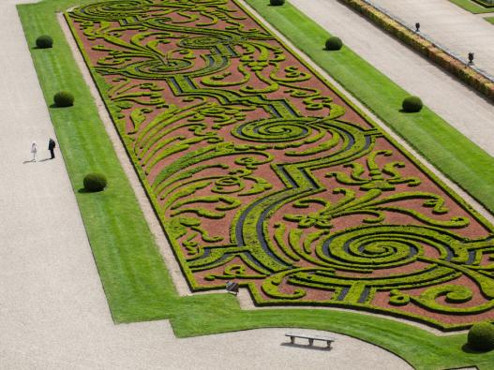
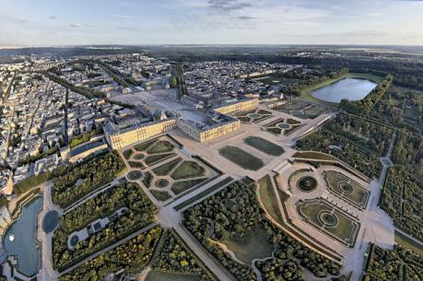
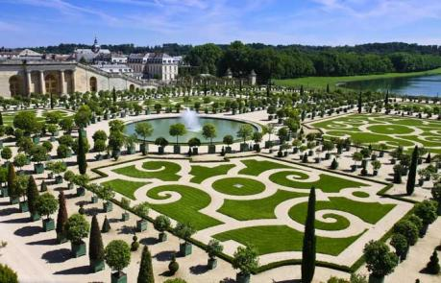
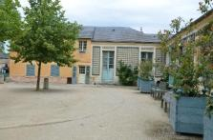
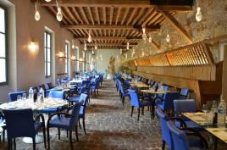
Enjoy all « Geometries »
(Diner at Versailles Palace Gardens)
Restaurant of
GSI’15 Gala Diner

Slide 20
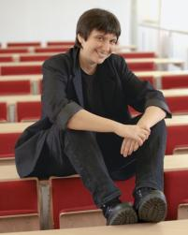
Keynote Speakers
Prof. Mathilde MARCOLLI (CALTECH, USA)
From Geometry and Physics to Computational Linguistics
Abstact: I will show how techniques from geometry (algebraic geometry and topology) and physics (statistical physics) can be applied to Linguistics, in order to provide a computational approach to questions of syntactic structure and language evolution, within the context of Chomsky's Principles and Parameters framework.
Biography:
Laurea in Physics, University of Milano, 1993
Master of Science, Mathematics, University of Chicago, 1994
PhD, Mathematics, University of Chicago, 1997
Moore Instructor, Massachusetts Institute of Technology, 1997-2000
Associate Professor (C3), Max Planck Institute for Mathematics, 2000-2008
Professor, California Institute of Technology, 2008-present
Distinguished Visiting Research Chair, Perimeter Institute for Theoretical Physics, 2013-present
.
Talk chaired by
Daniel Bennequin

Slide 21
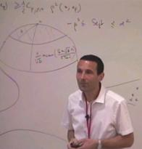
Keynote Speakers
Prof. Marc ARNAUDON (Bordeaux University, France)
Stochastic Euler-Poincaré reduction
Abstact: We will prove a Euler-Poincaré reduction theorem for stochastic processes taking values in a Lie group, which is a generalization of the Lagrangian version of reduction and its associated variational principles. We will also show examples of its application to the rigid body and to the group of diffeomorphisms, which includes the Navier-Stokes equation on a bounded domain and the Camassa-Holm equation.
Biography:
Marc Arnaudon was born in France in 1965. He graduated from Ecole Normale Supérieure de Paris, France, in 1991. He received the PhD degree in mathematics and the Habilitation à diriger des Recherches degree from Strasbourg University, France, in January 1994 and January 1998 respectively. After postdoctoral research and teaching at Strasbourg, he began in September 1999 a full professor position in the Department of Mathematics at Poitiers University, France, where he was the head of the Probability Research Group. In January 2013 he left Poitiers and joined the Department of Mathematics of Bordeaux University, France, where he is a full professor in mathematics.
Talk chaired by
Frank Nielsen

Slide 22
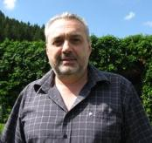
Keynote Speakers
Prof. Tudor RATIU (EPFL, Switzerland)
Symmetry methods in geometric mechanics
Abstact: The goal of these lectures is to show the influence of symmetry in various aspects of theoretical mechanics. Canonical actions of Lie groups on Poisson manifolds often give rise to conservation laws, encoded in modern language by the concept of momentum maps. Reduction methods lead to a deeper understanding of the dynamics of mechanical systems. Basic results in singular Hamiltonian reduction will be presented. The Lagrangian version of reduction and its associated variational principles will also be discussed. The understanding of symmetric bifurcation phenomena in for Hamiltonian systems are based on these reduction techniques. Time permitting, discrete versions of these geometric methods will also be discussed in the context of examples from elasticity.
Biography:
BA in Mathematics, University of Timisoara, Romania, 1973
MA in Applied Mathematics, University of Timisoara, Romania, 1974
Ph.D. in Mathematics, University of California, Berkeley, 1980
T.H. Hildebrandt Research Assistant Professor, University of Michigan, Ann Arbor, USA 1980-1983
Associate Professor of Mathematics, University of Arizona, Tuscon, USA 1983-1988
Professor of Mathematics, University of California, Santa Cruz, USA, 1988-2001
Chaired Professor of Mathematics, Ecole Polytechnique Federale de Lausanne, Switzerland, 1998 - present
Professor of Mathematics, Skolkovo Institute of Science and Technonology, Moscow, Russia, 2014 - present
Talk chaired by
Xavier Pennec

Slide 23
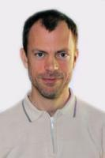

Short Course
Prof. Dominique SPEHNER (Grenoble University)
Geometry on the set of quantum states and quantum correlations
Abstact: I will show that the set of states of a quantum system with a finite-dimensional Hilbert space can be equipped with various Riemannian distances having nice properties from a quantum information viewpoint, namely they are contractive under all physically allowed operations on the system. The corresponding metrics are quantum analogs of the Fisher metric and have been classified by D. Petz. Two distances are particularly relevant physically: the Bogoliubov-Kubo-Mori distance studied by R. Balian, Y. Alhassid and H. Reinhardt, and the Bures distance studied by A. Uhlmann and by S.L. Braunstein and C.M. Caves. The latter gives the quantum Fisher information playing an important role in quantum metrology. A way to measure the amount of quantum correlations (entanglement or quantum discord) in bipartite systems (that is, systems composed of two parties) with the help of these distances will be also discussed.
Biography:
Diplôme d'Études Approfondies (DEA) in Theoretical Physics at the École Normale Supérieure de Lyon, 1994
Civil Service (Service National de la Coopération), Technion Institute of Technology, Haifa, Israel, 1995-1996
PhD in Theoretical Physics, Université Paul Sabatier, Toulouse, France, 1996-2000.
Postdoctoral fellow, Pontificia Universidad Católica, Santiago, Chile, 2000-2001
Research Associate, University of Duisburg-Essen, Germany, 2001-2005
Maître de Conférences, Université Joseph Fourier, Grenoble, France, 2005-present
Habilitation à diriger des Recherches (HDR), Université Grenoble Alpes, 2015
Member of the Institut Fourier (since 2005) and the Laboratoire de Physique et Modélisation des Milieux Condensés (since 2013) of the university Grenoble Alpes, France
Talk chaired by
Roger Balian

Slide 24


Guest Speakers
Prof. Charles-Michel MARLE (UPMC, France)
Actions of Lie groups and Lie algebras on symplectic and Poisson manifolds. Application to Hamiltonian systems
Abstact: I will present some tools in Symplectic and Poisson Geometry in view of their applications in Geometric Mechanics and Mathematical Physics. Lie group and Lie algebra actions on symplectic and Poisson manifolds, momentum maps and their equivariance properties, first integrals associated to symmetries of Hamiltonian systems will be discussed. Reduction methods taking advantage of symmetries will be discussed.
Biography:
Charles-Michel Marle was born in 1934; He studied at Ecole Polytechnique (1953-1955), Ecole Nationale Supérieure des Mines de Paris (1957-1958) and Ecole Nationale Supérieure du Pétrole et des Moteurs (1957-1958).
He obtained a doctor's degree in Mathematics at the University of Paris in 1968. From 1959 to 1969 he worked as a research engineer at the Institut Français du Pétrole. He joined the Université de Besançon as Associate Professor in 1969, and the Université Pierre et Marie Curie, first as Associate Professor (1975) and then as full Professor (1981). His resarch works were first about fluid flows through porous media, then about Differential Geometry, Hamiltonian systems and applications in Mechanics and Mathematical Physics.
Talk chaired by
Frédéric
Barbaresco

