Slide 1


Curved representational Bregman divergences and their applications
Frank Nielsen
Sony Computer Science Laboratories, Inc.
Geometric Science of Information
2025

Slide 2


Bregman divergences (1960’s)
F: Θ⊆ℝ^{m}→ℝ a strictly convex and smooth
real-valued function on a finite dim. Hilbert space <.,.>
Bregman divergence B_{F}: Θ x RelInt(Θ) →ℝ_{≥0}
Lev M. Bregman
(1941 - 2023)
Photo: courtesy of
Alexander Fradkov
B_{F}(θ₁ : θ₂)=F(θ₁)-F(θ₂)-< θ₁ - θ_{2 ,} ∇F(θ₂) >
Smooth measure of discrepancy, not a metric distance because it violates the triangle inequality, and it is asymmetric when F is not quadratic function. Hence the delimiter notation “:” instead of B_{F}(θ₁ , θ₂)
BD interpreted as remainder of a first order Taylor expression of F(θ₁) around θ₂:
F(θ₁)=F(θ₂)+< θ₁ - θ_{2 ,} ∇F(θ₂) >+ B_{F}(θ₁ : θ₂)
Taylor remainder
Example of remainder: Lagrange remainder (smooth C² generators): ∇²F SPD ⇒ B_{F}(θ₁ : θ₂) ≥ 0
B_{F}(θ₁ : θ₂)= ½ (θ₂- θ₁)^{T} ∇²F(θ) (θ₂- θ₁) ≥0 , θ ∈ [θ₁ θ₂]
Notes:
https://en.wikipedia.org/wiki/Mathematical_operators_and_
ℝ
symbols_in_Unicode
Θθ∇≻ξ∈
http://lib.physcon.ru/doc?id=5d34ad008433
Σ
Lev Meerovich Bregman
(1941 - 2023)

Slide 3
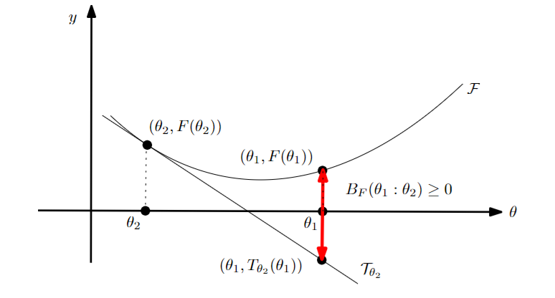
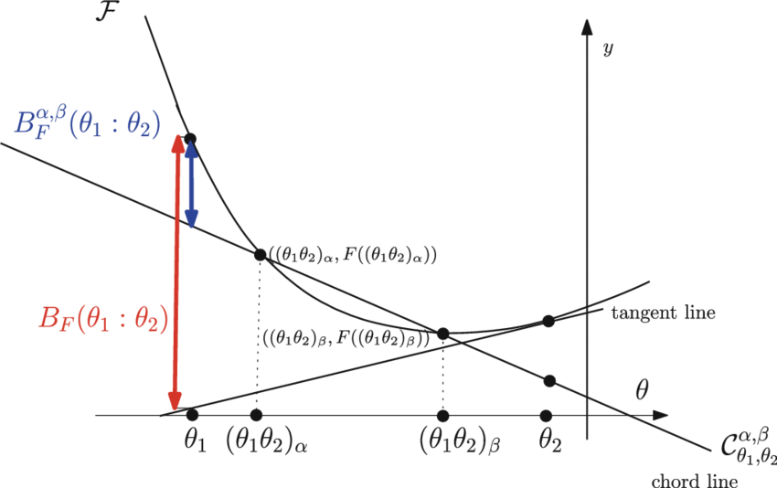
Geometric interpretation as a vertical gap using the graph (θ,F(θ)):
B_{F}(θ₁ : θ₂)=F(θ₁) - (F(θ₂)+< θ₁ - θ_{2 ,} ∇F(θ₂) >)
= T_{θ2}(θ₁) : Tangent of the function graph at θ₂ evaluated at θ₁
Design novel divergences from graph of convex functions…
Example: Bregman chord divergence, application: zero-order optimization in ML
The chord gap divergence and a generalization of the Bhattacharyya distance, IEEE ICASSP 2018

Slide 4
Kullback-Leibler divergence between multivariate normal distributions…

Slide 5
Bregman divergences in machine learning…
Kullback-Leibler divergence between two probability densities:
D_{KL}[p(x):q(x)]= ∫ p(x) log (p(x)/q(x)) dμ(x)
is difficult to calculate in closed form because of the integral ∫ …
But Kullback-Leibler divergence between two probability densities of a natural exponential family
amount to a reverse Bregman divergence B_{F}^{rev}(θ₁ : θ₂):= B_{F}(θ₂ : θ₁)
D_{KL}[p(x|θ₁) : p(x|θ₂) ] = B_{F}^{rev}(θ₁ : θ₂) = B_{F}(θ₂ : θ₁)
⇒ Easy calculations of KLDs
with densities p(x| θ) ∝ exp(<x, θ >)
Bypass the ∫, ∇F in BD easy to calculate!
Azoury, Katy S., and Manfred K. Warmuth. "Relative loss bounds for on-line density estimation with the exponential family of distributions." Machine learning 43 (2001)
Notes:
∫μ
∇F easy!
Information geometry proves that B_{F}(θ₁ : θ₂)= D_{KL}*[p(x|θ₁) : p(x|θ₂) ]
when F(θ)=log ∫ exp(<x, θ >) dμ(x) where D_{KL}*[p(x):q(x)]:= D_{KL}[q(x):p(x)] is the reverse Kullback-Leibler divergence

Slide 6
Representational Bregman divergences (2009)
Use a representation function R :
B_{F,R}(λ ₁ : λ ₂):= B_{F}(R(λ ₁ ):R(λ ₂))
= F(R(λ ₁))-F(R(λ ₂))-< R(λ ₁)–R(λ ₂ ),∇F(R(λ ₂) ) >
Note that F∘R may not be a Bregman generator, i.e., not be strictly convex.
For example, consider the KLD between two densities of a generic exponential family (natural parameter from representation function)
θ(λ ): natural parameter corresponding to λ, representation function R(.)=θ(. )
include normal, Gamma/Beta, Wishart, Poisson, etc.
D_{KL}[p(x| λ ₁) : p(x| λ ₂) ] = B_{F}^{rev}(θ (λ ₁): θ (λ ₂))=B_{F}(θ (λ ₂): θ (λ ₁))
NEF density p(x| θ) ∝ exp(<x, θ >)
D_{KL}[p(x|θ₁) : p(x|θ₂) ] = B_{F}^{rev}(θ₁ : θ₂) = B_{F}(θ₂ : θ₁)
Notes:
Λ
A *representational Bregman divergence* is a Bregman divergence applied on a representation of the parameter space.
The α-divergences extended positive measures are an example of representational Bregman divergences.
Dual representational Fenchel-Young divergence with dual representation function
But restricted to the (m-1)-dimensional probability simplex is not a
Nielsen, Frank, and Richard Nock.
"The dual Voronoi diagrams with respect to representational Bregman divergences." IEEE ISVD 2009

Slide 7
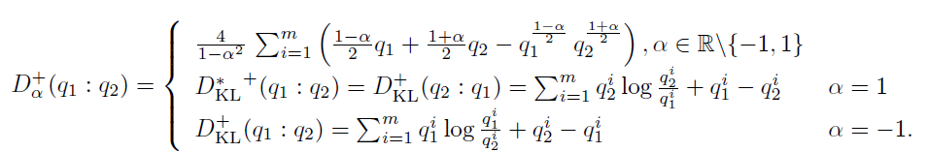



Extendedα-divergences are representational BDs
α-divergences extended to m-dimensional positive measures
are representational Bregman divergences:
Bregman generator:
Representation function:
Bregman divergence:
B_{F}(θ₁ : θ₂)=F(θ₁)-F(θ₂)-< θ₁ - θ_{2 ,} ∇F(θ₂) >
"The dual Voronoi diagrams with respect to representational Bregman divergences." IEEE ISVD 2009

Slide 8
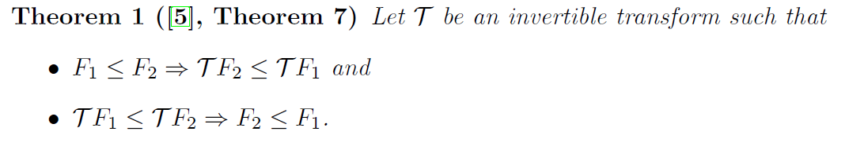
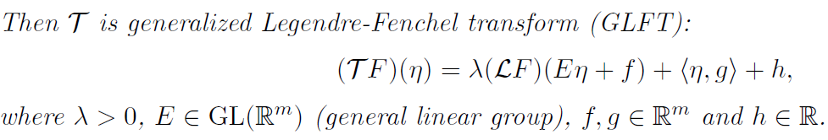

Generalized Artstein-Avidan—Milman Legendre transforms
where
is the Legendre-Fenchel transform
Shiri Artstein-Avidan and Vitali Milman. The concept of duality in convex analysis, and the
characterization of the Legendre transform. Annals of mathematics, 169:661–674, 2009.

Slide 9
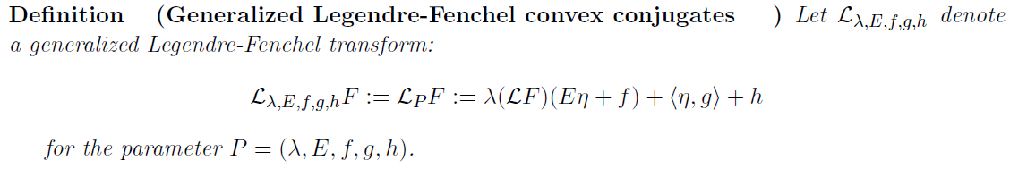



Generalized Artstein-Avidan—Milman Legendre transforms
where
Affine-deformed convex functions of both argument and returned value remain convex:
arXiv:2507.20577

