Slide 1

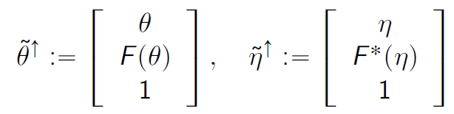
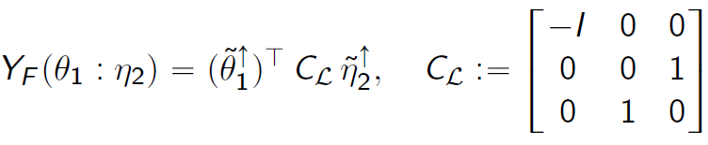
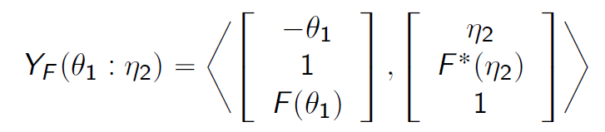
Fenchel-Young divergence interpreted as matrix-vector/inner product operations (GPU friendly)
F a Legendre-type strictly convex function with convex conjugate F*
Fenchel-Young divergence:
Homogeneous vectors of points on the graphs of potential functions:
Rewrite FY divergence using matrix vector/inner products (GPU):
(stems from polarity viewpoint)
Neural Legendre-Fenchel transform with Hessian Preconditioning, arXiv: 2606.09077

Slide 2
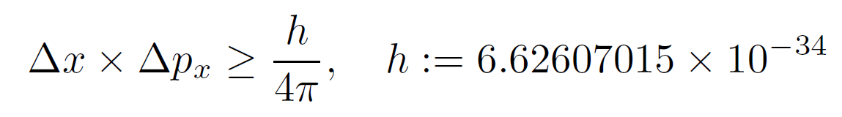
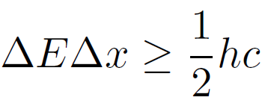
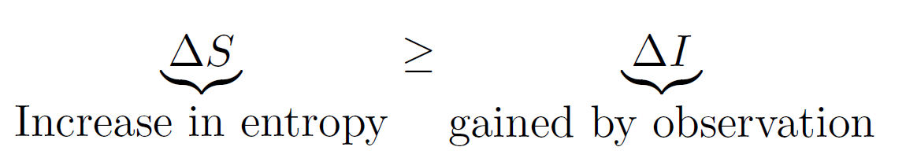
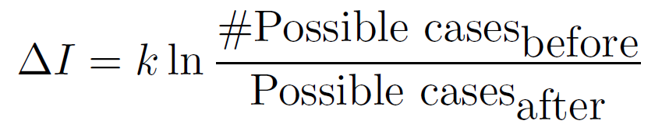

Brillouin’s negentropy principle of information
Heisenberg’s uncertainty principle
Precision in x:
requires energy
Negentropy principle of information
k=1.380649 × 10⁻²³
Observations are irreversible processes:
Energy must be degraded into heat when observing.
Observation apparatus makes a coupling with the environment
Strict causality should be replaced with statistical probabilities
Brillouin, Leon. "The negentropy principle of information." Journal of Applied Physics 24.9 (1953): 1152-1163.
Notes:
$$\Delta x \times \Delta p_x \geq \frac{h}{4\pi},\quad h := 6.62607015\times 10^{-34}$$$$\Delta I=k \ln \frac{\#\mbox{Possible cases}_{\mbox{before}}}{\mbox{Possible cases}_{\mbox{after}}}$$$$\underbrace{\Delta S}_{\mbox{Increase in entropy}} \geq \underbrace{\Delta I}_{\mbox{gained by observation}}$$$$\Delta E \Delta x\geq \frac{1}{2} hc$$
$$ΔI+ΔN≤0, ΔN=−ΔS$$
$$ΔI+ΔN≤0, ΔN=−ΔS$$

Slide 3
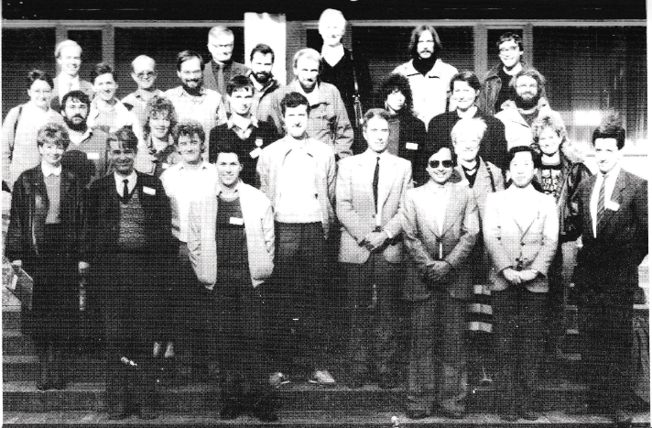
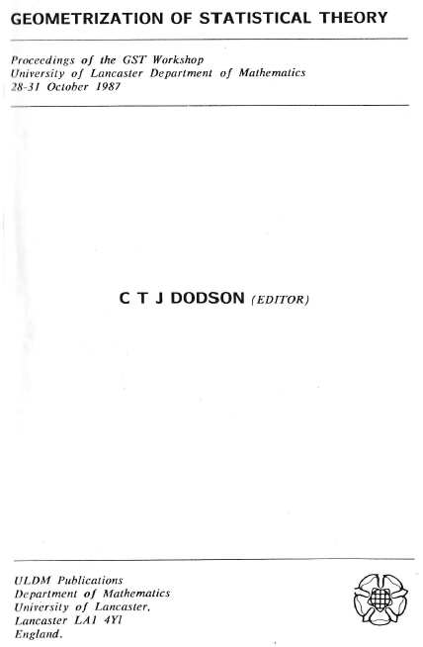
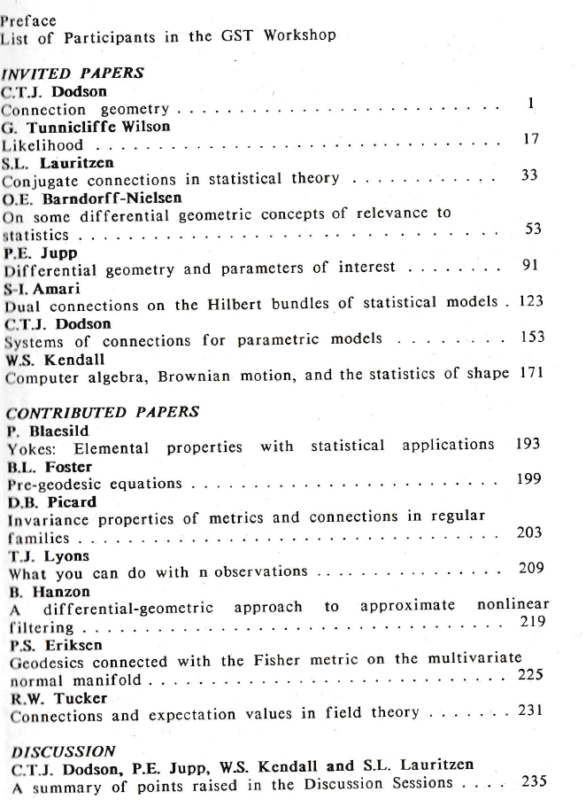
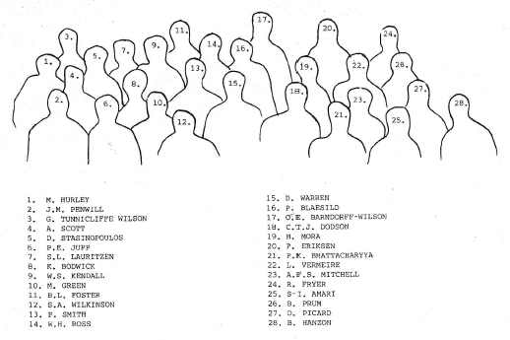

Slide 4
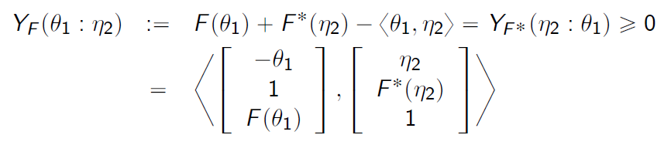
Fenchel-Young divergences as inner products (GPU)
F a Legendre-type strictly convex function with convex conjugate F*, (F*)*=F
Fenchel-Young divergences are equivalent to Bregman divergences:
Geometric interpretation: Legendre transform considered as a polarity
are homogeneous vectors of
points on the graphs of potential functions
where
Neural Legendre-Fenchel transform with Hessian Preconditioning, arXiv: 2606.09077

Slide 5
