Slide 2
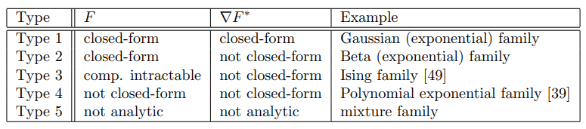
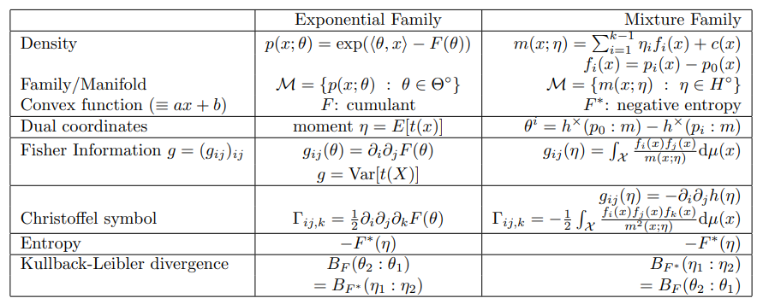
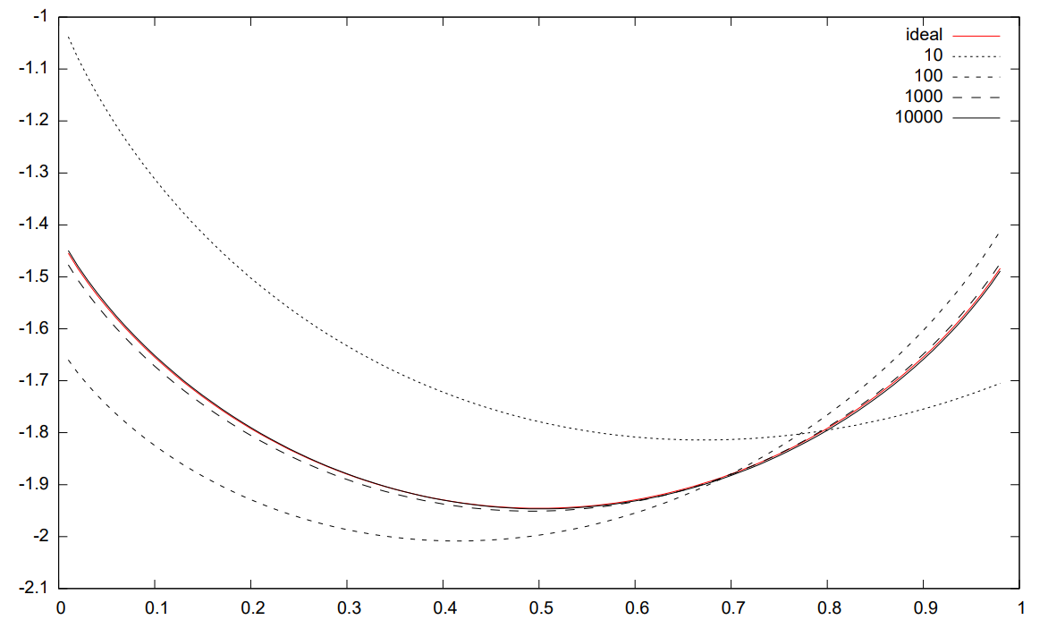
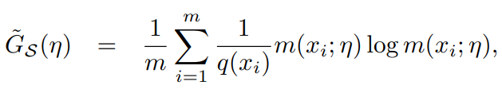
Neural information geometry?
Random IG: Monte Carlo generators
https://arxiv.org/abs/1803.07225
Notes:
https://arxiv.org/pdf/math/0612041

Slide 3
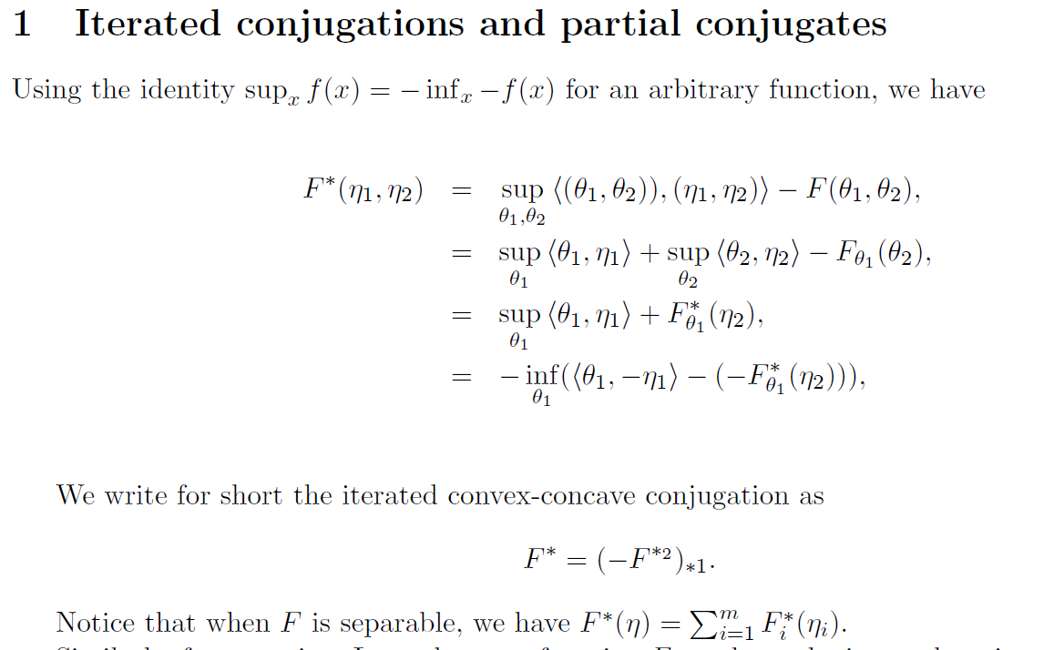

Slide 4
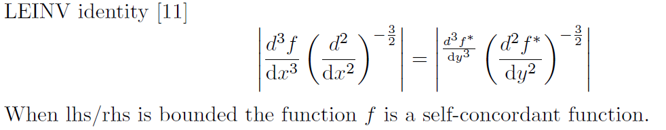
Notes:
Dual Bregman divergences with mixed parameterizations and
partial conjugates

Slide 5
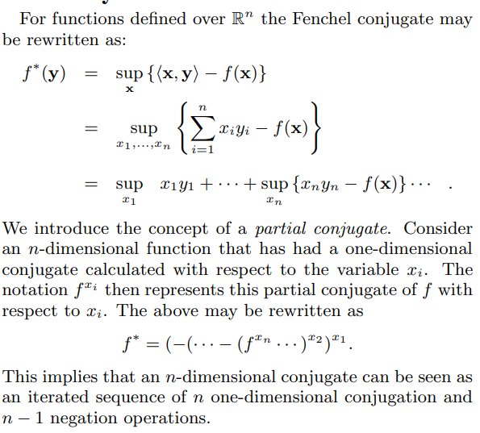
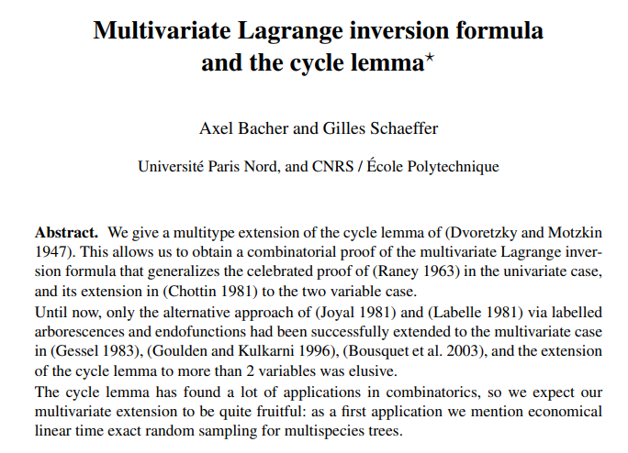
Partial Legendre transform
Notes:
https://hal.science/hal-00989632/document

Slide 6
Problem: How to simultaneously learn/approximate a pair of convex conjugate functions?
Notes:
https://arxiv.org/abs/1609.05988
The Partial Legendre Transformation
for Plurisubharmonic Functions

Slide 8
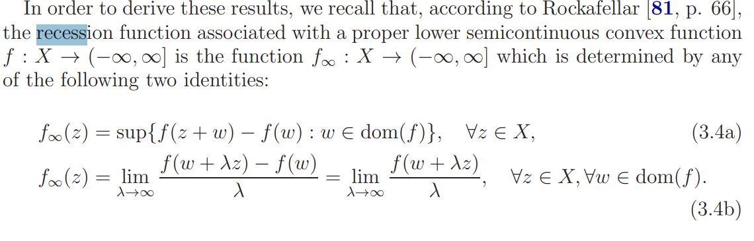
Recession function, recession cone
Notes:
https://arxiv.org/pdf/1610.01871
https://ocw.mit.edu/courses/6-253-convex-analysis-and-optimization-spring-2012/69136e797daa75d9481c21d1f6b84a31_MIT6_253S12_lec05.pdf
Hilbert’s projective metric on Lorenz cones and Birkhoff formula for Lorentzian compressions

Slide 9
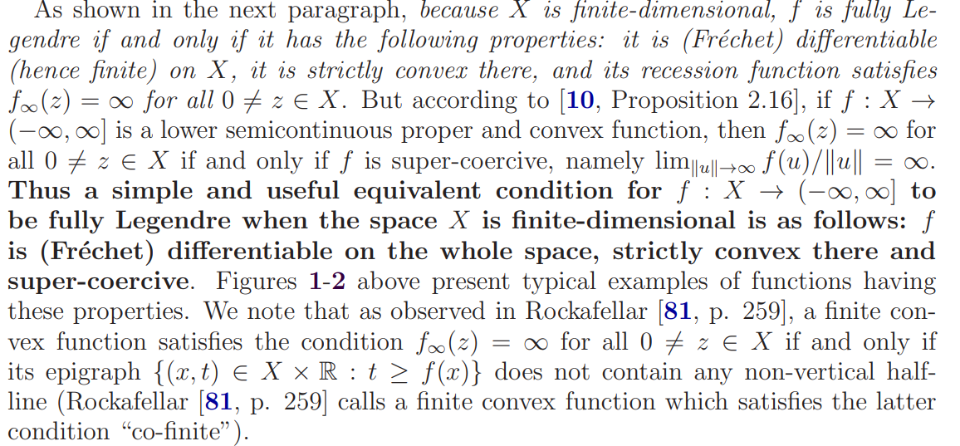

Slide 10
