Slide 1
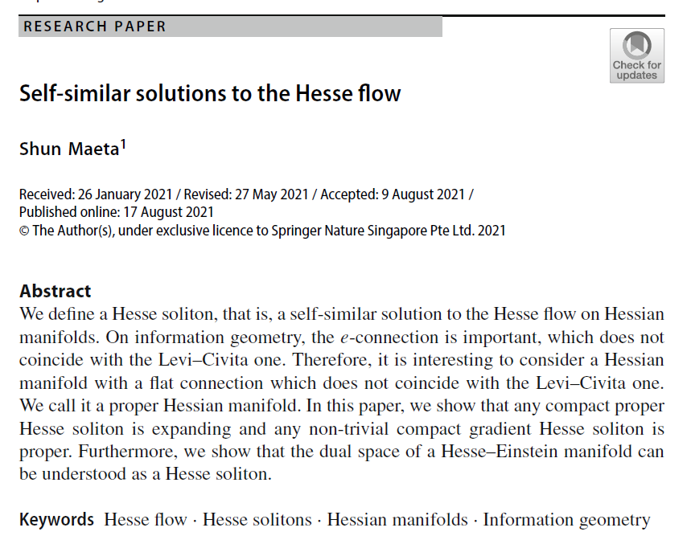

Volume 4
Issue 2
Article 36
Notes:
Self-similar solutions to the Hesse flow
https://link.springer.com/article/10.1007/s41884-021-00054-6

Slide 2
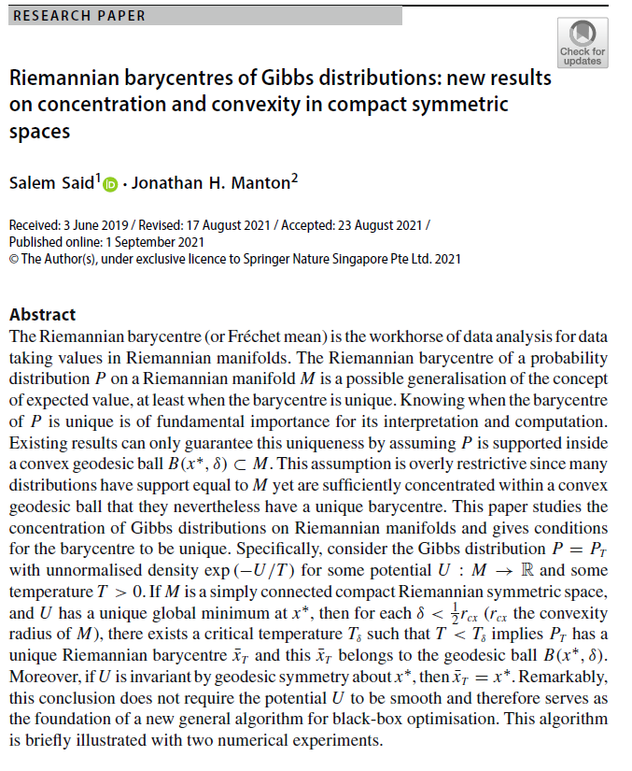
Volume 4
Issue 2
Article 37
Riemannian barycentres of Gibbs distributions: new results on concentration and convexity in compact symmetric spaces
Notes:
Riemannian barycentres of Gibbs distributions: new results on concentration and convexity in compact symmetric spaces

Slide 3

Volume 4
Issue 2
Article 38
Notes:
The Bonnet theorem for statistical manifolds
https://link.springer.com/article/10.1007/s41884-021-00056-4

Slide 4
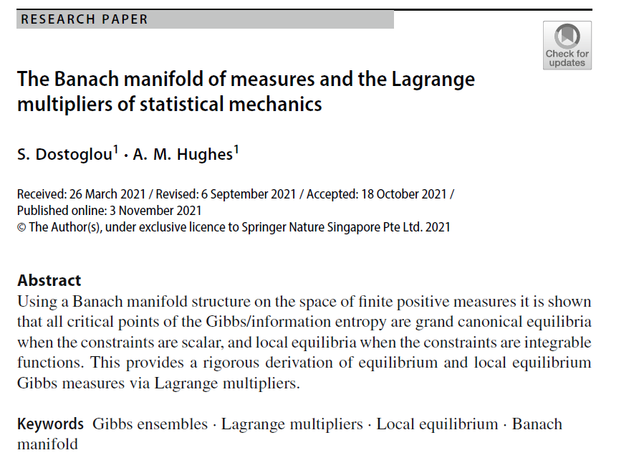
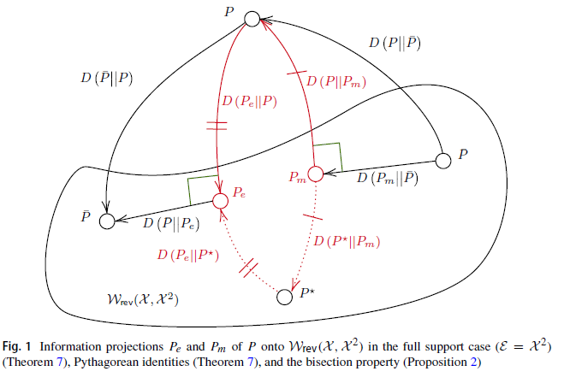
Volume 4
Issue 2
Article 39
Notes:
The Banach manifold of measures and the Lagrange multipliers of statistical mechanics
https://link.springer.com/article/10.1007/s41884-021-00057-3

Slide 5

Volume 4
Issue 2
Article 40
Notes:
Information Geometry of Reversible Markov Chains
https://link.springer.com/article/10.1007/s41884-021-00061-7

Slide 6

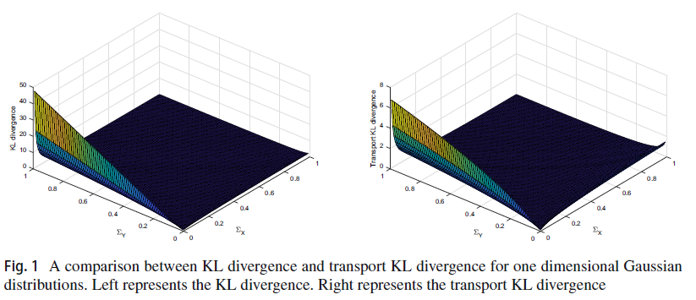
Volume 4
Issue 2
Article 41
Notes:
Transport information Bregman divergences
https://link.springer.com/article/10.1007/s41884-021-00063-5

