Slide 1
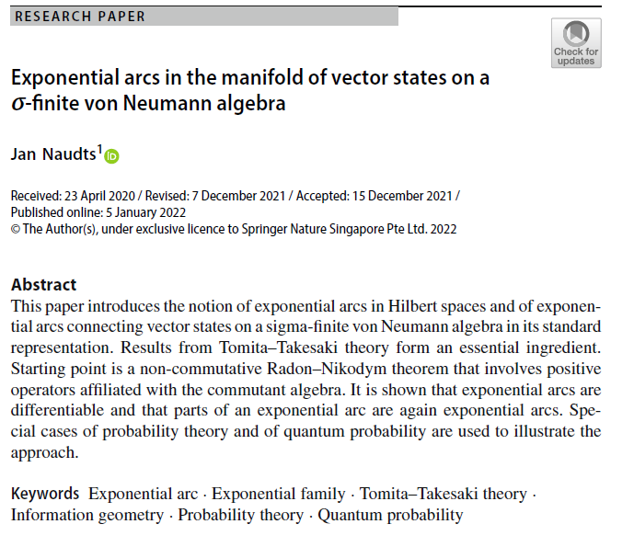

Volume 5
Issue 1
Article 42
Notes:
Exponential arcs in the manifold of vector states on a σ-finite von Neumann algebra
https://link.springer.com/article/10.1007/s41884-021-00064-4

Slide 2
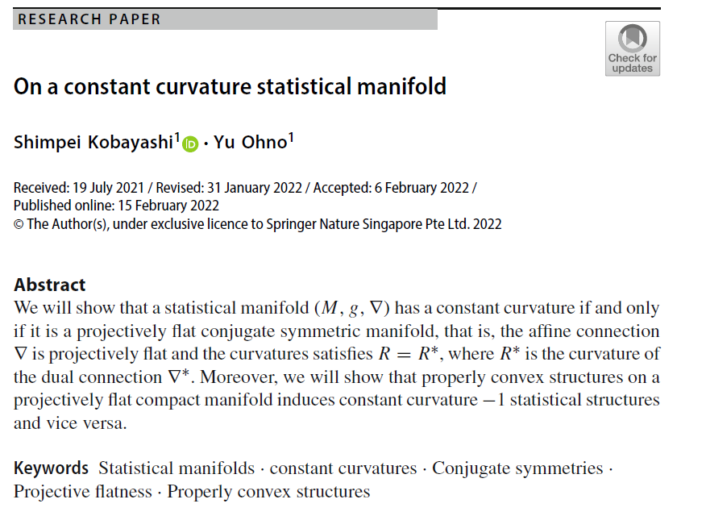
Volume 5
Issue 1
Article 43
Notes:
On a constant curvature statistical manifold
https://link.springer.com/article/10.1007/s41884-022-00065-x

Slide 3
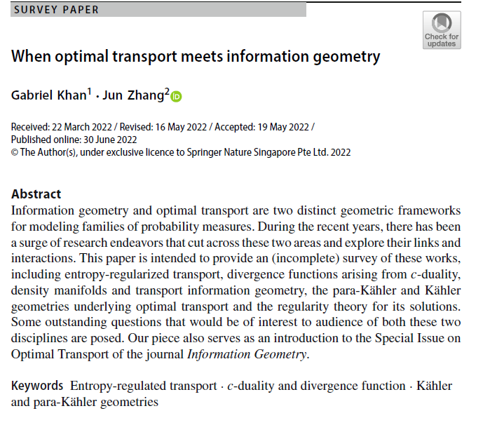
Volume 5
Issue 1
Article 44
Notes:
When optimal transport meets information geometry
https://link.springer.com/article/10.1007/s41884-022-00066-w

Slide 4
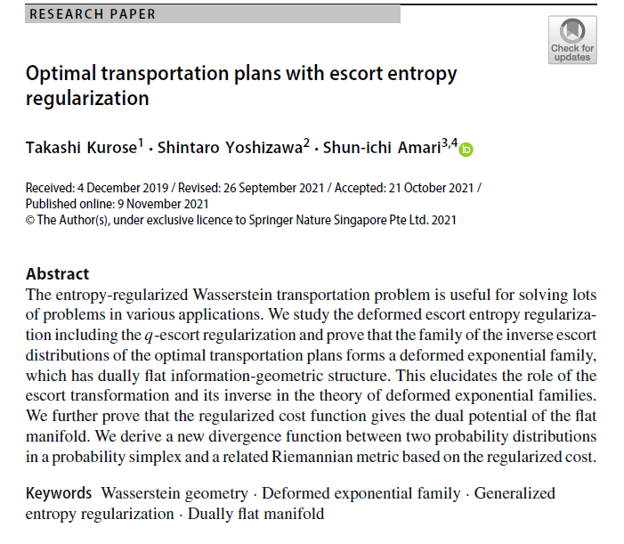
Volume 5
Issue 1
Article 45
Notes:
Optimal transportation plans with escort entropy regularization
https://link.springer.com/article/10.1007/s41884-021-00058-2

Slide 5
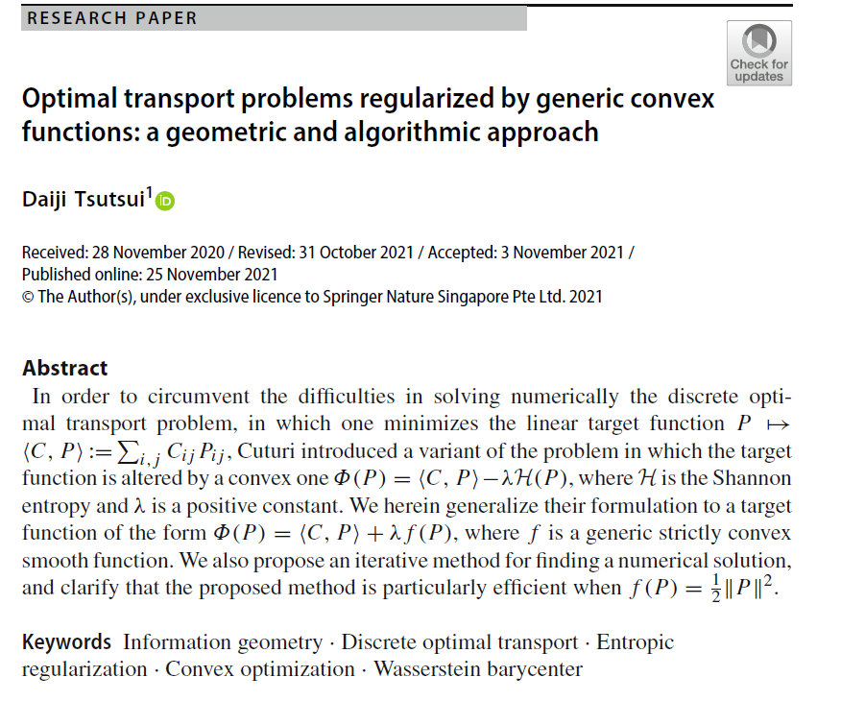
Volume 5
Issue 1
Article 46
Notes:
Optimal transport problems regularized by generic convex functions: a geometric and algorithmic approach
https://link.springer.com/article/10.1007/s41884-021-00062-6

Slide 6
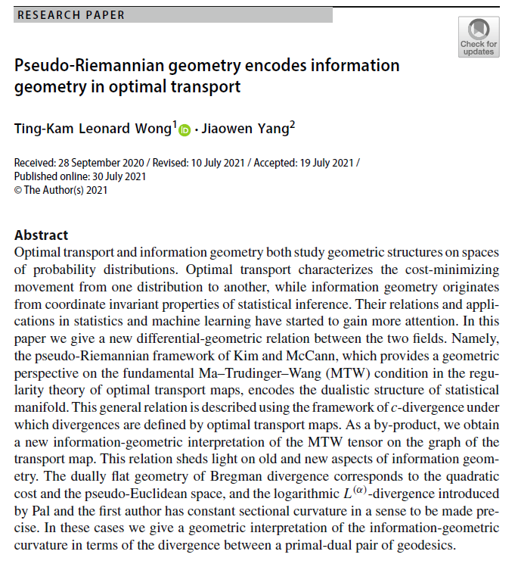

Volume 5
Issue 1
Article 47
Notes:
Pseudo-Riemannian geometry encodes information geometry in optimal transport
https://link.springer.com/article/10.1007/s41884-021-00053-7

Slide 7
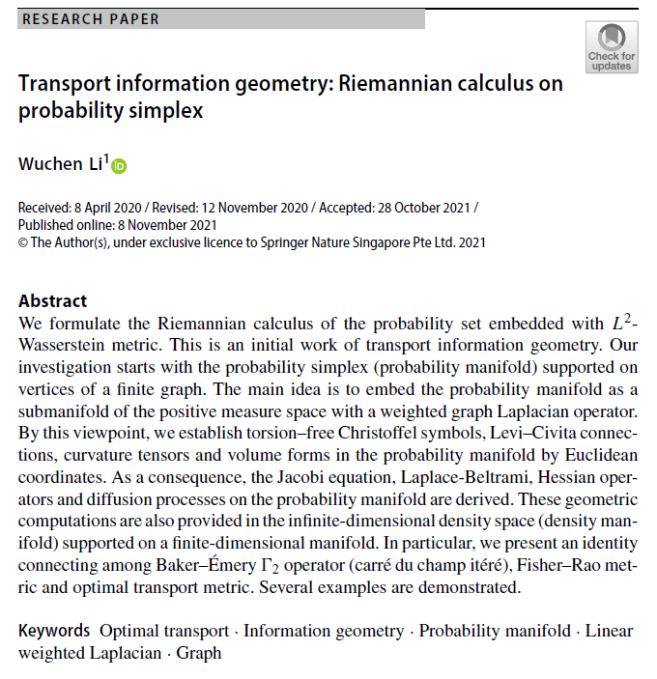
Volume 5
Issue 1
Article 48
Notes:
Transport information geometry: Riemannian calculus on probability simplex
https://link.springer.com/article/10.1007/s41884-021-00059-1

Slide 8
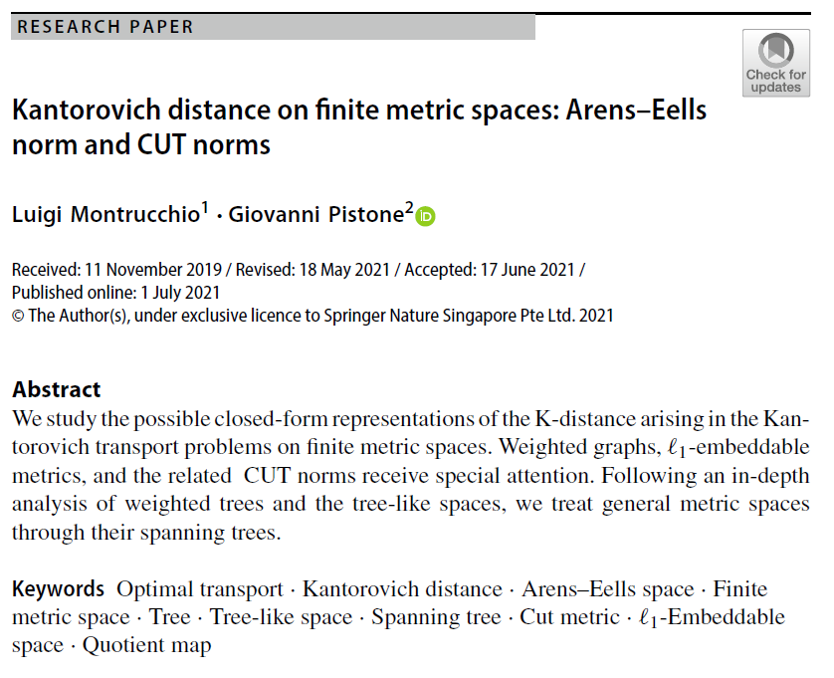
Volume 5
Issue 1
Article 49
Notes:
Kantorovich distance on finite metric spaces: Arens–Eells norm and CUT norms
https://link.springer.com/article/10.1007/s41884-021-00050-w

Slide 9
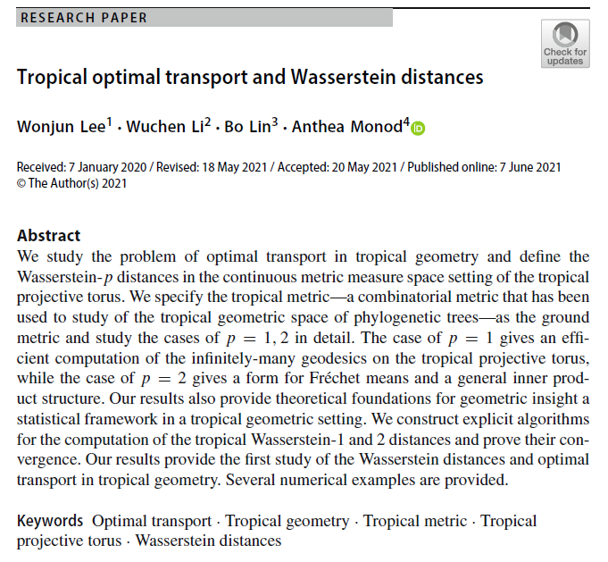
Volume 5
Issue 1
Article 50
Notes:
Tropical optimal transport and Wasserstein distances
https://link.springer.com/article/10.1007/s41884-021-00046-6

Slide 10
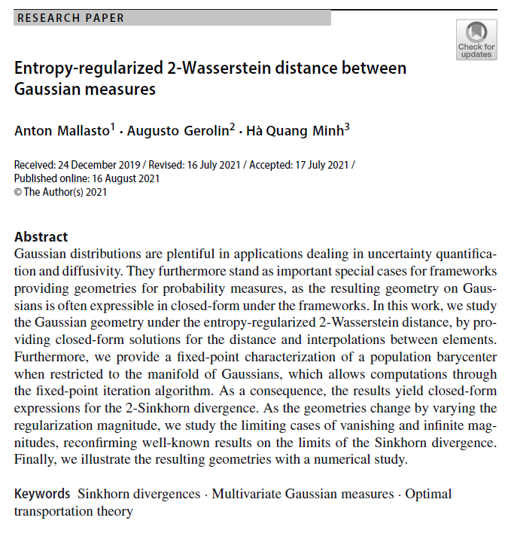
Volume 5
Issue 1
Article 51
Notes:
Entropy-regularized 2-Wasserstein distance between Gaussian measures
https://link.springer.com/article/10.1007/s41884-021-00052-8

Slide 11
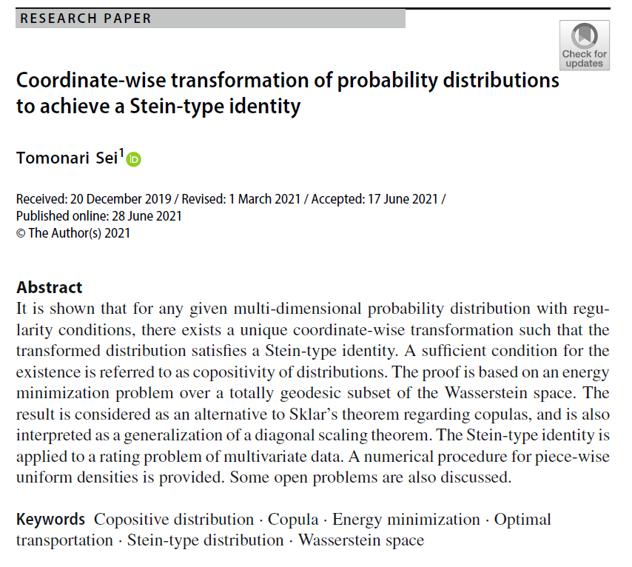
Volume 5
Issue 1
Article 52
Notes:
Coordinate-wise transformation of probability distributions to achieve a Stein-type identity
https://link.springer.com/article/10.1007/s41884-021-00051-9

