Slide 1

Information Geometry: An Introduction* for Machine Learning
Frank Nielsen
Sony Computer Science Laboratories Inc.
Tokyo, Japan
https://franknielsen.github.io/
^{*: invitation}
December 2021
Notes:
https://neuripsmeetup.jp/2021/

Slide 2
Outline
Machine learning & computational geometry: A long history!

Slide 3
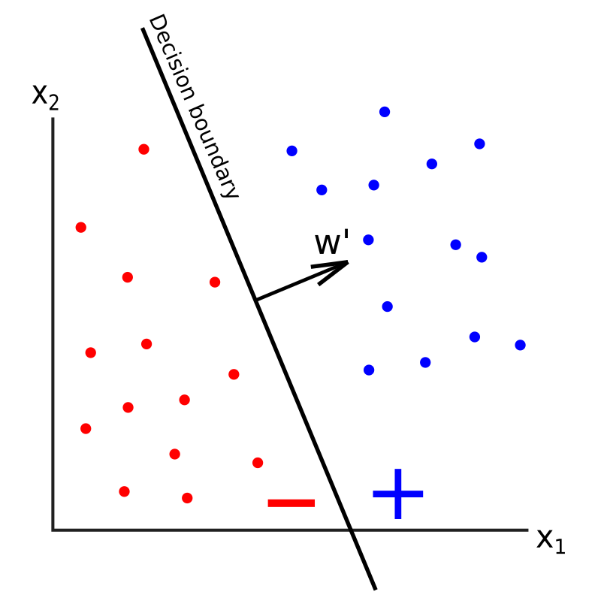
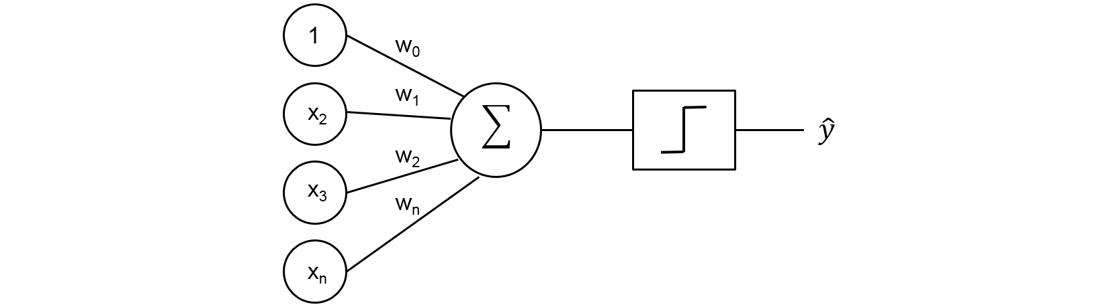
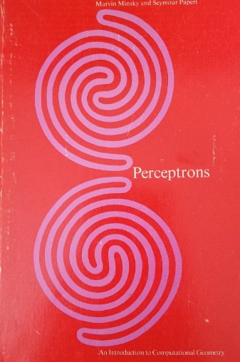
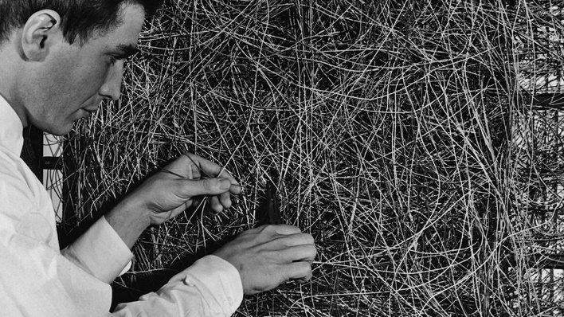
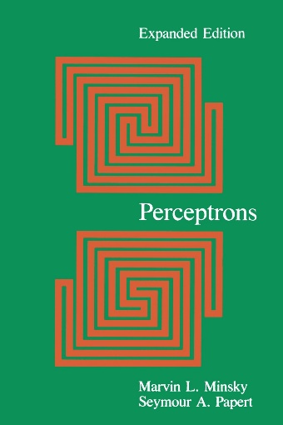
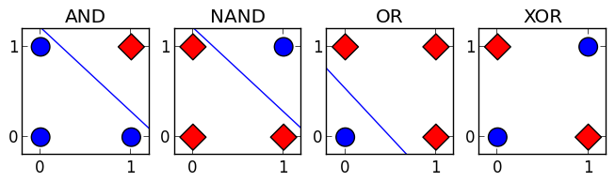
Geometric learning machines: I. Perceptron (1960’s)
MIT Press, 1969
Decision boundary: hyperplanes
XOR cannot be learned…
Connectionism machine
≠ von Neumann machine
MIT Press, 1987
Marvin Minsky and Seymour Papert:
Perceptrons: An Introduction to Computational Geometry, 1969
Notes:
https://jtsulliv.github.io/perceptron/
https://mitpress.mit.edu/books/perceptrons
https://towardsdatascience.com/perceptron-explanation-implementation-and-a-visual-example-3c8e76b4e2d1

Slide 4
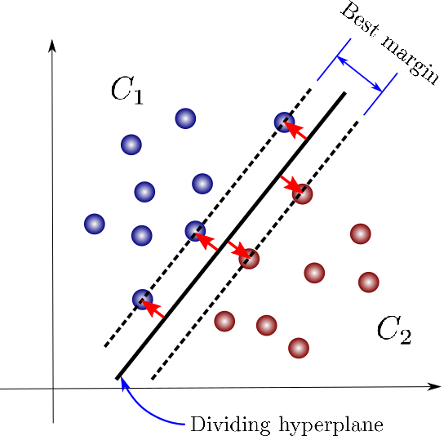
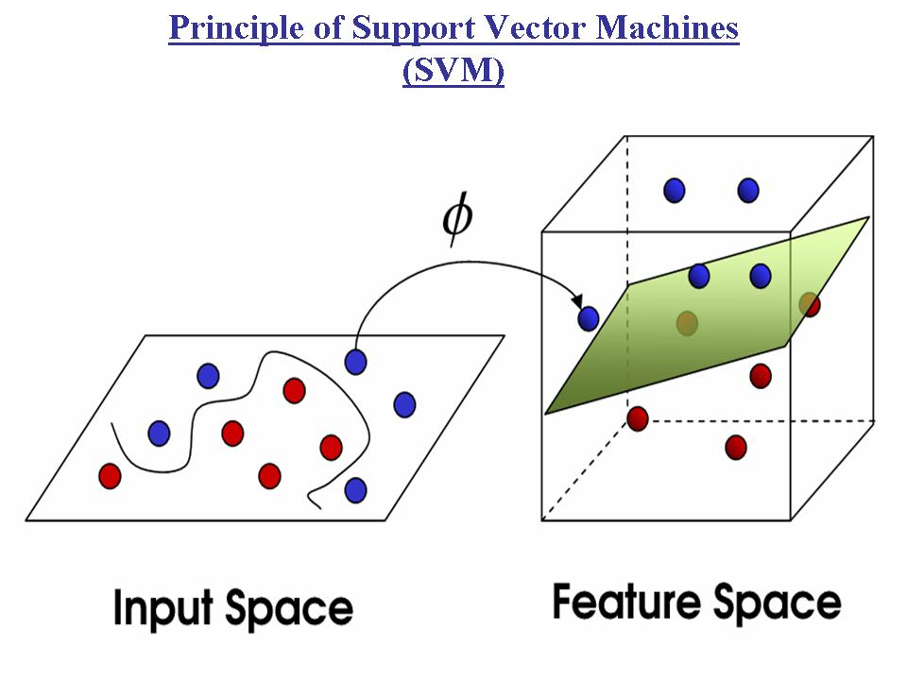
Geometric learning machines: II. SVMs (1970’s, 1992)
Linear separator
Non-linear separator
Support vector
Feature map
Inner product
(Hilbert space)
Kernel machines
(RKHS geometry)
1970
1992

Slide 5
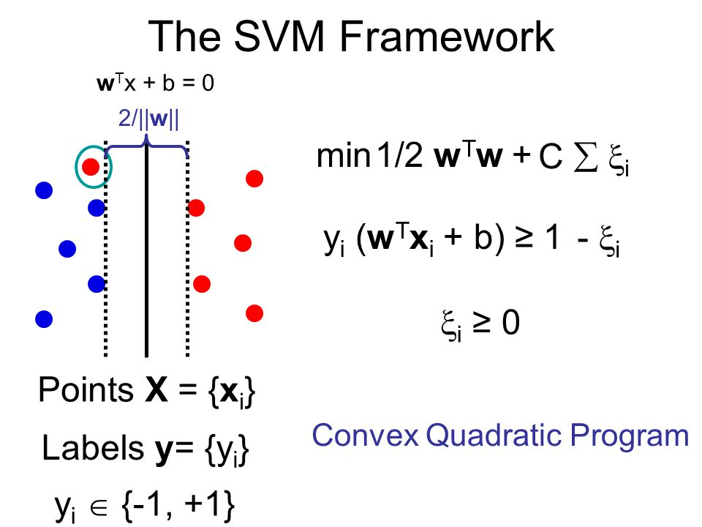
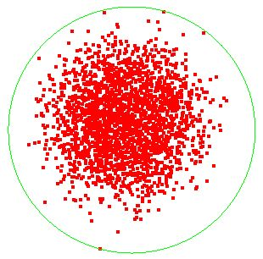
SVM: Dual quadratic program amount to solve for a smallest enclosing ball (= SEB): Computational geometry !
Smallest enclosing ball:
Smallest ball with respect to
radius or set inclusion
Approximating Smallest Enclosing Balls with Applications to Machine Learning, IJGA 2009
Notes:
https://phazcode.gitlab.io/meb/

