Slide 1

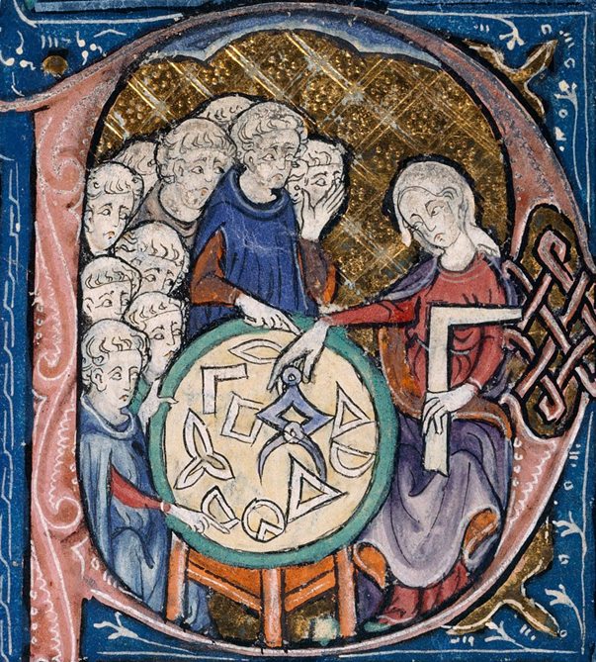



The 5th international conference on
Geometric Science of Information
Learning geometric structures
WiMLDS Best Paper Award
GSI 2021
July 21st-23rd 2021
Paris-Sorbonne University
PRESENTED TO
SPONSORED BY
Rosa Kowalewski and Barbara Gris
AUTHORS OF THE PAPER
Multi-shape registration with constrained deformations
Frédéric Barbaresco
Thales, France
General co-chair
Frank Nielsen
Sony Computer Science Laboratories, Japan
General co-chair
Gabriel Peyré
CNRS, ENS, France
Prize committee, President
xxx…..
WiMLDS
Prize committee, President

