Slide 1
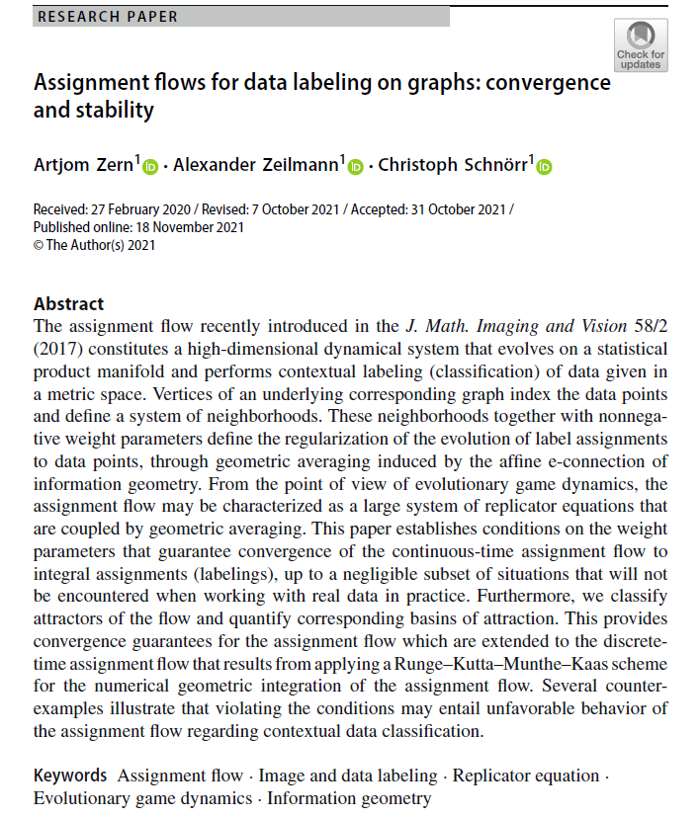

Volume 5
Issue 2
Article 53
Notes:
Assignment flows for data labeling on graphs: convergence and stability
https://link.springer.com/article/10.1007/s41884-021-00060-8

Slide 2
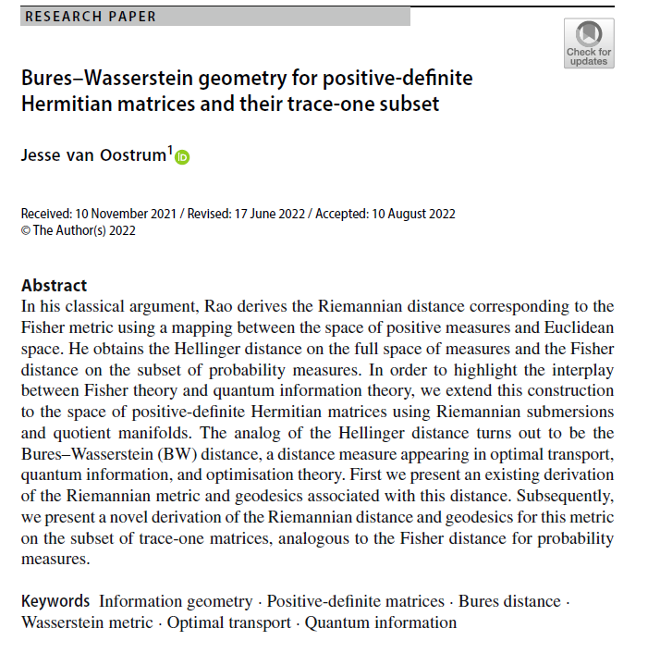
Volume 5
Issue 2
Article 54
Notes:
Bures–Wasserstein geometry for positive-definite Hermitian matrices and their trace-one subset
https://link.springer.com/article/10.1007/s41884-022-00069-7

Slide 3
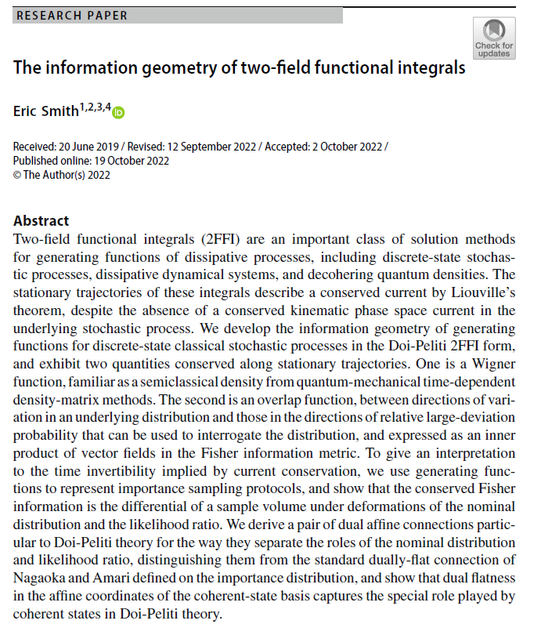
Volume 5
Issue 2
Article 55
Notes:
The information geometry of two-field functional integrals
https://link.springer.com/article/10.1007/s41884-022-00071-z

Slide 4
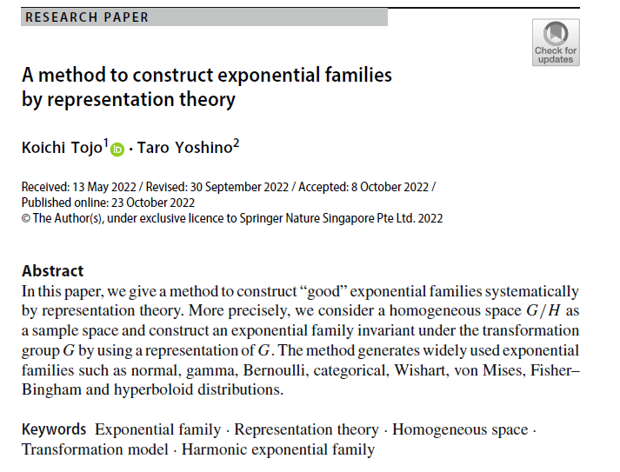
Volume 5
Issue 2
Article 56
Notes:
A method to construct exponential families by representation theory
https://link.springer.com/article/10.1007/s41884-022-00072-y

Slide 5
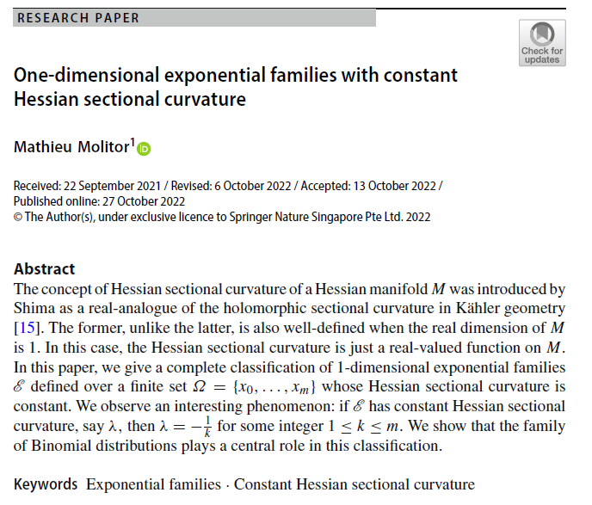
Volume 5
Issue 2
Article 57
Notes:
One-dimensional exponential families with constant Hessian sectional curvature
https://link.springer.com/article/10.1007/s41884-022-00074-w

