Slide 1
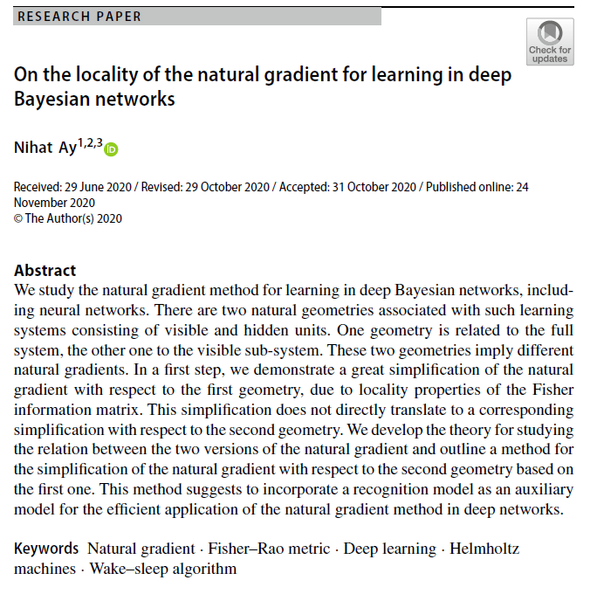

Volume 6
Issue 1
Article 58
Notes:
On the locality of the natural gradient for learning in deep Bayesian networks
https://link.springer.com/article/10.1007/s41884-020-00038-y

Slide 2
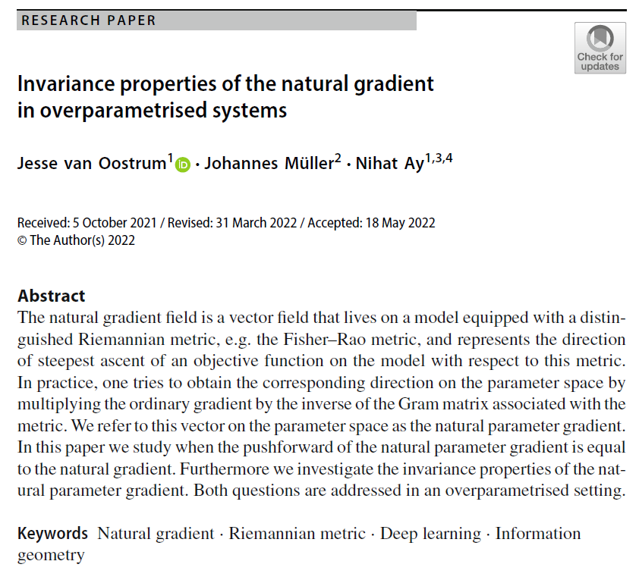
Volume 6
Issue 1
Article 59
Notes:
Invariance properties of the natural gradient in overparametrised systems
https://link.springer.com/article/10.1007/s41884-022-00067-9

Slide 3
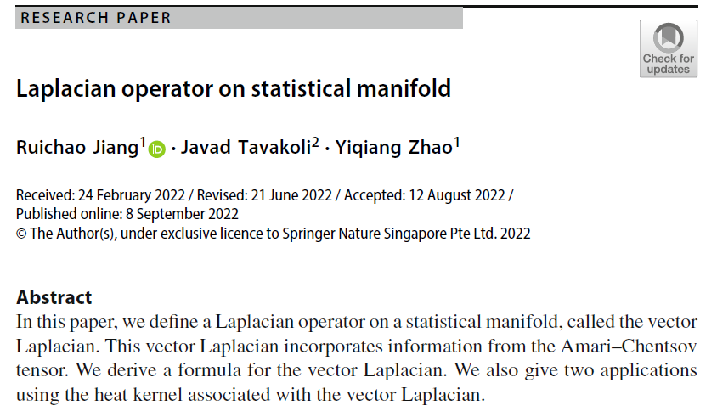
Volume 6
Issue 1
Article 60
Notes:
Laplacian operator on statistical manifold
https://link.springer.com/article/10.1007/s41884-022-00070-0

Slide 4

Volume 6
Issue 1
Article 61
Notes:
Active learning by query by committee with robust divergences
https://link.springer.com/article/10.1007/s41884-022-00081-x

Slide 5

Volume 6
Issue 1
Article 62
Notes:
The Fisher–Rao loss for learning under label noise
https://link.springer.com/article/10.1007/s41884-022-00076-8

Slide 6

Volume 6
Issue 1
Article 63
Notes:
Information geometry of warped product spaces
https://link.springer.com/article/10.1007/s41884-022-00091-9

Slide 7
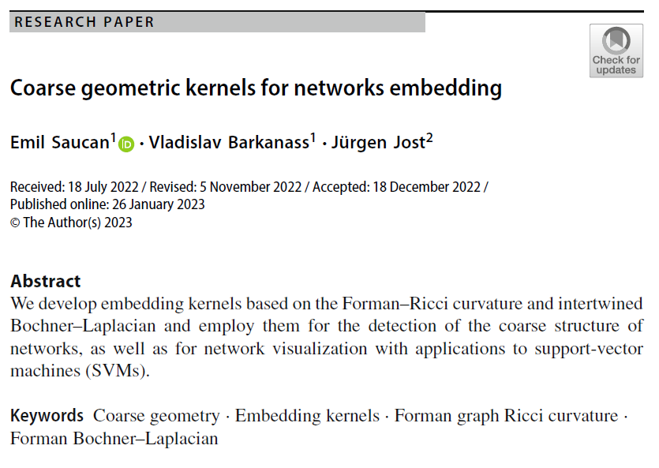
Volume 6
Issue 1
Article 64
Notes:
Coarse geometric kernels for networks embedding
https://link.springer.com/article/10.1007/s41884-022-00095-5

Slide 8
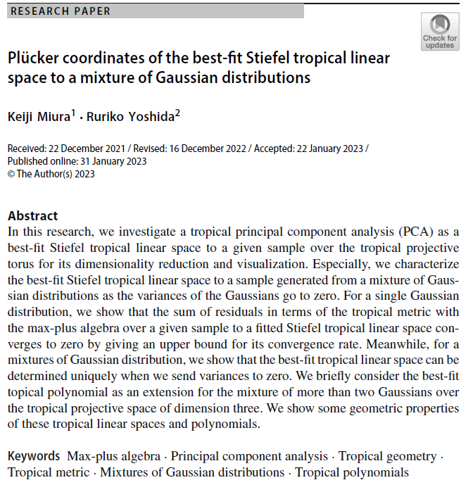
Volume 6
Issue 1
Article 65
Notes:
Plücker coordinates of the best-fit Stiefel tropical linear space to a mixture of Gaussian distributions
https://link.springer.com/article/10.1007/s41884-023-00098-w

Slide 9
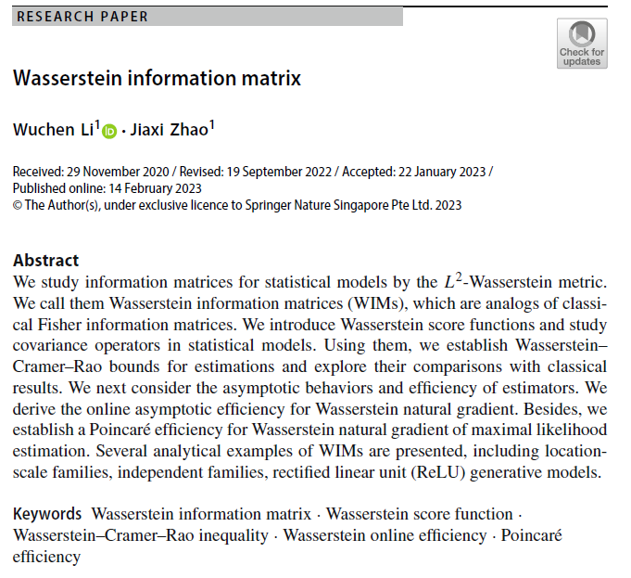
Volume 6
Issue 1
Article 66
Notes:
Wasserstein information matrix
https://link.springer.com/article/10.1007/s41884-023-00099-9

Slide 10

Volume 6
Issue 1
Article 67
Notes:
Non-negative low-rank approximations for multi-dimensional arrays on statistical manifold
https://link.springer.com/article/10.1007/s41884-023-00100-5

Slide 11
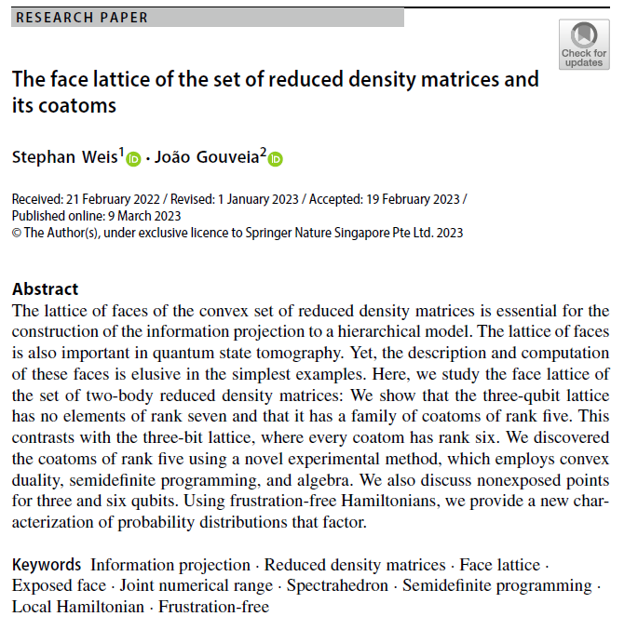
Volume 6
Issue 1
Article 68
Notes:
The face lattice of the set of reduced density matrices and its coatoms
https://link.springer.com/article/10.1007/s41884-023-00103-2

Slide 12

Volume 6
Issue 1
Article 69
Notes:
Power transformations of relative count data as a shrinkage problem
https://link.springer.com/article/10.1007/s41884-023-00104-1

Slide 13
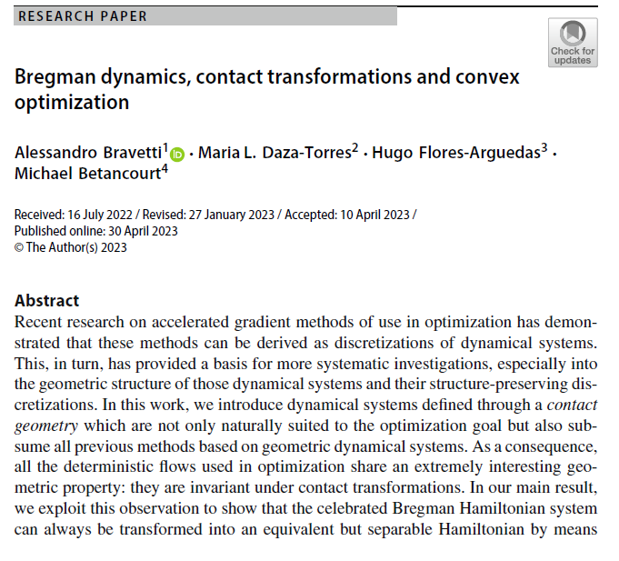
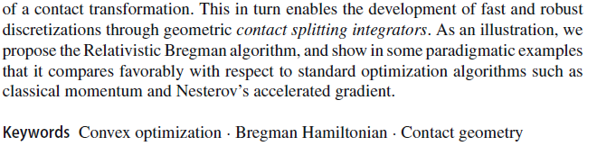
Volume 6
Issue 1
Article 70
Notes:
Bregman dynamics, contact transformations and convex optimization
https://link.springer.com/article/10.1007/s41884-023-00105-0

