Slide 1

Revisiting Chernoff information with Likelihood Ratio Exponential Families
Frank Nielsen
Sony Computer Science Laboratories Inc.
Tokyo, Japan
https://franknielsen.github.io/
Entropy 2022
[2207.03745]
Notes:
20 minutes : 15 minutes + question

Slide 2
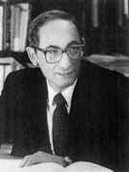



Chernoff information: A symmetric statistical divergence
Originally introduced by Chernoff (1952) to upper bound the probability of error (Bayes' error) in statistical hypothesis testing.
skewed Bhattacharyya coefficient ρ_{α} (similarity)
Herman Chernoff
(1923-)
(via Hölder inequality)
Synonyms: Chernoff divergence, Chernoff information number, Chernoff index...
Found later many applications in information fusion, radar target detection,
generative adversarial networks, etc. due to its empirical robustness

Slide 3




Chernoff information = Maximally skewed Bhattacharyya distance
skewed Bhattacharyya distance (a Ali-Silvey f-divergence):
Chernoff information:
scaled skewed Bhattacharyya distance = Rényi divergence (extends KLD)
Optimal values of α is called ``Chernoff (error) exponent'' (due to its seminal use in statistical hypothesis testing)

Slide 4
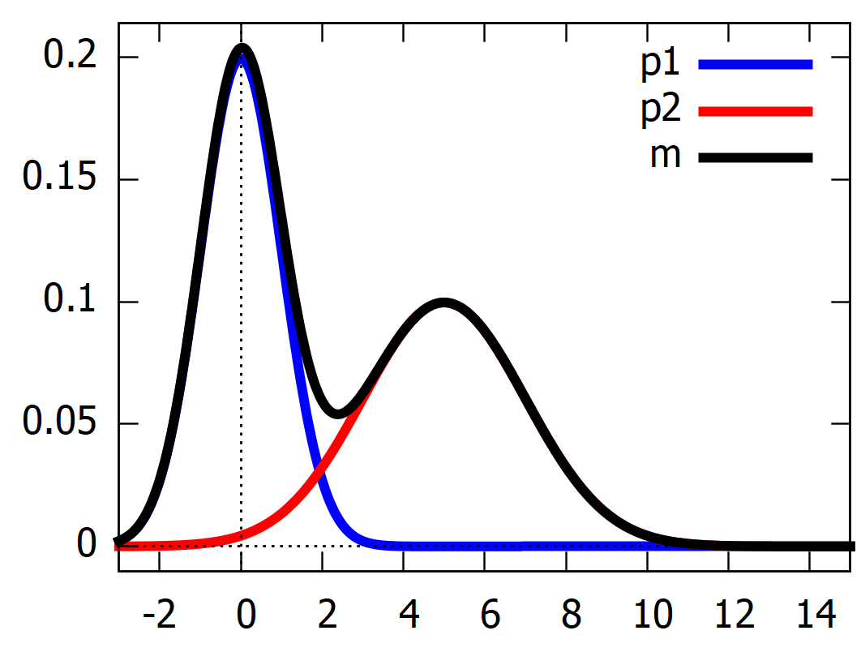

Rationale: Statistical hypothesis testing
Statistical mixture:
m(x)=0.5*N(0,1)+0.5*N(5,2)
Hypothesis task:
Decides whether x emanates
from p1 or p2?
Classification rule:
Maximum a posteriori (MAP)
if p1(x)>p2(x) classify as p1
else classify as p2
Error at x: min(p1(x),p2(x))
Histogram intersection similarity:
x classified p1
x classified p2
Notes:
/*m(x)=0.5*N(0,1)+0.5*N(5,2)*/normal(x,mu,sigma) := (1.0/(sqrt(2*%pi)*sigma))*exp(-((x-mu)**2)/(2*sigma**2) );p1(x):=0.5*normal(x,0,1);p2(x):=0.5*normal(x,5,2);m(x):=p1(x)+p2(x);plot2d([p1(x),p2(x),m(x)],[x,-3,15], [xlabel,"x"], [ylabel,"Probability"],[legend, "p1", "p2", "m"],[style, [lines,5,1],[lines,5,2],[lines,5,5]]);

Slide 5


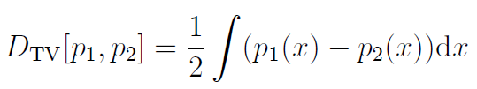





Rewriting and bounding the probability of error
Use rewriting trick min(a,b)=(a+b)/2 + |b-a|/2 for a,b>0
express the probability of error using the total variation distance:
Use a generic (weighted) mean which necessarily falls inbetween its extrema:
geometric weighted mean
"Generalized Bhattacharyya and Chernoff upper bounds on Bayes error using quasi-arithmetic means." Pattern Recognition Letters 42 (2014): 25-34.

Slide 6
Outline of the contributions of this talk
(Background, done)
Interplay of non-parametric with parametric study of Chernoff information via the concept of log-ratio exponential families (LREFs)
Derive various optimality conditions for the chernoff exponent α*
Give some geometric interpretations on Bregman manifolds which yield fast approximations algorithms
novel closed-form solutions for the Chernoff information between univariate Gaussians, centered scaled covariance matrices, etc.

Slide 7



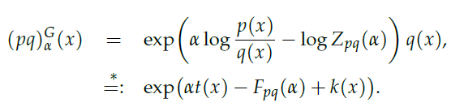


Likelihood ratio exponential families (LREFs)
Geometric mixture (Bhattacharyya /exponential arc )
between two densities p, q of Lebesgue Banach space L₁(μ)
Set of geometric mixtures:
with normalization factor:
geometric mixture interpreted as a 1D exponential family: LREF
Natural parameter space:
k(x)=log q(x)
-

Slide 8
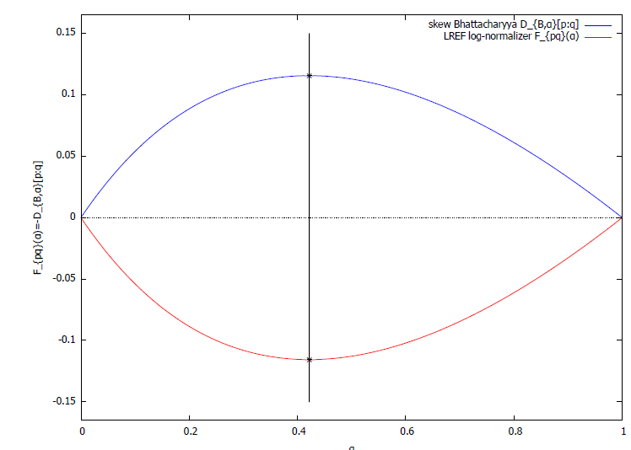


LREFs: EF cumulant function is always analytic C^{ω}
Cumulant function of EF is strictly convex
(and smooth for regular EFs)
Cumulant function is neg-Bhattacharyya distance:
⇒ Bhattacharyya. distance is strictly concave
Theorem:
Chernoff exponent exists and is unique
p=N(0,1)
q=N(1,2)

Slide 9

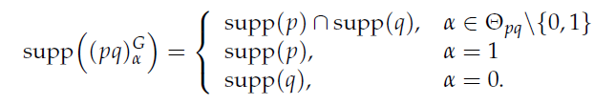

Geometric mixtures and LREFs: Regular EFs
Natural parameter space:
always contains (0,1) since
What happens at extremities and when extrapolating (support):
Exponential family is said regular when the natural parameter space Θ is open (e.g., normal family, Dirichlet family, Wishart family, etc.)
Definition:
regular EF

Slide 10
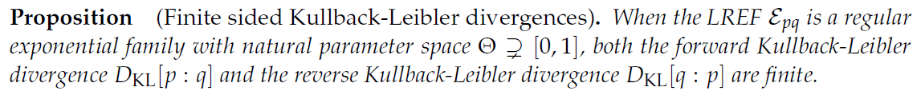

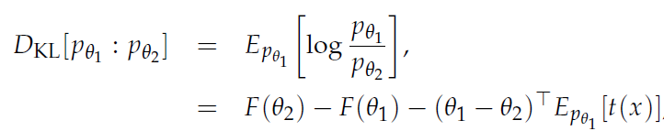

When (0,1) is strictly included in regular LREFs
KLD between two densities of a regular EF = reverse Bregman divergence:
steep ⇒
regular EF ⇒ steep EF

Slide 11
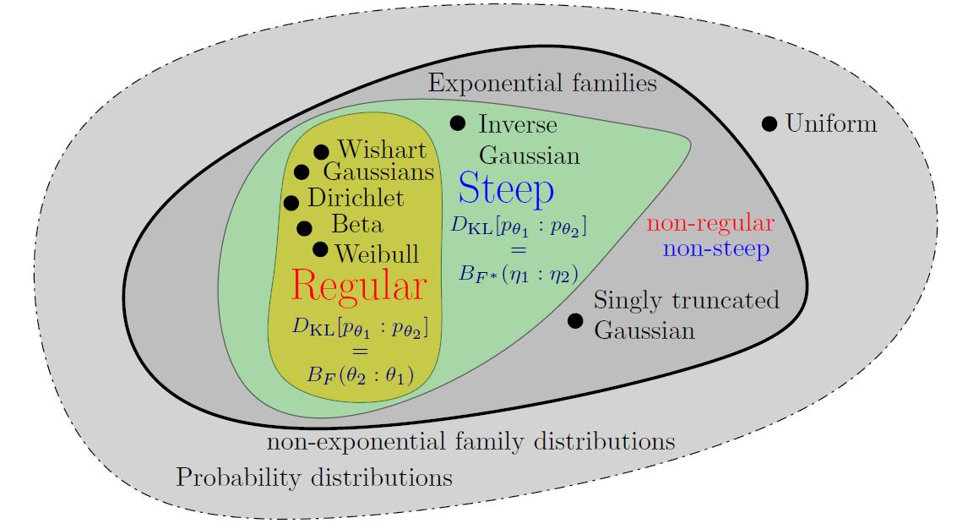
Venn diagram: Regular & steepness of (LR)EFs
Steepness implies duality between natural θ and moment 𝜂 parameters

Slide 12


PROOF
Remember KLD=Bregman divergence between densities of a regular (LR)EF
Scalar Bregman divergence
idem for

Slide 13



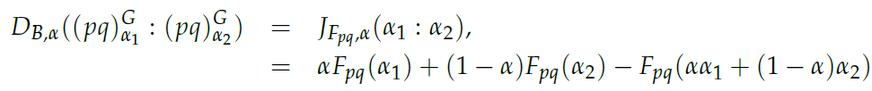





Chernoff information (for densities of a LREF)
Proposition:
PROOF
First, Bhattacharyya distance = Jensen divergence
Thus we have:
At the optimal value α*, we have
①
②
③

Slide 14
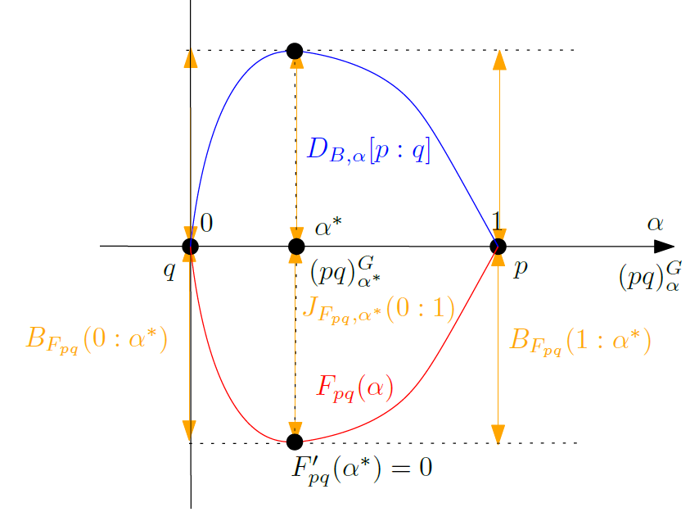
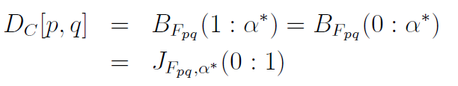

Jensen-Chernoff divergence
non-parametric arguments
scalar parametric arguments
In general, define Jensen-Chernoff divergence
Notes:
\begin{eqnarray*}
D_C[p,q] &=& B_{F_{pq}}(1:\alpha^*)=B_{F_{pq}}(0:\alpha^*)\\
&=& J_{F_{pq}}(0:1)
\end{eqnarray*}

Slide 15
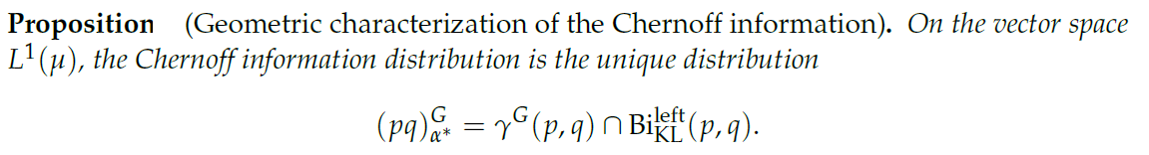


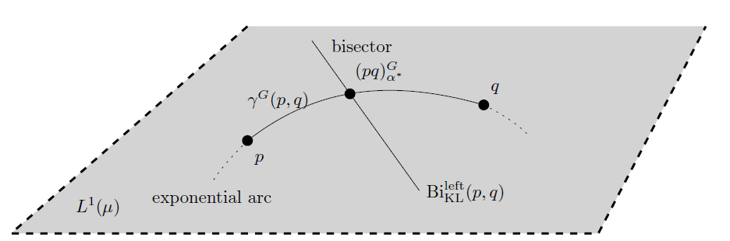

Geometric interpretation for densities on L₁(μ)
Left KL Voronoi bisector:
Geodesic = exponential arc:
2209.07481
Chernoff point:

Slide 16
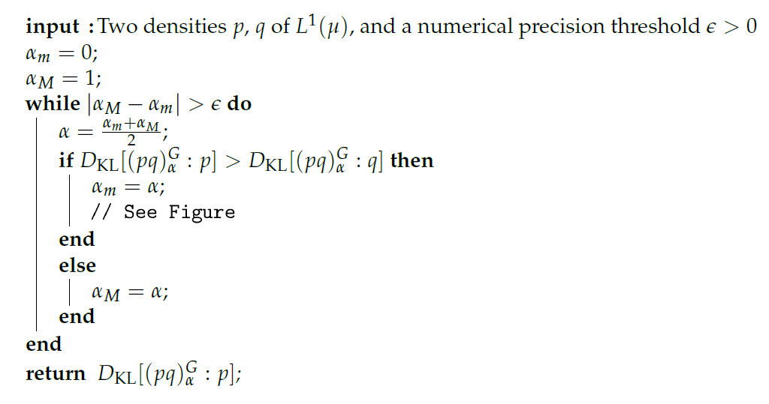
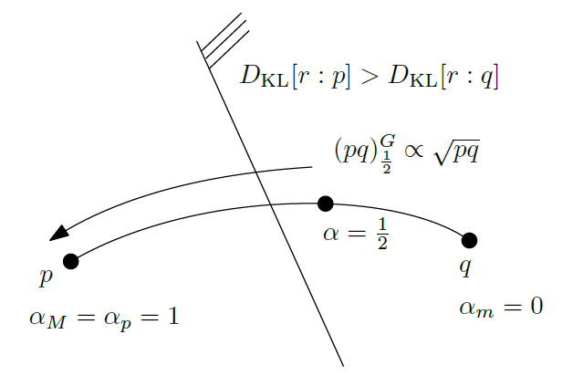
Fast dichotomic search for approximating the Chernoff point
Bisection algorithm:
Exponential arc
Chernoff point
KL bisector

Slide 17

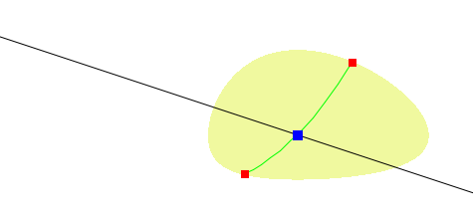
Chernoff information as a symmetrization of KLD
Rewrite
as
Chernoff information as the radius of
a minimum enclosing left-sided Kullback–Leibler ball
Chernoff point r*
(eKLD)
circum center r

Slide 18
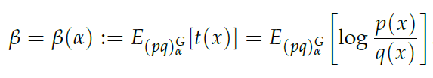






Dual moment parameterizations β of LREFs
Dual moment parameter:
α = natural primal parameter
Legendre transform

Slide 19

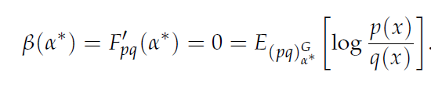
Dual parameterizations of LREFs and optimality condition for finding Chernoff exponent
Primal optimality condition
Dual optimality condition

Slide 20
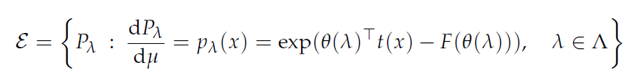
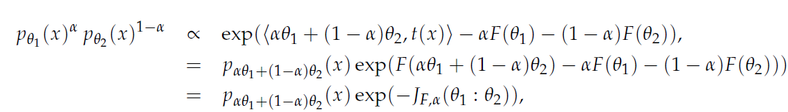



Special case of LREF: p,q are densities of an EF!
EF includes Gaussians, Beta, Dirichlet, Wishart, etc.

Slide 21
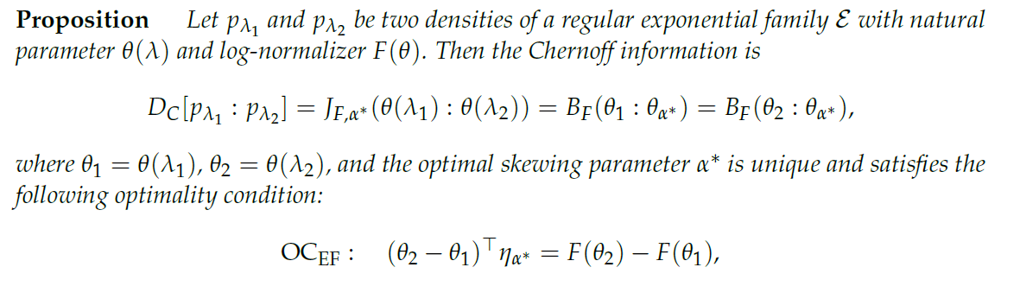
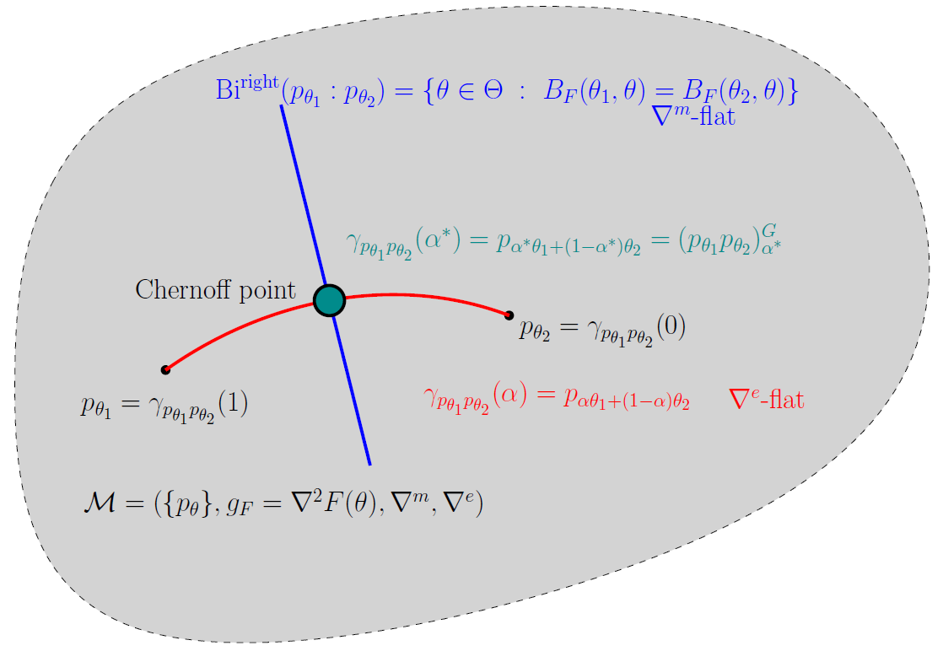

Slide 22
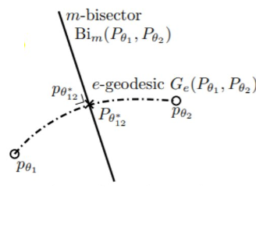
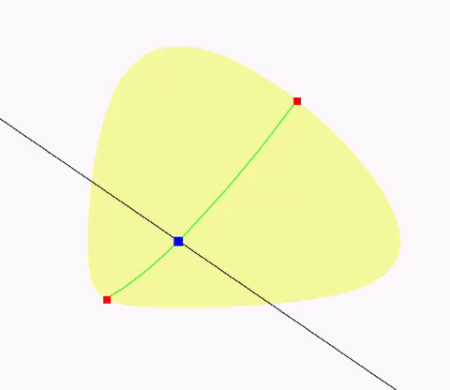
Chernoff point (in blue) for extended KLD case
input distributions
Chernoff point
exponential arc (e-flat dim. 1)
Voronoi bisector (m-flat codim. 1)

Slide 23
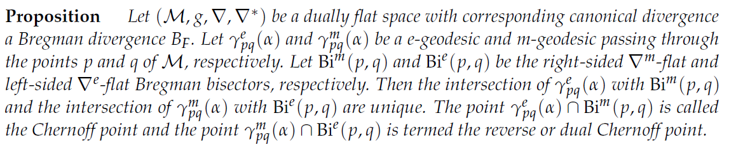
Interpreting the uniqueness of Chernoff exponent from information geometry point of view
Since the Chernoff point is unique, we can also interpret more generally this property in a general dually flat space (not necessarily an EF) as known as a Bregman manifold
"On geodesic triangles with right angles in a dually flat space."
Progress in Information Geometry. Springer, 2021. 153-190.

Slide 24
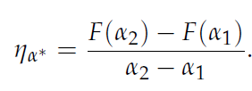
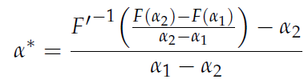
Special exponential family case: Uniparameter
Unidimensional case

Slide 25
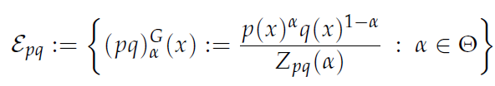
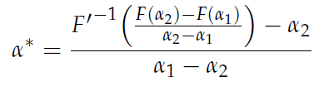
Recap: Closing the loop!
Started from two densities p,q of L₁(μ), built LREF and got 1D optimal condition
Applied to case where p,q are densities of the same exponential family
In particular get closed-form for univariate 1D EFs = LREFs
1D LREF p,q
p,q in (multivariate) EF
closed form for unidim EF

Slide 26

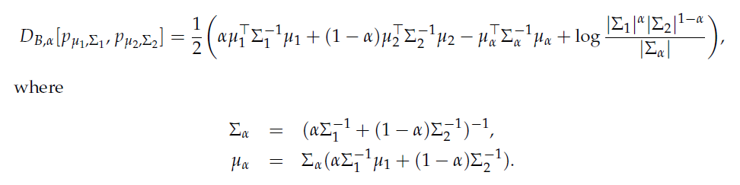
Bhattacharyya distances between Gaussian densities
Density:
Bhattacharyya distance (non-metric) in closed form:
Harmonic weighted mean

Slide 27


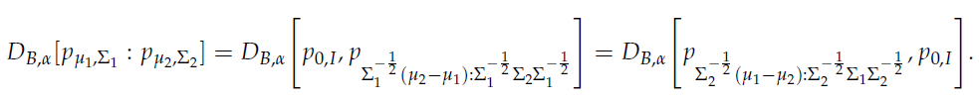
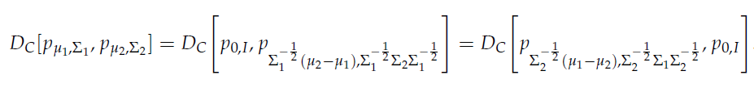



Invariance under the action of the affine group
Affine group action:
Matrix group element representation:
where
Wlog, we can assume this canonical case

Slide 28
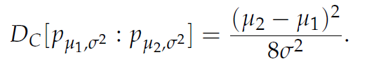


Exact closed form for Chernoff information between same-covariance matrix Gaussians
Trivial case, α*=1/2
square Mahalanobis distance:

Slide 29

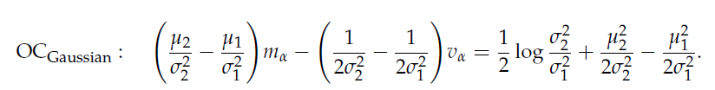
New result: Exact closed-form for Chernoff between univariate Gaussian distributions
Optimality condition amounts to solve a quadratic equation for α
Use symbolic computing to get (very long) closed-form formula

Slide 30
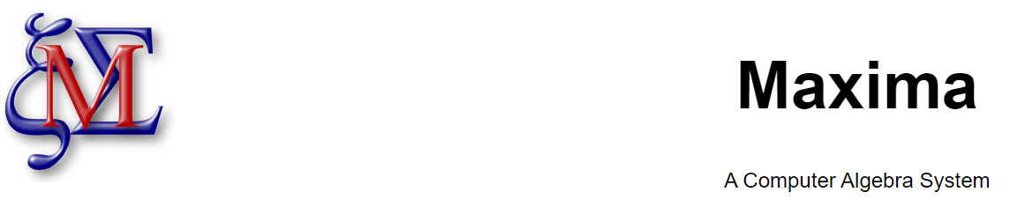
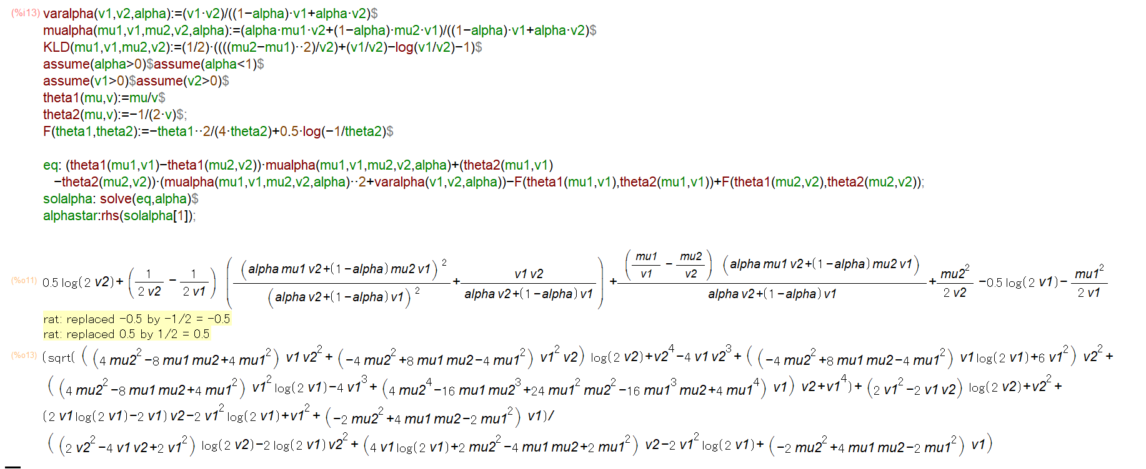
Symbolic
computing

Slide 31
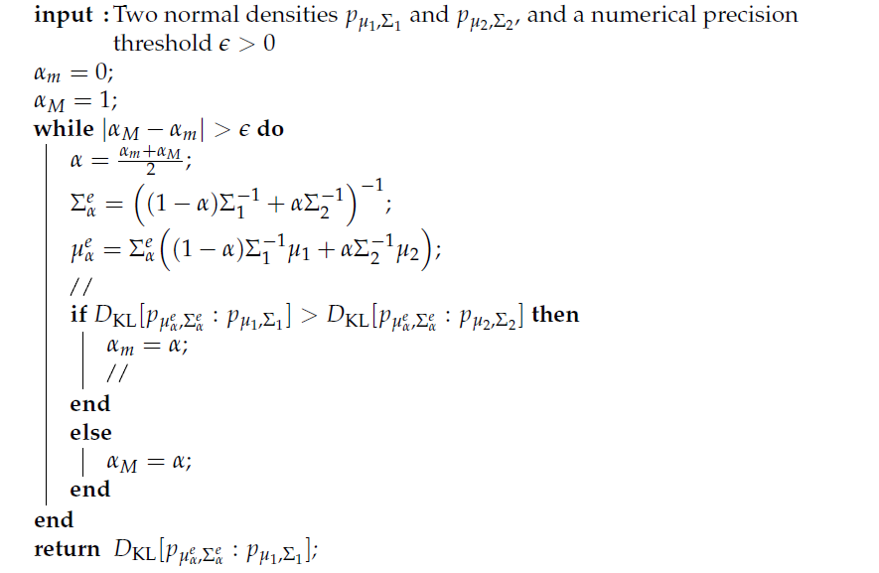

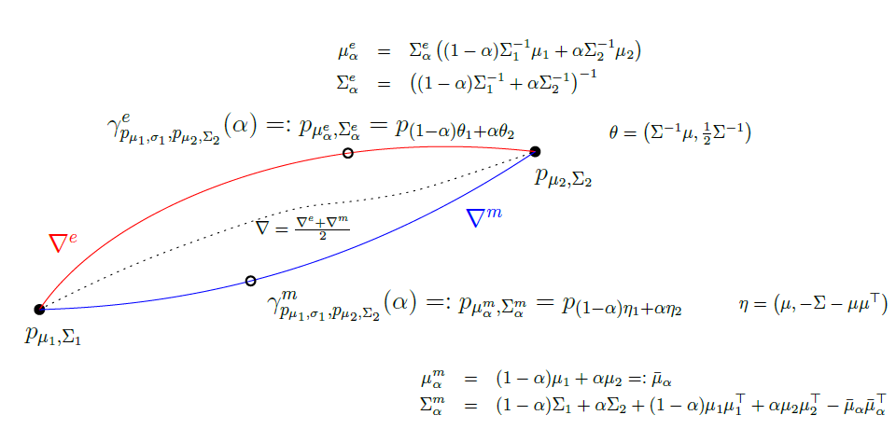
General multivariate Gaussian case
Kullback-Leibler divergence (= rev. Bregman div):
Efficient
algorithm

Slide 32
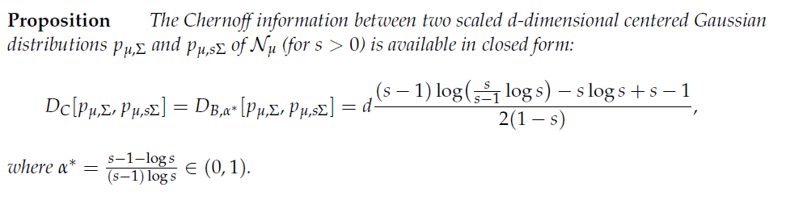
New results: centered multivariate Gaussian case
Optimality condition for centered multivariate Gaussian distributions:
Special case of centered scaled covariance matrices Σ₁=Σ and Σ₂=sΣ in closed-form (s>0):

Slide 33



Robustness of Chernoff information (informal viewpoint)
CI often used in information fusion community instead of a priori
For Chernoff information we have
Wlog, assume EF +
Chernoff information more stable and robust
than any other Bhattacharyya distances
Julier, Simon J. "An empirical study into the use of Chernoff information for robust, distributed fusion of Gaussian mixture models."
9th International Conference on Information Fusion. IEEE, 2006.

Slide 34
Conclusion
We revisited Chernoff information of two probability distributions under the umbrella of special exponential families
The geometric mixture is a 1D log-ratio exponential family:
Chernoff exponent is unique (from the convexity of log-normalizer)
Geometrically, Chernoff point = intersection of a Voronoi bisector with a geodesic
Approximate the Chernoff information by bisection search on exponential arc
Express the optimality condition of Chernoff error exponent in various ways
Consider Chernoff information between Gaussian densities:
exact closed-form for univariate Gaussians (solve quadratic eq. using symbolic computing)
exact closed-form for centered scaled covariance matrices
Practical bisection search on the exponential arc with numerical experiments

Slide 35
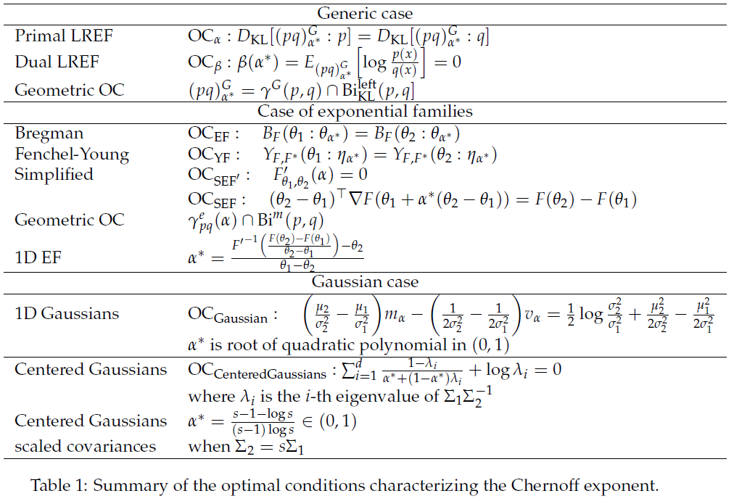
Thank you!
https://franknielsen.github.io/ChernoffInformation/index.html
Optimality conditions (OCs)
for Chernoff exponenti
Codes
Entropy 2022
[2207.03745]

Slide 36
Some references
Entropy 2022
[2207.03745]
Chernoff, Herman. "A measure of asymptotic efficiency for tests of a hypothesis based on the sum of observations." The Annals of Mathematical Statistics (1952): 493-507.
Nielsen, Frank. "Generalized Bhattacharyya and Chernoff upper bounds on Bayes error using quasi-arithmetic means." Pattern Recognition Letters 42 (2014): 25-34.
Nielsen, Frank. "An information-geometric characterization of Chernoff information." IEEE Signal Processing Letters 20.3 (2013): 269-272.
Deformed log-ratio exponential families (deformed LREFs):
Masrani, Vaden, et al. "q-Paths: Generalizing the geometric annealing path using power means." Uncertainty in Artificial Intelligence. PMLR, 2021.

Slide 37

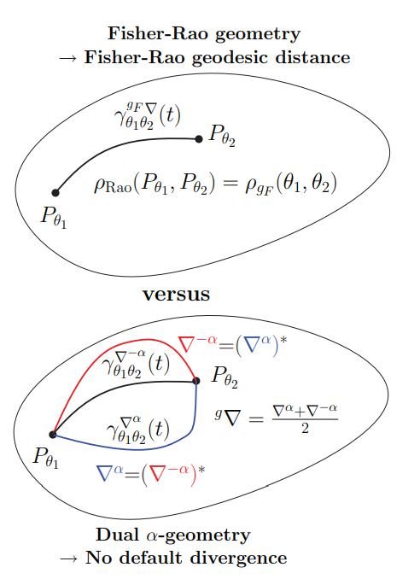
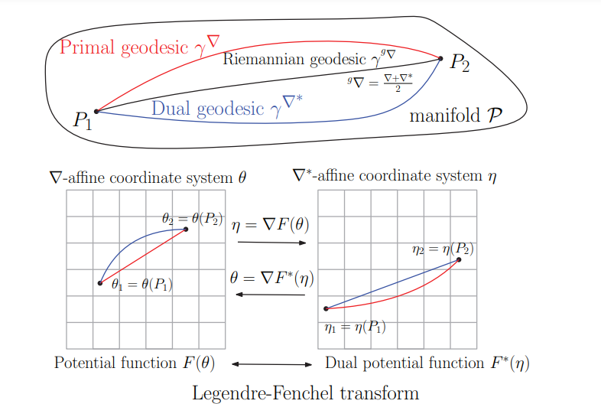

Slide 38

Graphical
abstract
Chernoff point
Entropy 2022
[2207.03745]

