Slide 1
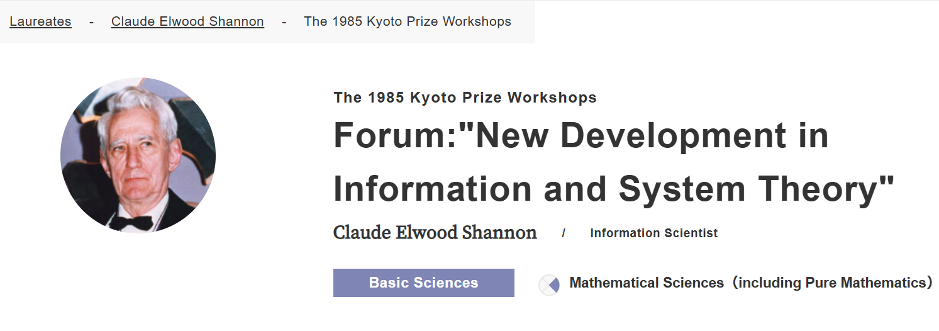

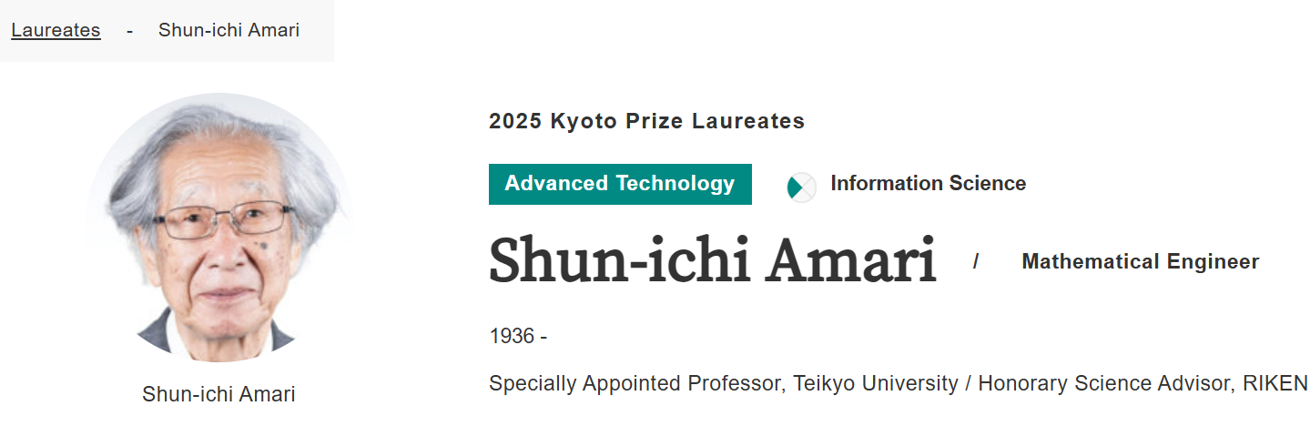
1985
2025
Notes:
In 1985, Claude Shannon received the Kyoto prize for "New Development in Information and System Theory“.
Prof. Shun-ichi Amari attended the forum following the commemorative lecture of Shannon and gave a speech.
In 2025, Prof. Amari was awarded the Kyoto prize for “Pioneering Contributions to Opening Up Theoretical Foundations of Artificial Intelligence and Establishment of Information Geometry”
https://www.kyotoprize.org/en/laureates/claude_elwood_shannon/

Slide 2

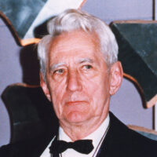
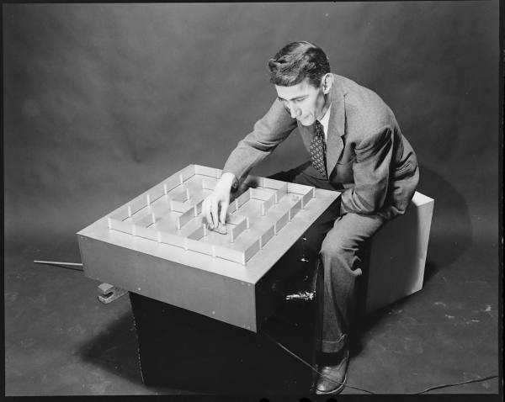
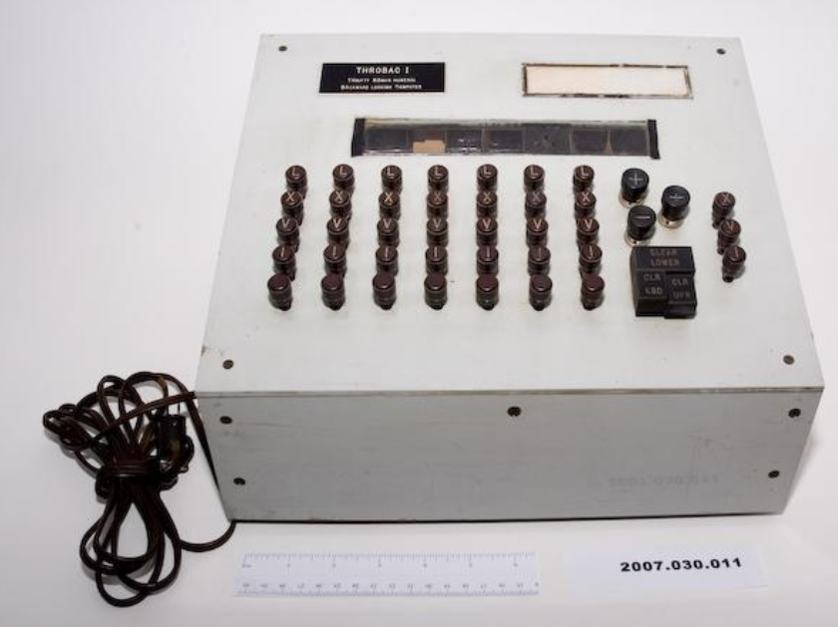
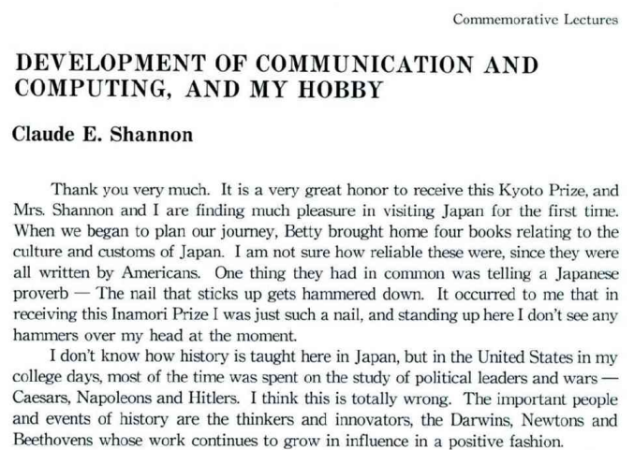
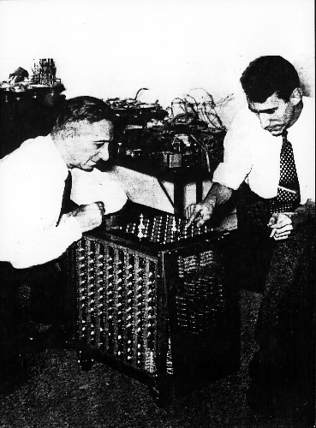
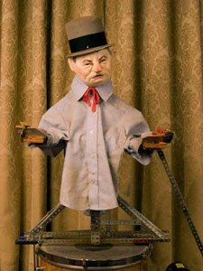
1985
Claude E. Shannon
Notes:
Very interesting script of the speech given by Shannon when he received the Kyoto prize in 1985.
“The important people and events of history are the thinkers and innovators, the Darwins, Newtons and Beethovens whose work continues to grow in influence in a positive fashion.
"Science and technology build on themselves in an exponential way.“
https://www.kyotoprize.org/wp-content/uploads/2019/07/1985_B.pdf

Slide 3
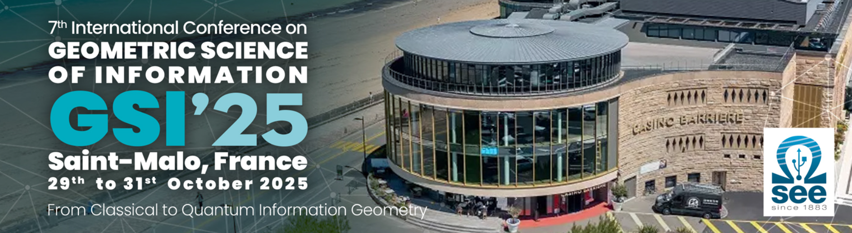
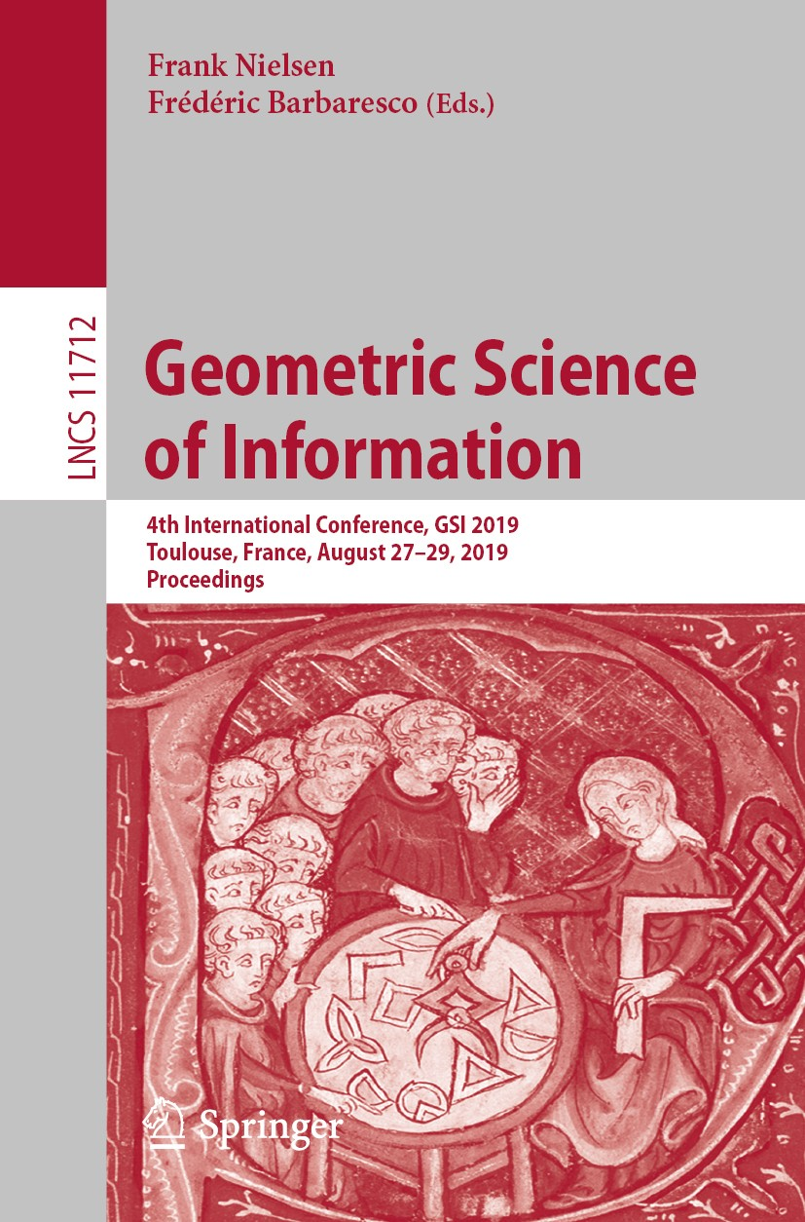

3-volume LNCS proceedings
Geometric Learning and Differential Invariants on Homogeneous Spaces
Statistical Manifolds and Hessian information geometry
Applied Geometry-Informed Machine Learning
Geometric Green Learning on Groups and Quotient Spaces
Divergences in Statistics and Machine Learning
Geometric Statistics
Computational Information Geometry and Divergences
Geometric Methods in Thermodynamics
Classical & Quantum Information, Geometry and Topology
Geometric Mechanics
Stochastic Geometric Dynamics
New trends in Nonholonomic Systems
Learning of Dynamic Processes
Optimization and learning on manifolds
Neurogeometry
Lie Group in Learning Distributions & in Filters
A geometric approach to differential equations
Information Geometry, Delzant Toric Manifold & Integrable System
Special issue at “Information Geometry”

