Slide 1

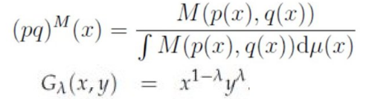
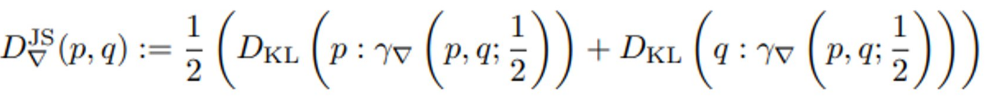
Geometric Jensen-Shannon divergences: Two meanings
Ordinary
Jensen-Shannon divergence
Replace arithmetic by abstract mean in the JSD: M-JSD
View JSD as a contrast divergence, a geometric function on the product manifold MxM using a ∇-geodesic: ∇-JSD
①
Mixture wrt
a mean M
Geometric mean M=G
②
Notes:
Two definitions of the geometric Jensen-Shannon divergences (G-JSD):
① Use M-statistical mixtures. Merit is to obtain closed-form formula for multivariate normal with M=geometric mean:
https://www.mdpi.com/1099-4300/21/5/485
② Define statistical divergence geometrically as a function on the product manifold. Then replace abstract mean by midpoint on a geodesic:
https://link.springer.com/chapter/10.1007/978-3-031-38271-0_15
Video: https://www.youtube.com/watch?v=m-mElw8nRPM

Slide 2
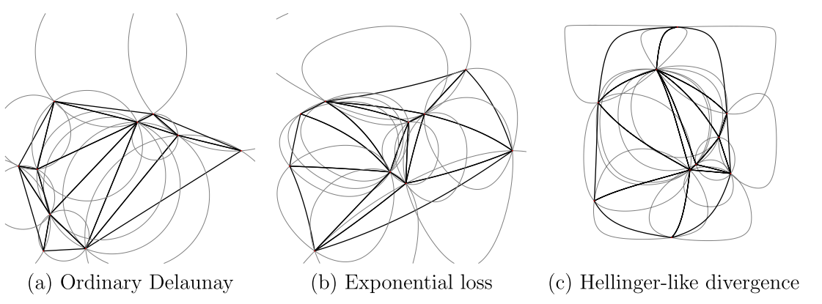
Bregman Delaunay triangulations/complexes
… satisfy the Bregman empty sphere property

Slide 3
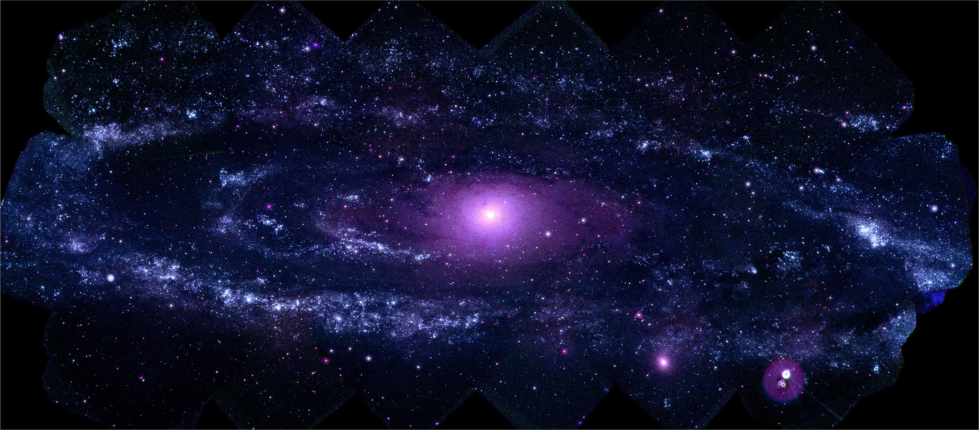
Physics is embedded Mathematics in Nature
Notes:
What is the math/physics of learning
Physics is embedded Mathematics in Nature

Slide 4
Strengths of generalized calculus in differential geometry:
Differential geometry offers a framework for coordinate-free calculus:
Intrinsic calculus is unbiased by representations with consistent changes of (local) coordinate systems
Covariant derivative ∇ generalizes ordinary derivative:
Coderivative of a tensor field by a vector field ∇_{V}T
Exterior derivative d generalizes ordinary differentials on differential forms ω :
Generalize integration on manifolds with Stokes-Cartan theorem
Geometric/real Clifford algebra:
multivectors allowing division by vectors
Notes:
https://en.wikipedia.org/wiki/Generalized_Stokes_theorem
https://en.wikipedia.org/wiki/Geometric_algebra

Slide 5

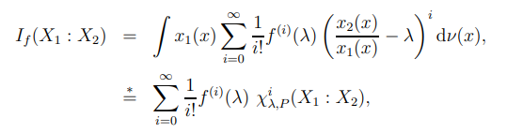

f-divergences as a series of signed 𝛘2-square type divergences
with

Slide 6
From niche research to hot engineering!
History of ANNs

Slide 7
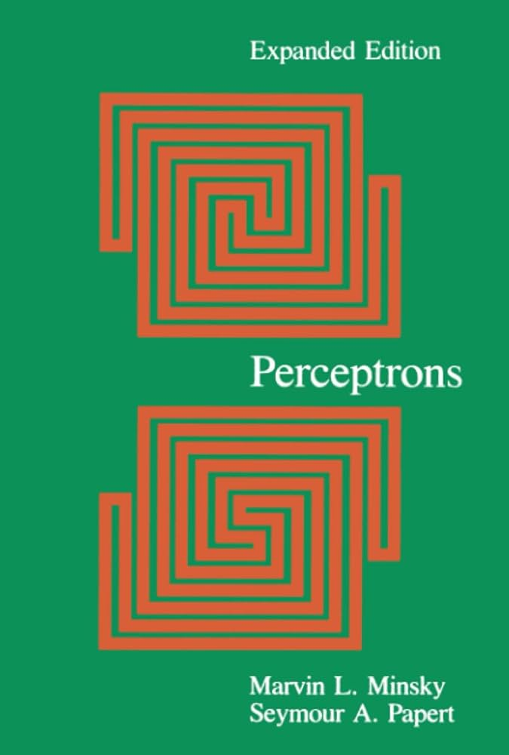
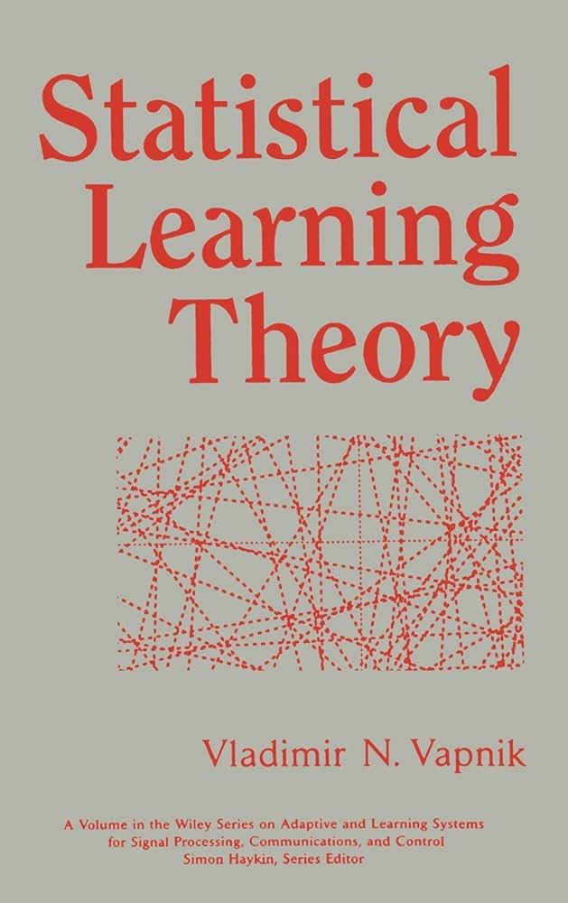



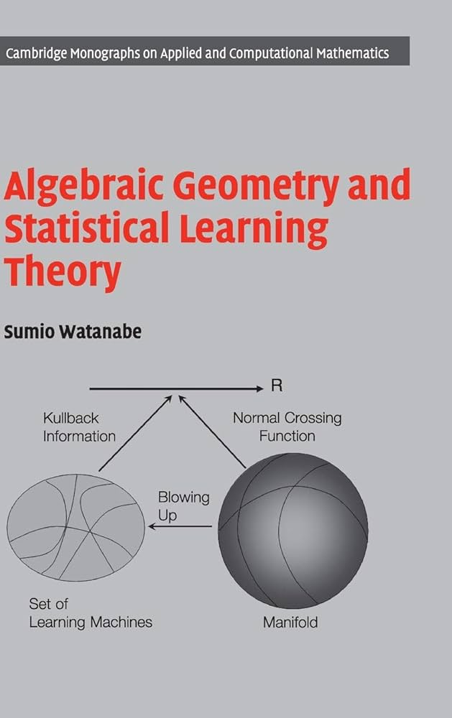
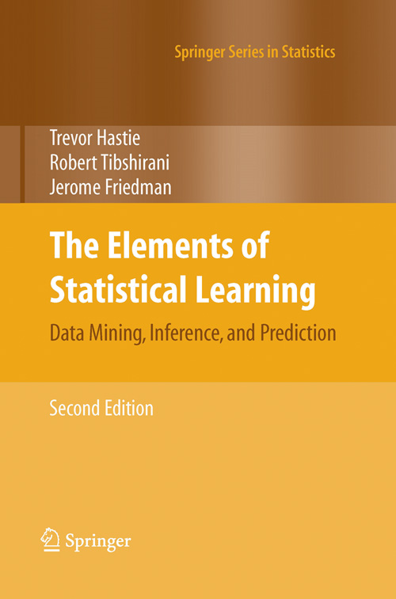
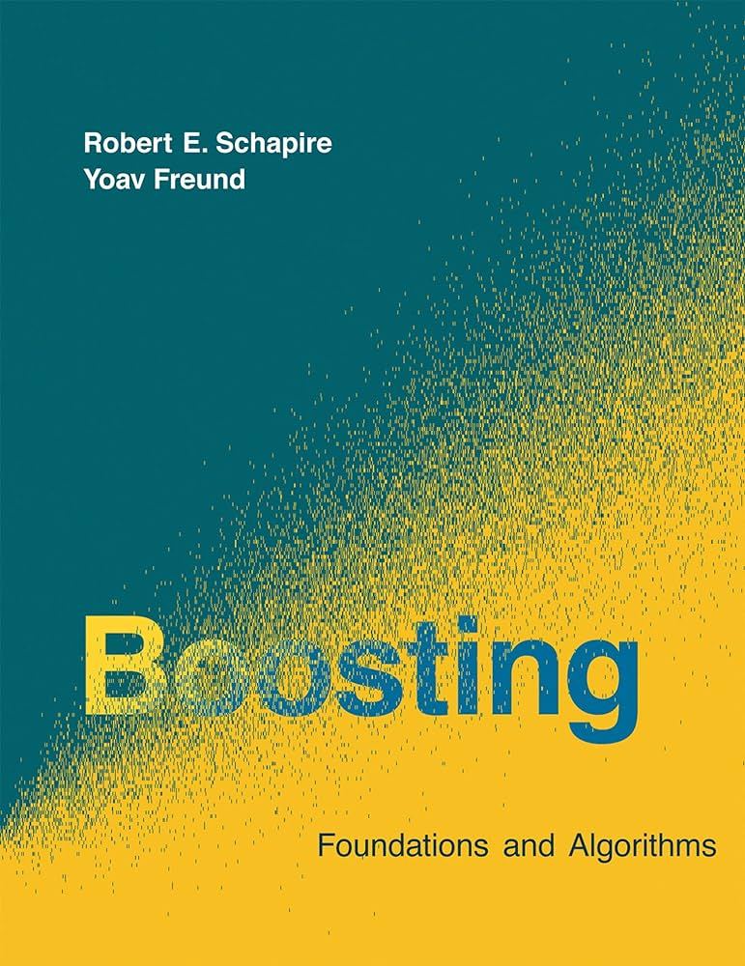

Notes:
Some masterpiece (text)books that shaped the field of Machine Learning

Slide 9

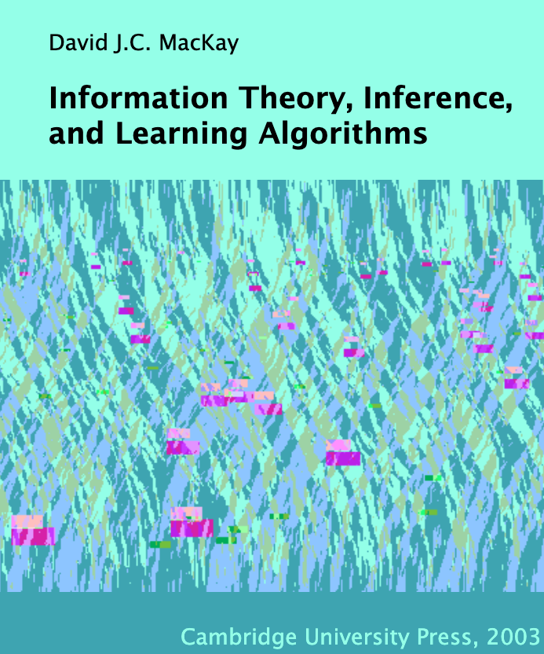

Slide 10

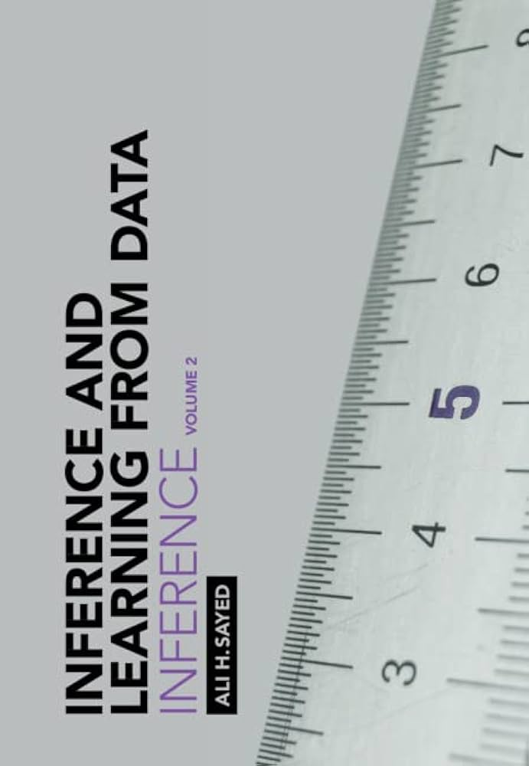

Notes:
Great trilogy books on machine learning by Prof. Ali Sayed (EPFL):
Foundations
Inference
Learning
https://tinyurl.com/TrilogyAliSayed

Slide 11

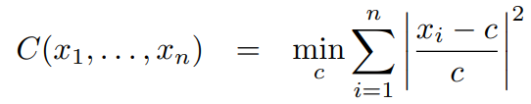
Contraharmonic or antiharmonic mean
Contraharmonic or antiharmonic mean of n positive reals:
The contraharmonic mean is the solution of the sum of the squares with relative errors:

Slide 12
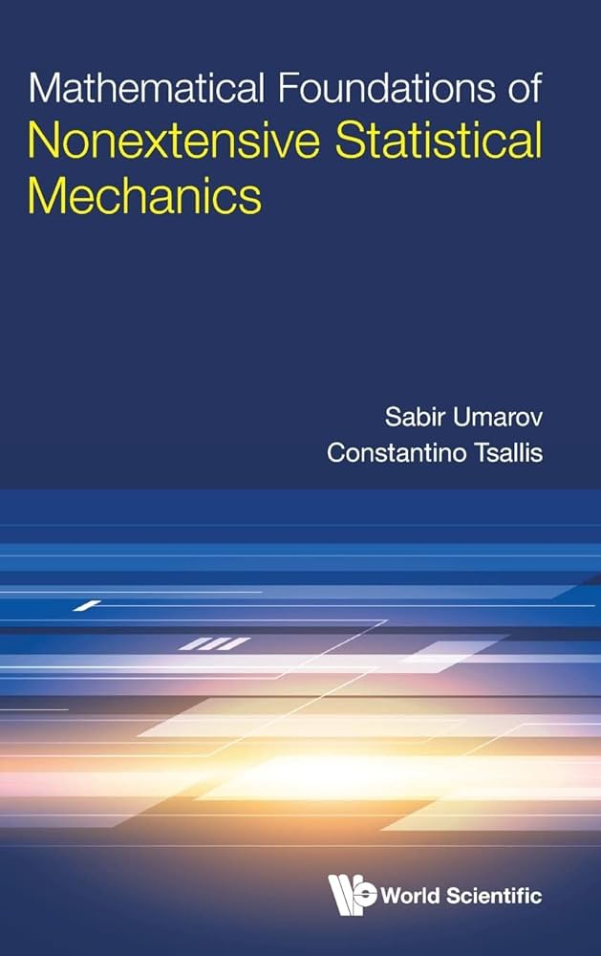
Andrej Karpathy

Slide 13

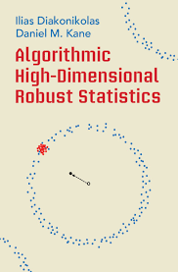


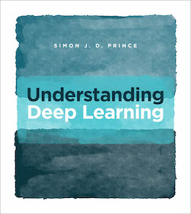

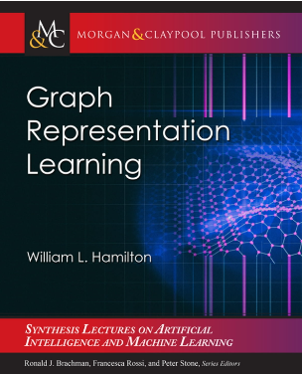

Slide 14


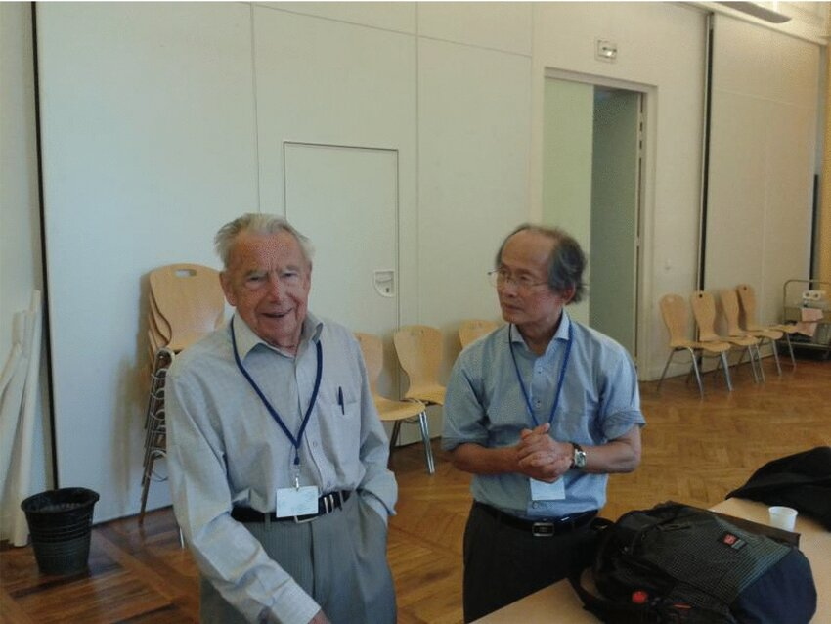
Hessian manifolds, Hessian geometry, Bregman geometry
Hessian structure on a manifold: (g, ∇) where g is a Hessian metric tensor and a torsion-free flat connection ∇
To every chart there is a potential function defining the Hessian metric in local coordinates of the chart
Hessian manifolds are special affine manifolds (M, ∇) where ∇ is a torsion-free flat connection
A Bregman divergence induces a Hessian manifold with a global chart, a Bregman manifold
Professor Jean-Louis Koszul (left)
Professor Hirohiko Shima (right)
at GSI 2013
志摩裕彦, へッセ幾何学， 裳華房， 2001
Shima, Hirohiko. The geometry of Hessian structures. World Scientific, 2007.
Tutorial on Bregman manifolds: "On geodesic triangles with right angles in a dually flat space." Progress in Information Geometry: Theory and Applications. Cham: Springer International Publishing, 2021. 153-190.
Notes:
Affine manifold (M, ∇): ∇ is a torsion-free flat connection
Hessian manifold : Affine manifold + Hessian metric tensor
Bregman manifold = Hessian manifold with global chart
Tutorial on Bregman manifolds:
https://tinyurl.com/HessBreg
https://twitter.com/FrnkNlsn/status/1712991125672518000
https://link.springer.com/chapter/10.1007/978-3-030-65459-7_7

Slide 15
Mathematics, proof, and computation
Mathematics can manipulate definite numbers (“mathematical entities”) as limits of computational processes. Shall computation be finite or how can we compute limits (halting problem, parallelism)?
For example: continued fractions, arithmetic-geometric means, etc.
Dualities in mathematics and computing: A program can be interpreted or solve many dual problems.
For example: cross product of two homogeneous 3D vectors interpreted as line passing through two points or dual intersection point of the corresponding two dual lines (here, projective geometry duality).

Slide 16
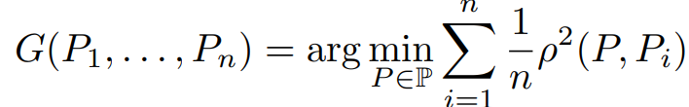
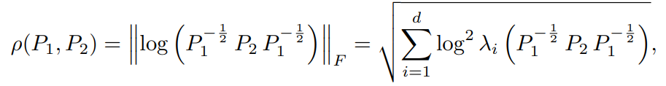






Geometric mean of n symmetric positive-definite matrices
Define the geometric mean of n SPD matrices as the unique minimizer of
When n=2: closed-form formula:
Unique solution is characterized by Karcher equation:
Simple inductive geometric mean: Let M₁=P₁ . Then iterate
In the limit, it converges to the geometric n-variable mean:
Extend to calculate expectations of SPD random variables with compact supports
with
with geodesic barycenter (weighted geometric bivariate mean):
What is... An inductive mean? AMS Notices, Dec. 2023
Notes:
Simple iterative algorithm to compute the geometric matrix mean of n SPD matrices.
Extend to approximate the expectations of SPD random variables with compact supports from variates:
https://franknielsen.github.io/MatrixGeometricMean/WhatIsInductiveMean-notformatted.pdf

