Slide 1
Notes:
https://link.springer.com/article/10.1007/s41884-018-0002-8
84

Slide 2
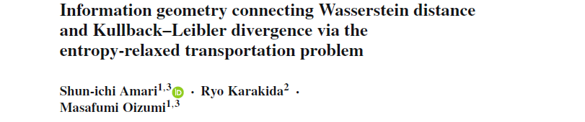
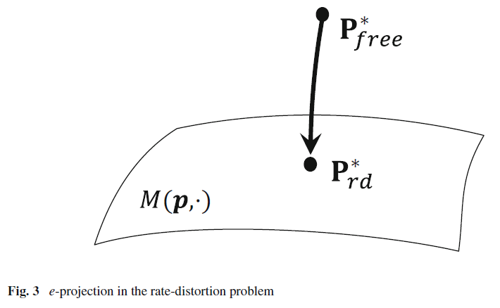

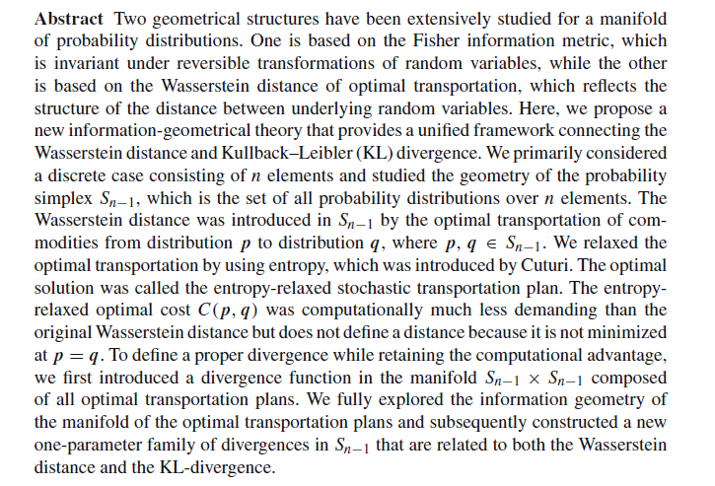
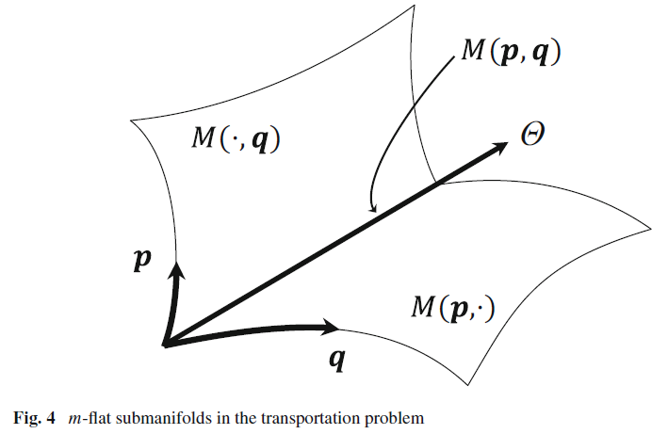
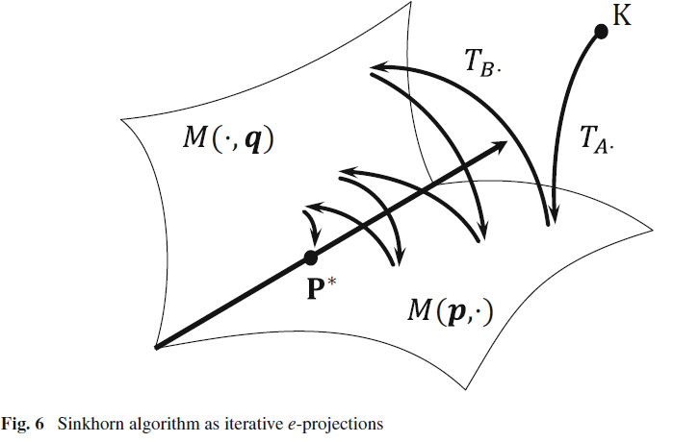
Notes:
Lambda Bregman divergence converge to KLD as lambda->oo
Clustering, stat estimation, rate distortion
geometry of optimal transportation plans and introduced a oneparameter
family of divergences in the probability simplex which connects the
Wasserstein distance and KL-divergence

Slide 3
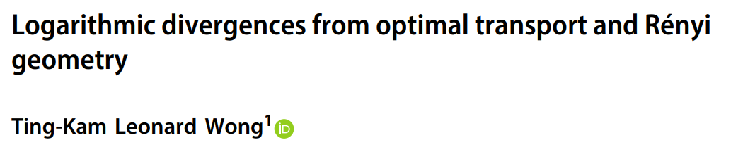
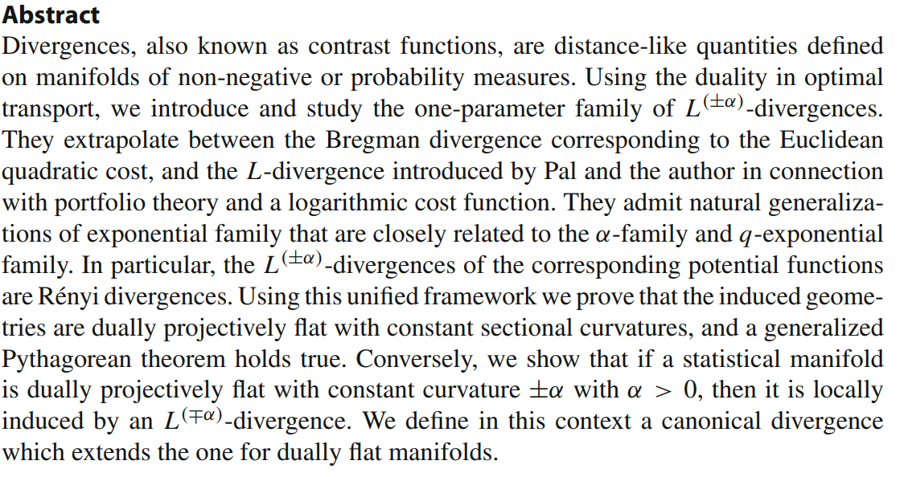
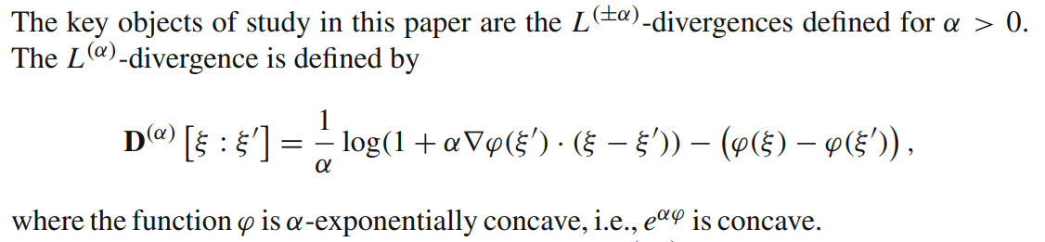
Volume 1
Issue 1
Article 2

Slide 4
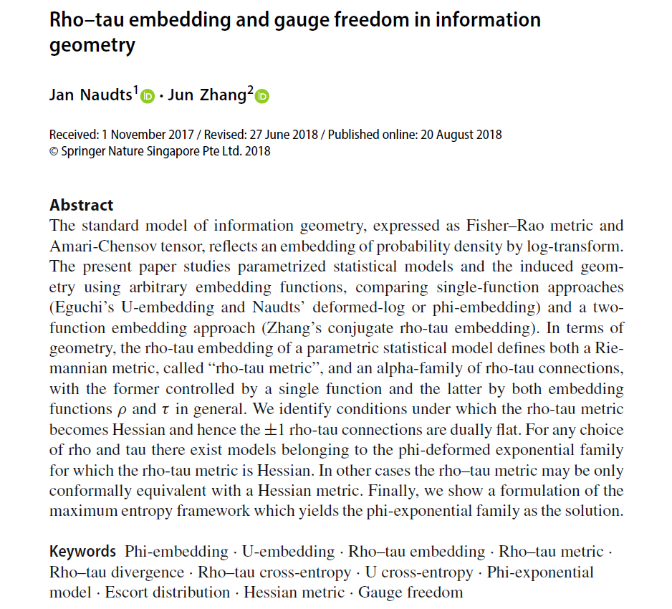
Volume 1
Issue 1
Article ３
Notes:
” Rho–tau embedding and gauge freedom in information geometry“
https://link.springer.com/article/10.1007/s41884-018-0004-6

Slide 5
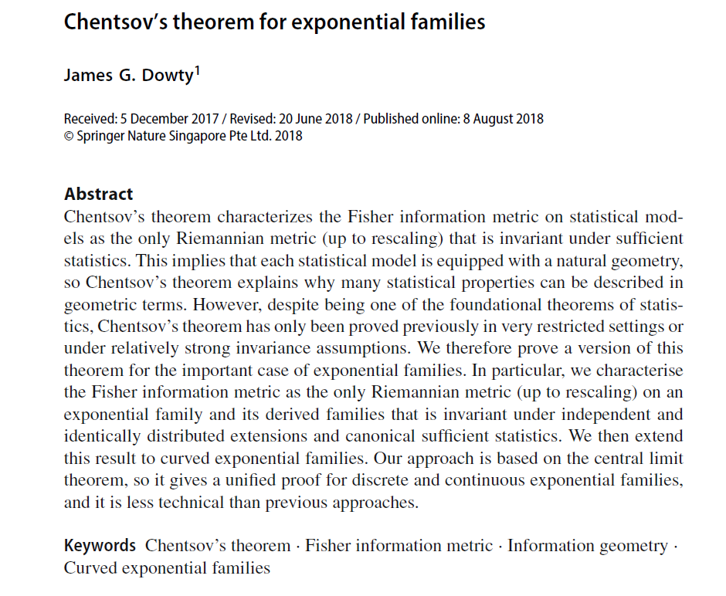
Volume 1
Issue 1
Article ４
Notes:
” Chentsov’s theorem for exponential families“
https://link.springer.com/article/10.1007/s41884-018-0006-4

