Slide 1
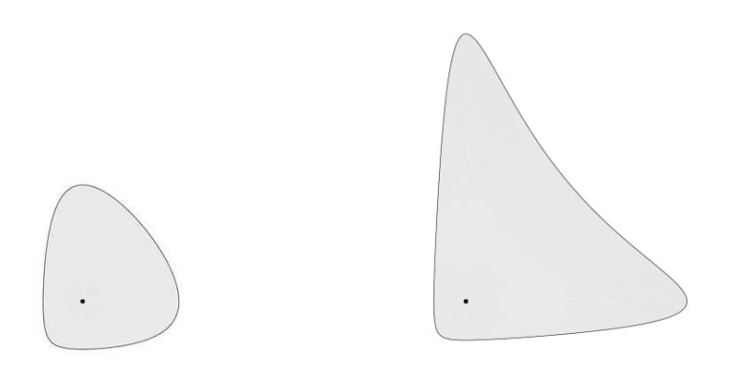
Space of Bregman spheres
Frank NIELSEN

Slide 2
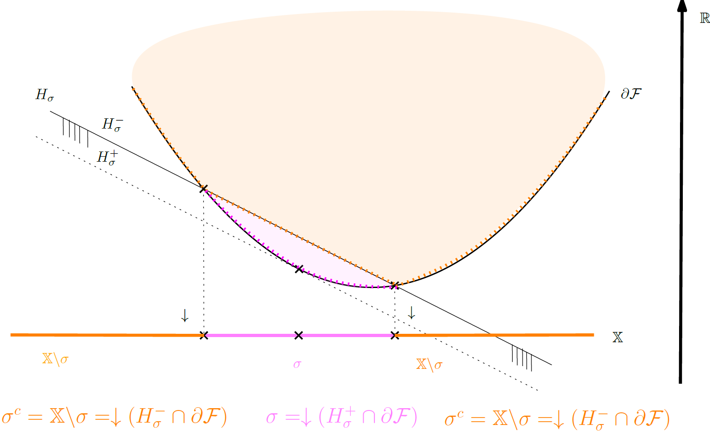

Slide 3
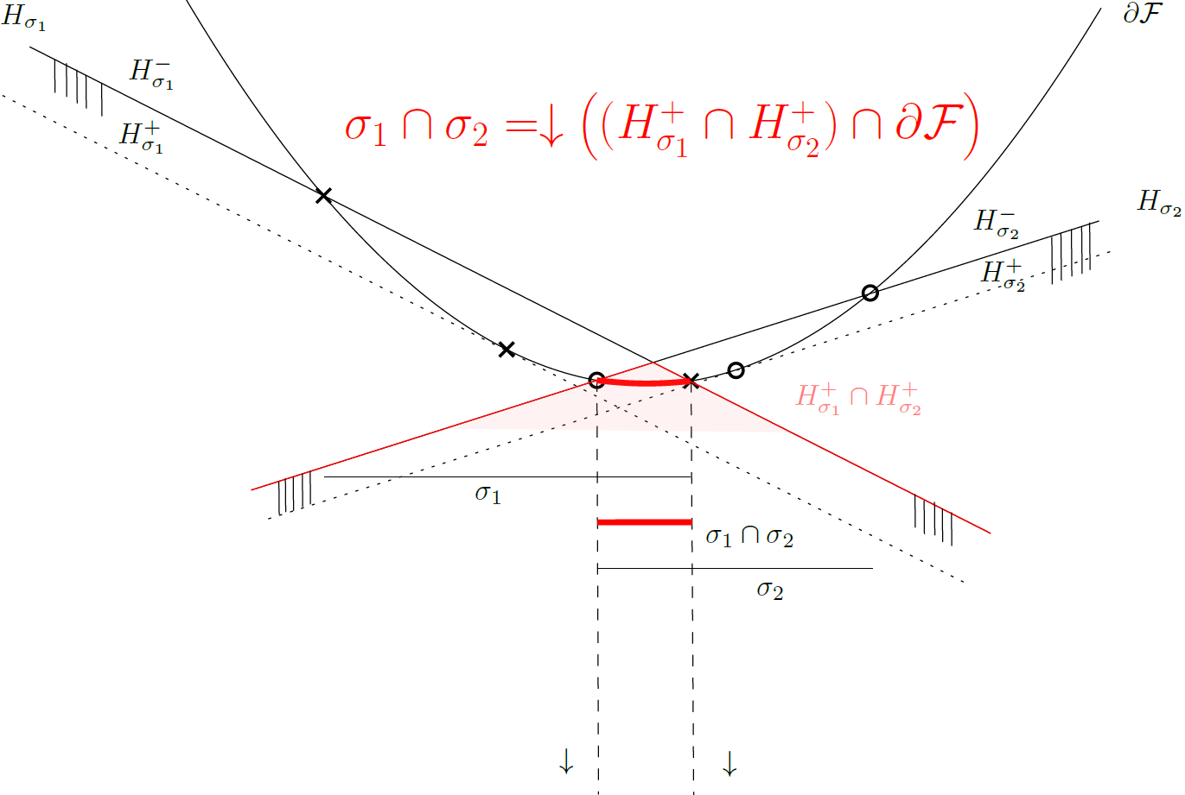

Slide 4
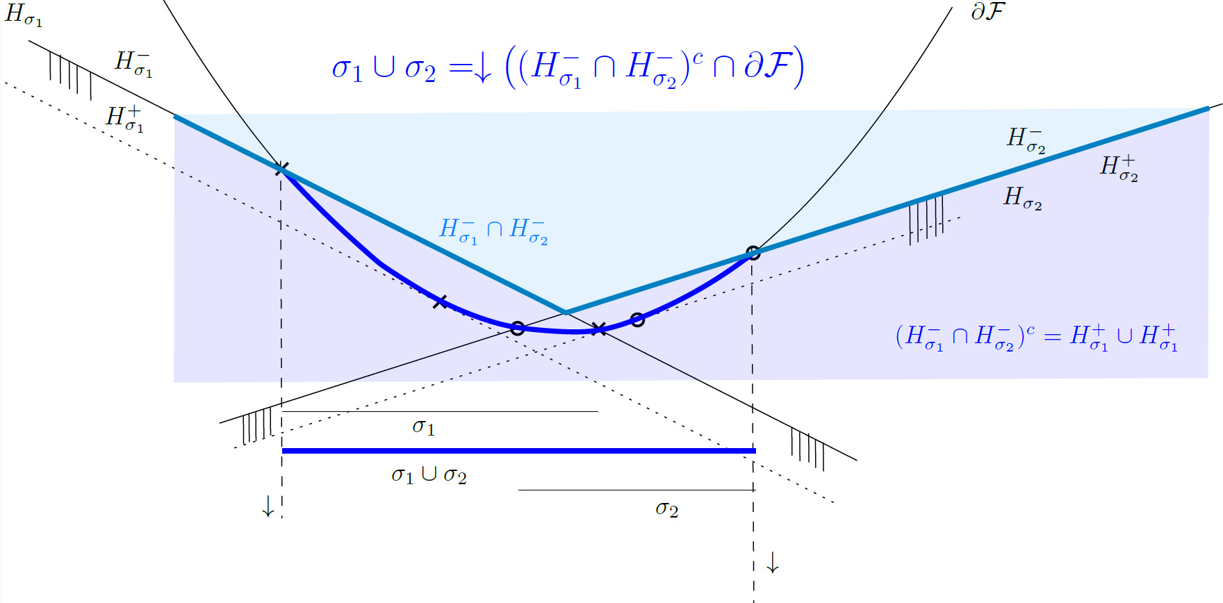
Notes:
De Morgan laws for sets

Slide 5
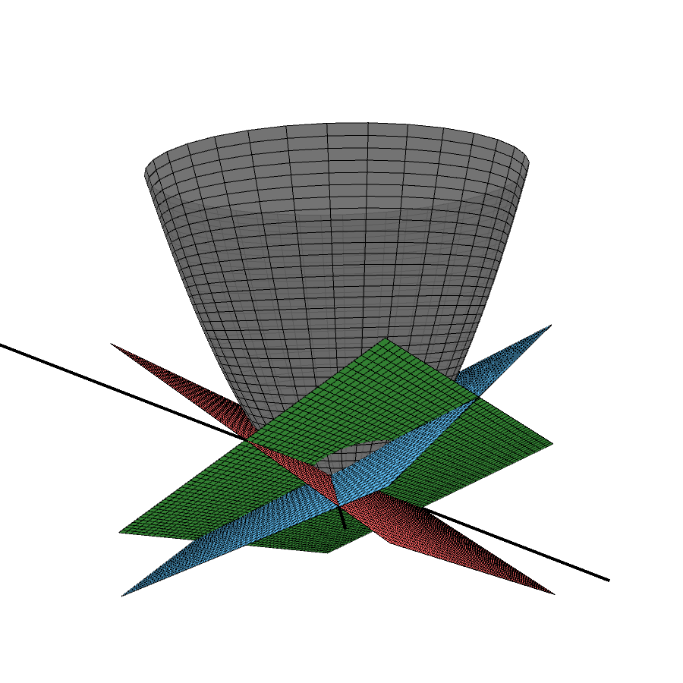
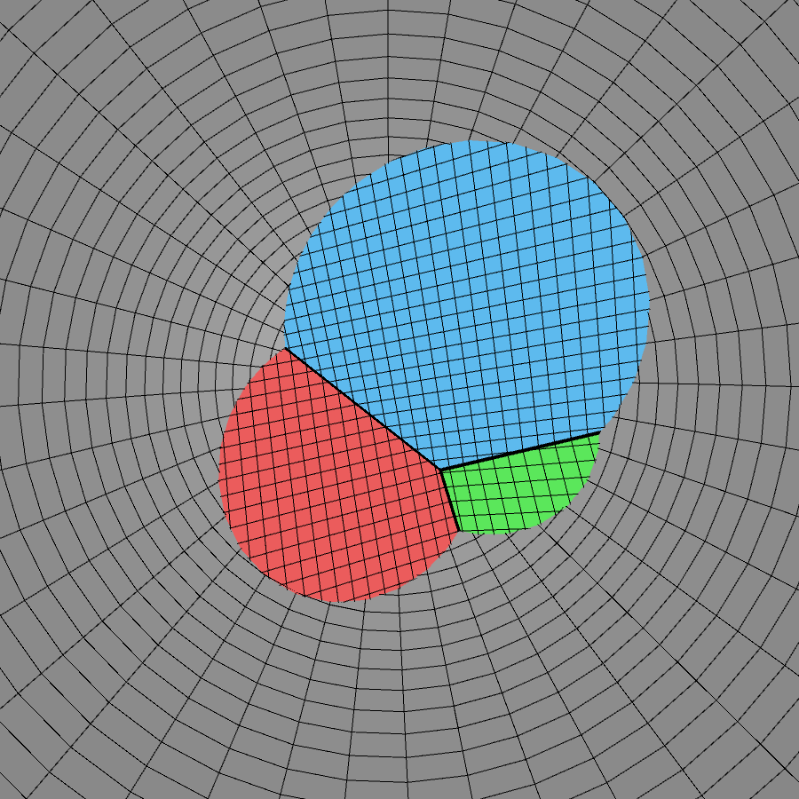
Example: Euclidean spheres potential function: paraboloid
Top view displays the union of disks

