Slide 1

On polarities and computational convexity
Frank Nielsen
Sony Computer Science Laboratories, Inc.
10th September 2026
Notes:
10th Sept 2026

Slide 2
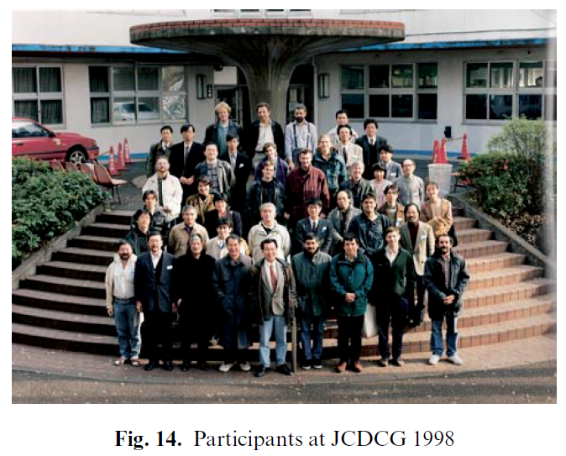


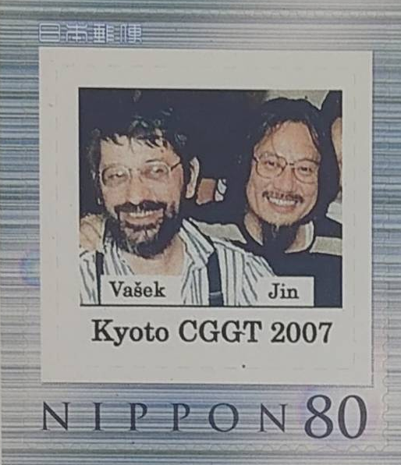

Background: G (1998) → GG (2007) → GGG (2026)

Slide 3
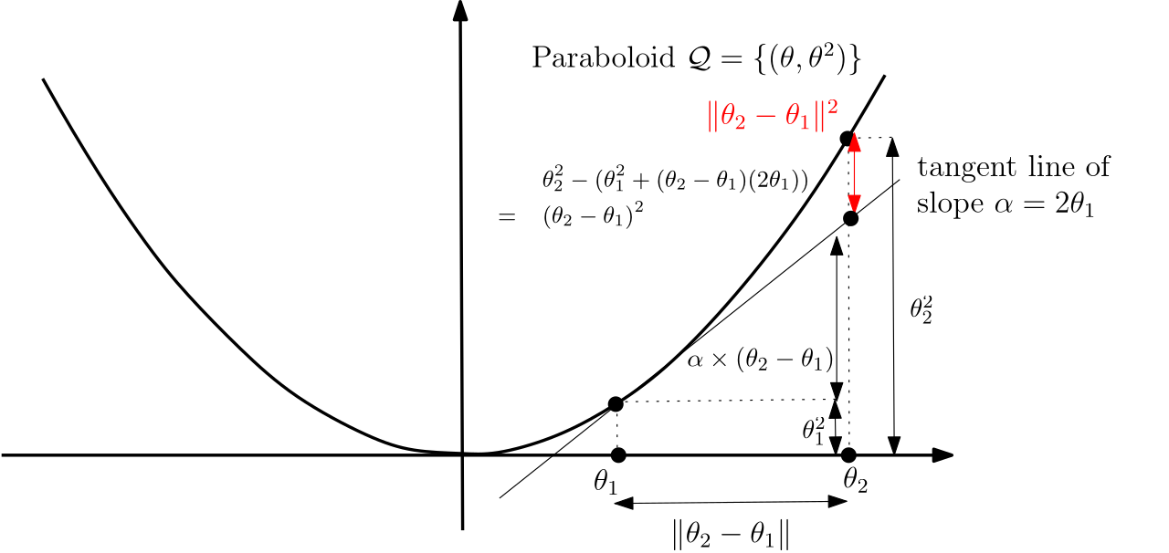
A view of the squared Euclidean distance
Squared Euclidean distance is not a metric because it violates the triangle inequality.
Smooth distances are called divergences
(Related to the paraboloid lifting in Computational Geometry for Voronoi/Delaunay)

Slide 4
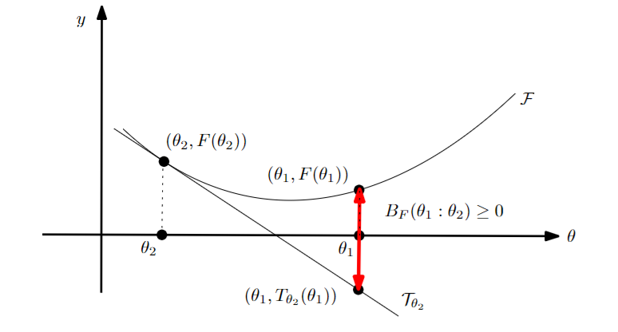
Bregman divergences: Convex potential functions
F: Θ⊆ℝ^{m}→ℝ a strictly convex and smooth real-valued function on a finite-dimensional Hilbert space equipped with inner product <.,.>
Bregman divergence B_{F}: Θ x Int(Θ) →ℝ
B_{F}(θ₁ : θ₂) = F(θ₁) - ( F(θ₂) + < θ₁ - θ_{2 ,} ∇F(θ₂) > )
= F(θ₁) - F(θ₂) - < θ₁ - θ_{2 ,} ∇F(θ₂) >
BD measures a convexity gap
Notes:
https://en.wikipedia.org/wiki/Mathematical_operators_and_
ℝ
symbols_in_Unicode
Θθ∇≻ξ∈
http://lib.physcon.ru/doc?id=5d34ad008433
Σ
Lev Meerovich Bregman
(1941 - 2023)

Slide 5
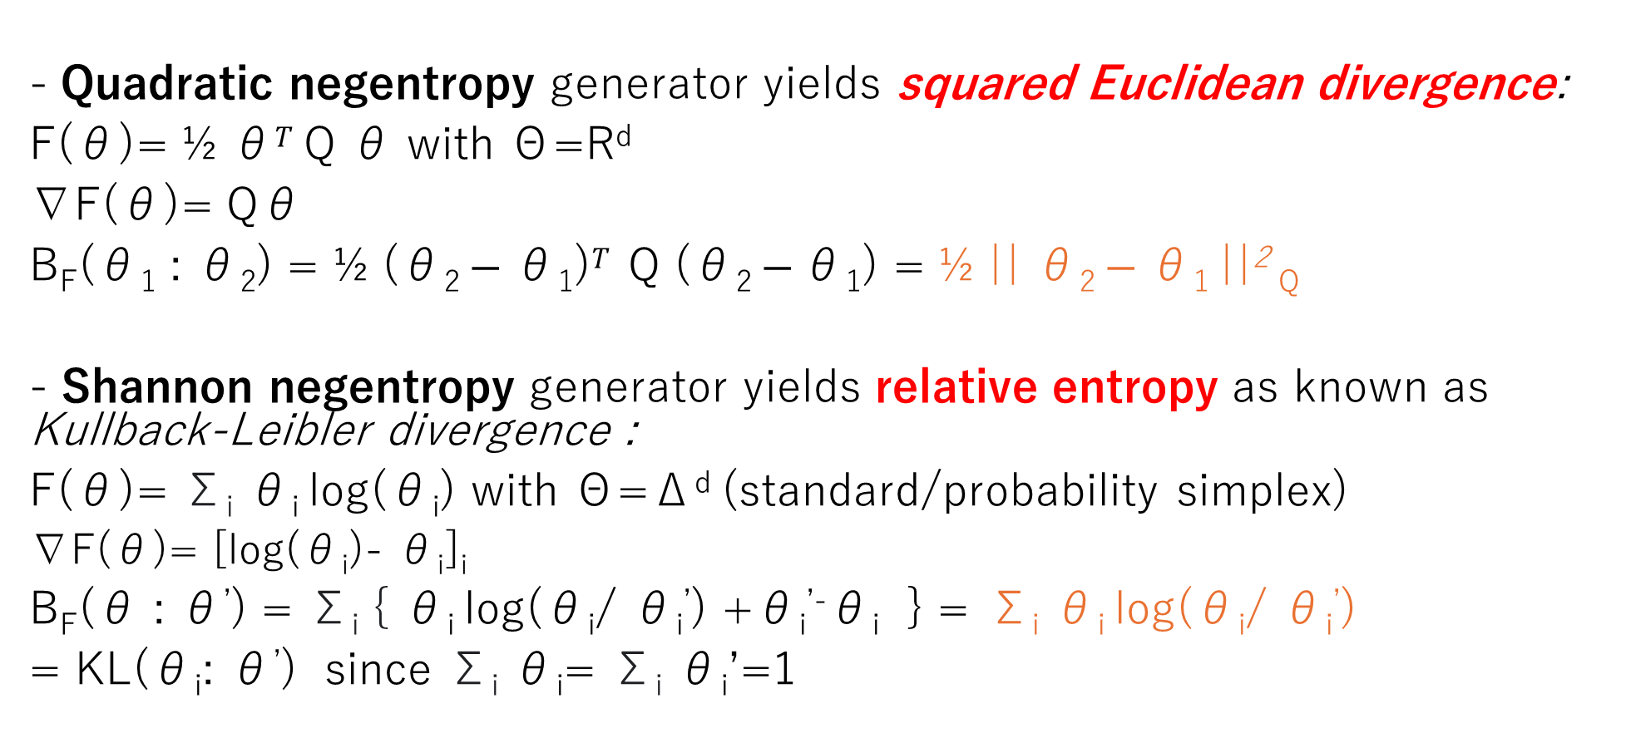
Bregman divergences unify important distortions
B_{F}(θ₁ : θ₂) = F(θ₁) - F(θ₂) - < θ₁ - θ_{2 ,} ∇F(θ₂) >
Quadratic negentropy generator yields squared Euclidean divergence:
F(θ)= ½ θ$T$ Q θ with Θ=R^{d}
∇F(θ)= Qθ
B_{F}(θ₁ : θ₂) = ½ (θ₂ $− \text{θ}\text{1}\text{)}T$ Q (θ₂ $− \text{θ}\text{1}\text{)}$ = ½ || θ₂ $− \text{θ}\text{1} \text{||}$² _{Q}
- Shannon negentropy generator yields relative entropy as known as Kullback-Leibler divergence :
F(θ)= Σ_{i} θ_{i} log(θ_{i}) with Θ=Δ^{d} (standard/probability simplex)
∇F(θ)= [log(θ_{i})- θ_{i}]_{i}
B_{F}(θ : θ’) = Σ_{i} { θ_{i} log(θ_{i}/ θ_{i}’) +θ_{i}^{’-}θ_{i} } = Σ_{i} θ_{i} log(θ_{i}/ θ_{i}’)
= KL(θ_{i}: θ’) since Σ_{i} θ_{i}= Σ_{i} θ_{i}’=1
Computational geometry L₂²
Information geometry
Notes:
Q SPD,

Slide 6
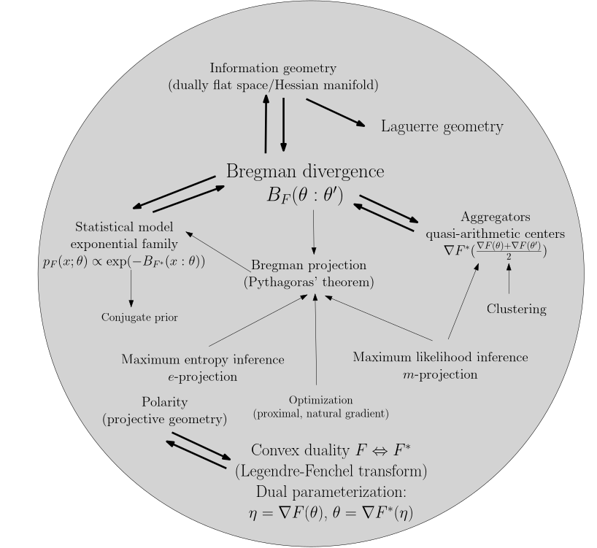
Bregman divergences are the workhorses in ML and AI
This talk describes
two connections of
Bregman divergences with computational geometry:
Power distances
Quadratic Polarities
Ecosystem
of dualities

Slide 7
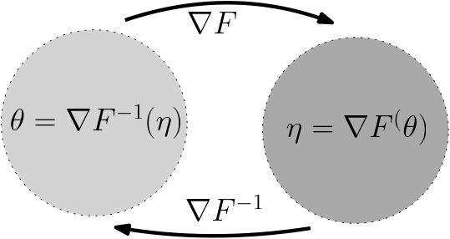
Dual Bregman/Fenchel-Young divergences
Gradient map ∇F yields dual parameterization
η= ∇F (θ)
Build the Fenchel-Young divergence from Young inequality:
F (θ₁)+F* (η₂) ≥ < θ_{1 ,} η₂>
Y_{F, F*}(θ_{1,} η₂) = F (θ₁) + F* (η₂) - < θ_{1 ,} η₂> ≥ 0
where F* is the Legendre-Fenchel transform of F:
F*(η) = sup _{θ ∈ ϴ} {< θ, η >-F(θ)}
with θ=∇F⁻¹ (η)=∇F* (η)

Slide 8

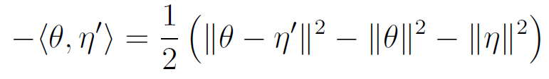
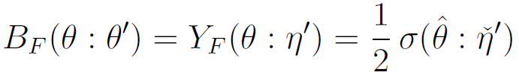
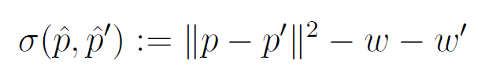




Bregman divergences as power distances
BD from Fenchel-Young divergence
Then use identity
and get BD as PD
Power distance
(signed measure)
Weighted points expressed in mixed parameterizations:
2607.24197

Slide 9
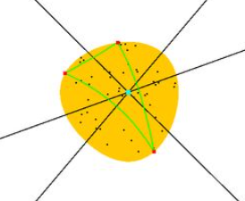
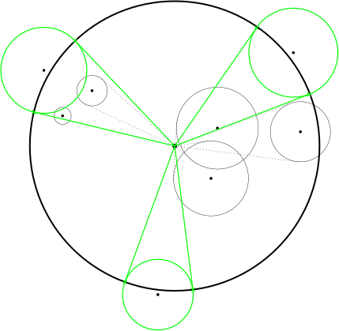


Bregman divergences as power distances: CG
Use toolbox of computational geometry in information geometry!
Bregman miniball inθ
as Power miniball in η
In information theory/ML, redundancy measure amounts to BD
2607.24197
Notes:
θ₁)+F* (η₂

Slide 10
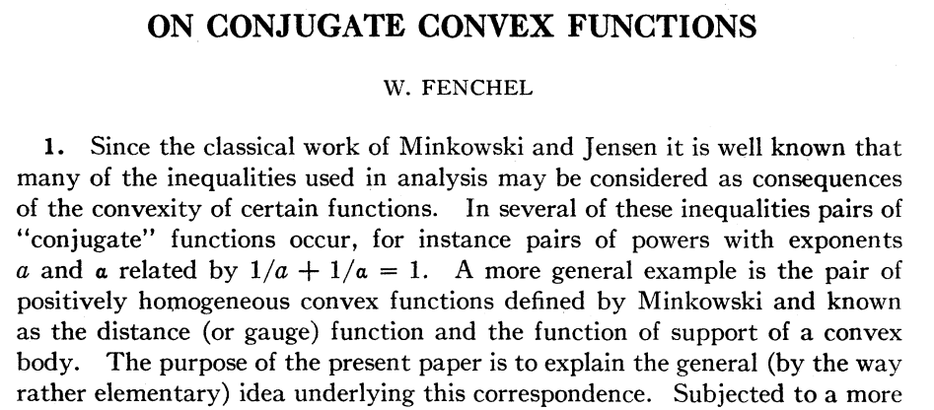
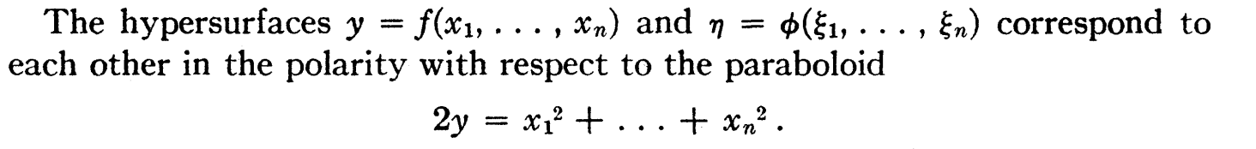
Canadian Journal of Mathematics, 1949

Slide 11

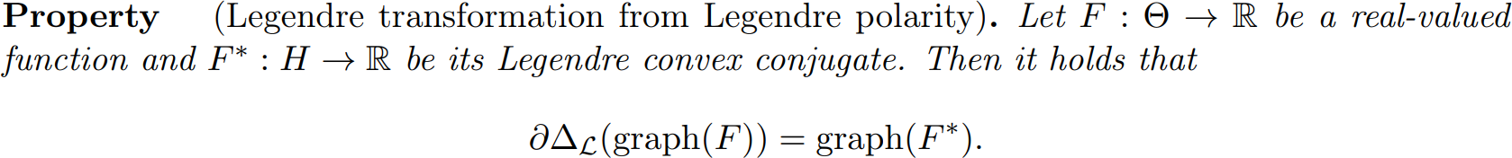
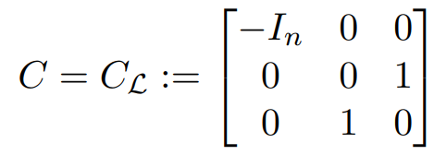
Convex conjugates from quadratic polarities*
*Joint work with Basile Plus-Gourdon and Mahito Sugiyama
Polarity of a set A:
Quadratic polarity when
[Fenchel 1949]
Legendre polarity
n-variate function → Graph (n+1)-dim → Projective space/homogeneous coordinates (n+2)-dim

Slide 12
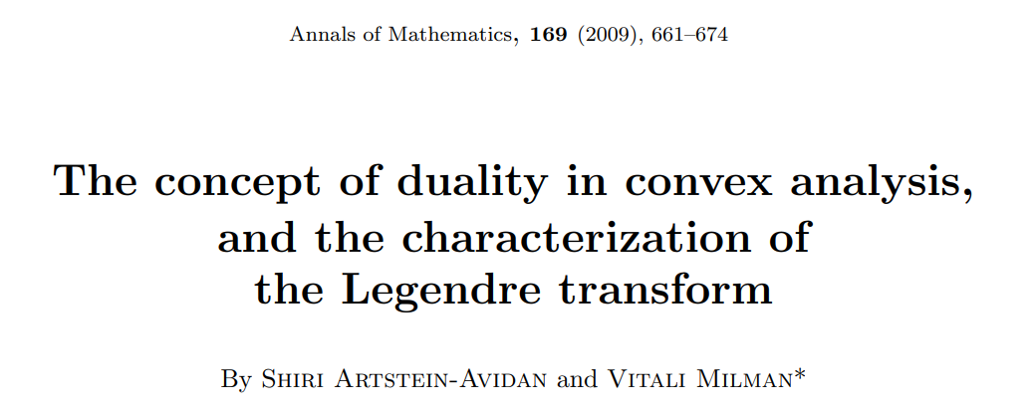
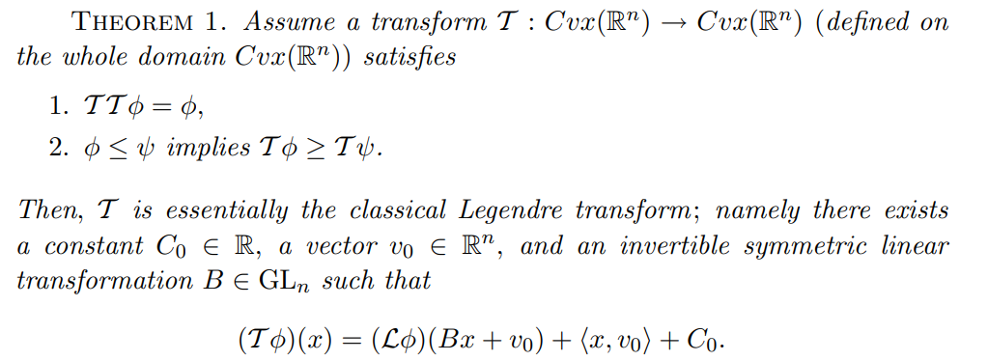
"Generalized Legendre Transforms Have Roots in Information Geometry." Entropy 28.1 (2025)

Slide 13
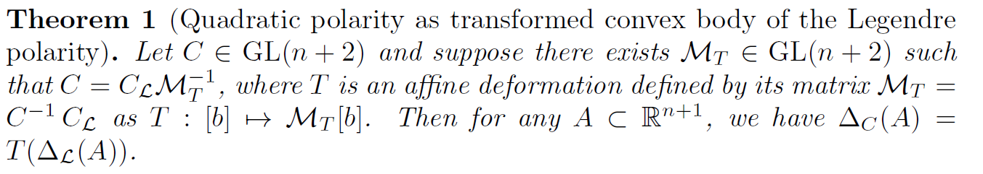
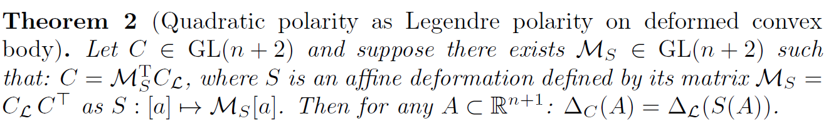


Legendre transform and gauge transformations*
*Joint work with Basile Plus-Gourdon and Mahito Sugiyama
Quadratic Polarity realized as Legendre Polarity → Deformation
Quadratic Polarity realized as Deformation → Legendre Polarity
with correspondences:
Gauge freedom with matrix pipeline

Slide 14
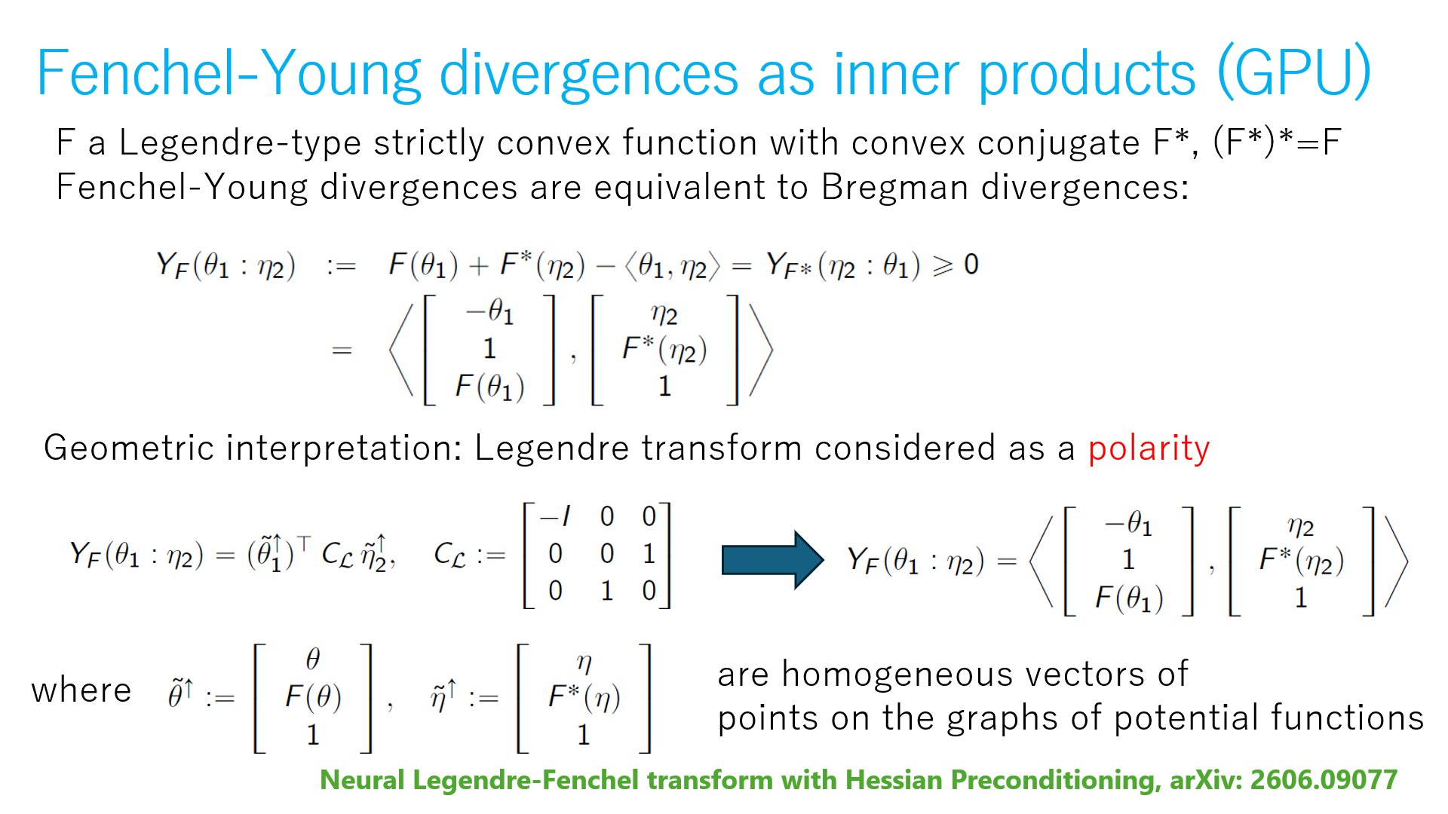
Fenchel-Young divergences as inner products (GPU)
Inner product on graph points
using homogeneous coordinates

Slide 15



Convex conjugates F* via neural networks*
*Joint work with Basile Plus-Gourdon
2606.09077
Conjugate F*(η) = < (∇F)⁻¹ (η), η > - F( (∇F)⁻¹(η) )
may not be in closed form when (∇F)⁻¹ not available or computationally intractable: Often the case in ML and optimal transport.
Conjugation map:
Train NN with loss function :
Once trained, we approximate the convex conjugate by
We use gauge freedom to stabilize numerically the NN learning…
Motivation: Half quadratic paraboloid yield identity, linear gradient map
Notes:
Paraboloid is the only self-conjugate function

Slide 16
Computational geometry for Machine Learning
Kullback-Leibler minimax called redundancy in information theory solved as equivalent smallest enclosing power balls
Computational convexity with NNs
References
Neural Legendre-Fenchel transform with Hessian Preconditioning, arXiv:2606.09077
Minimum enclosing Bregman balls made easy, arXiv:2607.24197

Slide 17
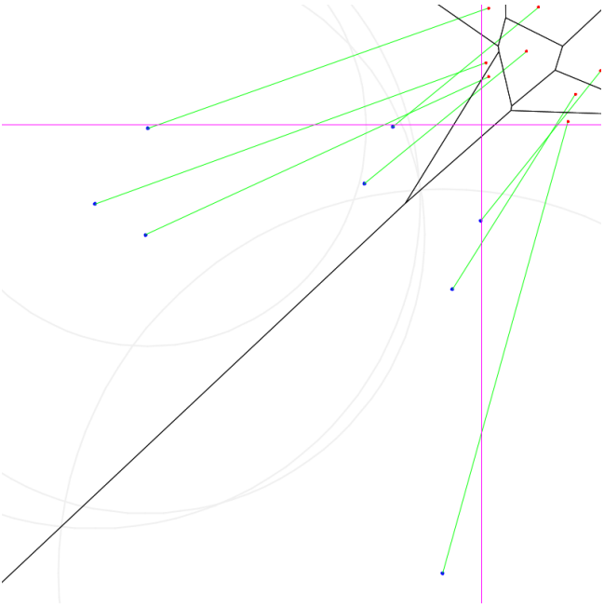
Bregman divergences as power distances: CG
Use toolbox of computational geometry in information geometry!
Kullback-Leibler Voronoi diagram
Bregman Voronoi inθ as clipped power diagrams in η
2607.24197
Notes:
θ₁)+F* (η₂

Slide 18
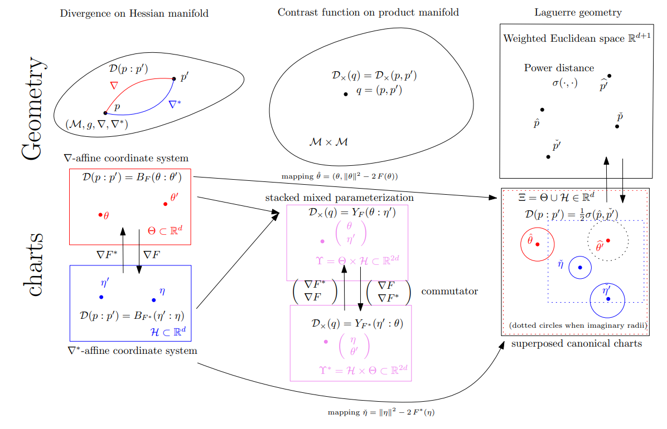

Slide 19
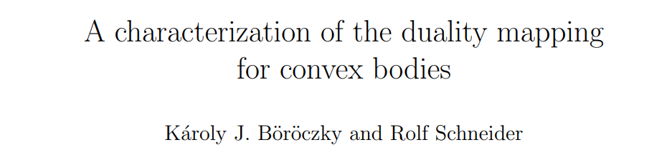

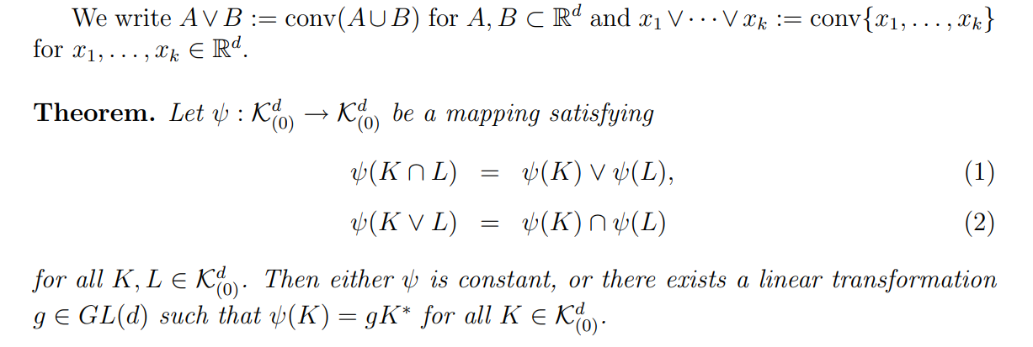
Geom. Funct. Anal 18 (2008)

Slide 20
Recap: On polarities and computational convexity
Bregman divergences and convex duality
Bregman divergences as power distances
Conjugate functions: quadratic polarities & gauge freedom
Neural computational convexity:
(Approximating untractable convex conjugates with neural networks)

Slide 22
Summary
Bregman divergences are coordinatization of “point distance” on Hessian manifolds expressed in dual charts as dual Bregman divergences or in the mixed parameterization as a Fenchel-Young divergence or equivalently power distance in a domain of R^{n}.
→ Computational Hessian information geometry from power distance CG
Conjugate functions defined via quadratic polarity allows one to express the divergence as inner products (fast on GPU) and consider affine deformations
When not available in closed form, conjugates can be approximated using neural networks where the gauge freedom is used to stabilize the learning/accuracy.
→ Neural information geometry = NN-approximations of IG
References
Neural Legendre-Fenchel transform with Hessian Preconditioning, arXiv:2606.09077
Minimum enclosing Bregman balls made easy, arXiv:2607.24197
Notes:
https://link.springer.com/book/10.1007/978-3-540-89550-3
Computational Geometry and Graph Theory
International Conference, KyotoCGGT 2007, Kyoto, Japan, June 11-15, 2007. Revised Selected Papers

Slide 23

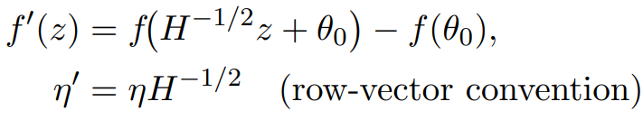

Preconditioning Neural Legendre transform
with conjugate map identity:
(initialization in NN)
Taylor approximation:
learning task in z-space is approximately that of the canonical paraboloid (stable!)

Slide 24
Convex duality via Legendre-Fenchel transform
Legendre-Fenchel transform of a convex function F:
F*(η) = sup _{θ ∈ ϴ} {< θ, η >-F(θ)} = sup _{θ ∈ ϴ} { H _{θ}(η) }
Supremum of affine functions. Involution (F*)*=F, H/V rep of polytopes
Graph(F): pointwise supremum of all affine functions majorized by F
Convex conjugate: F*(η) = < (∇F)⁻¹ (η), η > - F( (∇F)⁻¹(η) )
since supremum is obtained when ∇F (θ)=η.
Dual Bregman divergences/swapping param.: B_{F}(θ₁ : θ₂)=B_{F*}(η₂ :η ₁ )
Notes:
https://sites.math.washington.edu/~rtr/papers/rtr169-VarAnalysis-RockWets.pdf

Slide 25
Dual Fenchel-Young/Bregman divergences
Young inequality: F (θ₁)+F* (η₂) ≥ < θ_{1 ,} η₂>
with equality iff. η₂ = ∇F (θ₁)
Build the Fenchel-Young divergence from this inequality: lhs-rhs ≥0
Y_{F, F*}(θ_{1,} η₂) = F (θ₁) + F* (η₂) - < θ_{1 ,} η₂> ≥ 0
Mixed and dual parameterizations of an underlying geometric divergence
η= ∇F (θ) and θ=∇F* (η)
Notes:
Amari, Shun-ichi. Differential-geometrical methods in statistics. Vol. 28. Springer, 1985
Geometrically, it corresponds to the expression of a point divergence
on a Hessian manifold expressed in the θ-chart and the η-chart

Slide 26
Dual Bregman/Fenchel-Young divergences
Gradient map ∇F yields dual parameterization
η= ∇F (θ)
Dual Bregman divergences: B_{F}(θ₁ : θ₂)=B_{F*}(η₂ :η ₁ )
where F* is the Legendre-Fenchel transform of F:
F*(η) = sup _{θ ∈ ϴ} {< θ, η >-F(θ)}
with θ=∇F⁻¹ (η)=∇F* (η)
Build the Fenchel-Young divergence from Young inequality:
F (θ₁)+F* (η₂) ≥ < θ_{1 ,} η₂>
Y_{F, F*}(θ_{1,} η₂) = F (θ₁) + F* (η₂) - < θ_{1 ,} η₂> ≥ 0

Slide 27
Bregman divergences as power distances: CG
Use toolbox of computational geometry in information geometry!
Kullback-Leibler Voronoi diagram
Ex. 1:Bregman Voronoi inθ as
clipped power diagrams in η
Ex. 2:Bregman miniball inθ
As Power miniball in η
2607.24197
Notes:
θ₁)+F* (η₂

