Slide 1
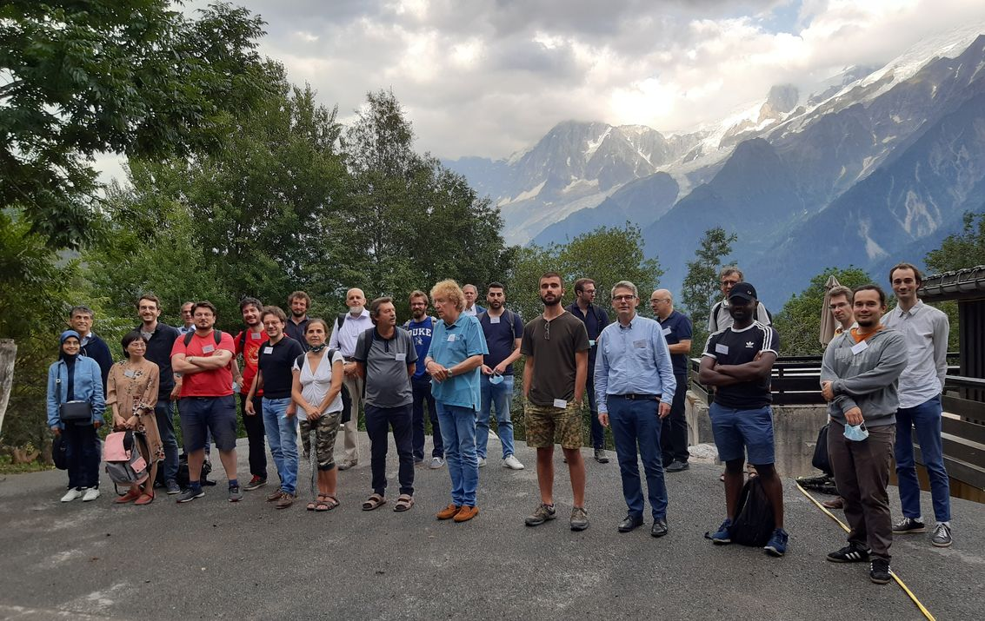

Joint Structures and Common Foundations of Statistical Physics, Information Geometry and Inference for Learning (SPIGL July 27-31th 2020, Les Houches, France)
Onsite participants:
Eric Moulines
Jean-Pierre Françoise
Jean-Claude Zambrini
Géry de Saxcé
Frédéric Barbaresco
Goffredo Chirco
Luigi Malago
Vân Lê
Bernhard Maschke
Zdravko Terze
Giovanni Pistone
Alessandro Barp
Kevin Grosvenor
Carlos Couto
Chafik Samir
Anis Fradi
Rita Fioresi
Filippo Masi
Emmanuel Chevallier
Nicolas Guigui
Riccardo Volpi
Sébastien Boyaval
Hatem Hajri
Avetik Karagulyan
Timothee Pouchon
Elvis Dohmatob
Pierre-Cyril Aubin-Frankowski
Bruno Sauvalle
Alexis Decurninge
Carlos Alcalde
Wolfgang Doerr
Karmouda Ouafae
Online participants:
Elena Celledoni
Francisco Chinesta
François Gay-Balmaz
Manuel de León
Steve Huntsman
Bernhard Maschke
Michel Nguiffo Boyom
Frank Nielsen
Susanne Still
Koichi Tojo
Arjan van der Schaft
Hiroaki Yoshimura

Slide 2
Onsite participants:
Eric Moulines
Jean-Pierre Françoise
Jean-Claude Zambrini
Géry de Saxcé
Frédéric Barbaresco
Goffredo Chirco
Luigi Malago
Vân Lê
Bernhard Maschke
Zdravko Terze
Giovanni Pistone
Alessandro Barp
Kevin Grosvenor
Carlos Couto
Chafik Samir
Anis Fradi
Rita Fioresi
Filippo Masi
Emmanuel Chevallier
Nicolas Guigui
Riccardo Volpi
Sébastien Boyaval
Hatem Hajri
Avetik Karagulyan
Timothee Pouchon
Elvis Dohmatob
Pierre-Cyril Aubin-Frankowski
Bruno Sauvalle
Alexis Decurninge
Carlos Alcalde
Wolfgang Doerr
Karmouda Ouafae

