Slide 1
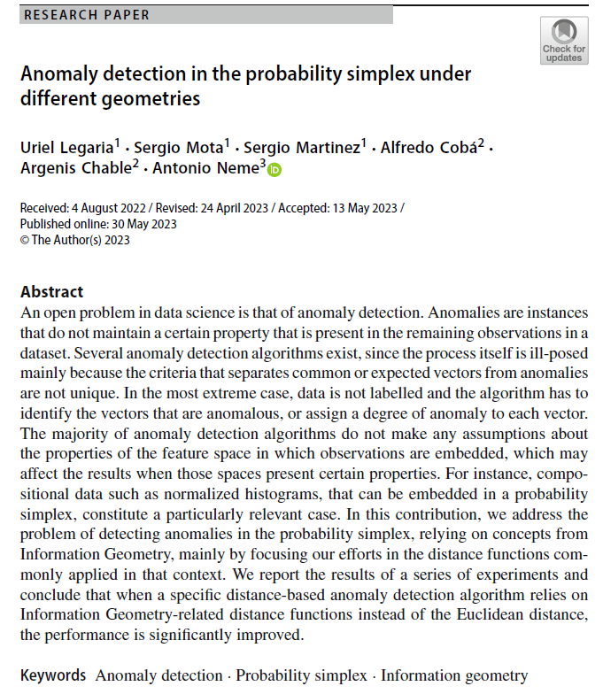

Volume 6
Issue 2
Article 71
Notes:
Anomaly detection in the probability simplex under different geometries
https://link.springer.com/article/10.1007/s41884-023-00107-y

Slide 2
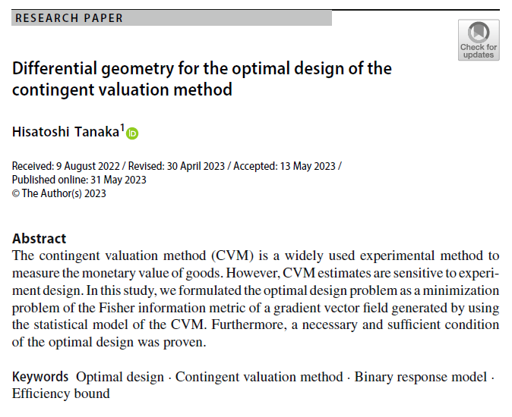
Volume 6
Issue 2
Article 72
Notes:
Differential geometry for the optimal design of the contingent valuation method
https://link.springer.com/article/10.1007/s41884-023-00109-w

Slide 3
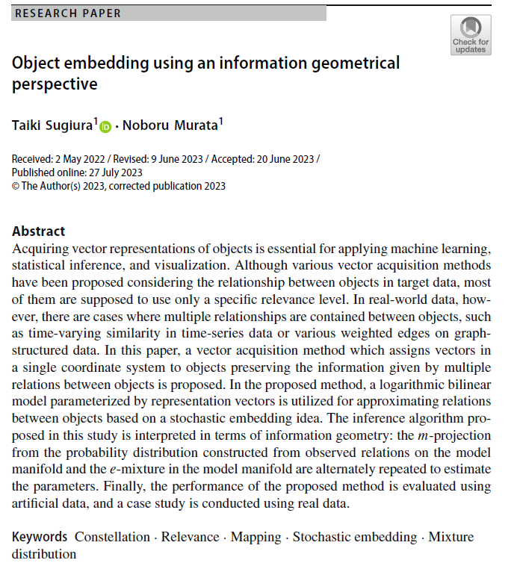
Volume 6
Issue 2
Article 73
Notes:
Object embedding using an information geometrical perspective
https://link.springer.com/article/10.1007/s41884-023-00114-z

Slide 4
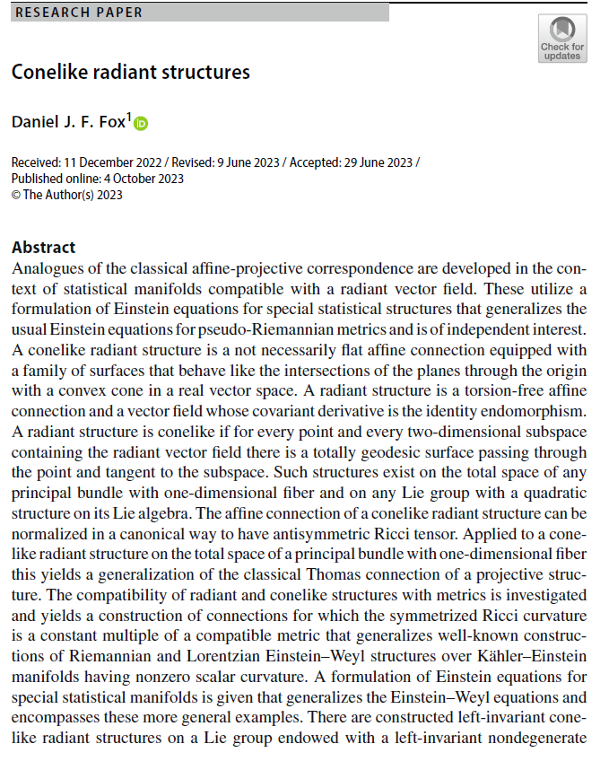
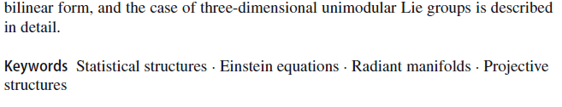
Volume 6
Issue 2
Article 74
Notes:
Conelike radiant structures
https://link.springer.com/article/10.1007/s41884-023-00115-y

