Slide 1
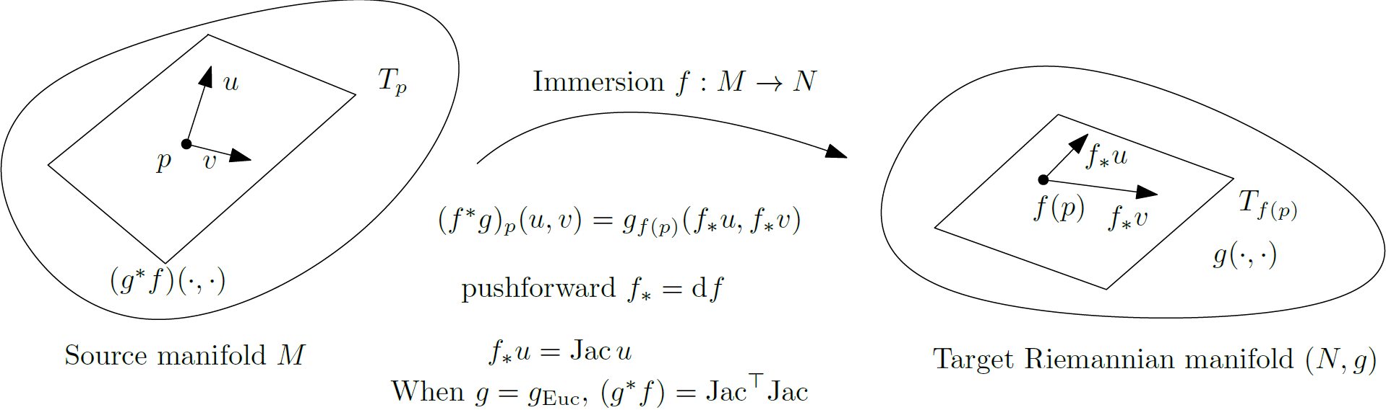
Pullback metric
Immersion f:M→N, source manifold M, target Riemannian manifold (N,g)
Pullback metric f*g on M: f*g_{p}(u,v) = g_{f(p)}(f*u,f*v)
Pushfoward: f*=df , differential of f, linear approximation of f between tangent planes
Pushfoward vector: f*u= Jac × v, Jacobian
When g = Euclidean metric then f*g=Jac^{T} × Jac
Notes:
FigIpe-PullbackRieMetric.pdf

Slide 2
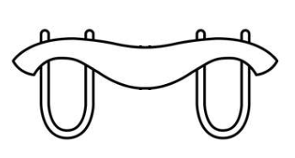
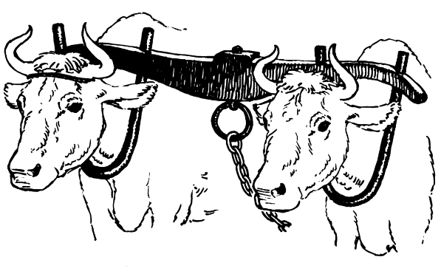
Divergences, contrast functions, and yokes
Wait what is a divergence on a manifold... we need pairs, yokes

Slide 3
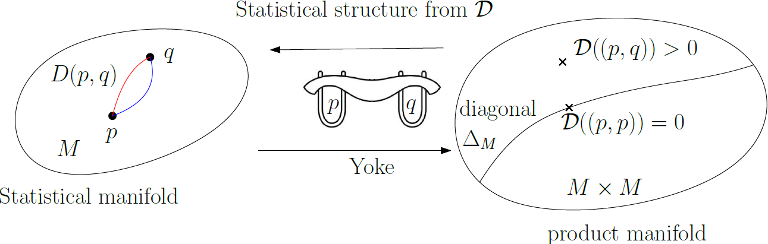
Divergences vs contrast functions/yokes
A smooth dissimilarity function D(p,q) is called a divergence
A divergence is a biparametric function interpreted geometrically as a function on
the product manifold MxM called a contrast function or yoke
(yoke= wooden beam used between a pair of working animals to pull together load)
The contrast function/yoke vanishes on the diagonal Δ_{M} of the product manifold
A contrast function or yoke induces a statistical structure on a manifold
An elementary introduction to information geometry." Entropy 22.10 (2020): 1100.

Slide 4



Notes:
Affine Differential Geometry: Geometry of Affine Immersions (Cambridge Tracts in Mathematics, Series Number 111) Hardcover – November 10, 1994
English Edition by Katsumi Nomizu (著), Takeshi Sasaki (著)
AffDiffGeo-1994
https://www.cambridge.org/9780521441773
https://mathshistory.st-andrews.ac.uk/Biographies/Su_Buqing/
https://www.degruyter.com/document/doi/10.1515/9783110268898/html?lang=en

Slide 5


Graph of a function as a Riemannian manifold
Graph of a d-variate function:
An extrinsic topological manifold of R^{d+1} of codimension 1
Can be interpreted as a d-dimensional intrinsic manifold with metric:
Notes:
$$
\Gamma_f=\left\{ (x,y)\in\bbR^{d+1} \st y=f(x)\right\}
$$
$\Gamma_f$ isometric to $(M\subset\bbR^d,g)$ with
$$
G=I+\nabla f \nabla f^\top
$$

Slide 6
alpha-projection unique on doubly-autoparallel submanifolds

Slide 7
can we be dually flat with non-Hessian metric?

Slide 8




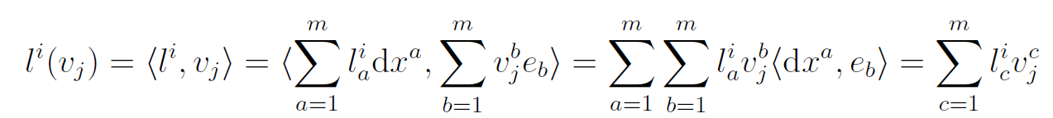


Wedge product of 1-covectors: matrix determinant
V: m-dimensional real vector space with basis
V*: dual space of covectors (= linear functions) with dual basis
Natural dual pairing :
Evaluation linear functionals (covectors) on vectors via bilinear dual pairing:
Wedge product of k covectors
For example, volume form for integration:
Notes:
$$
\{e_1,\ldots, e_m\}
$$
$$
\{\dx^1,\ldots, \dx^m\}
$$
$$
\inner{\cdot}{\cdot}
$$
$$
\dx^i(e_j)=\inner{\dx^i}{e_j}=\delta_{ij}
$$
$$
l^1,\ldots, l^k
$$
$$
v_1,\ldots, v_k
$$
$$
l^i(v_j)=\inner{l^i}{v_j}=\inner{ \sum_{a=1}^m l^i_a \dx^a}{\sum_{b=1}^m v_j^b e_b}= \sum_{a=1}^m \sum_{b=1}^m
l^i_a v_j^b \inner{\dx^a}{e_b}=\sum_{c=1}^m l^i_c v_j^c
$$
$$
(l^1\wedge \ldots\wedge l^k)(v_1,\ldots, v_k)=\det\left([l^i(v_j)]_{ij}\right)
$$
$$
(\dx^1\wedge \ldots\wedge \dx^m)(e_1,\ldots, e_m)=\det(I_{m,m}) =1
$$

