Slide 1


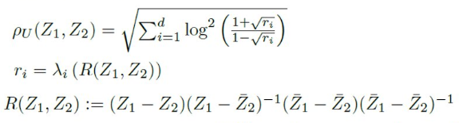
Geometry of complex matrices
Riemann matrix: Complex symmetric matrix with positive-definite imaginary part: Z=S+iP
Space of Riemann matrices: Siegel upper space U
Generalize Poincaré upper plane : z=x+iy (dimension 1)
Contains the symmetric positive-definite (SPD) cone on i-axis
Siegel metric generalize the SPD trace metric:
Siegel distance:
Matrix information geometry. Heidelberg: Springer, 2013.
The Siegel–Klein disk: Hilbert geometry of the Siegel disk domain.Entropy 22.9 (2020): 1019.
Notes:
Geometry of complex matrices:
- Riemann matrix = complex symmetric matrix with positive-definite imaginary part
- Space of Riemannian matrices = Siegel upper space, generalize Poincaré upper plane
- *SPD trace metric* on i-axis
👉 https://www.mdpi.com/1099-4300/22/9/1019
https://twitter.com/FrnkNlsn/status/1620314475902697472
https://www.mdpi.com/1099-4300/22/9/1019
https://twitter.com/FrnkNlsn/status/1620314475902697472

Slide 2
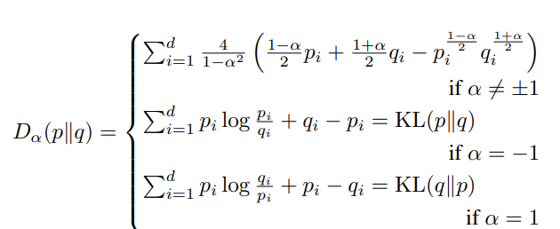


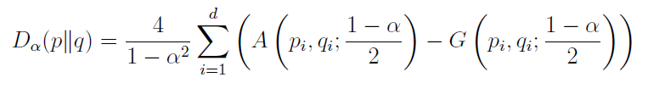

Meaning of α-divergences: Average difference of arithmetic minus geometric density means
Arithmetic weighted mean:
Geometric weighted mean:
α-divergences as difference of arithmetic/geometric weighted means:
Non-negativity by dominance of means (AG inequality):
Generalizing the Alpha-Divergences and the Oriented Kullback–Leibler Divergences
with Quasi-Arithmetic Means. Algorithms 15.11 (2022): 435. arXiv:2001.09660
Notes:
By observing that the α-divergences are the pointwise sum difference of the weighted arithmetic mean with the weighted geometric mean, we can define divergences by difference of two weighted means and in the limit of α→±1, we get new Kullback-Leibler type divergence:
https://www.mdpi.com/1999-4893/15/11/435

Slide 3
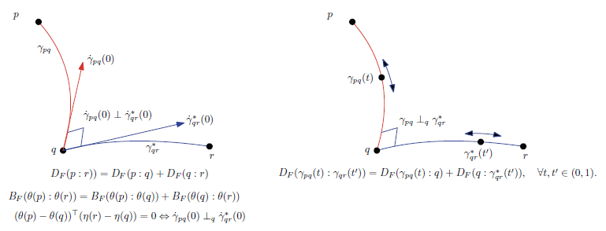
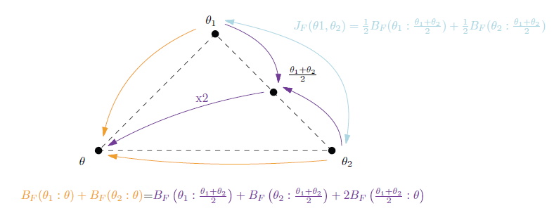

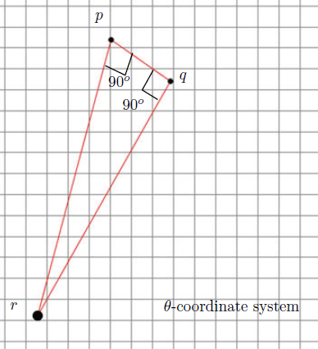
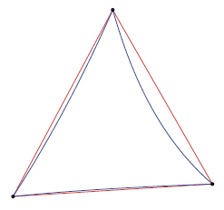
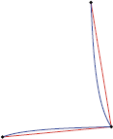
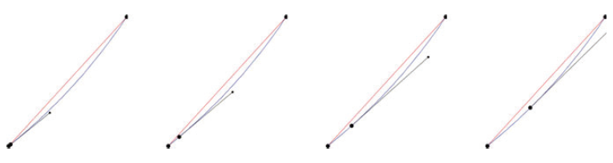
Bregman manifolds: Hessian manifolds with global charts
Generalized Pythagoras theorem
Bregman parallelogram identity
2³=8 geodesic triangles
Hessian metric tensor
Double Pythagoras theorem
geodesic triangle with
two right angles
Parallel transport

Slide 4
Road to differential geometry

Slide 5
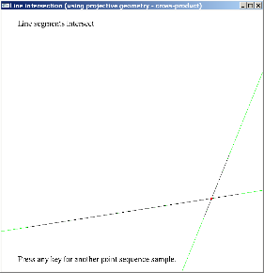
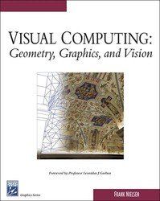

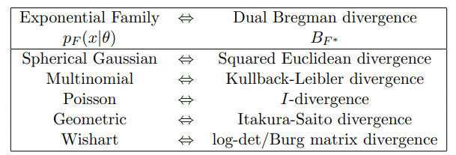
A code can be realized by several algorithms solving different problems using dualities
Example 1: Duality point/line in projective geometry
Use 3D homogeneous vectors and cross product to find the intersection point p=l₁xl₂ of two lines l₁ and l₂ or dually the line passing l through points l₁* and l₂*
Example 2: Duality exponential families/Bregman divergences
Use Bregman k-means to learn a mixture of exponential families: amount to dually do a classification expectation-maximization (CEM):
or k-MLE for k-Maximum Likelihood Expectation
Notes:
An algorithm A solving a problem P can be *implemented* using several codes C1, C2, ...
Conversely, a code C can be *interpreted* as several algorithms A1, A2, ... solving problems P1, P2, ...
Examples:
- Computing in projective geometry with duality point/line:
https://franknielsen.github.io/VisualComputing2005/
- Computing in machine learning with duality Bregman divergences/exponential families:
https://arxiv.org/abs/1203.5181
---
Algorithm A solving problem P implemented with codes C1, C2, ... Code C *interpreted* as algorithms A1, A2, ... solving problems P1, P2, ... Ex: - point/line duality of projective geometry - Bregman divergences/exponential families duality https://arxiv.org/abs/1203.5181

Slide 6
Asymptotic MLE, CRLB and IG
Notes:
Estimate in eta-coordinates, Fisher metric in eta in closed-form provided we can convert lambda->eta.
Gauss-Newton Conversion
Example PEF

Slide 7


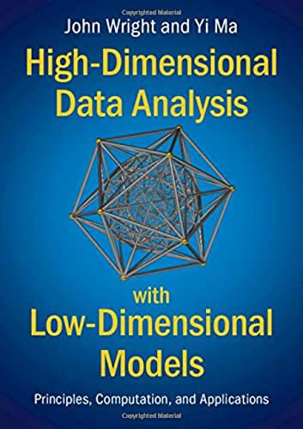



Notes:
These great textbooks are all available in PDFs from the book pages!
More than 50+ other books too at:
https://franknielsen.github.io/Books/CuratedBookLists.html
Spread the knowledge, RT!

