Slide 2



Geometry of domains vs geometry of manifolds
A manifold M is covered by several local coordinate charts forming an atlas
View a domain ϴ as a single global chart with coordinate θ in ϴ of a manifold: M_{ϴ}
Dually flat spaces are single chart manifolds induced by a Legendre-type strictly convex and smooth function defined on a convex domain ϴ, the parameter spaces of statistical models: They are global single chart examples of Hessian manifolds
Geometry of domains:
Dually flat spaces
Geometry of manifolds:
Hessian manifolds
Notes:
Geometry of domains versus geometry of manifolds:
Consider a domain as a *global chart of an underlying manifold* vs consider a general manifold covered by several local charts forming an atlas.
Examples: Dually flat spaces (information geometry of domains) versus Hessian manifolds (several charts)
https://arxiv.org/abs/1910.03935

Slide 3
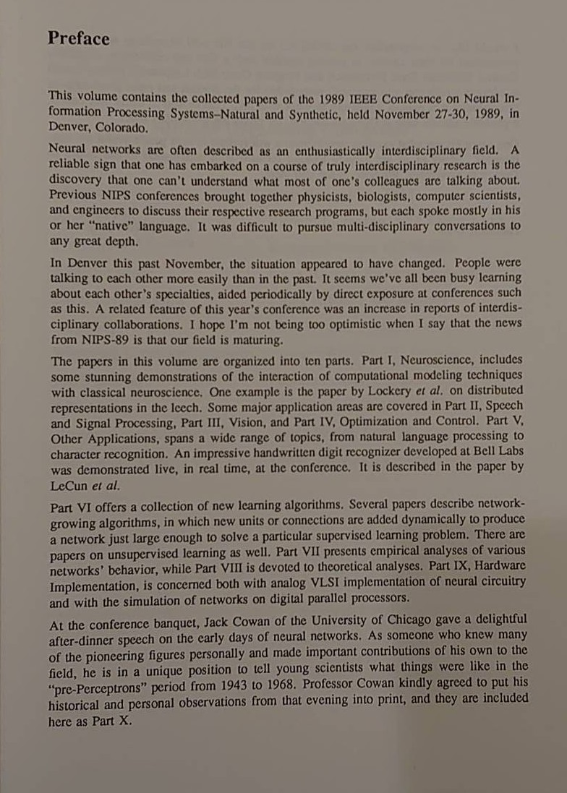
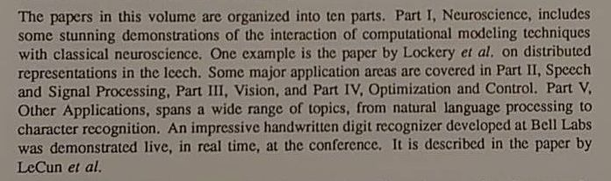


Slide 4
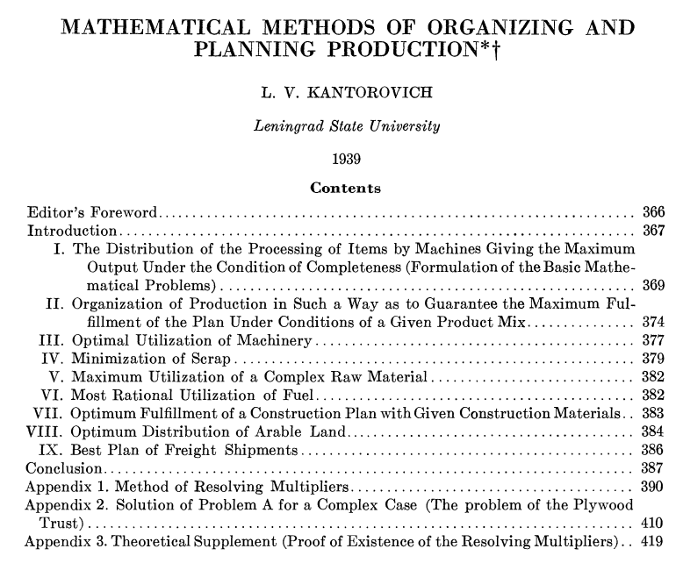

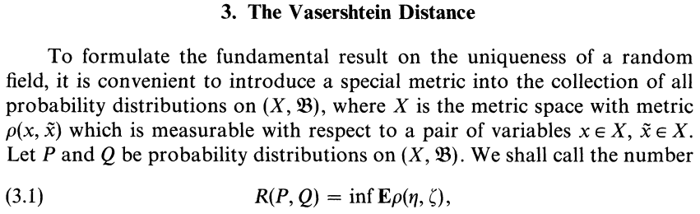
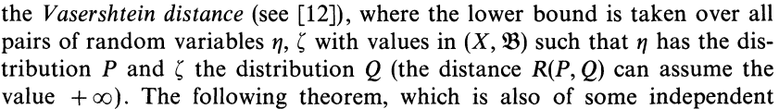
Origin of the Wasserstein distance
Stigler law of eponymy: No scientific discovery is named after its original discover!
Dobrushin termed the Vasershtein distance in 1970
citing a paper of Vasershtein 1969:
But first definition given by Kantorovich in 1939:
Notes:
Stigler law of eponymy: No scientific discovery is named after its original discover!
Example: Wasserstein distance was first defined and used by Kantorovich in 1939
https://en.wikipedia.org/wiki/Wasserstein_metric

