Slide 1

Divergences and comparative convexity
Frank Nielsen
Sony Computer Science Laboratories Inc
Tokyo, Japan
arXiv:2312.12849
2024

Slide 2
Outline
Kullback-Leibler divergence, exponential families, and Bregman divergences
Information geometry of convex functions
Two normalizations of exponential families: cumulant or partition functions, and their relationships with divergences:
Bhattacharyya distances/Rényi divergences and skewed Jensen divergences wrt cumulant function
α-divergences and skewed Jensen divergences wrt partition function
Comparative convexity, quasi-arithmetic means, and convex deformations preserving convexity
Some generalization of Bregman divergences

Slide 3
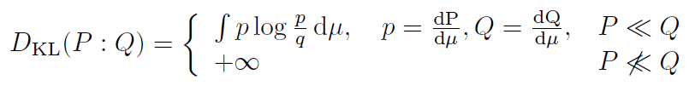
Kullback-Leibler divergence: relative entropy
The Kullback-Leibler divergence (KLD) is a dissimilarity measure between probability distributions/measures P and Q :
Fails symmetry and triangle inequality of metrics but is always non-negative as known as Gibbs’ inequality:
KLD also called relative entropy because it is the difference between the cross-entropy and Shannon entropy:
Interpretations in information theory: expected difference of the number of bits required for Huffman encoding of P using a code optimized for Q rather than the Huffman code optimized for P.

Slide 4
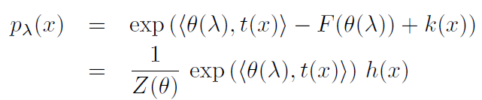


Exponential families: Discrete/continuous/measures
A parametric family of distributions {P_{λ}} all dominated by a measure μ is an exponential family iff the densities wrt μ can be expressed canonically as
θ is natural parameter
t(x) is sufficient statistics and k(x) and h(x) are auxiliary carrier term
Inner product (e.g., scalar product for vectors)
Unnormalized density:
Subtractive normalization:
Divisive normalization:
F called cumulant function in statistics
F called free energy and Z called partition function in thermodynamics

Slide 5
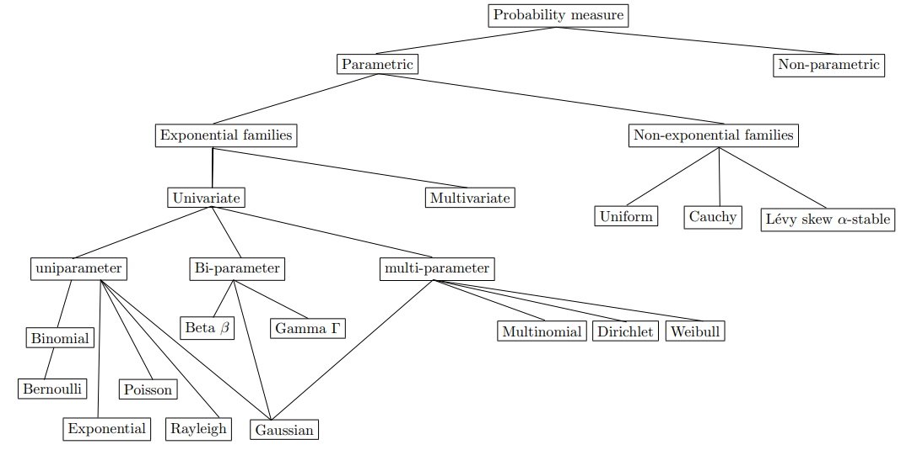
Exponential families (EFs): Some examples
Many common distributions in statistics are exponential families in disguise
Many statistical models in machine learning are exponential families: undirected graphical models, energy-based models including Markov random fields and conditional random fields

Slide 6
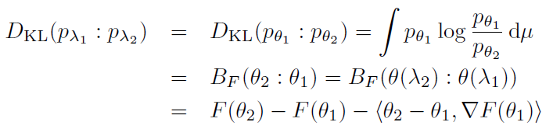
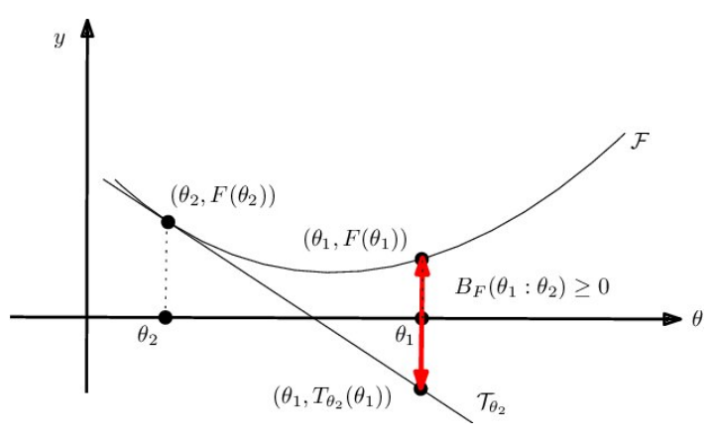




KLD between two densities of an EF
Bypass integral calculations of KLDs and express it as a divergence between parameters: Bregman divergences
Dual expectation/moment parameterization:
Many equivalent parameterizations of EFs:

Slide 7









Convex duality: convex conjugates (F,F*)
Legendre-Fenchel transformation of a function:
as known as slope transform:
Supremum reached for : defines the gradient map
Moment parameter space:
Restrict F to Legendre-type function so that
convex conjugate is also of Legendre type:
And we have: and , reciprocal gradient:
Legendre transformation:
(need to invert ∇F)

Slide 8

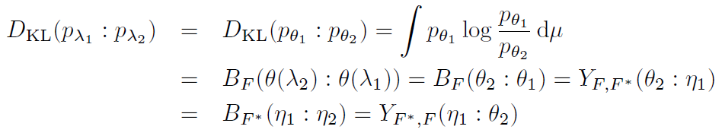
Dual Bregman divergence/Fenchel-Young divergence
Bregman divergence can be expressed equivalently as
a Fenchel-Young divergence:
Dual Bregman divergence:
Thus KLD between densities of an exponential family expressed as:

Slide 9
Information geometry: Dually structures
Riemannian metric g is smooth inner product on a manifold which allows to measure vector lengths and angles between vectors
Affine connection ∇ defines how to connect vectors between infinitesimally close tangent spaces. Affine connection defines ∇-geodesic
Information geometry considers dual structures: A manifold M equipped with a Riemannian metric tensor g and dual torsion-free affine connections ∇ and ∇* coupled to the metric so that the Levi-Civita connection wrt g is (∇+∇* )/2: Structure (M,g, ∇,∇*)
Information geometry induced by statistical models {p_{θ}}, information geometry induced by divergences, information geometry induced by convex functions, information geometry induced by regular cones, etc.

Slide 10
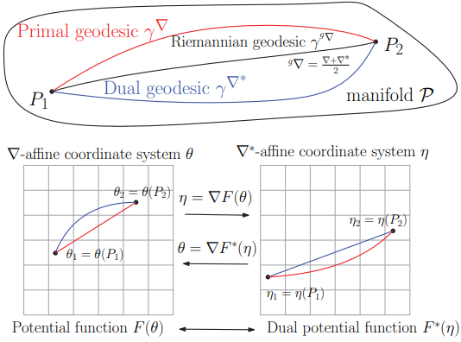
Information geometry of convex functions: Dually flat spaces
An affine connection ∇ is flat if there exists a coordinate system θ called ∇-affine coordinate system such that the Christoffel symbols Γ vanish
∇-geodesics are straight lines in θ-chart
Hessian metric tensor g expressed in θ-chart as ∇²F(θ)
Legendre duality yields dual expression of Hessian metric ∇²F*(η) and dual affine flat connection ∇* with ∇*-geodesics straight inη-chart
Dually flat space DFS(F(θ), ϴ)=(M,g, ∇, ∇*)

Slide 11
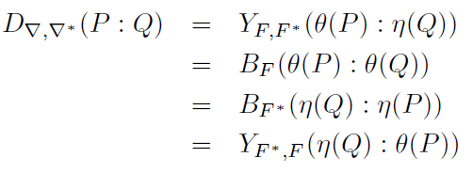
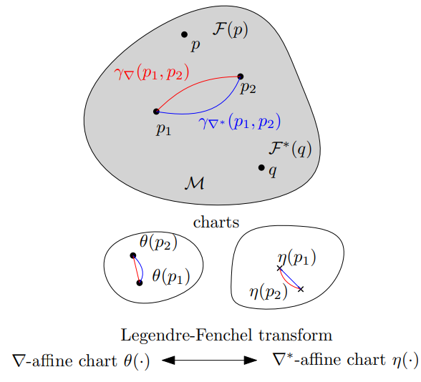

Canonical divergences of dually flat spaces: Dually flat divergences
Given a dually flat space (M,g, ∇, ∇*), we can reconstruct locally two potential functions F(θ) and F*(η) related by Legendre-Fenchel transformation
The dually flat divergence D∇, ∇* (P:Q) can be expressed using the mixed coordinate system θ and η as a Fenchel-Young divergence or equivalently using dual Bregman divergences either in the θ- or η-charts

Slide 12


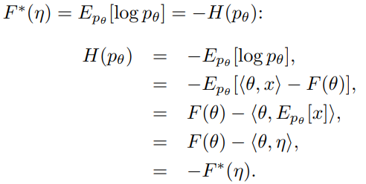
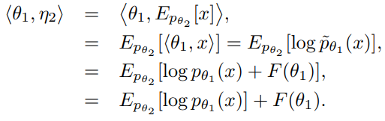
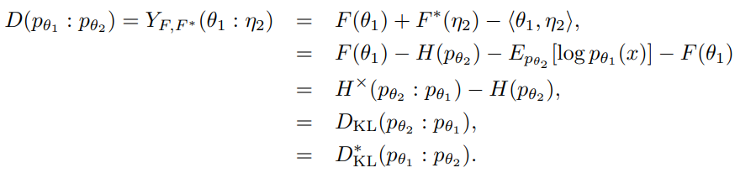
Canonical divergence of cumulant functions amount to statistical reverse KLD:
Usually, in Statistics/ML, we prove ⇒:
where D* is dual divergence:
Let us prove ⇐ from information geometry of canonical divergence of DFS(F(θ), ϴ)
①
②
③

Slide 13
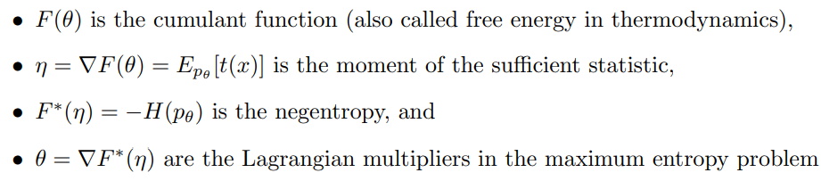
Canonical divergence of cumulant functions amount to statistical reverse KLD:
We reconstruct Kullback-Leibler divergence by relaxing to arbitrary densities
⇒KLD
Interpretations:

Slide 14
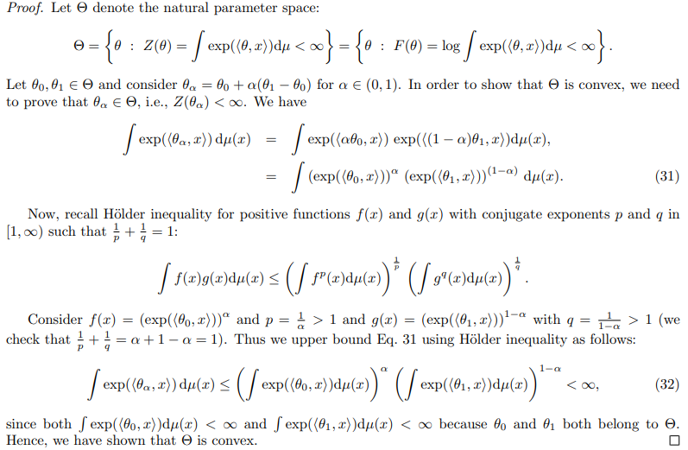
Natural parameter space ϴ is convex

Slide 15


Partition function Z(θ)=exp(F(θ)) is strictly log-convex Cumulant function F(θ)=log Z(θ) is strictly convex
When we proved that natural parameter space is convex, we had
That is for short:
Take the logarithm on both sides:
F is strictly convex since Eq. iff θ₁= θ₂
Definition: A function Z is stricty log-convex is log Z is strictly convex
⇒ Z(θ)=exp(F(θ)) is strictly convex because F(θ) strictly convex:

Slide 16
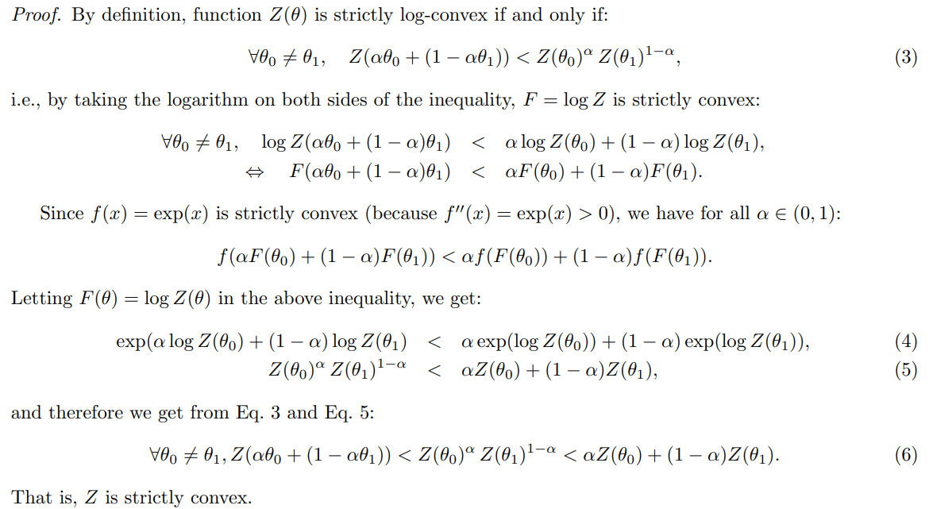
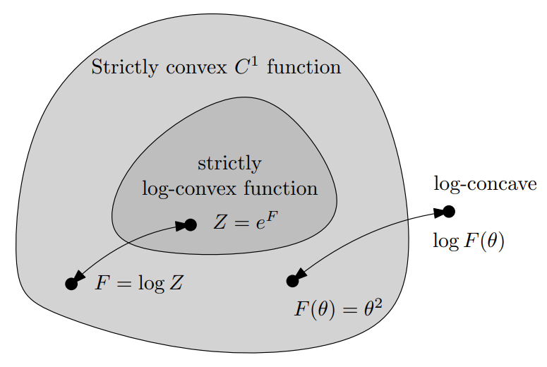
A log-convex function is also convex (but not necessarily the converse)

Slide 17
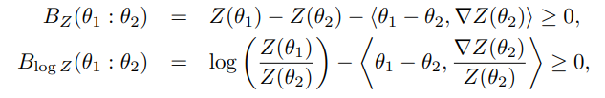
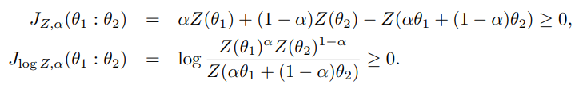

Bregman divergences B_{F=log Z} and B_{Z=exp F}
And furthermore, we can define skewed Jensen divergences from the convex generators:
Including the symmetric Jensen divergence:

Slide 18



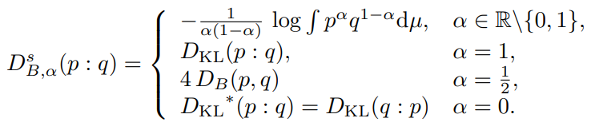
Bhattacharyya distances and Rényi divergences
If KLD between EF densities = B_{F}*, to what statistical divergences correspond J_{F} and J_{𝛼,F}?
Define scaled skewed Bhattacharyya distances:
which are scaled Rényi divergences:
Scaling allows to unify KLD with Bhattacharyya distances:

Slide 19
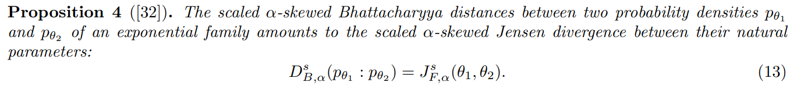
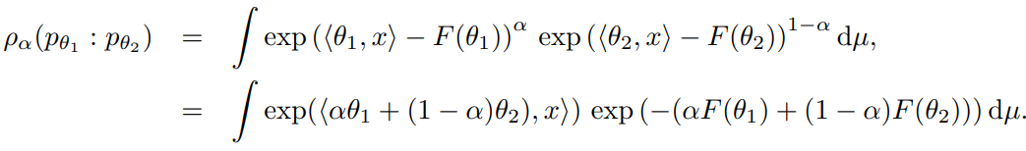

Bhattacharyya distances and Rényi divergences between densities of an exponential family
Proof: consider the α-skewed Bhattacharyya similarity coefficient:

Slide 20
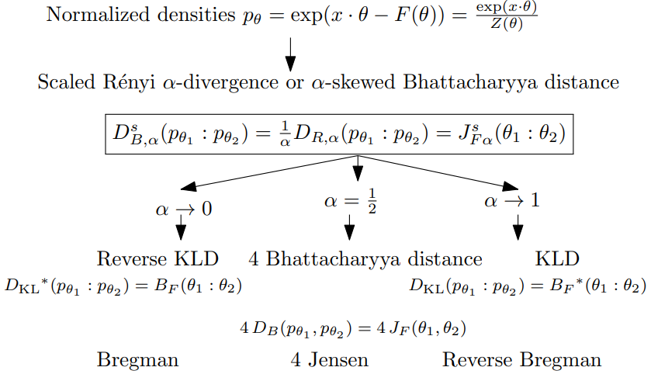
Overview of classical divergences

Slide 21
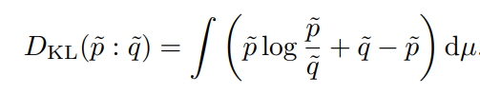



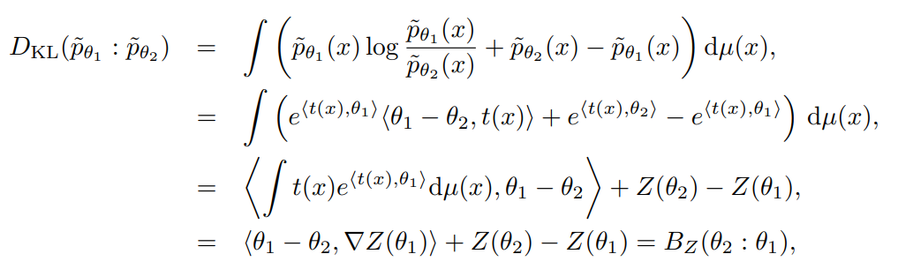

Extended Kullback-Leibler divergences between unnormalized densities: Bregman divergence B_{Z}
Extend KLD to unnormalized densities:
Reverse extended KLD:

Slide 22
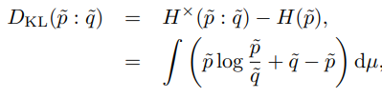





KLD between arbitrary positive densities
When specialized to densities of exponential family:

Slide 23
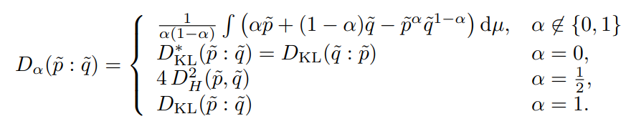
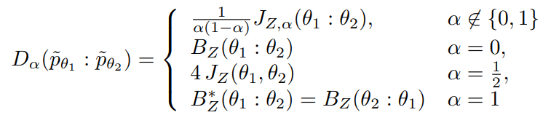
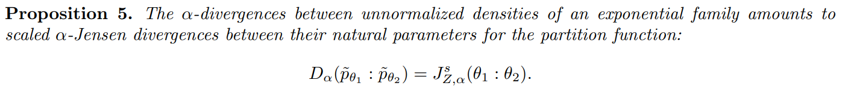
α-divergences between unnormalized densities
Statistical α-divergences between positive measures:
When considering unnormalized exponential family densities:

Slide 24
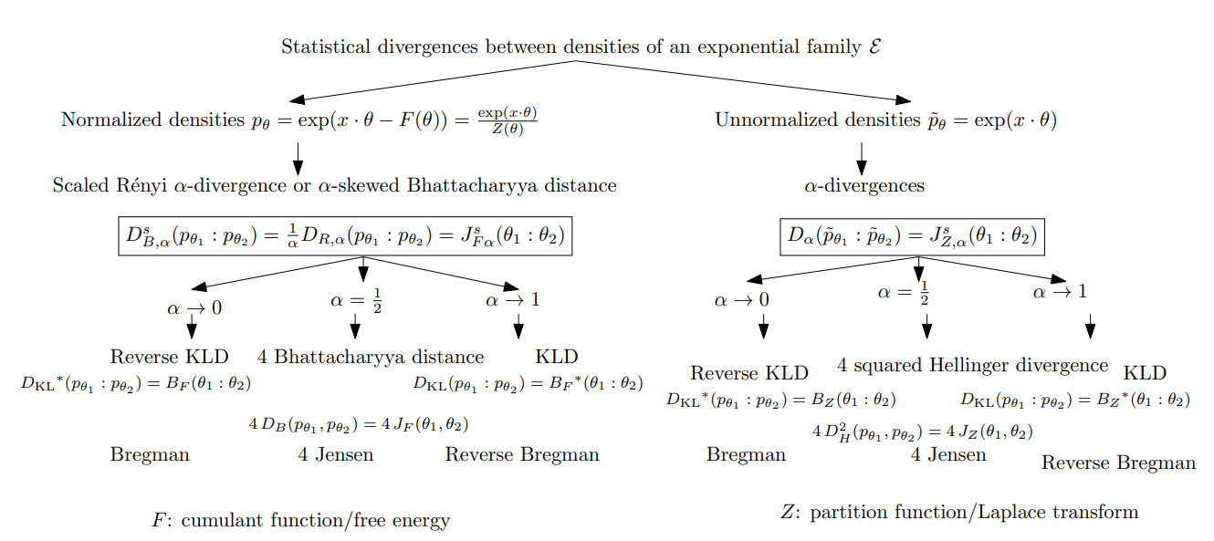
Overview of divergences between (un)normalized EF densities

Slide 25


Comparative convexity: (M,N)-convexity
A function Z is (M,N)-convex iff for in α in [0,1]:
Ordinary convexity: (A,A)-convexity wrt to arithmetic weighted mean
Log-convexity: (A,G)-convexity wrt to A/geometric weighted means:

Slide 26



Comparative convexity wrt quasi-arithmetic means
Kolmogorov-Nagumo-De Finitti quasi-arithmetic mean for a strictly monotone generator h(u):
Includes power means which are homogeneous means:
Include the geometric mean when p→0

Slide 27
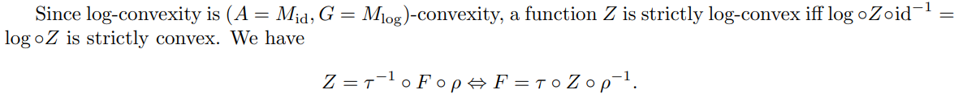
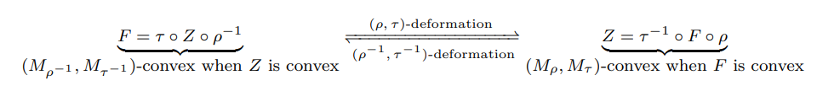
Deforming convex functions with comparative convexity
We consider deformations with two strictly monotone functions which preserve
convexity and thus induces family of Bregman and Jensen divergences,
and families of dually flat spaces:
We deform both the function F (by 𝜏⁻¹) and the argument θ (by ρ)
by considering functions Z

Slide 28
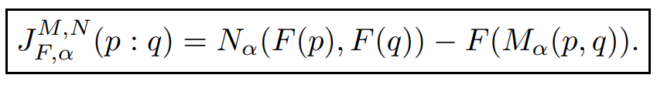
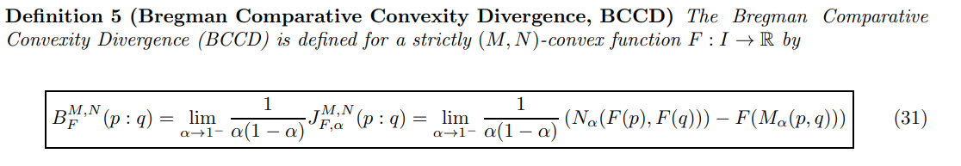
Generalizing Bregman divergences with (M,N)-convexity
Skew Jensen comparative convexity divergence:
Non-negative for (M,N)-convex generators F provided regular means M and N (e.g. power means)

Slide 29
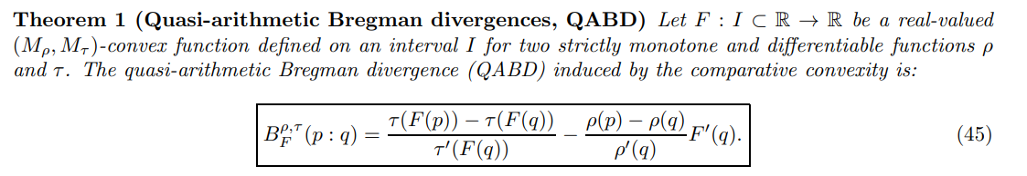
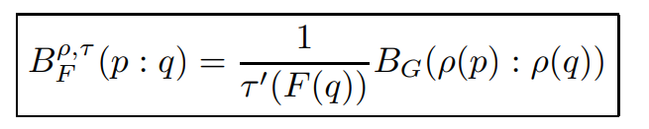

Generalizing Bregman divergences with quasi-arithmetic mean convexity
Amounts to a conformal Bregman divergence:
with
Remark: Conformal Bregman divergences may yield robustness in applications

Slide 30
References
NF and Richard Nock. "Generalizing skew Jensen divergences and Bregman divergences with comparative convexity." IEEE Signal Processing Letters 24.8 (2017): 1123-1127.
NF. "Divergences induced by dual subtractive and divisive normalizations of exponential families and their convex deformations." arXiv preprint arXiv:2312.12849 (2023).
Nock, Richard, FN, and Shun-ichi Amari. "On conformal divergences and their population minimizers." IEEE Transactions on Information Theory 62.1 (2015): 527-538.

Slide 31
Kullback-Leibler divergence: relative entropy
Exponential families: Discrete, continuous, measures
KLD between densities of an EF
Information geometry of convex function: Dually flat space
Information geometry of divergence
Bhattacharyya distance and Rényi divergence
Jensen divergence
Overview of classical divergences
Partition function is log-convex and hence convex
Bregman divergence wrt Z: KLD between unnormalized EF densities
Jensen divergence wrt Z: alpha divergences
Overview of divergences between (un)normalized EF densities
Comparative convexity
Comparative convexity wrt quasi-arithmetic means
Deforming convex functions wrt quasi-arithmetic generators
(M,N)-Jensen divergence
(M,N)-Bregman divergence
Equivalence with a conformal Bregman divergence
Power Bregman divergences
Conclusion

