Slide 1

On the Jensen–Shannon Symmetrization of Distances Relying on Abstract Means
Frank Nielsen
Sony Computer Science Laboratories, Inc
https://franknielsen.github.io/
Paper:
https://www.mdpi.com/1099-4300/21/5/485
July 2020
Code:
https://franknielsen.github.io/M-JS/

Slide 2
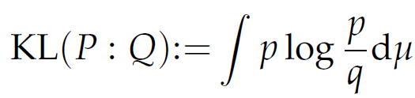


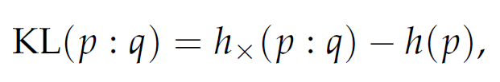
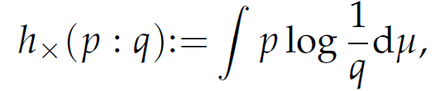
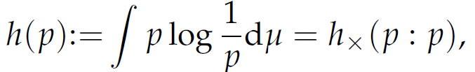
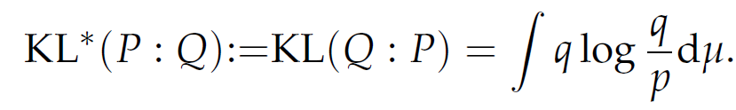
Unbounded Kullback-Leibler divergence (KLD)
Also called relative entropy:
Cross-entropy:
Shannon’s entropy:
(self cross-entropy)
Reverse KLD:
(KLD=forward KLD)

Slide 3
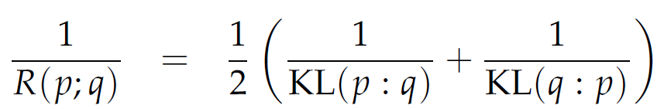
Symmetrizations of the KLD
Jeffreys’ divergence (twice the arithmetic mean of oriented KLDs):
Resistor average divergence (harmonic mean of forward+reverse KLD)
Question: Role and extensions of the mean?

Slide 4
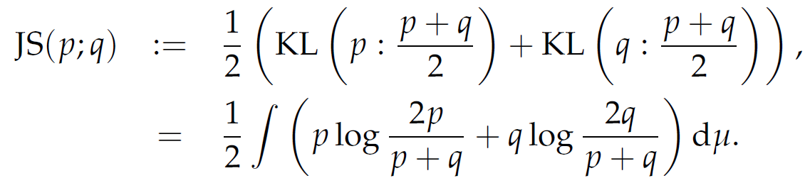
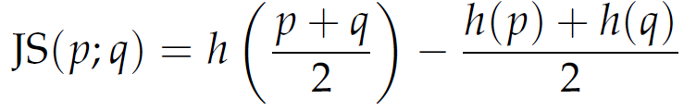

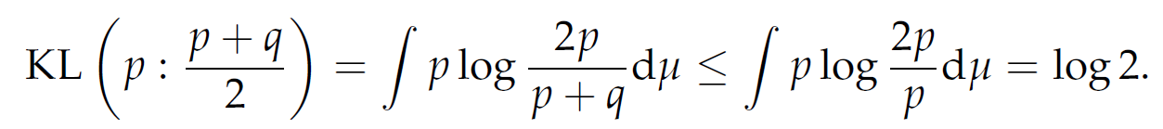

Bounded Jensen-Shannon divergence (JSD)
(Shannon entropy h is
strictly concave, JSD>=0)
JSD is bounded:
Proof:
: Square root of the JSD is a metric distance (moreover Hilbertian)

Slide 5
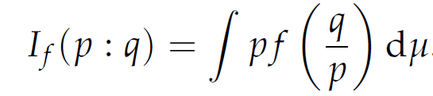
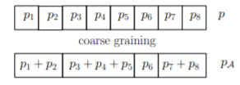

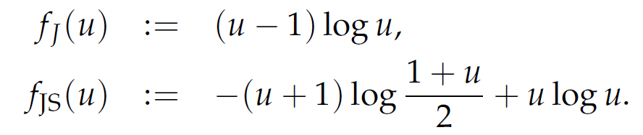
Invariant f-divergences, symmetrized f-divergences
Convex generator f, strictly convex at 1
with f(1)=0 (standard when f’(1)=0, f’’(1)=1)
f-divergences are said invariant in information geometry because they
satisfy coarse-graining (data processing inequality)
f-divergences can always be symmetrized: Reverse f-divergence for
Jeffreys f-generator:
Jensen-Shannon f-generator:

Slide 6


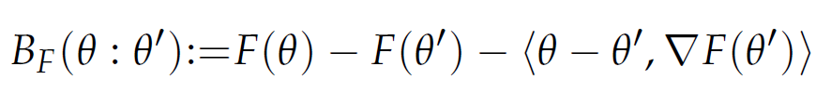
Statistical distances vs parameter vector distances
A statistical distance D between two parametric distributions of a same
family (eg., Gaussian family) amount to a parameter distance P:
For example, the KLD between two densities of a same exponential family
amounts to a reverse Bregman divergence for the Bregman cumulant generator:
From a smooth C3 parameter distance (=contrast function),
we can build a dualistic information-geometric structure

Slide 7
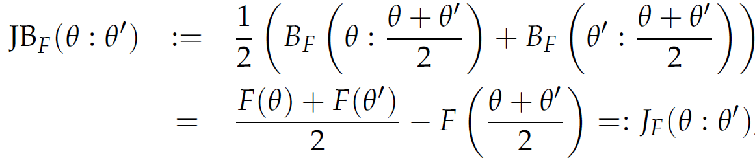

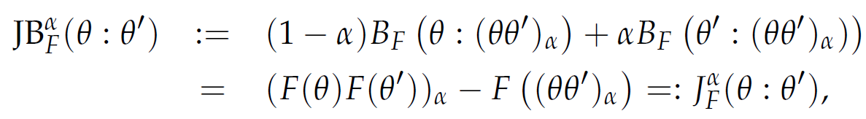
Skewed Jensen-Bregman divergences
JS-kind symmetrization of the parameter Bregman divergence:
Notation for the linear interpolation:

Slide 8
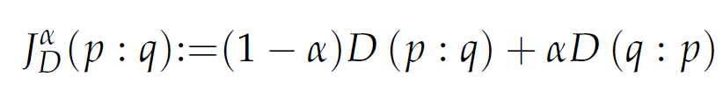

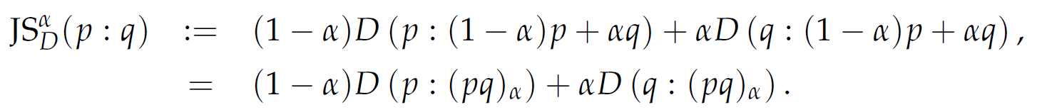
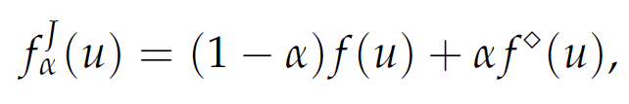


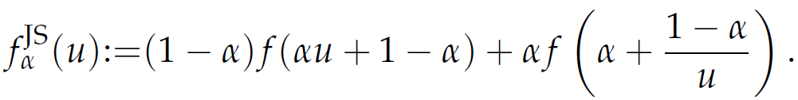
J-Symmetrization and JS-Symmetrization
J-symmetrization of a statistical/parameter distance D:
JS-symmetrization of a statistical/parameter distance D:
Example: J-symmetrization and JS-symmetrization of f-divergences:
Conjugate f-generator:

Slide 9
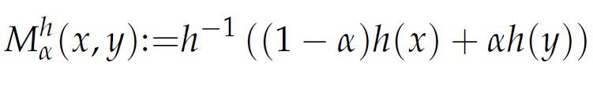
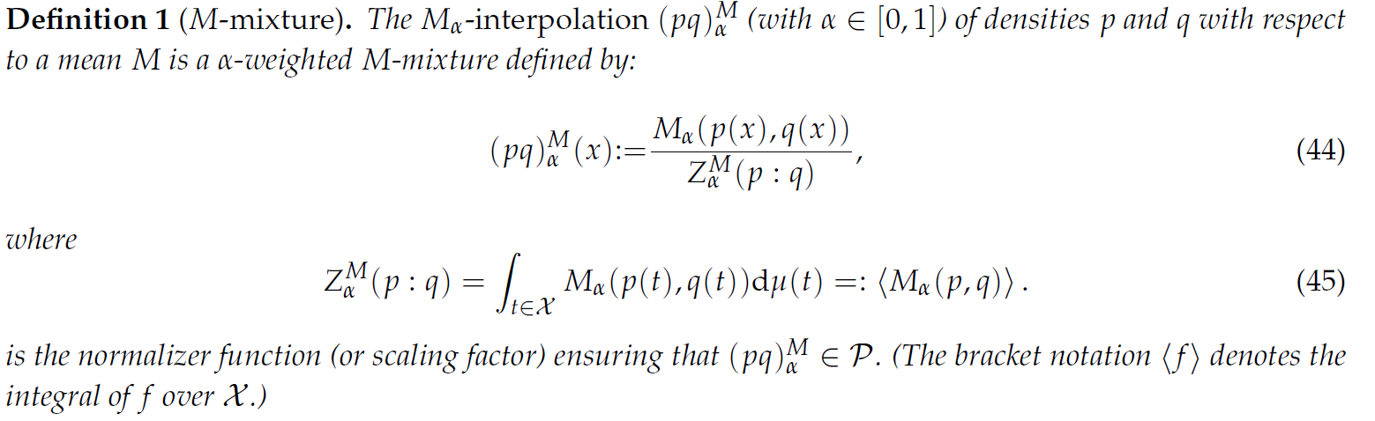
Generalized Jensen-Shannon divergences: Role of abstract weighted means, generalized mixtures
Quasi-arithmetic weighted means for a strictly increasing function h:
When M=A
Arithmetic mean,
Normalizer Z is 1

Slide 10
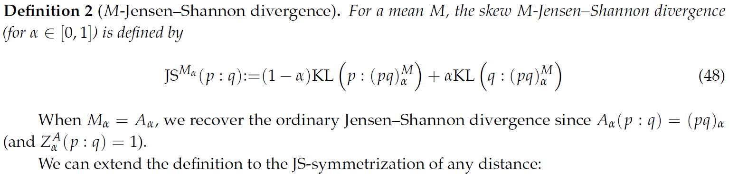
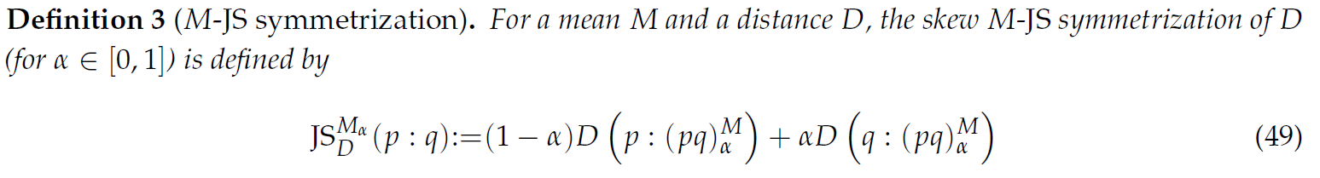
Definitions: M-JSD and M-JS symmetrizations
For generic distance D (not necessarily KLD):

Slide 11
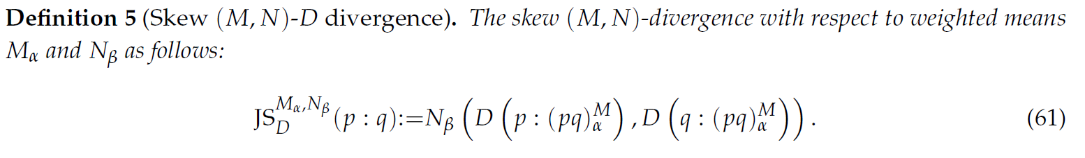
Generic definition: (M,N)-JS symmetrization
Consider two abstract means M and N:
The main advantage of (M,N)-JSD is to get closed-form formula
for distributions belonging to given parametric families
by carefully choosing the M-mean.
For example, geometric mean for exponential families,
or harmonic mean for Cauchy or t-Student families, etc.

Slide 12


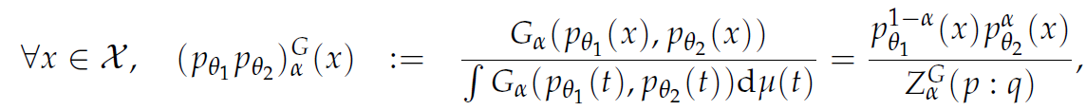


(A,G)-Jensen-Shannon divergence for exponential families
Exponential family:
Natural parameter space:
Geometric statistical mixture:
Normalization coefficient:
Jensen parameter divergence:

Slide 13
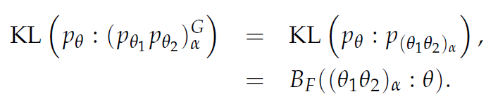
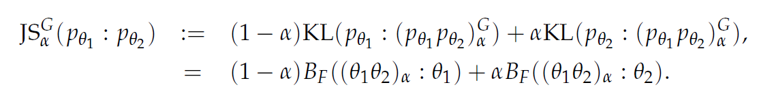
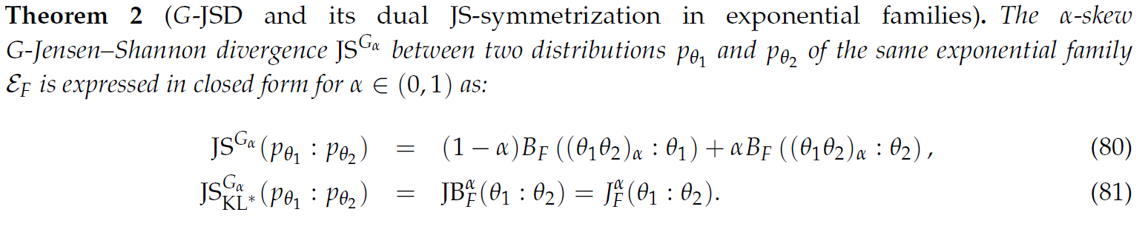
(A,G)-Jensen-Shannon divergence for exponential families
Closed-form formula the KLD between two geometric mixtures in term of a
Bregman divergence between interpolated parameters:

Slide 14


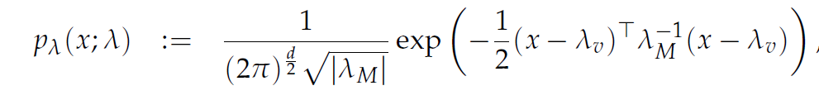

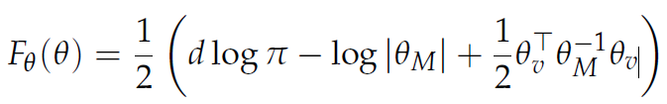


Example: Multivariate Gaussian exponential family
Family of Normal distributions:
Canonical factorization:
Sufficient statistics:
Cumulant function/log-normalizer:

Slide 15

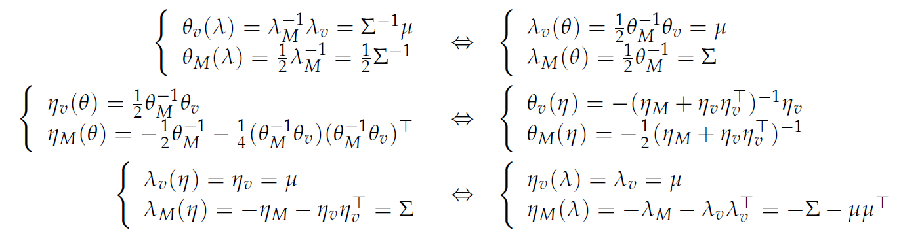
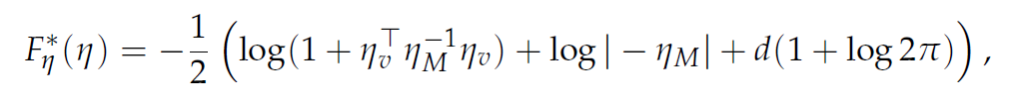
Example: Multivariate Gaussian exponential family
Dual moment parameterization:
Conversions between ordinary/natural/expectation parameters:
Dual potential function (=negative differential Shannon entropy):

Slide 16
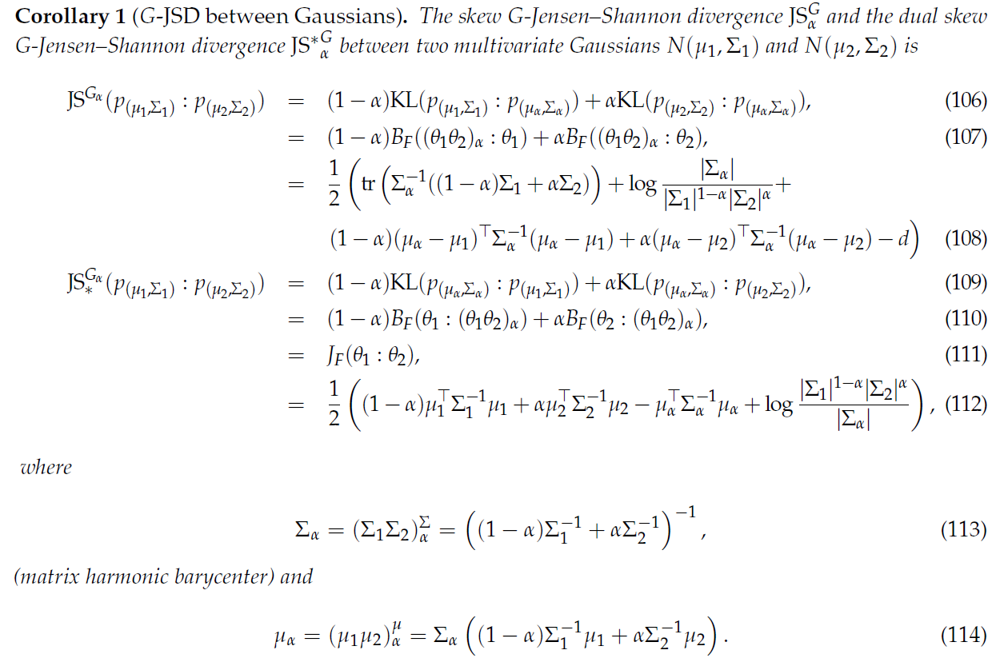

Slide 17
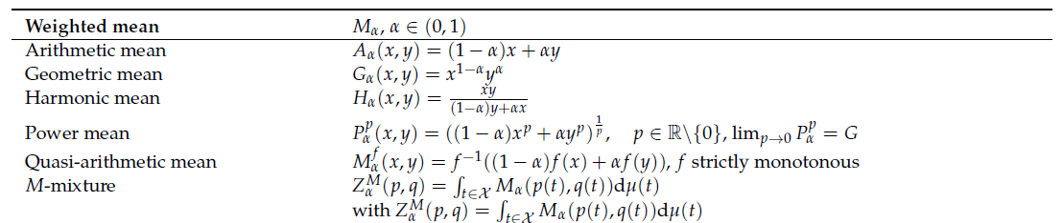
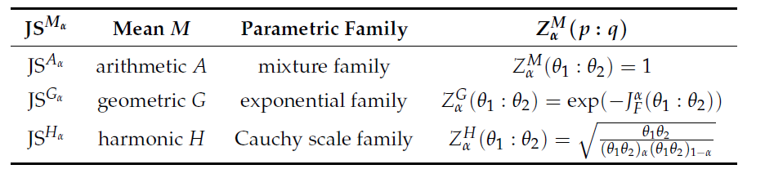
More examples: Abstract means and M-mixtures
https://www.mdpi.com/1099-4300/21/5/485

Slide 18
Summary: Generalized Jensen-Shannon divergences
Jensen-Shannon divergence (JSD) is a bounded symmetrization of the Kullback-Leibler divergence (KLD). Jeffreys divergence (JD) is an unbounded symmetrization of KLD. Both JSD and JD are invariant f-divergences.
Although KLD and JD between Gaussians (or densities of a same exponential family) admits closed-form formulas, the JSD between Gaussians does not have a closed expression, and these distances need to be approximated in applications.
(machine learning, eg., deep learning in GANs)
The skewed Jensen-Shannon divergence is based on statistical arithmetic mixtures. We define generic statistical M-mixtures based on an abstract mean, and define accordingly the M-Jensen-Shannon divergence, and the (M,N)-JSD.
When M=G is the geometric weighted mean, we obtain closed-form formula for the G-Jensen-Shannon divergence between Gaussian distributions. Applications to machine learning (eg, deep learning GANs)
https://arxiv.org/abs/2006.10599
Code:
https://franknielsen.github.io/M-JS/
Notes:
https://arxiv.org/abs/2006.10599

