Slide 1

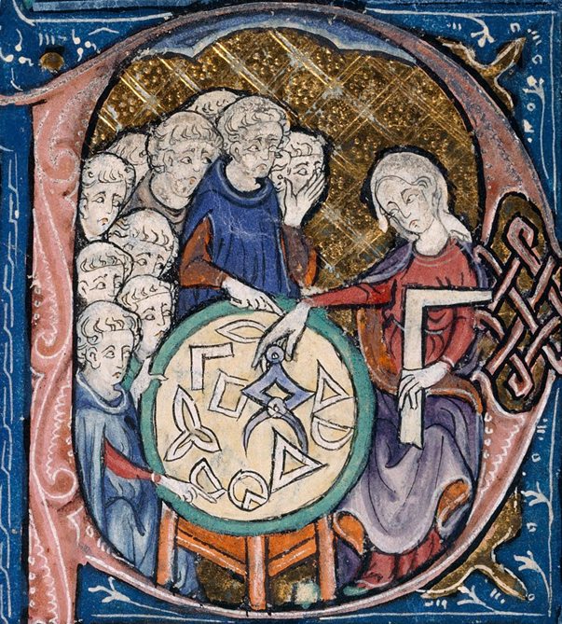


The 7th international conference on
Geometric Science of Information
Best Paper Award
GSI 2025
October 29th-31st 2025
Saint-Malo
PRESENTED TO
SPONSORED BY
…
AUTHORS OF THE PAPER
…
Frédéric Barbaresco
Thales, France
General co-chair
Frank Nielsen
Sony Computer Science Laboratories, Japan
General co-chair
Barbara Tumpach
Lille University, France
CNRS Pauli Institute, Austria
Prize committee, President
xxx…..
WiMLDS
Prize committee, President

