Slide 1
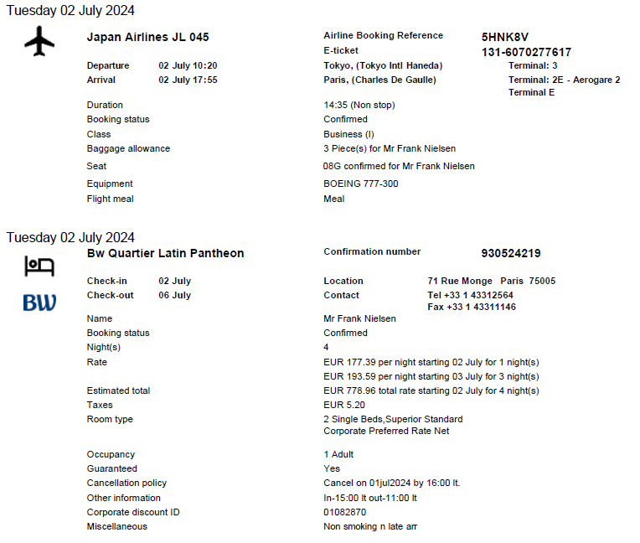


Slide 2
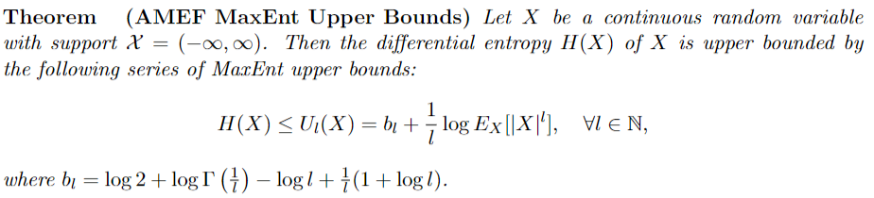
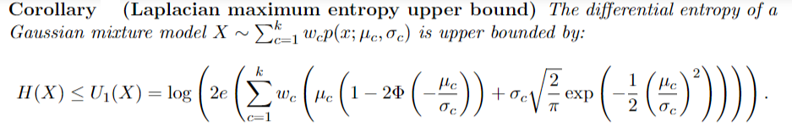
Bounding differential entropies of random variables X
"MaxEnt upper bounds for the differential entropy of univariate continuous distributions."
IEEE Signal Processing Letters 24.4 (2017)
Notes:
We can upper bound the differential entropy of *any random variable X* by the differential entropy of *any exponential family* for the moment parameter η=E_X[t(x)] where t(x) is the sufficient statistics of the exponential family. Differential entropy of an exponential family is –F^*(η) where F^* is the convex conjugate of the cumulant function (the Cramer transform in large deviation theory).
https://arxiv.org/abs/1612.02954
----
Nielsen, Frank, and Richard Nock. "MaxEnt upper bounds for the differential entropy of univariate continuous distributions." IEEE Signal Processing Letters 24.4 (2017): 402-406.

Slide 3








Slide 4
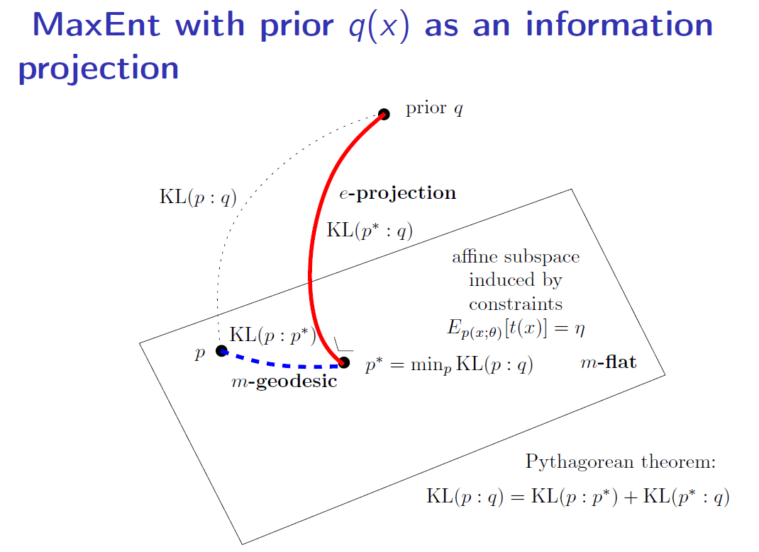
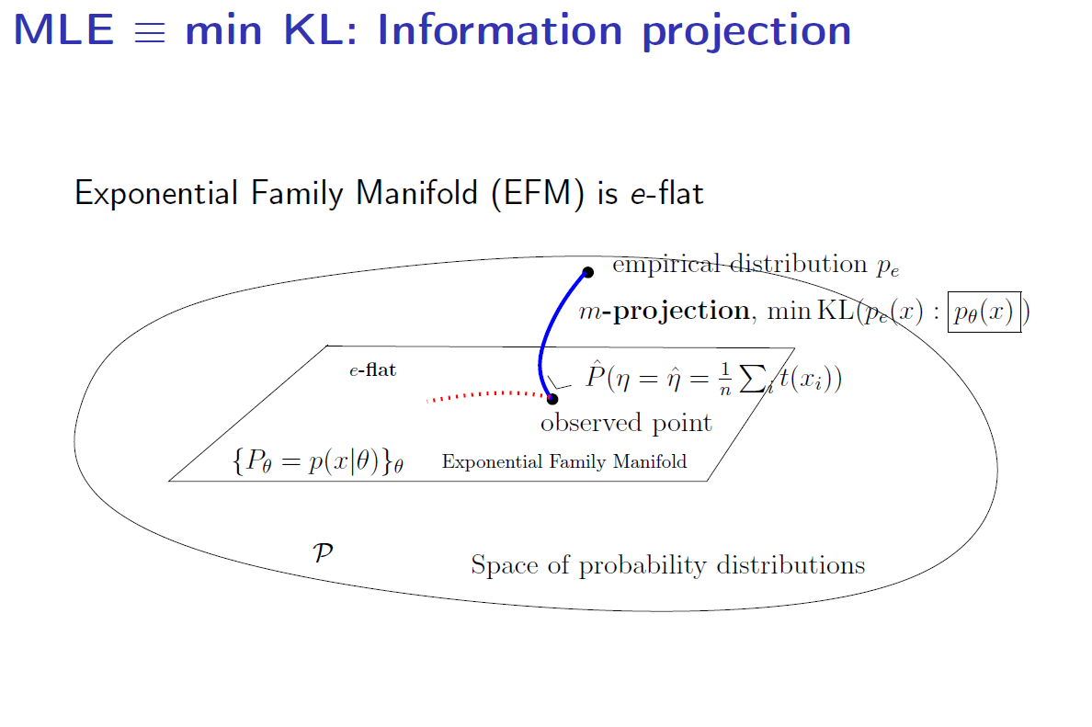
Dual MLE = MEP (MaxEnt Maximum entropy principle)
MLE: Minimize right-side of Kullback-Leibler divergence
Divergence duality KLD ↔ KLD*
Maxent: Minimize left-side of Kullback-Leibler divergence (=right-side of KLD*)
Notes:
Dual of Maximum Likelihood Estimator (MLE) is Maximum Entropy (MaxEnt).
Both interpreted as information projections with respect to the Kullback-Leibler divergence and dual the Kullback-Leibler divergence (=reverse KLD)
https://www.ams.org//journals/notices/201803/rnoti-p321.pdf
https://www.mdpi.com/1099-4300/22/10/1100

Slide 5




Slide 6


Slide 7


Slide 8


Notes:
Introduction to HPC with MPI for Data Science (ISBN 978-3-319-21902-8 in English) 基于MPI的大数据高性能计算导论 (ISBN 978-7111602149, in Chinese)
- simulate on PC/laptop clusters of machines using Message Passing Interface (MPI) + job scheduler SLURM
- implement // linear algebra and // machine learning tasks on clusters.
https://franknielsen.github.io/HPC4DS/

Slide 9
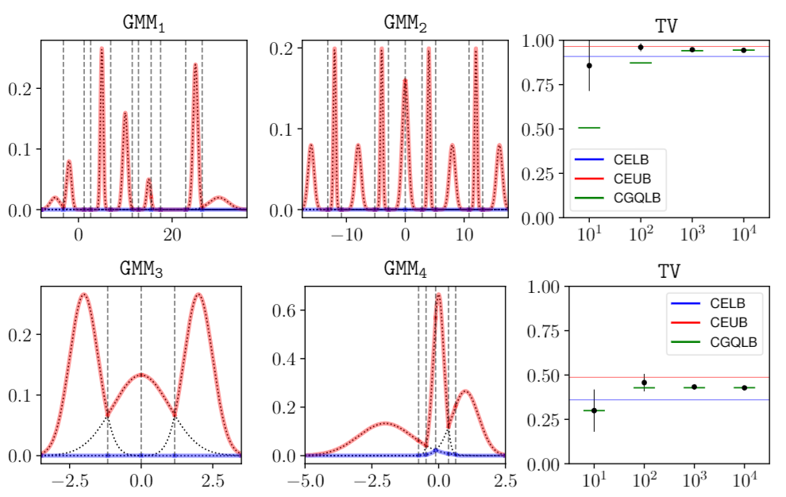
Lower and upper bounds on the total variation between Gaussian mixture models
Closed-form for
When single component
Upper and lower bounds
arXiv:1806.11311
"Guaranteed deterministic bounds on the total variation distance between univariate mixtures."
28th International Workshop on Machine Learning for Signal Processing (MLSP). IEEE, 2018.
Notes:
Getting non-trivial lower and upper bounds on the total variation between Gaussian mixtures (GMMs) is difficult because TV varies in the range [0,1].
2 methods based on information monotonicity of TV and on geometric lower/upper envelopes of the PDFs
👉 https://arxiv.org/abs/1806.11311
----
Getting non-trivial lower and upper bounds on the total variation between Gaussian mixture models (GMMs) is difficult because TV varies in the range [0,1].
Proposed 2 methods: (1) based on information monotonicity of TV, (2) based on geometric lower and upper envelopes of the PDFs
https://arxiv.org/abs/1806.11311
based on the informationmonotonicity property of the total variation to design guaranteed nested deterministic lower bounds.The second method relies on computing the geometric lower and upper envelopes of weighted mixturecomponents to derive deterministic bounds based on density ratio.
Nielsen, Frank, and Ke Sun. "Guaranteed deterministic bounds on the total variation distance between univariate mixtures." 2018 IEEE 28th International Workshop on Machine Learning for Signal Processing (MLSP). IEEE, 2018.

Slide 10



Geometry of domains vs geometry of manifolds
A manifold M is covered by several local coordinate charts forming an atlas
View a domain ϴ as a single global chart with coordinate θ in ϴ of a manifold: M_{ϴ}
Dually flat spaces are single chart manifolds induced by a Legendre-type strictly convex and smooth function defined on a convex domain ϴ, the parameter spaces of statistical models: They are global single chart examples of Hessian manifolds
Geometry of domains:
Dually flat spaces
Geometry of manifolds:
Hessian manifolds
Notes:
Geometry of domains versus geometry of manifolds:
Consider a domain as a *global chart of an underlying manifold* vs consider a general manifold covered by several local charts forming an atlas.
Examples: Dually flat spaces (information geometry of domains) versus Hessian manifolds (several charts)
https://arxiv.org/abs/1910.03935

Slide 11
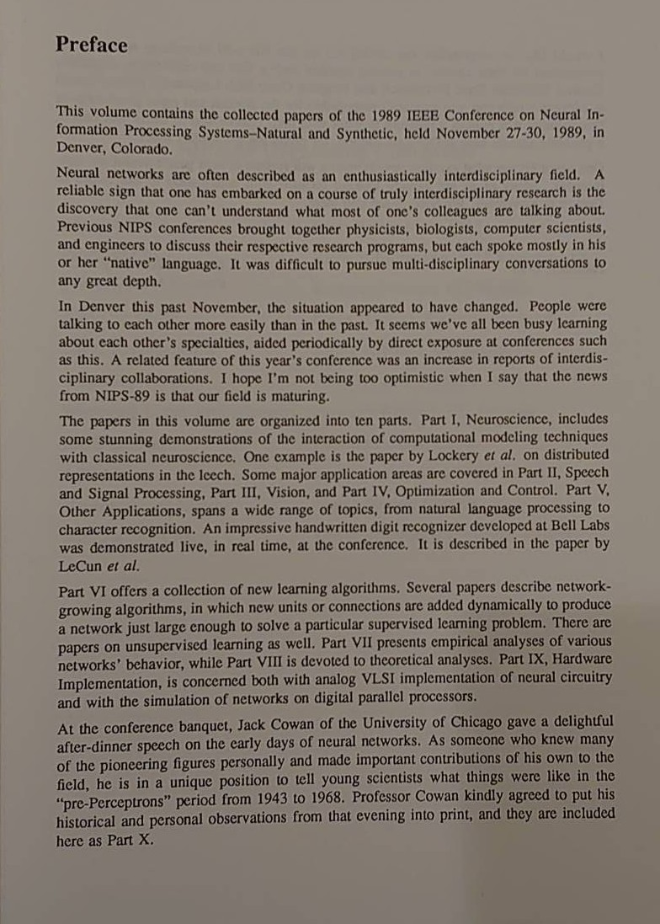
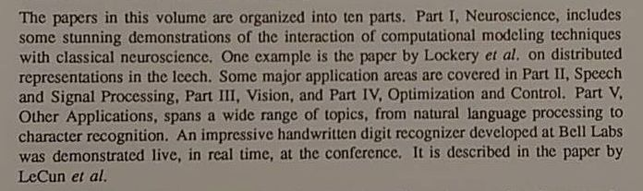
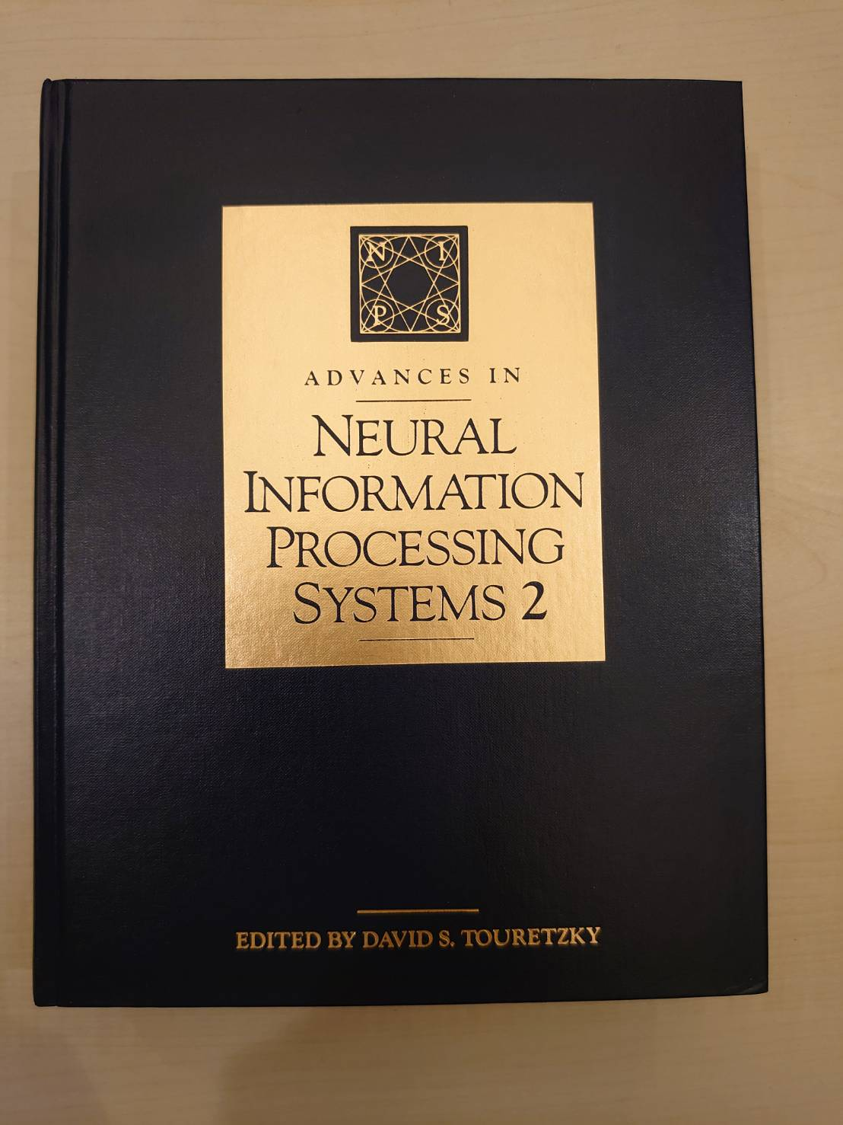

Slide 12
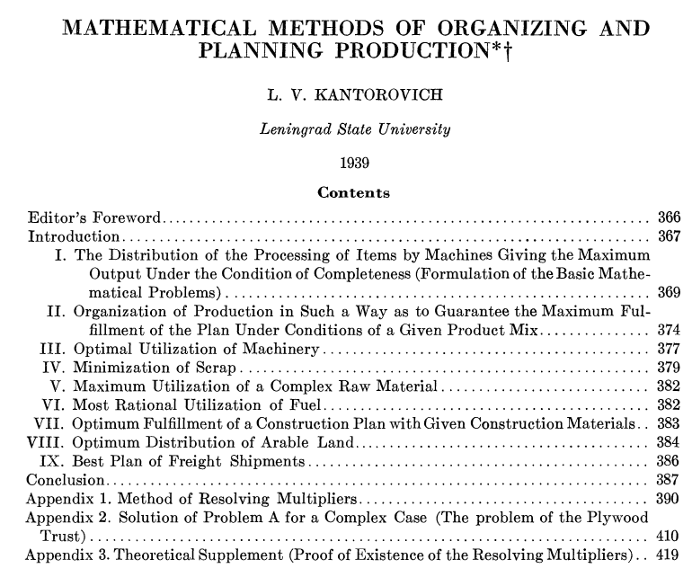
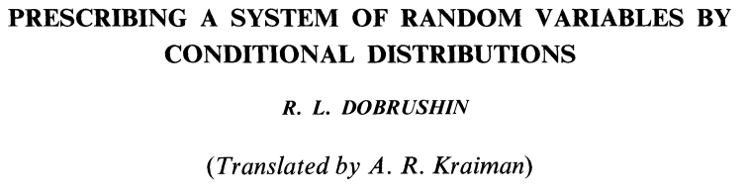
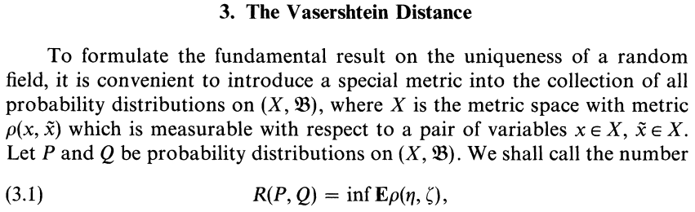
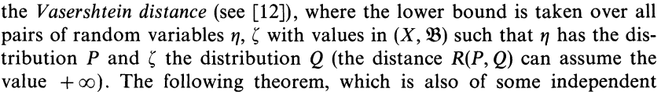
Origin of the Wasserstein distance
Stigler law of eponymy: No scientific discovery is named after its original discover!
Dobrushin termed the Vasershtein distance in 1970
citing a paper of Vasershtein 1969:
But first definition given by Kantorovich in 1939:
Notes:
Stigler law of eponymy: No scientific discovery is named after its original discover!
Example: Wasserstein distance was first defined and used by Kantorovich in 1939
https://en.wikipedia.org/wiki/Wasserstein_metric

Slide 13

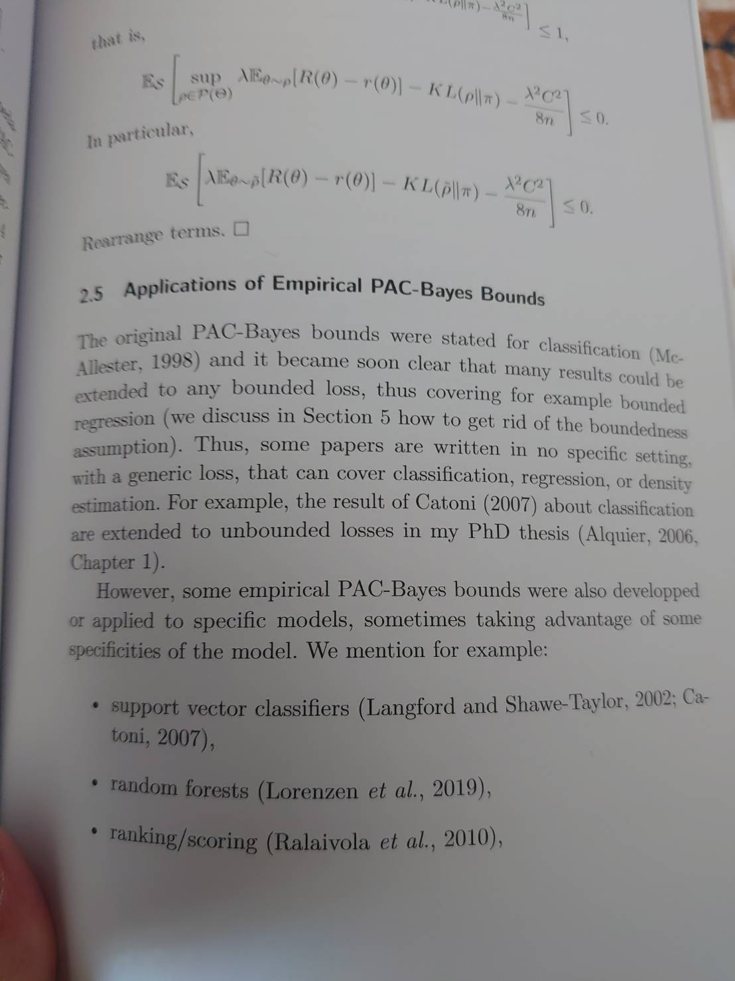

Slide 14


Slide 15
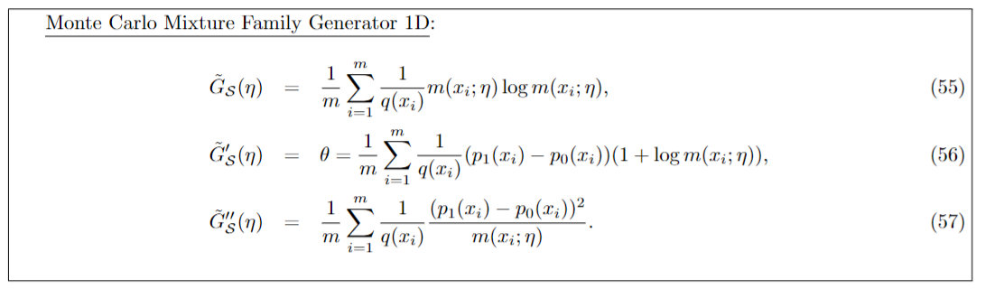
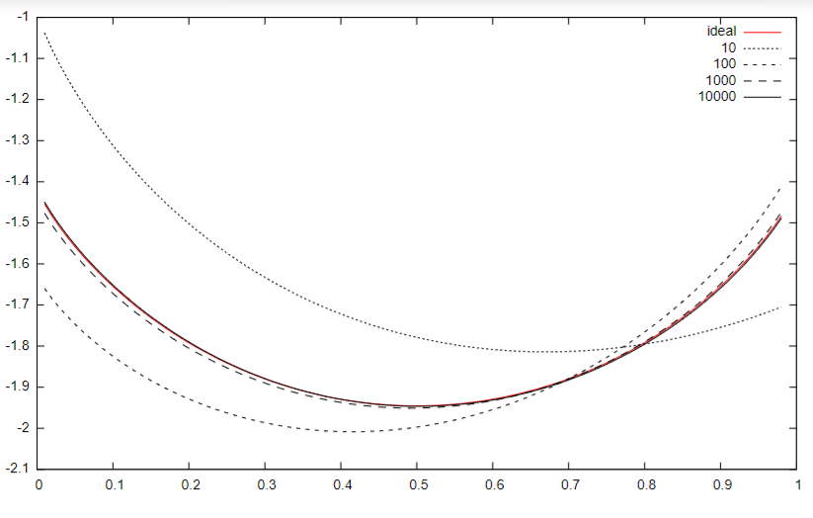
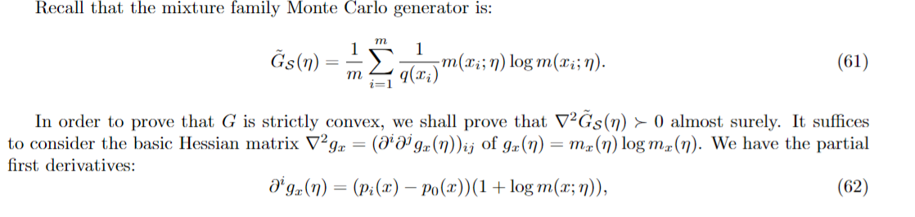
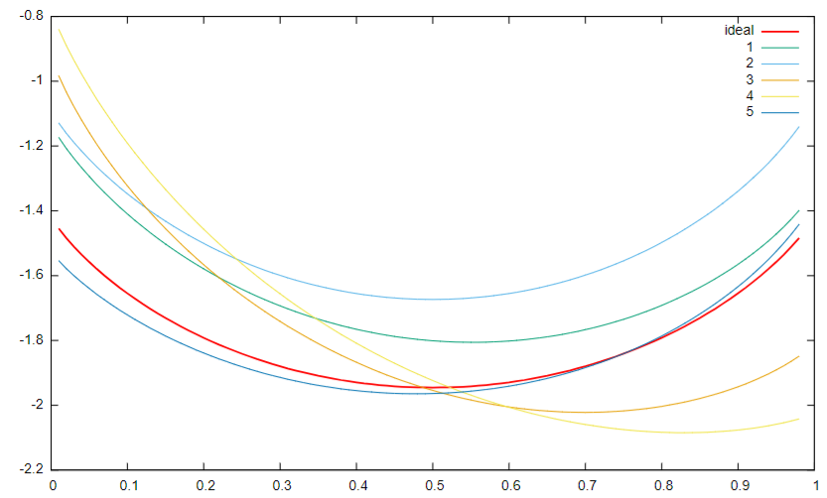
Functional Random Variable
Realizations

